Slide 1

Miss Chatter’s letter
February 11th
Dear Jim and Jill,
Thank you for the party. I am very happy.
My pupils and I are in Green School again.
We have got a lot of friends in England but we haven’t got any friends in Russia.
Have you got a friend from Russia? Would you like to get a letter from this country?
Please write back.
Your Miss Chatter

Slide 2
Miss Chatter:
“Dear children!
I would like to have friends from Russia.
I think you can write me a letter.”

Slide 3
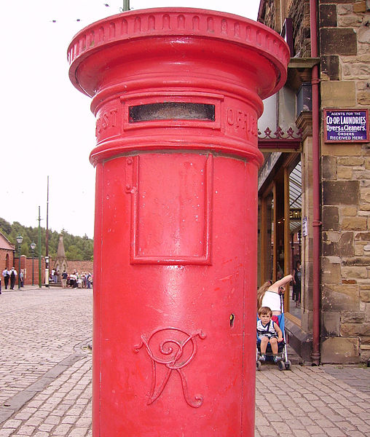
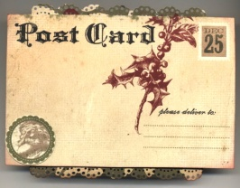


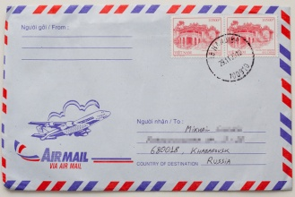

Homework WB Ex 3p48
1) 3 three letterboxes
2) 4 four postcards
3) 8 eight letters
4) 5 five stamps
5) 9 nine envelopes/addresses
6) 2 two posters

Slide 4
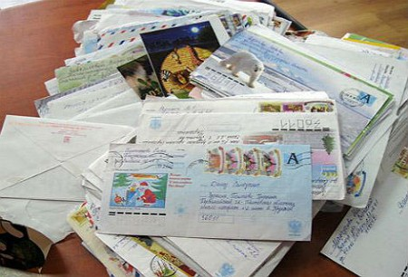

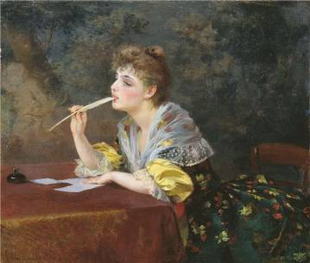
What does Miss Chatter do with Letters?
SB Ex. 2 p.77

Slide 5

How to write and send letters:
Use these words: write, address, paper, post office, envelope, stamp, post, letterbox.
Take clean ……..and a pen.
Sit down and ……...... …a letter.
Put the letter into an …………….. .
Put a ……….......... on the envelope.
Write an ………. …on the envelope.
Take your letter and go to the …………………. .
Find a …………. . and ………………. the letter.

Slide 6
How to write and send letters:
Use these words: write, address, paper, post office, envelope, stamp, post, letterbox.
Take clean paper and a pen.
Sit down and write a letter.
Put the letter into an envelope.
Put a stamp on the envelope.
Write an address on the envelope.
Take your letter and go to the post office.
Find a letterbox and post the letter.

Slide 7
Our Letter to Miss Chatter
_____________________,
We go to _________ 55. Our school is___________________.
We ________________ many friends. They are ________and____________. We like English. We can ________ English songs, __________poems and __________tales,_____________and speak English. We _________write letters too. We write ___________to Santa Claus at Christmas. We would like to ________you and your pupils. ____________ you like to ___________to Kraskovo and ___________our school?
Please, ________back.
Your friends,
_______________and_________________.

Slide 8
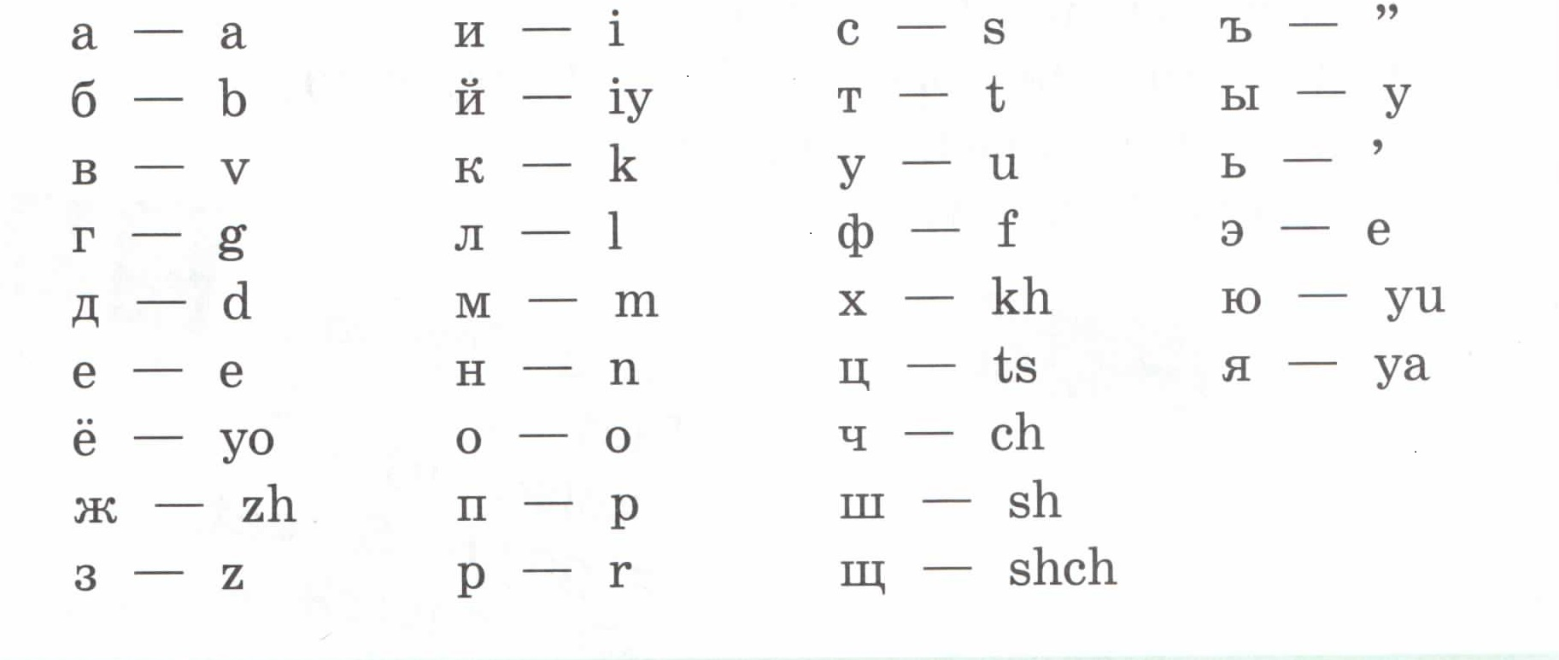
Воспользуемся таблицей соответствия русских букв английским буквам и буквосочетаниям

Slide 9
Home task
WB Ex. 3, 4 p.49-50, SB Ex.1p77 (if you want)

Slide 10

Please, put a smiley into the envelope. Thank you for the lesson.

