Slide 1
Шанявская Людмила Валентиновна
Грамматический тест
Настоящие времена
МОУ «Средняя общеобразовательная школа №1 с углубленным изучением отдельных предметов»
г. Надым
2017

Slide 2
Grammar Test
Present Tenses

Slide 3
1. It`s 12 o`clock but my younger brother still (to sleep).
A
is sleeping
B
sleeps
C
has slept
D
slept
E
have been sleeping

Slide 4
2. George …tennis since his childhood.
A
plays
B
has been playing
C
have played
D
is playing
E
played

Slide 5
3. I am very tired. I … my homework for two hours.
A
am doing
B
do
C
has done
D
have been doing
E
shall do

Slide 6
4. Ned … a competition this year.
A
has won
B
has win
C
have won
D
wins
E
won

Slide 7
5. -Where is your Granny?
-She … in the garden.
A
work
B
works
C
is working
D
have been working
E
worked

Slide 8
6. How long … you… your room? –For about ten minutes.
A
has…been tidying
B
have…been tidying
C
are... tidying
D
do… tidy
E
did…tidy

Slide 9
7. The pupils … dictations once a month.
A
are writing
B
have written
C
has written
D
write
E
writes

Slide 10
8. I … my neighbours for a long time.
A
know
B
knows
C
have known
D
have been knowing
E
has known

Slide 11
9. The boys … football since
2 o`clock.
A
play
B
plays
C
has been playing
D
have been playing
E
are playing

Slide 12
10. We … just some delicious cakes.
A
eat
B
are eating
C
have eaten
D
has eaten
E
has been eating

Slide 13

Congratulations!
Your mark is "5“
No mistakes

Slide 14
2. George … tennis since his childhood.
A
plays
B
has been playing
C
have played
D
is playing
E
played

Slide 15
3. I am very tired. I … my homework for two hours.
A
am doing
B
do
C
has done
D
have been doing
E
shall do

Slide 16
4. Ned … a competition this year.
A
has won
B
has win
C
have won
D
wins
E
won

Slide 17
5. -Where is your Granny?
- She … in the garden
A
work
B
works
C
is working
D
have been working
E
worked

Slide 18
6. How long … you… your room? –For about ten minutes.
A
has…been tidying
B
have…been tidying
C
are... tidying
D
do… tidy
E
did…tidy

Slide 19
7. The pupils … dictations once a month. .
A
are writing
B
have written
C
has written
D
write
E
writes

Slide 20
8. I … my neighbours for a long time.
A
know
B
knows
C
have known
D
have been knowing
E
has known

Slide 21
9. The boys … football since
2 o`clock.
A
play
B
plays
C
has been playing
D
have been playing
E
are playing

Slide 22
10. We … just some delicious cakes.
A
eat
B
are eating
C
have eaten
D
has eaten
E
has been eating

Slide 23

Your mark is "4"
You`ve got one mistake

Slide 24
3. I am very tired. I … my homework for two hours.
A
am doing
B
do
C
has done
D
have been doing
E
shall do

Slide 25
4. Ned …a competition this year.
A
has won
B
has win
C
have won
D
wins
E
won

Slide 26
5. -Where is your Granny?
- She … in the garden.
A
work
B
works
C
is working
D
have been working
E
worked

Slide 27
6. How long … you … your room? –For about ten minutes.
A
has…been tidying
B
have…been tidying
C
are... tidying
D
do… tidy
E
did…tidy

Slide 28
7. The pupils … dictations once a month.
A
are writing
B
have written
C
has written
D
write
E
writes

Slide 29
8. I … my neighbours for a long time.
A
know
B
knows
C
have known
D
have been knowing
E
has known

Slide 30
9. The boys … football since
2 o`clock.
A
play
B
plays
C
has been playing
D
have been playing
E
are playing

Slide 31
10. We … just some delicious cakes.
A
eat
B
are eating
C
have eaten
D
has eaten
E
has been eating

Slide 32
Your mark is "4"
You`ve got two mistakes!

Slide 33
4. Ned … a competition this year.
A
has won
B
has win
C
have won
D
wins
E
won

Slide 34
5. -Where is your Granny?
-She … in the garden.
A
work
B
works
C
is working
D
have been working
E
worked

Slide 35
6. How long … you… your room? –For about ten minutes.
A
has…been tidying
B
have…been tidying
C
are... tidying
D
do… tidy
E
did…tidy

Slide 36
7. The pupils … dictations once a month.
A
are writing
B
have written
C
has written
D
write
E
writes

Slide 37
8. I … my neighbours for a long time.
A
know
B
knows
C
have known
D
have been knowing
E
has known

Slide 38
9. The boys … football since
2 o`clock.
A
play
B
plays
C
has been playing
D
have been playing
E
are playing

Slide 39
10. We … just some delicious cakes.
A
eat
B
are eating
C
have eaten
D
has eaten
E
has been eating

Slide 40

Your mark is "3"
You`ve got
three mistakes!

Slide 41
5. -Where is your Granny?
-She … in the garden.
A
work
B
works
C
is working
D
have been working
E
worked

Slide 42
6. How long … you… your room? –For about ten minutes.
A
has…been tidying
B
have…been tidying
C
are... tidying
D
do… tidy
E
did…tidy

Slide 43
7. The pupils … dictations once a month.
A
are writing
B
have written
C
has written
D
write
E
writes

Slide 44
8. I … my neighbours for a long time.
A
know
B
knows
C
have known
D
have been knowing
E
has known

Slide 45
9. The boys … football since
2 o`clock.
A
play
B
plays
C
has been playing
D
have been playing
E
are playing

Slide 46
10. We … just some delicious cakes.
A
eat
B
are eating
C
have eaten
D
has eaten
E
has been eating

Slide 47
Your mark is "3"
You`ve got
four mistakes!

Slide 48
6. How long … you… your room? –For about ten minutes.
A
has…been tidying
B
have…been tidying
C
are... tidying
D
do… tidy
E
did…tidy

Slide 49
7. The pupils … dictations once a month.
A
are writing
B
have written
C
has written
D
write
E
writes

Slide 50
8. I … my neighbours for a long time.
A
know
B
knows
C
have known
D
have been knowing
E
has known

Slide 51
9. The boys … football since
2 o`clock.
A
play
B
plays
C
has been playing
D
have been playing
E
are playing

Slide 52
10. We … just some delicious cakes.
A
eat
B
are eating
C
have eaten
D
has eaten
E
has been eating

Slide 53
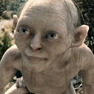
Your mark is "2"
You`ve got
five mistakes!

Slide 54
7. The pupils … dictations once a month.
A
are writing
B
have written
C
has written
D
write
E
writes

Slide 55
8. I … my neighbours for a long time.
A
know
B
knows
C
have known
D
have been knowing
E
has known

Slide 56
9. The boys … football since
2 o`clock.
A
play
B
plays
C
has been playing
D
have been playing
E
are playing

Slide 57
10. We … just some delicious cakes.
A
eat
B
are eating
C
have eaten
D
has eaten
E
has been eating

Slide 58
Your mark is "2"
You`ve got
six mistakes!

Slide 59
8. I … my neighbours for a long time.
A
know
B
knows
C
have known
D
have been knowing
E
has known

Slide 60
9. The boys … football since
2 o`clock.
A
play
B
plays
C
has been playing
D
have been playing
E
are playing

Slide 61
10. We … just some delicious cakes.
A
eat
B
are eating
C
have eaten
D
has eaten
E
has been eating

Slide 62
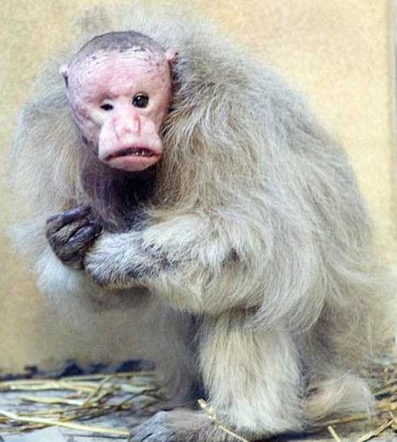
Your mark is "2"
You`ve got
seven mistakes!

Slide 63
9. The boys … football since
2 o`clock.
A
play
B
plays
C
has been playing
D
have been playing
E
are playing

Slide 64
10. We … just some delicious cakes.
A
eat
B
are eating
C
have eaten
D
has eaten
E
has been eating

Slide 65
Your mark is "2"
You`ve got
eight mistakes!

Slide 66
10. We … just some delicious cakes.
A
eat
B
are eating
C
have eaten
D
has eaten
E
has been eating

Slide 67
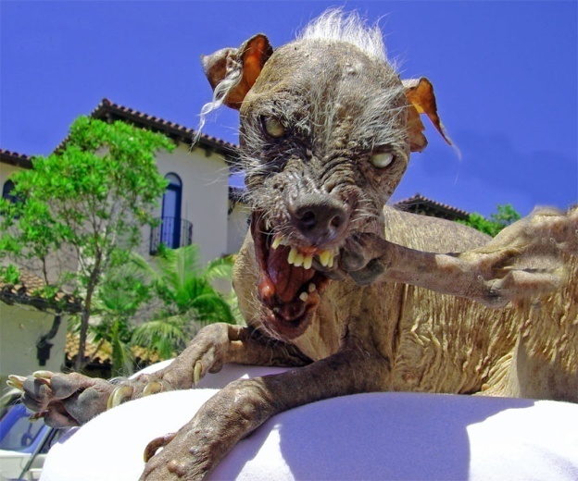
Your mark is "2"
You`ve got
nine mistakes!

Slide 68
Your mark is "2"
You`ve got
ten mistakes!

