Slide 1
Открытое занятие в МБУ ДО «ДДТ ЗАТО г.Островной
Объединение
«Забавный английский»
Педагог дополнительного образования
Мутаирова Эльмира Уллубиевна

Slide 2
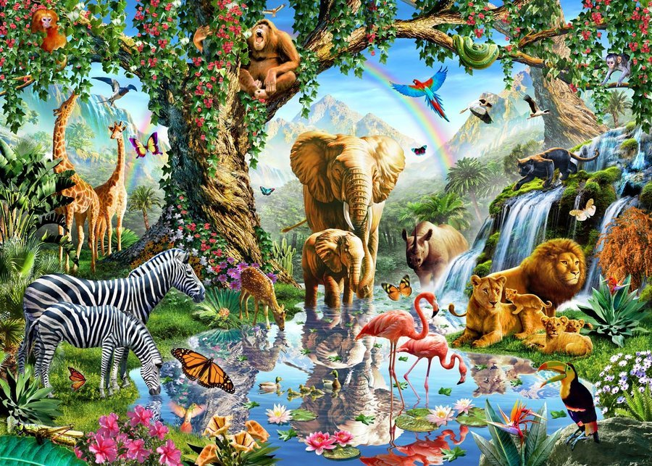

Slide 3
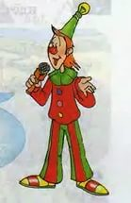

Slide 4
«A world of animals»
«Животный мир»

Slide 5
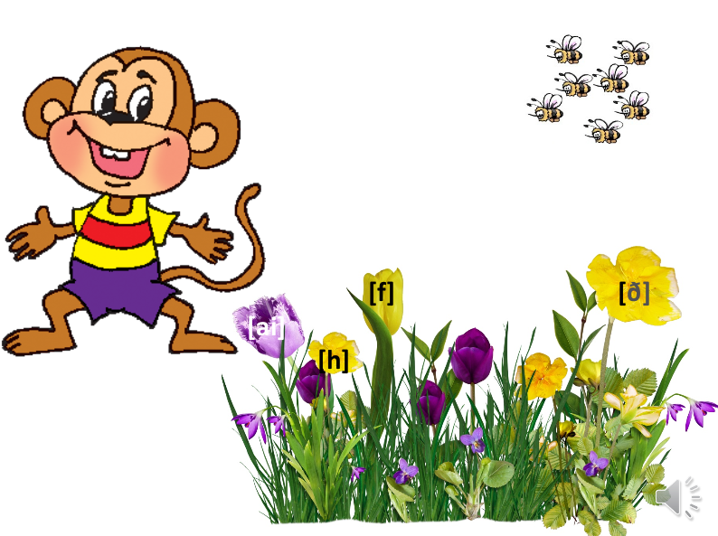
Фонетическая зарядка

Slide 6
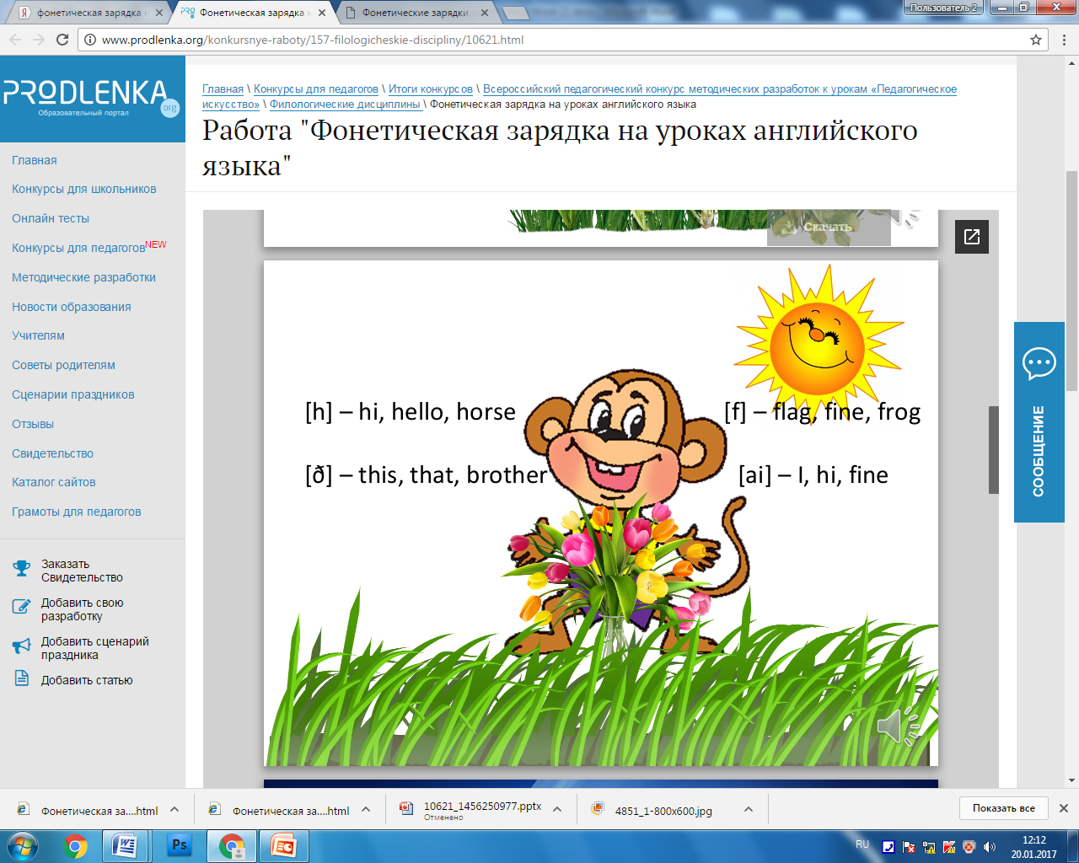

Slide 7
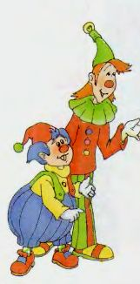
Игра «Who lives in there?»

Slide 8
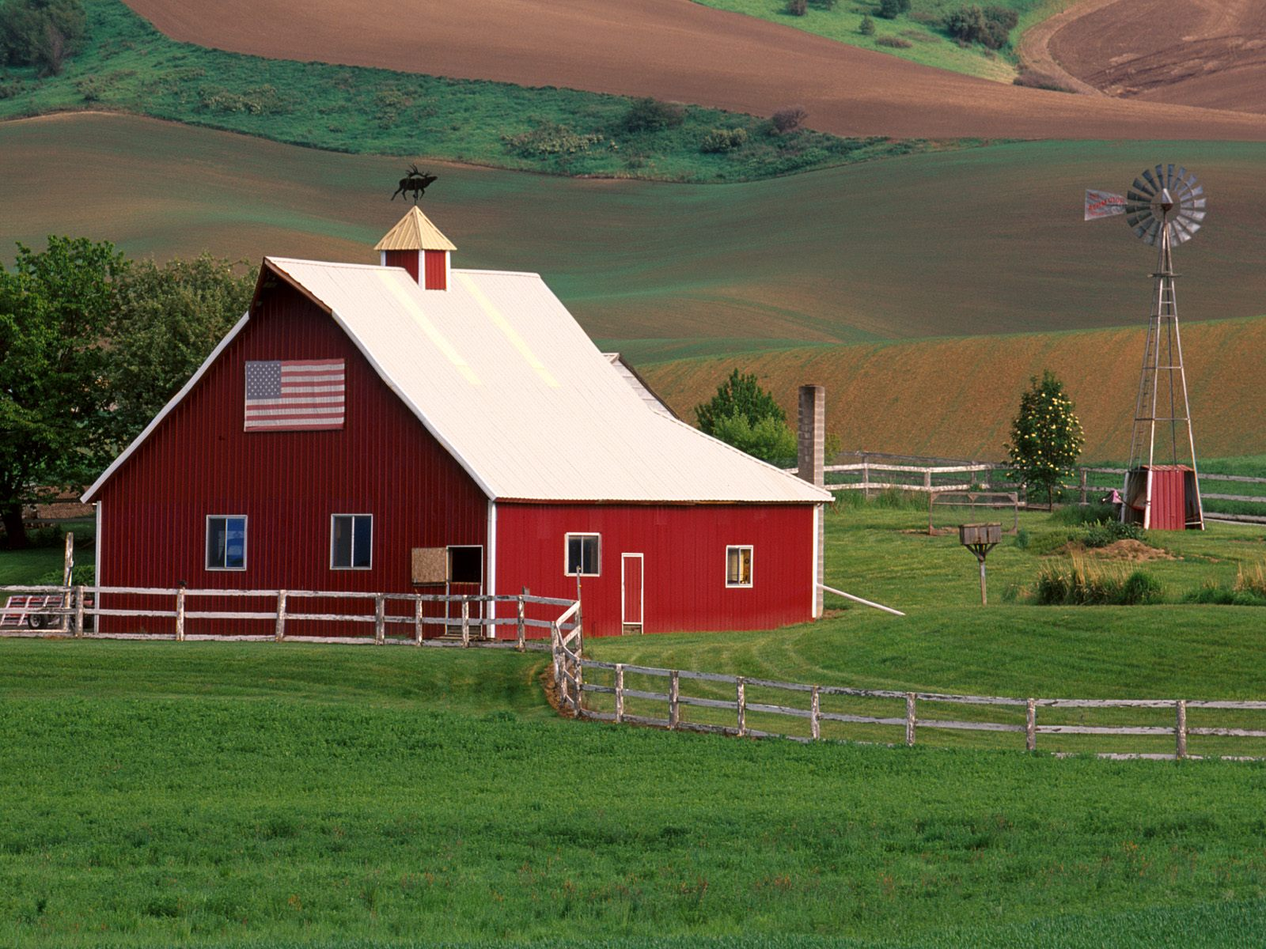
1)Who lives on the farm?

Slide 9
1)Who lives on the farm?
a cow, a pig, a horse, a cockerel

Slide 10
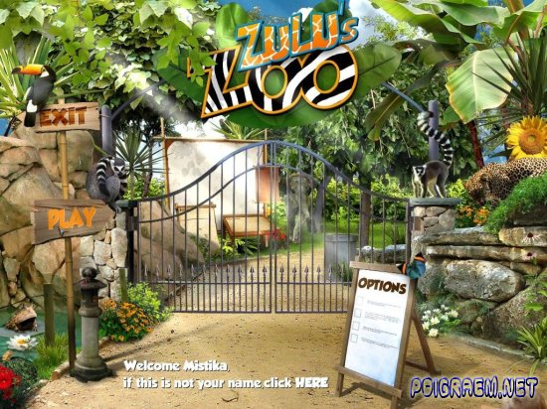
2) Who lives in the zoo?

Slide 11
2) Who lives in the zoo?
a lion, a tiger, an elephant

Slide 12
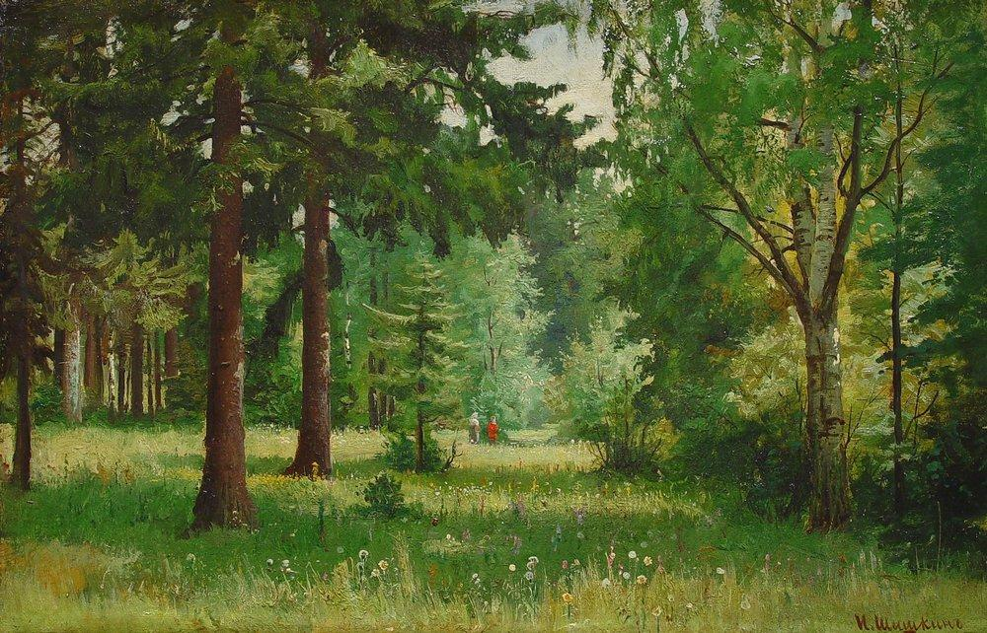
3)Who lives in the forest?

Slide 13
3)Who lives in the forest?
a fox, a bear, a wolf
р

Slide 14
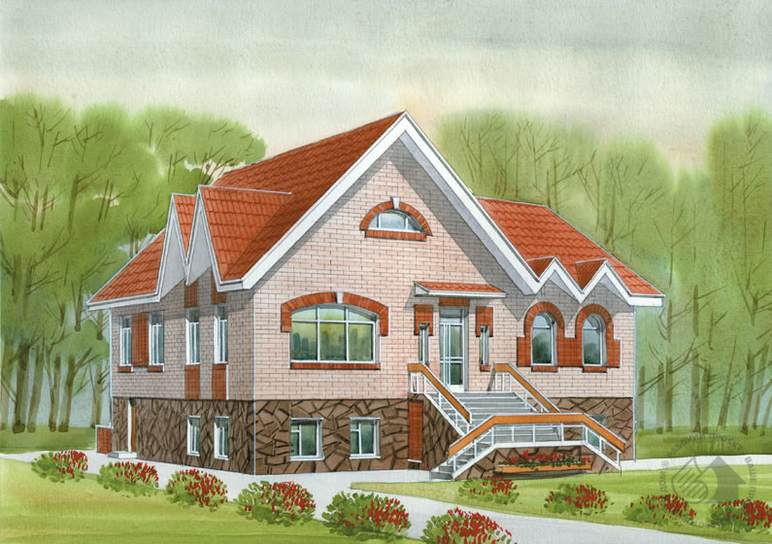
4) Who lives in the house?

Slide 15
4) Who lives in the house?
a cat, a dog, a parrot

Slide 16
Выбрать лишнее слово в строчке
1). a hen, a fox, a sheep, a cow, a horse.

Slide 17
Выбрать лишнее слово в строчке
1). a hen, a fox, a sheep, a cow, a horse.

Slide 18
2). a cockerel, a hen, a cow, a duck.

Slide 19
2). a cockerel, a hen, a cow, a duck.

Slide 20
3). a whale, a fish, a crocodile, a dolphin.

Slide 21
3). a whale, a fish, a crocodile, a dolphin.

Slide 22
4). a camel, an elephant, an ant, a monkey.

Slide 23
4). a camel, an elephant, an ant, a monkey.

Slide 24
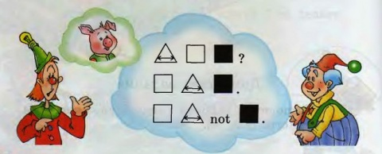
Who did lose?
e,h,n.
i,g,p.
g,r,o,f.
x,f,o.
o,h,e,r,s.

Slide 25
Who did lose?
e,h,n - hen
i,g,p - pig
g,r,o,f - frog
x,f,o - fox
o,h,e,r,s - horse

Slide 26
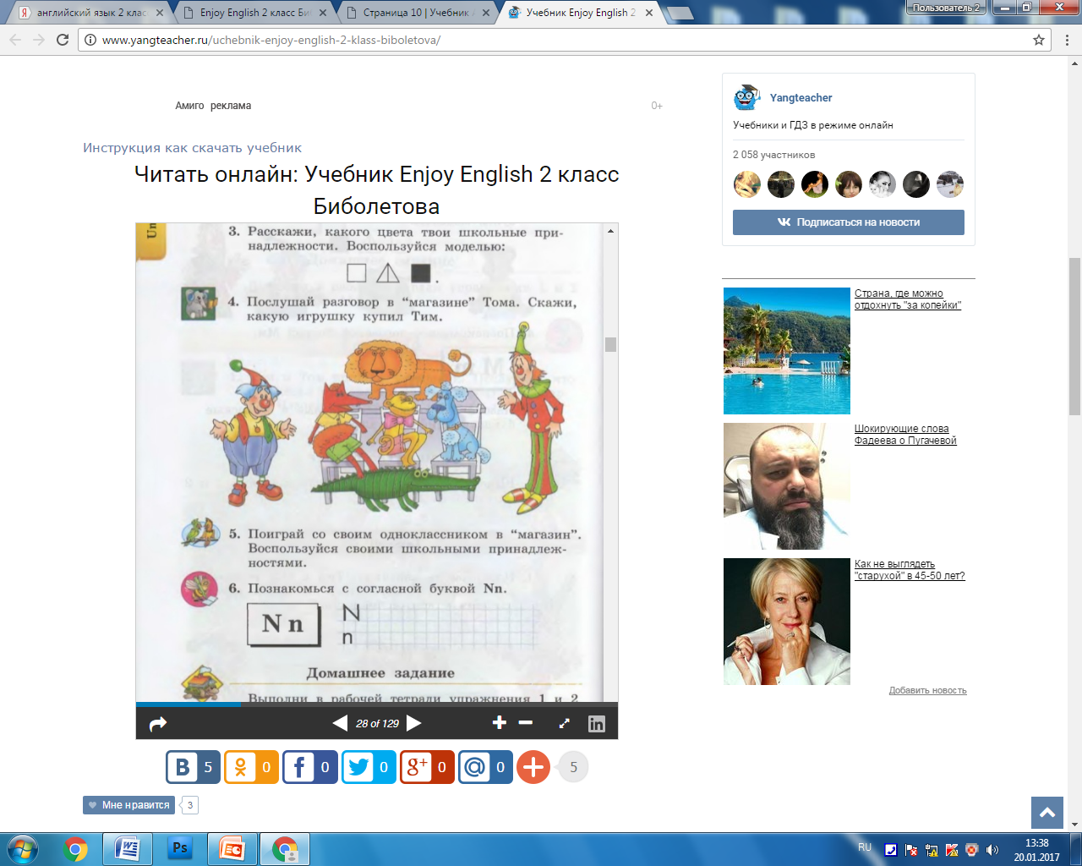
Make sentences from the words:
is, dog, My, black.
pink,I, pig, have.
3. cat, My, white, is.

Slide 27
Make sentences from the words:
My dog is black.
I have pink pig.
3. My cat is white.

Slide 28
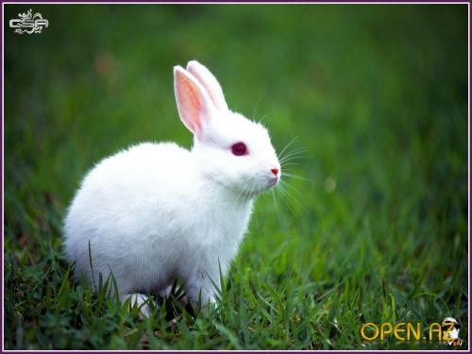
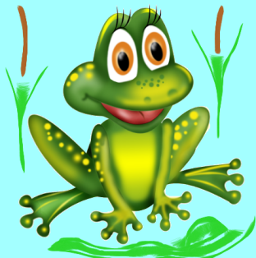
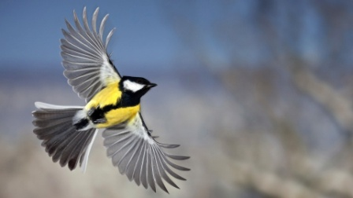
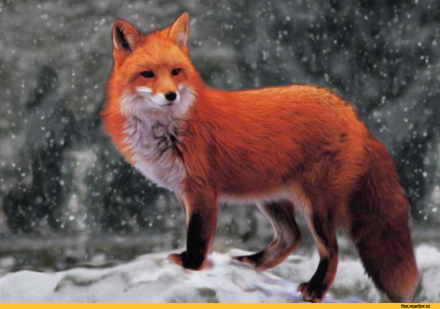
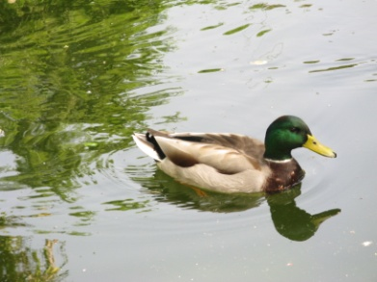
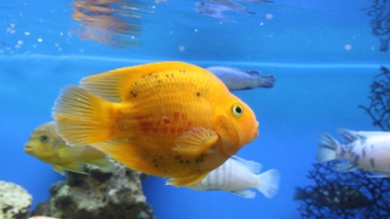

Stand up!
I can hop like a rabbit.
I can jump like a frog. I can fly like a bird. I can run like a foх. I can walk like a duck. I can swim like a fish. And be still as good children!

Slide 29
Rhymes on the names of animals
Рифмовка на названия животных

Slide 30
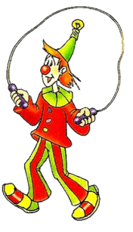
I say the phrase in Russian, you translate in into English

Slide 31
Игра «Plural form»

Slide 32
Игра «Plural form»
Звуки [s], [z], [iz]

Slide 33
Fox – foxes [iz]
Elephant – elephants [s]
Hen – hens [z]
Lion – lions [z]
Parrot – parrots [s]
Tiger – tigers [s]
Cockerel – cockerels [s]
Dog – dogs [z]
Bear – bears [s]
Monkey – monkeys [s]

Slide 34
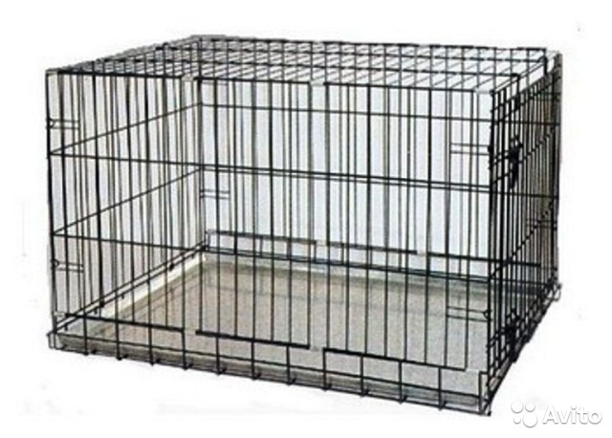
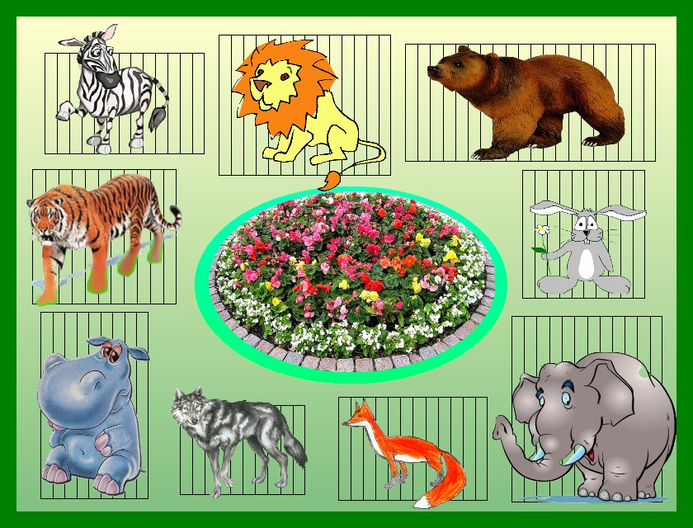
j
volf
bear
elephant
tiger
zebra
lion

Slide 35
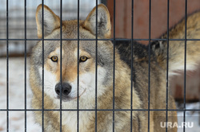
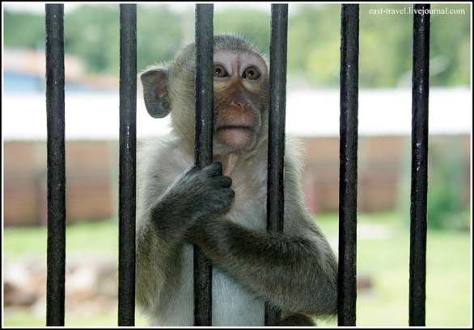
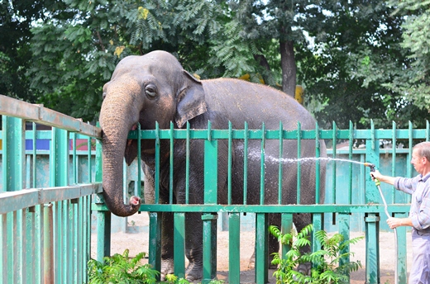
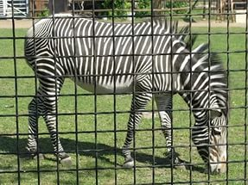
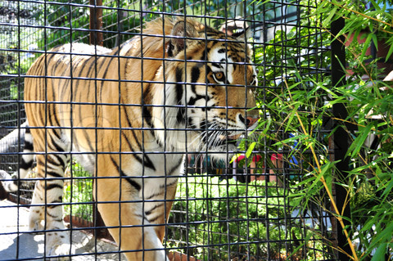
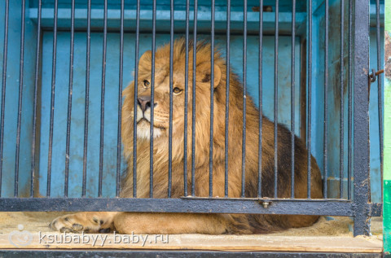
j
volf
monkey
elephant
tiger
zebra
lion

Slide 36
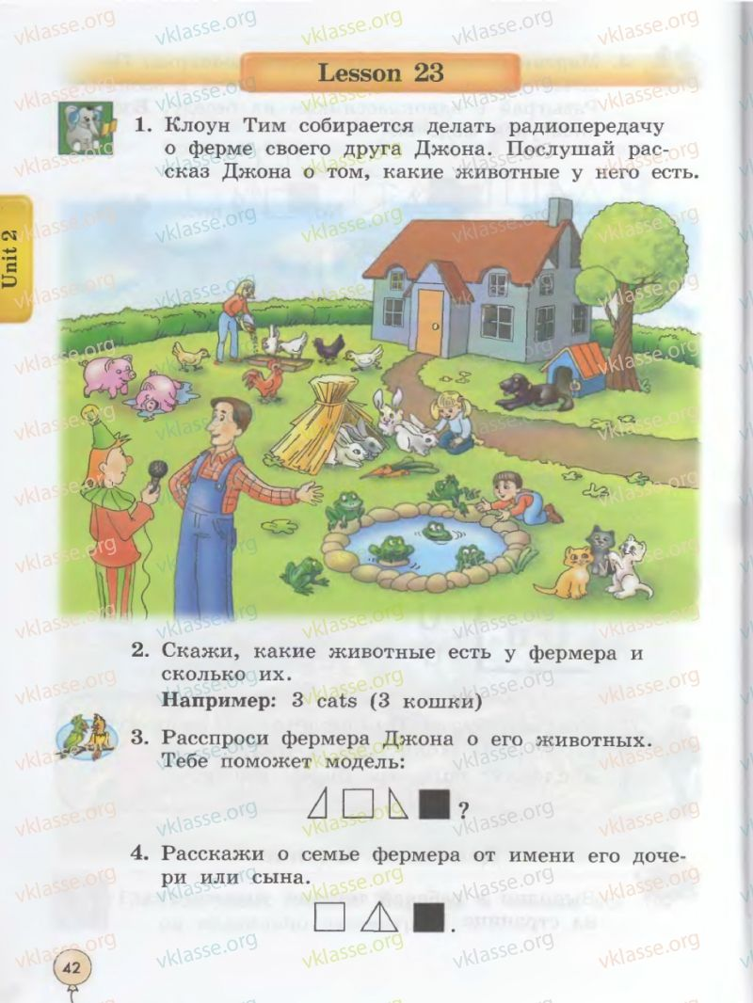

Slide 37


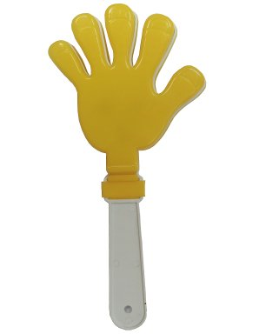

Рефлексия
EXELLENT
GOOD
BAD
Отлично
Хорошо
Плохо

Slide 38
Thank you for your attention!
Спасибо за внимание!

