Slide 1
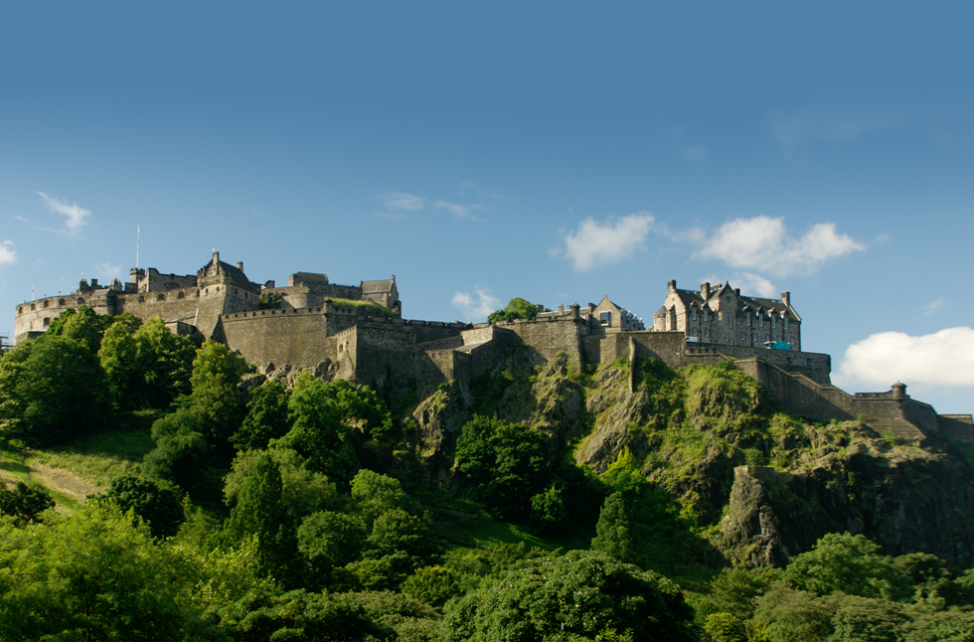
Edinburgh
Surname: Miheeva
Name: Ekaterina
Form: 8 «V»
Liceum: №28
Teacher: Zemskova N.A.
N.Novgorod
2018

Slide 2
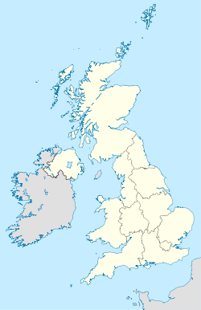
Edinburgh on the map
Edinburgh is the capital of Scotland since 1437 and it is the second biggest city in the UK.
It is on the East side of Scotland.

Slide 3
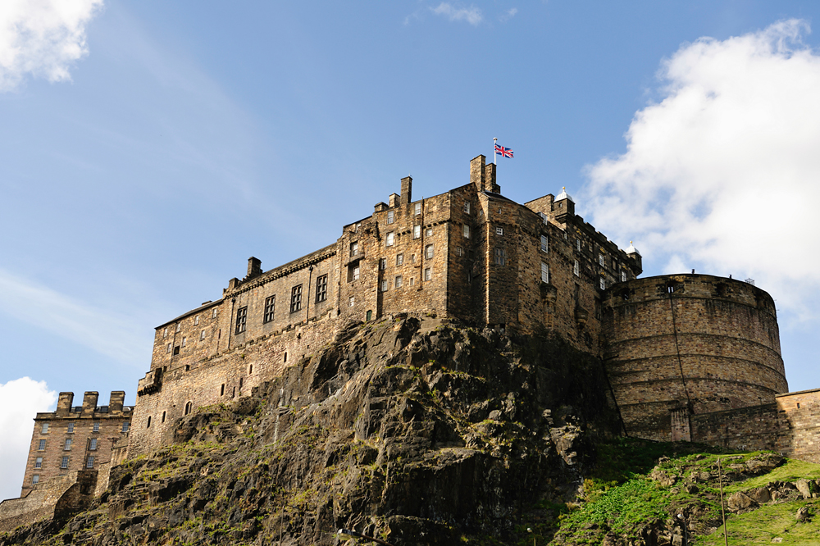
Edinburgh Castle
Edinburgh Castle is one thousand
years old.
Over one million people visit the castle every year.

Slide 4
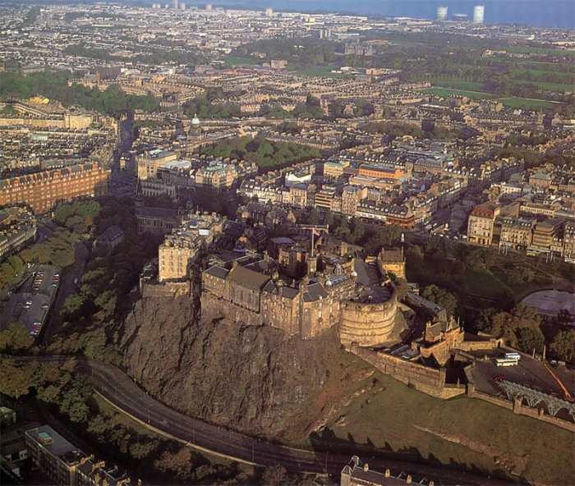
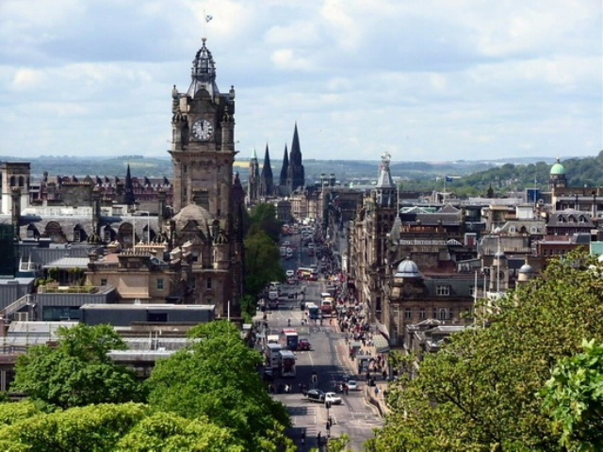
This is an old part of the city.
The new part of Edinburgh is beautiful, too.

Slide 5
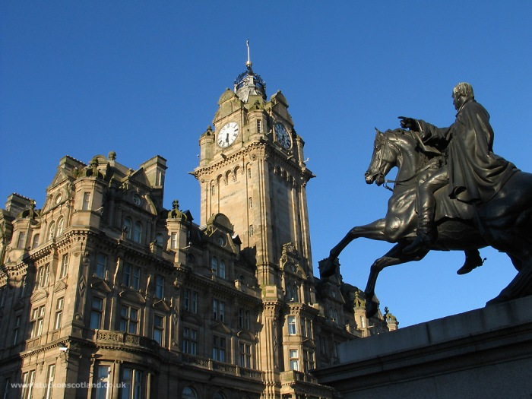
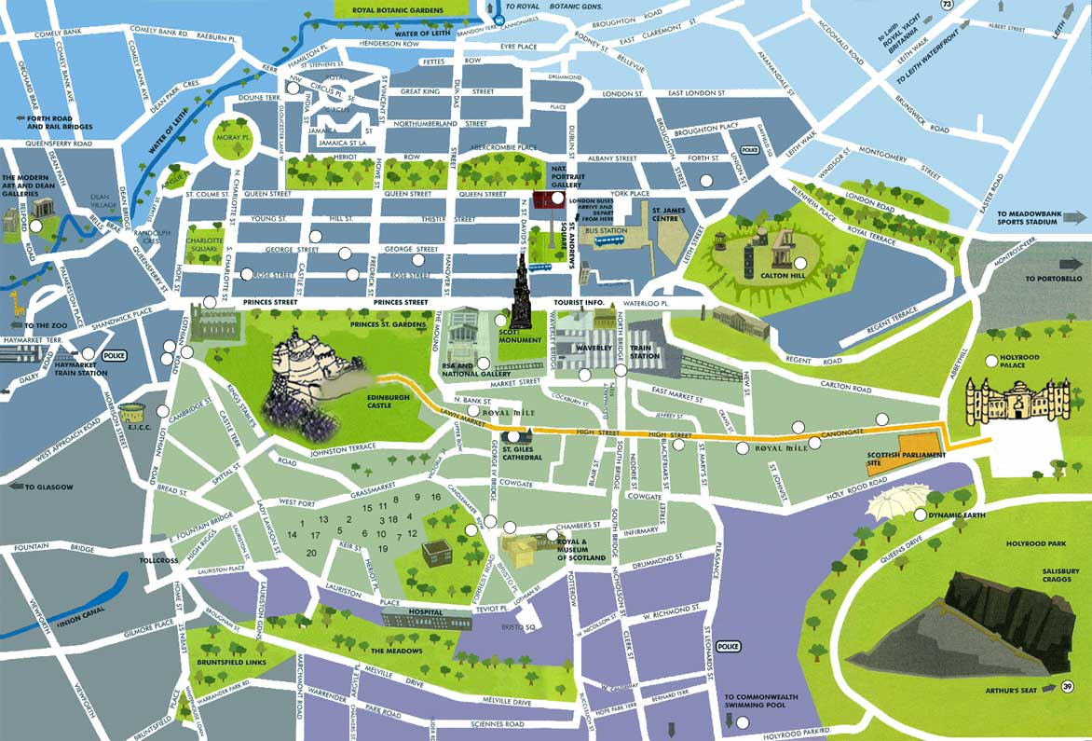
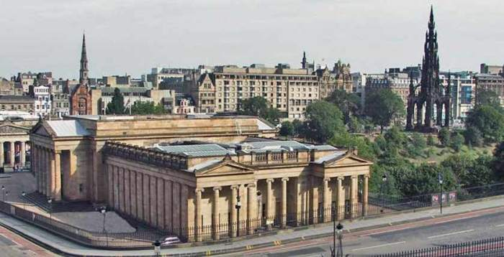
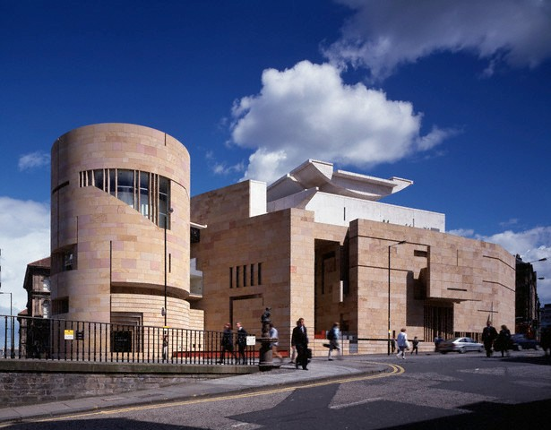
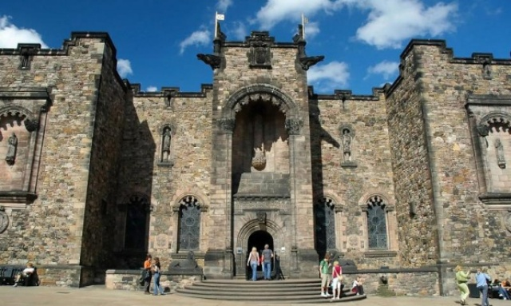
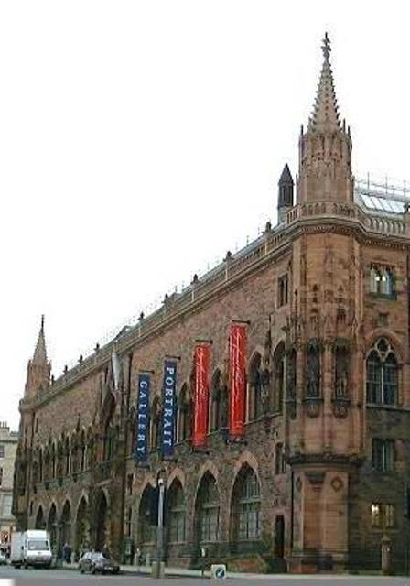
There are a lot of places to visit
A monument to Nelson.
National Gallery.
National Museum.
National Military Museum.
National Portrait Gallery

Slide 6
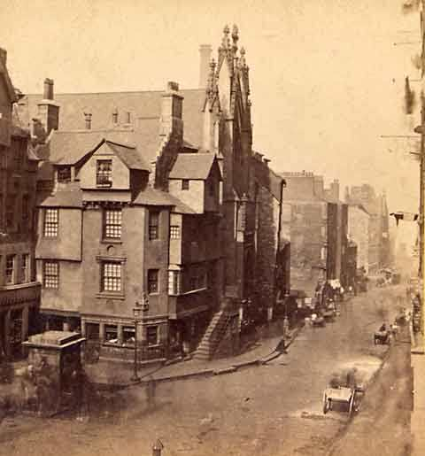
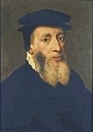
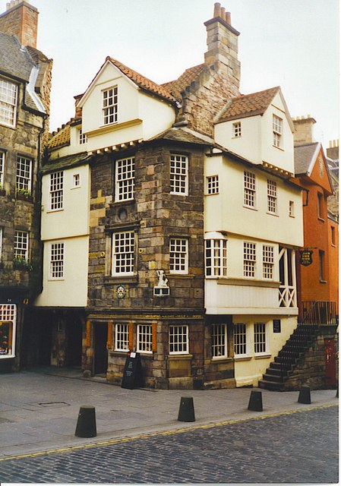
John Knox’s House is the most interesting sight
It looked so in the sixteenth century.
John Knox lived in this house.
It looks so today

Slide 7
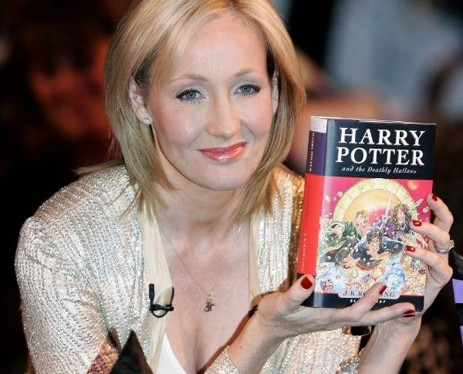
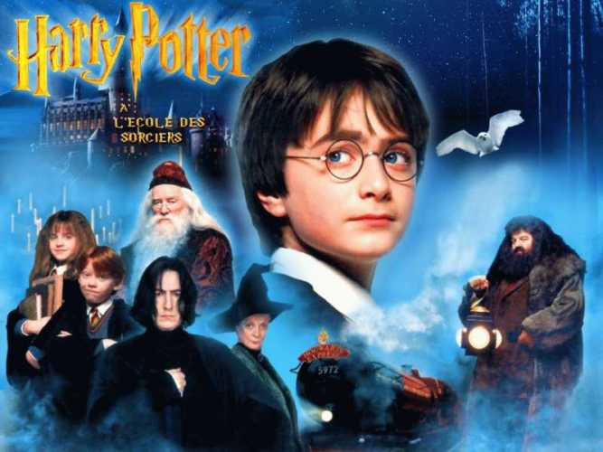
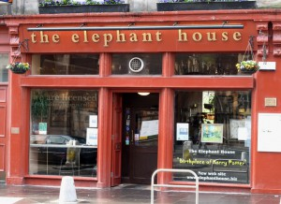
In this Café in 1990 Joanne Rowling began to write her book about Harry Potter.

Slide 8
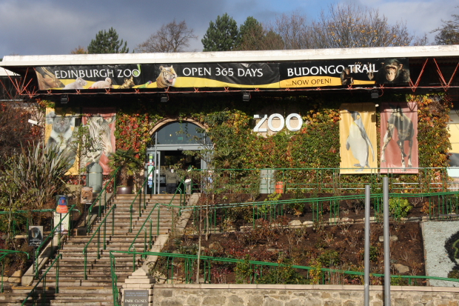
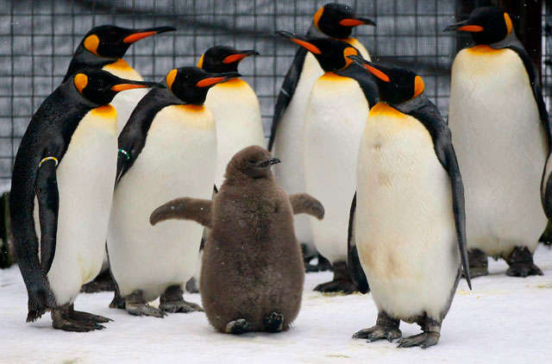
Edinburgh Zoo
Is famous for its parade of penguins and interesting productions.

Slide 9
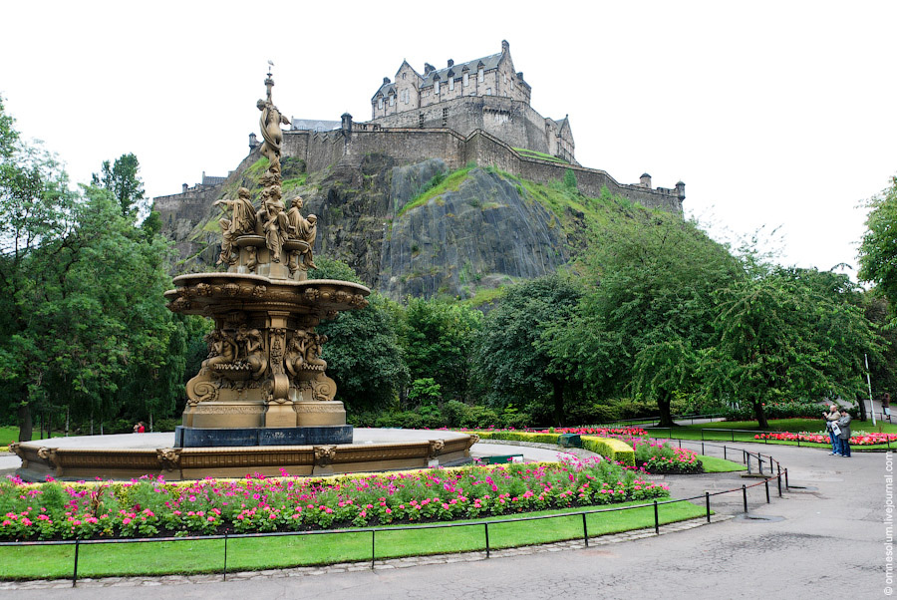
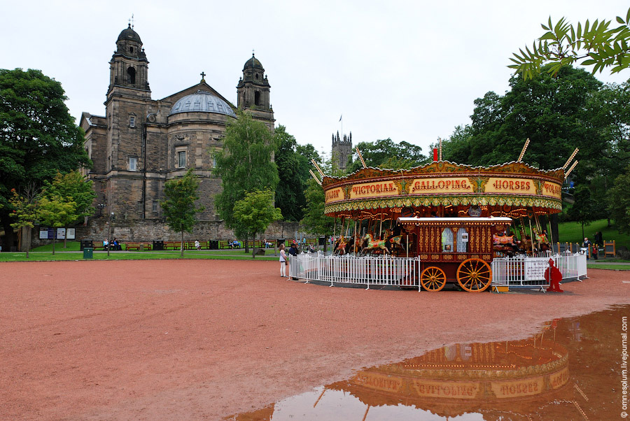
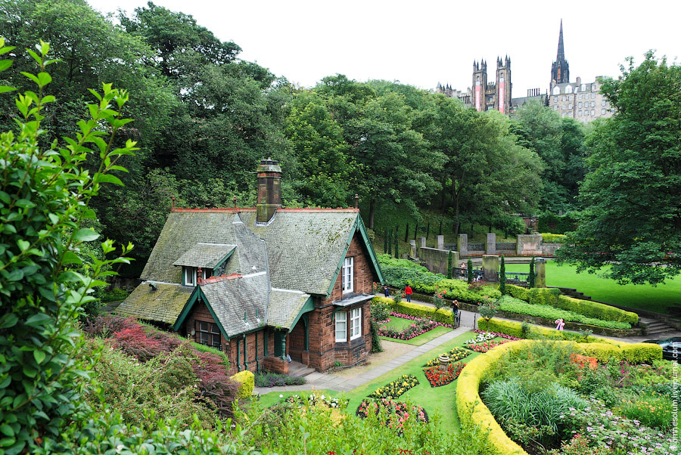
The most beautiful park is Princess street Garden.
It was open in 1820.
Now it became a popular place for rest, picnics, concerts and celebrations.

Slide 10
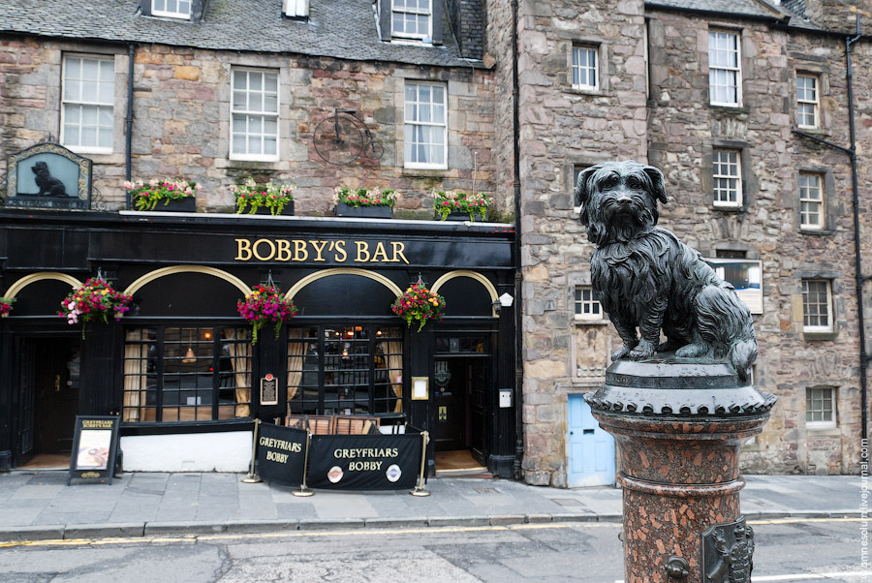
One of the most interesting monuments is the monument to Greyfriars Bobby, the dog who was sitting near his owner`s grave
14 year.
You can see it near Bobby`s Bar.

Slide 11
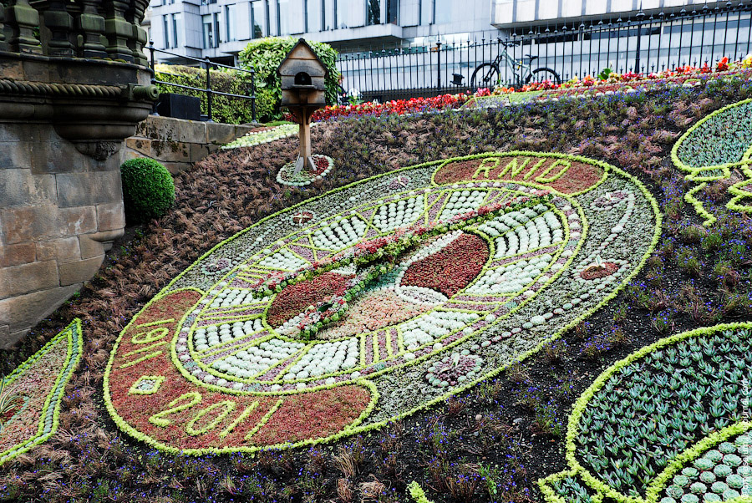
In Edinburgh you can see the oldest Flower clock in the world.
It was made in 1903.

Slide 12
This year I will visit Edinburgh.
See you there!
Thank you for your attention!

