Slide 1


Oleynik Stepan
Welcomе to my zoo!

Slide 2

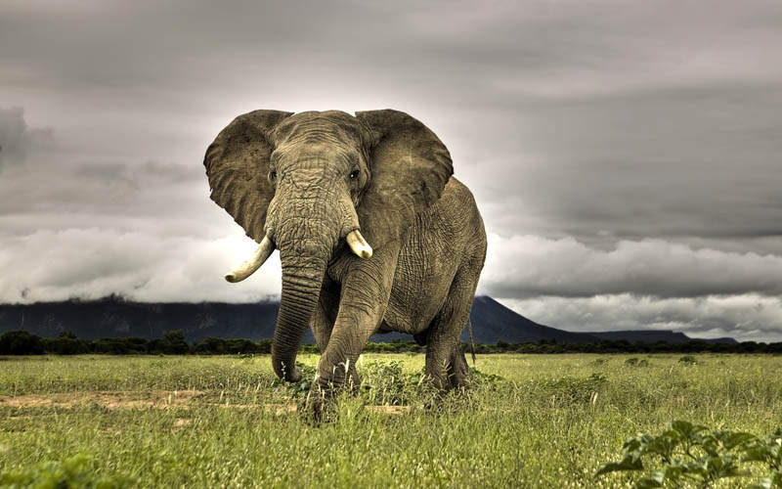
Elephant
An elephant is a very huge animal.
It has four legs, two large ears, a long trunk and a short tail.
The elephant lives for more than one hundred years.

Slide 3

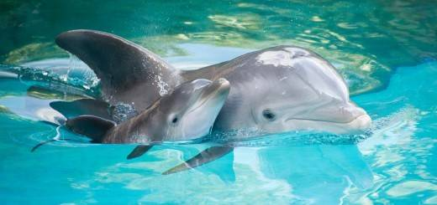
Dolphin
Dolphins live in the sea. Тhey are pretty big. Dolphins have got a tail. They are not fish. They are animals, because they feed their babies milk.

Slide 4

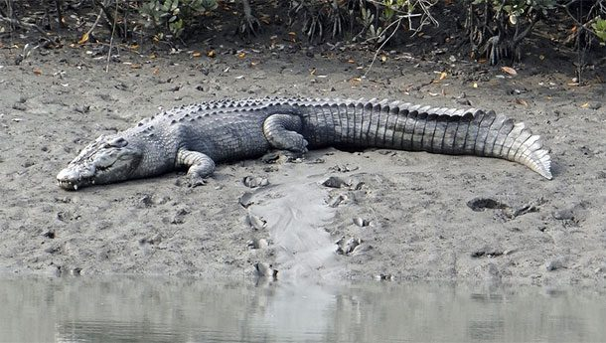
Crocodile
Crocodile is a predatory animal. Some crocodiles can be up to five metres long and live up to 80-100 years.
Crocodile has four short legs and a long tail.

Slide 5

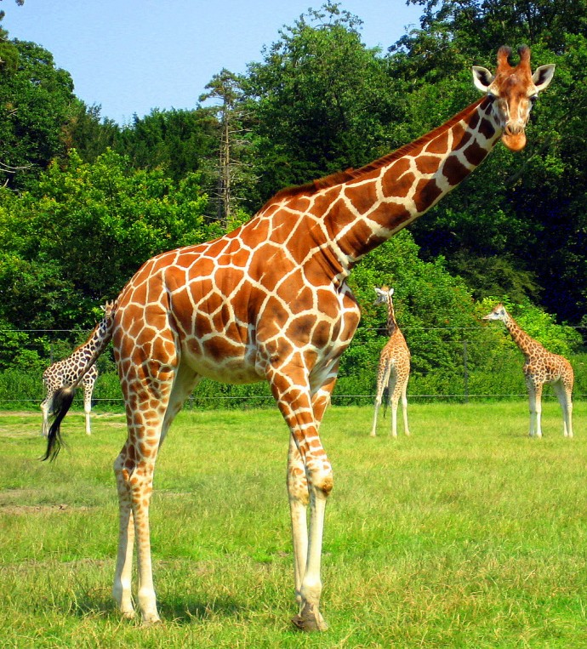
Giraffe
Giraffe is the tallest animal in the world.
Giraffe has a large body and four long slim legs. The animal’s neck is longer than its body.

