Slide 1
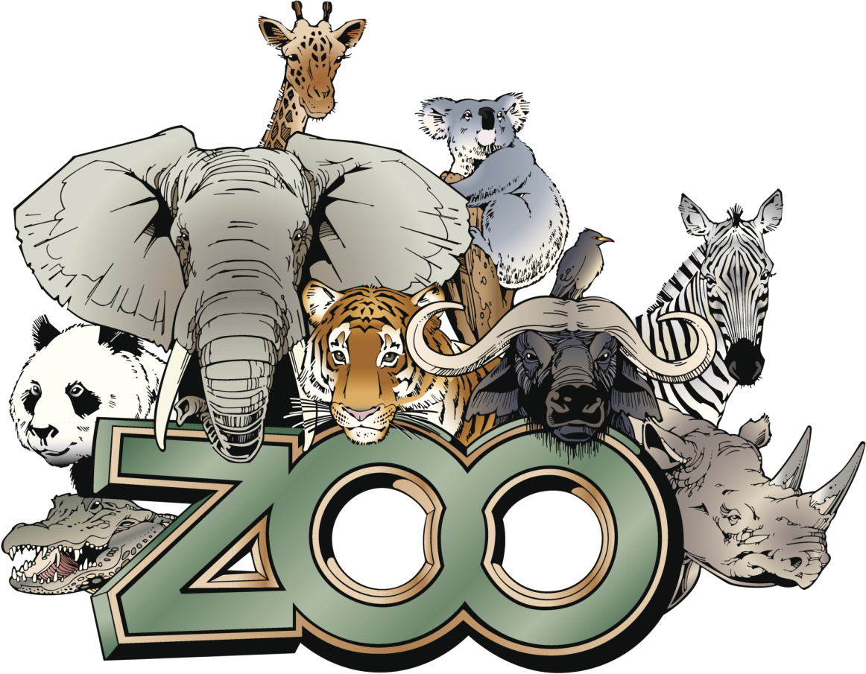
My Zoo
made by
Startsev Matvey
4B class

Slide 2
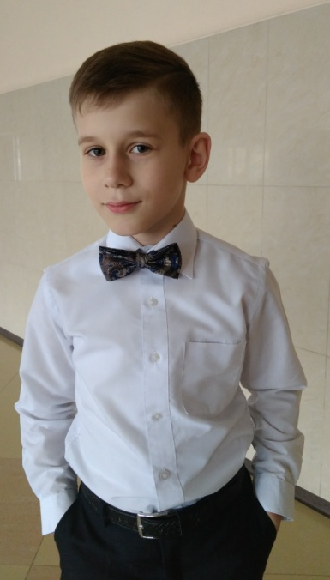
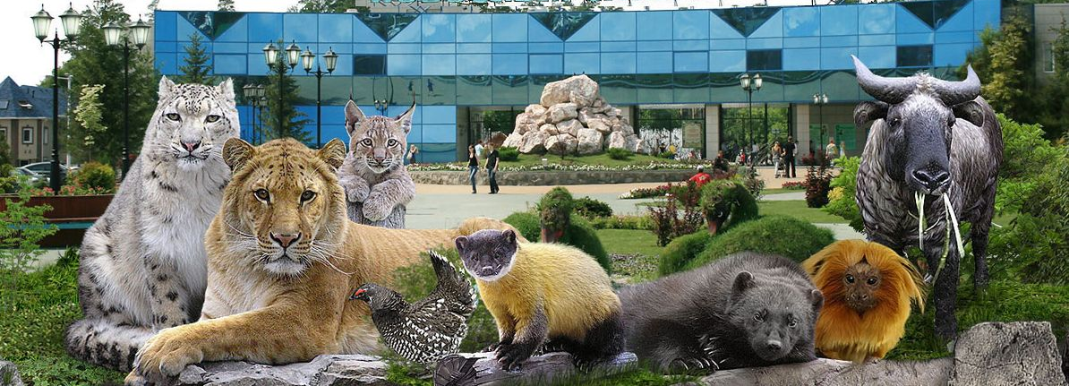
My Zoo is very big and there are many animals and birds. Our visitors like to come here. They can feed animals and birds and learn new information about them.
My name is
Startsev Matvey and
I am a director of the main Zoo in our town.

Slide 3
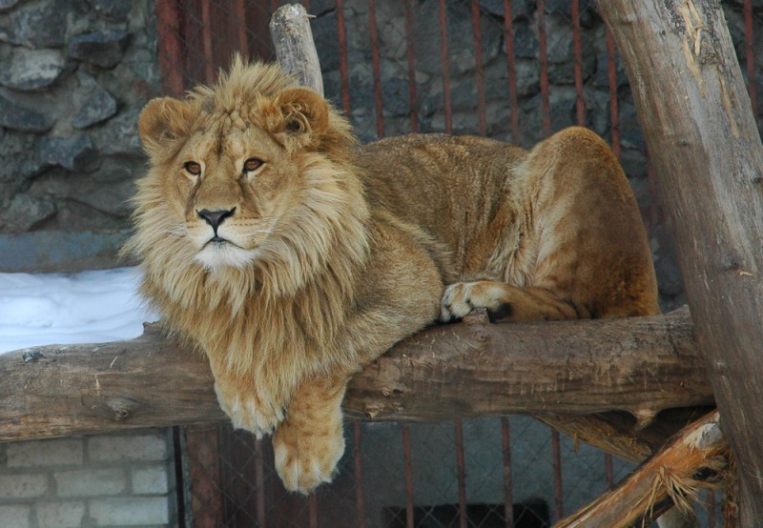
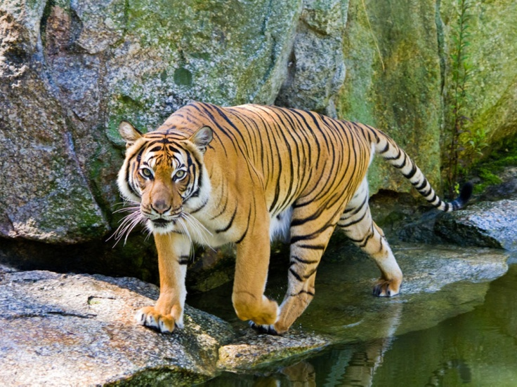
Tigress Sarah is one of the most beautiful animals in the zoo.
This lion’s name is Jack.
Lion is very beautiful and strong animal. Jack likes to eat meat. It’s very smart and calm.

Slide 4
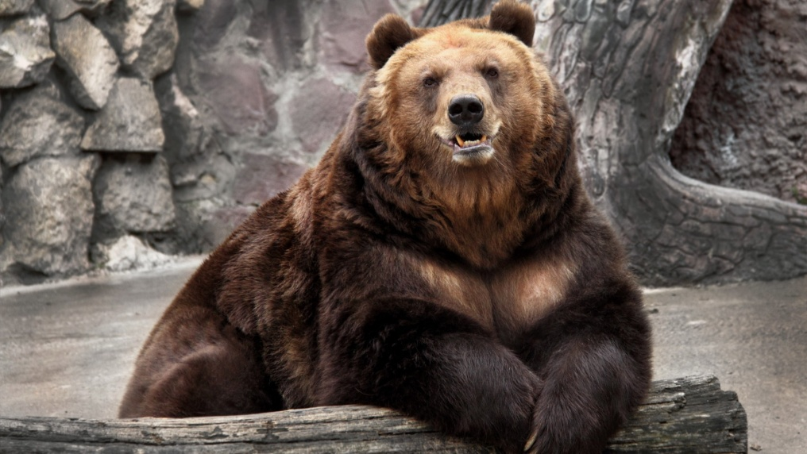
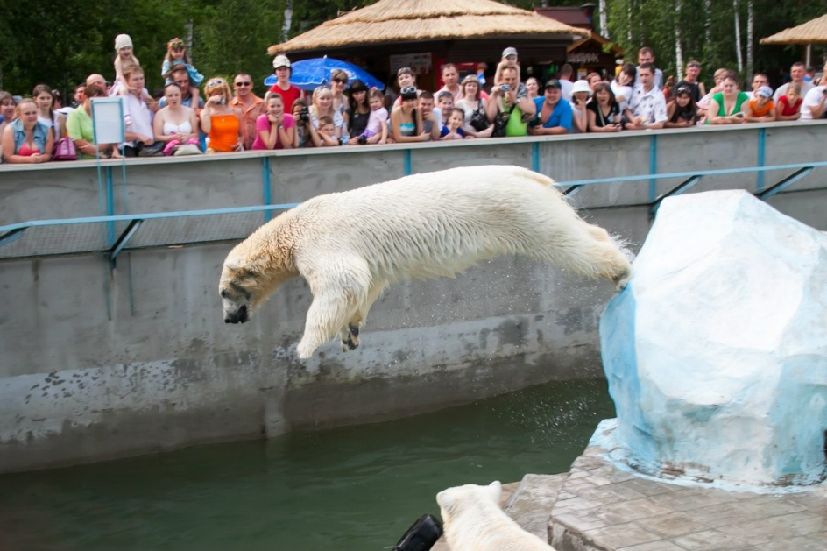
Bears are the most popular animals in our Zoo. We have a brown bear called Misha and a polar bear called Arctic.
Visitors love them very much and they like to feed our bears fish and meat.

Slide 5
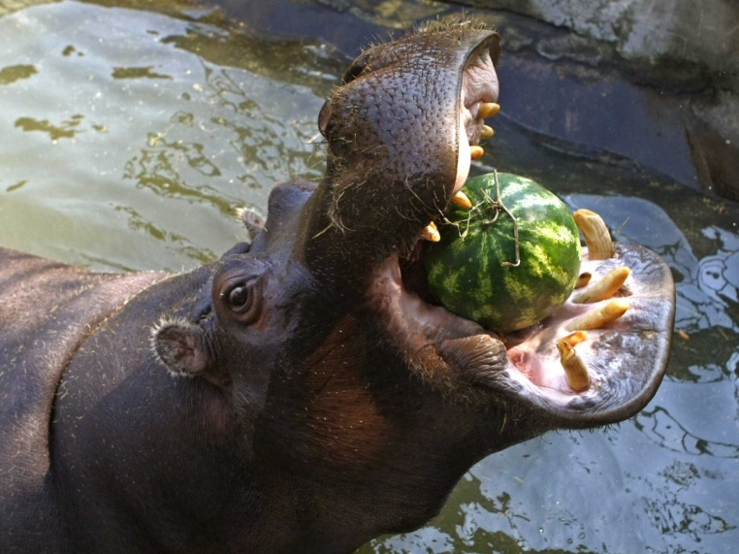
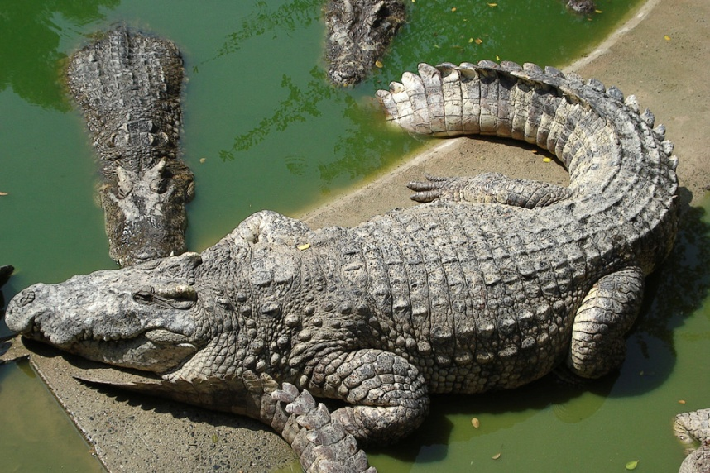
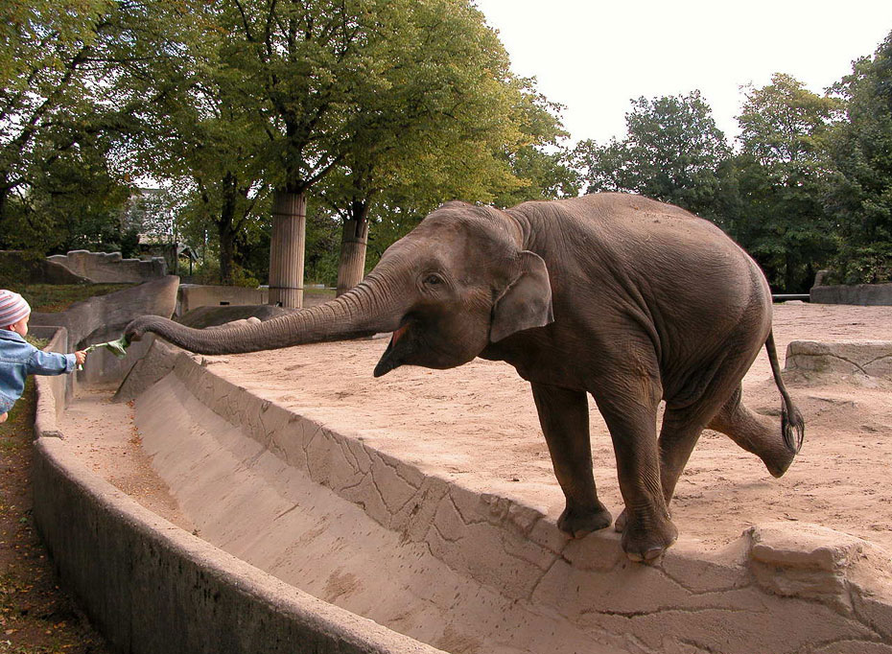
There are a hippo, a crocodile and an elephant in my Zoo.
Usually these animals live in Africa. A hippo and an elephant like to eat fruits and vegetables. A crocodile eats meat.

Slide 6
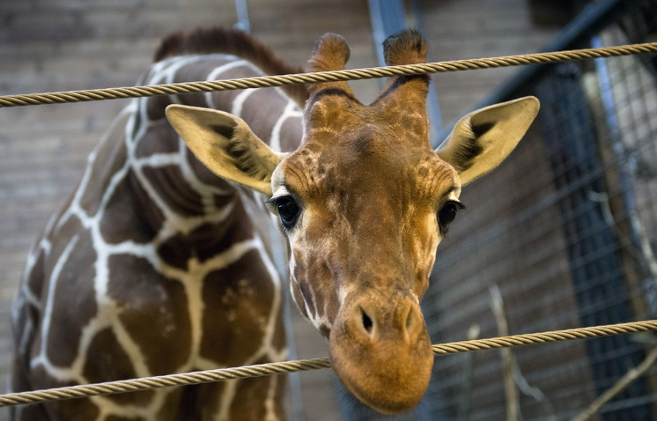
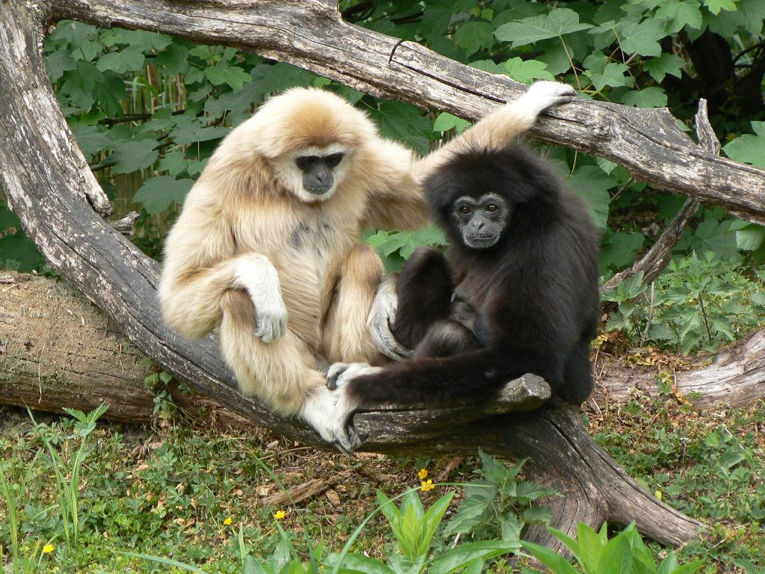
Giraffe Venya is very tall. He eats the leaves of the trees.
Monkeys are funny animals. They like to eat bananas. Our visitors like to feed them.

Slide 7
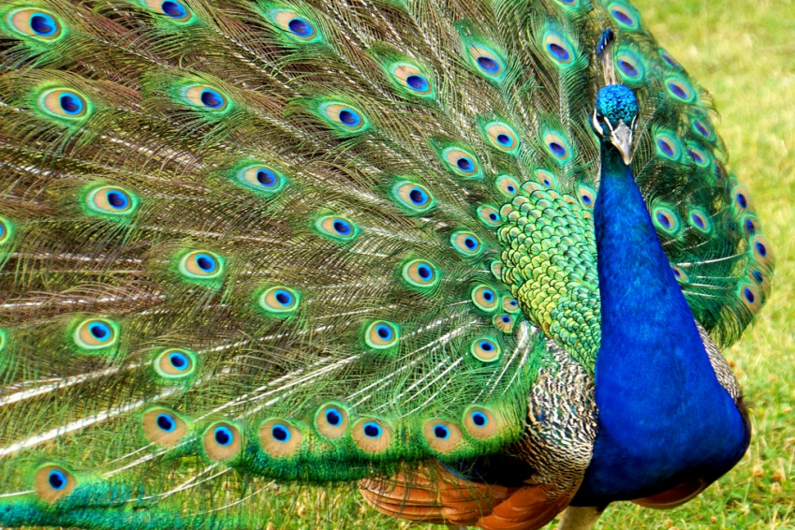
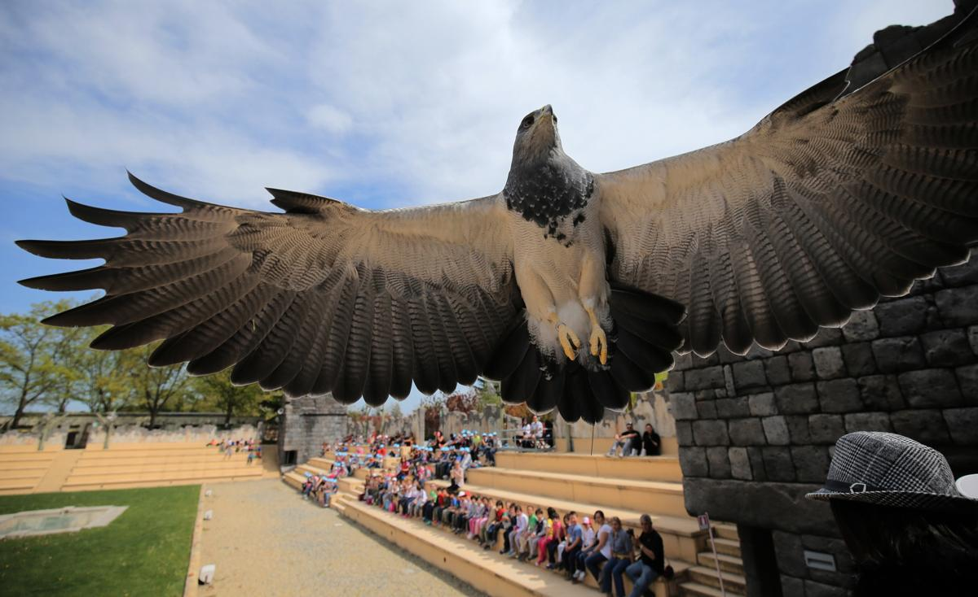
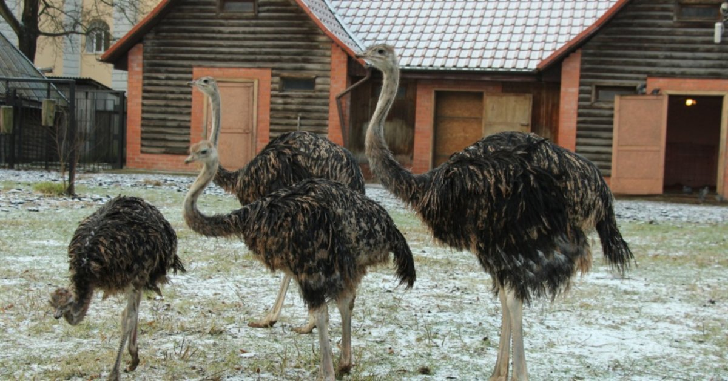
My Zoo is full of birds. There are peacocks, ostriches and eagles. The last one is a hunting bird so it lives in a cage.
Peacocks are very beautiful and colorful.
Ostriches are the fastest birds. They can run.
I would be very happy if you will visit my Zoo!

