Slide 1
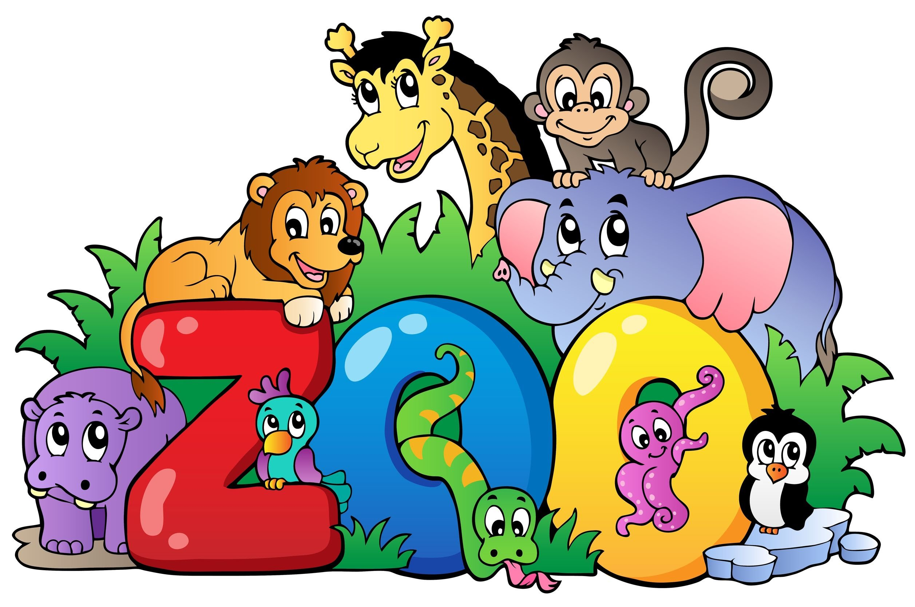
Анисарович Анна, 4 «б» класс

Slide 2
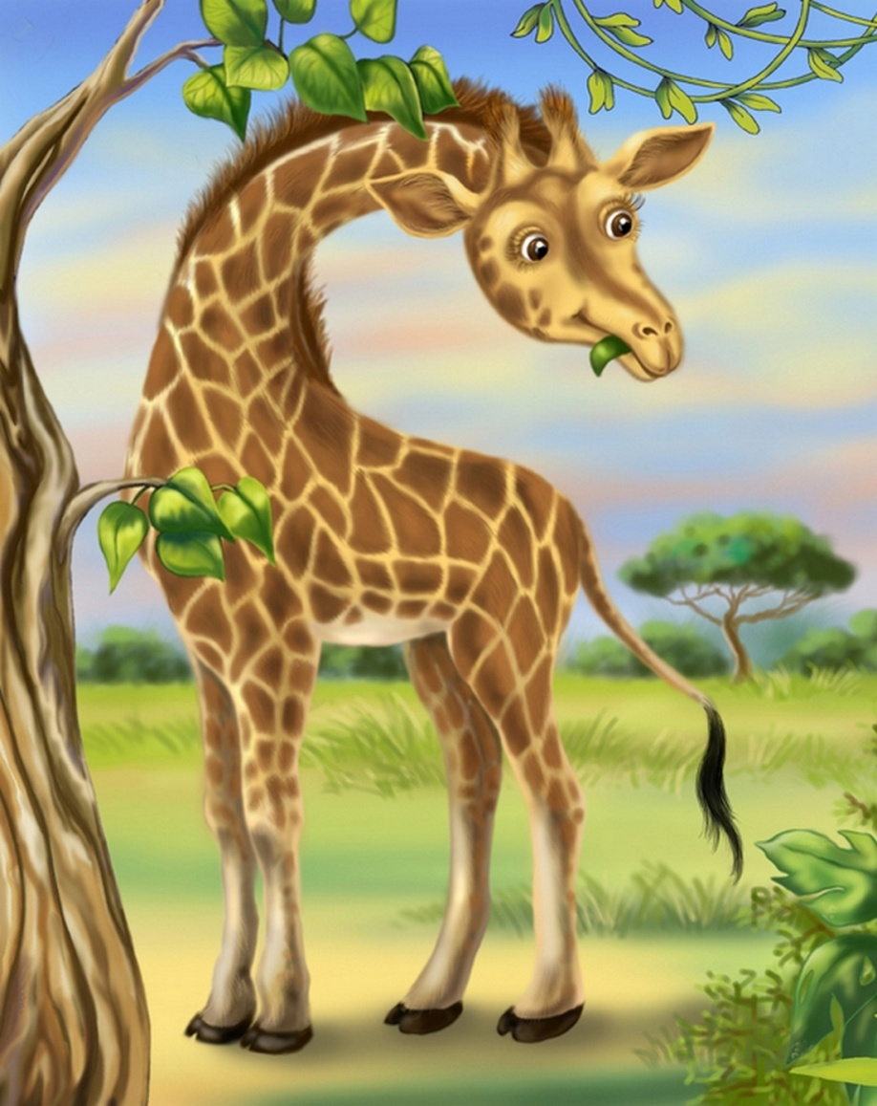
It's a giraffe. Giraffes are the tallest animals in the world. They have very long neck. Giraffes eat leaves on the trees. They live in Africa. Giraffes live about twenty-five years.

Slide 3
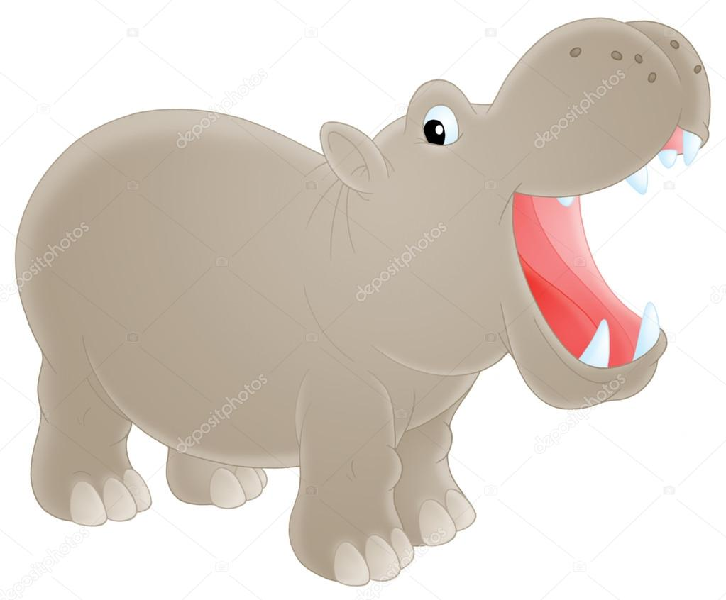
It's a hippo. Hippos are very big animals. They live in Africa. Hippos sleep most of the day and eat at night. They eat grass and live for about forty years.

Slide 4
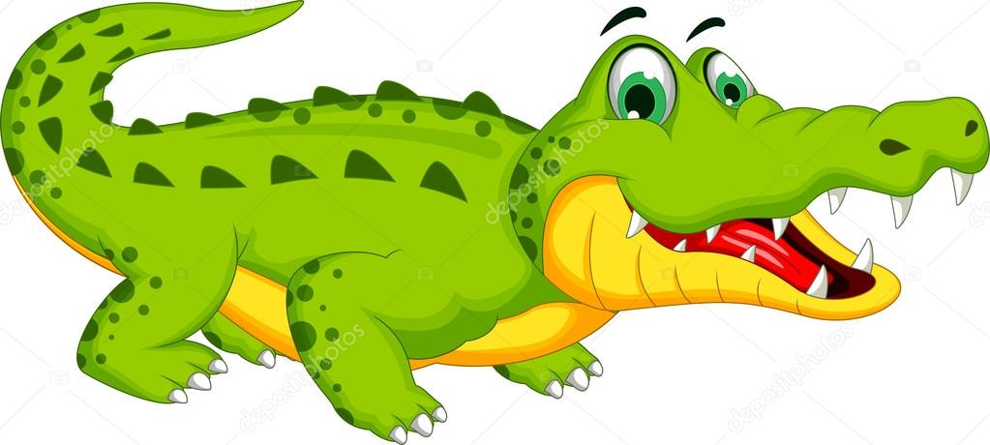
It's a crocodile. Crocodiles have very sharp teeth. They have four short legs and a long tail. They live in the water. Crocodiles are predatory animals. They can live for a hundred years.

Slide 5
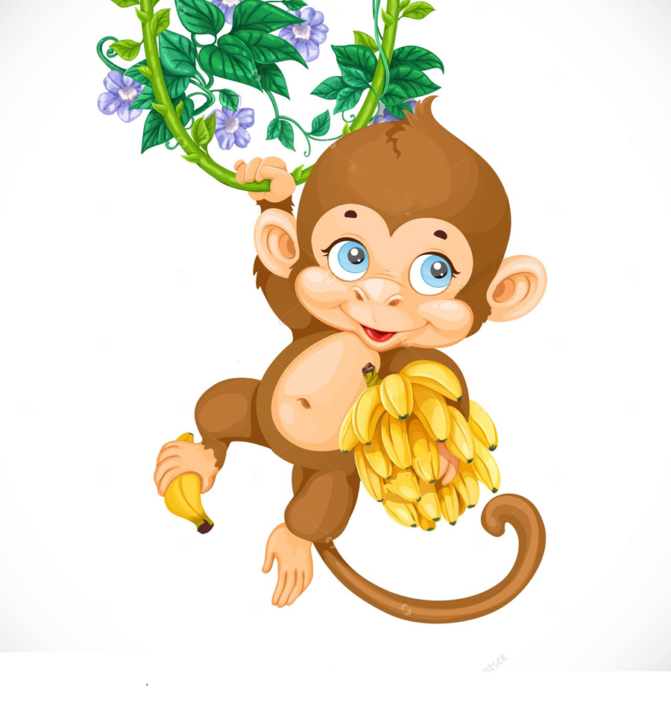
It's a monkey. Monkeys are funny and very clever animals. They have four hands and long tail. They live in the jungle. Monkeys like to eat bananas. They live from fifteen to thirty-five years.

Slide 6

It's an elephant. Elephants are very huge animals. They have four legs, two big ear, long trunk and short tail. They live in the jungle. Elephants eat leaves and plants. They help people. Elephants live more than a hundred years.

