Slide 1
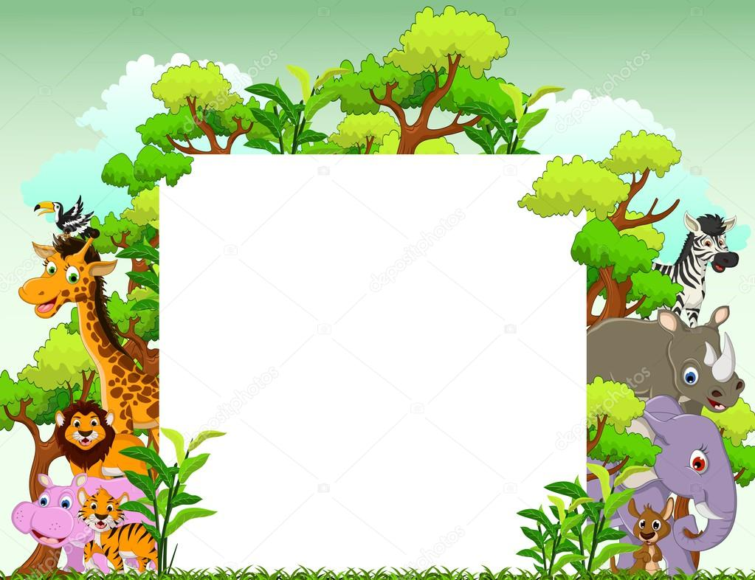
My Zoo
Васильева София 4а класс

Slide 2
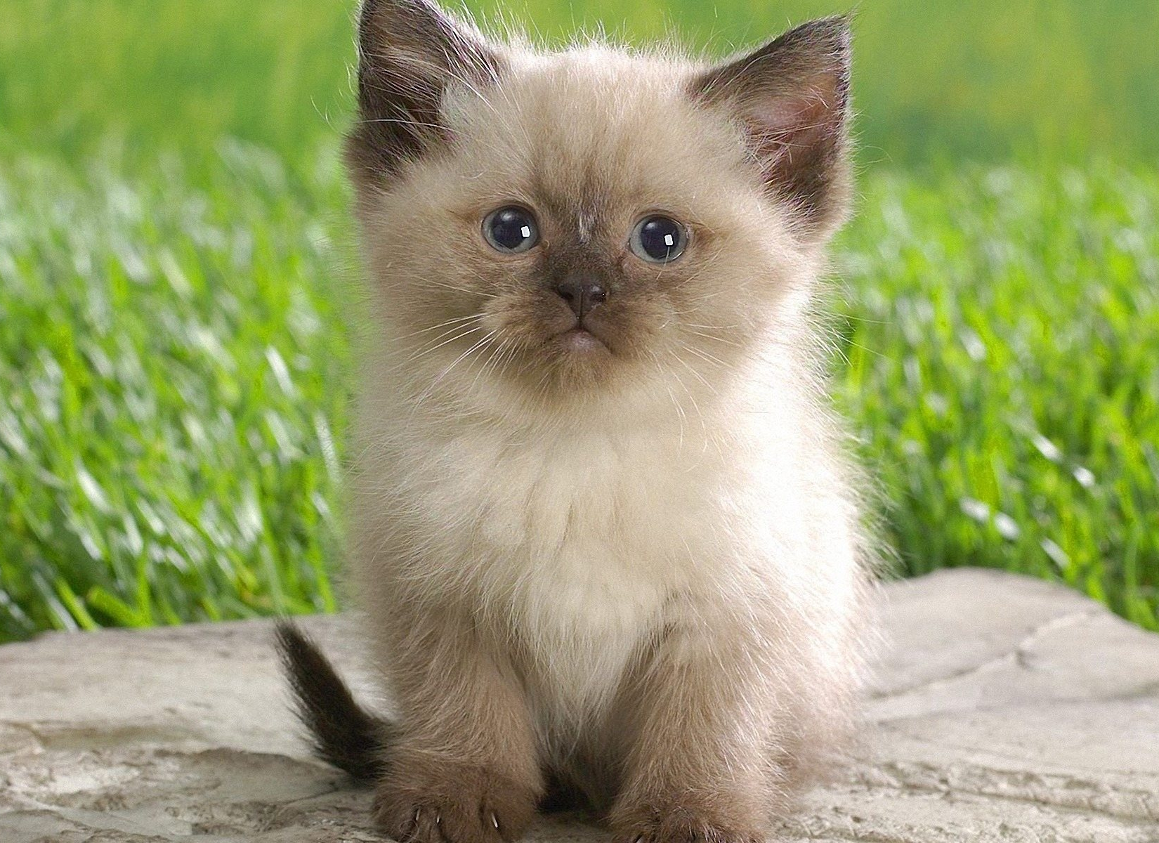
The cat is a pet that lives next to the man, catches mice and rats. She has a soft and smooth coat, long and fluffy tail. Large round eyes glow in the dark.

Slide 3
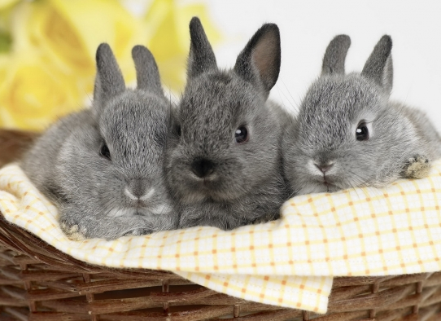
Rabbits - close relatives of birds. They have long ears and paws. They are often kept at home. They eat plants and the bark of trees.

Slide 4
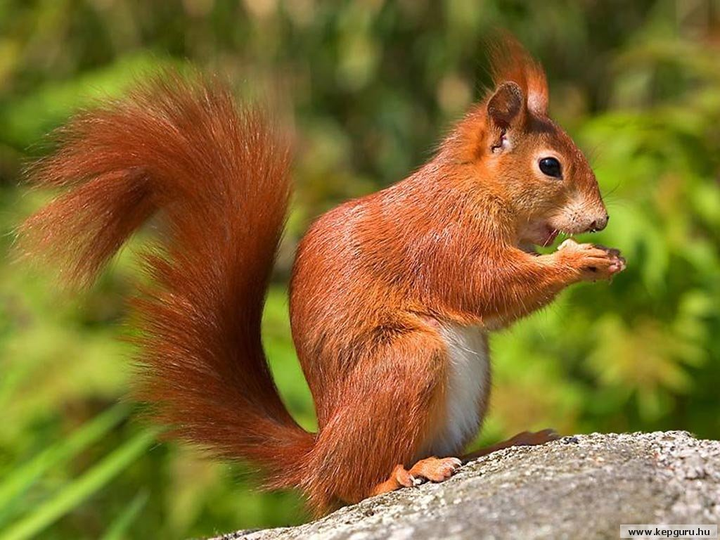
Squirrels live in trees. They have big fluffy tails. They easily jump from branch to branch in search of nuts, fruits and seeds, and sleep in a nest or hollow.

Slide 5
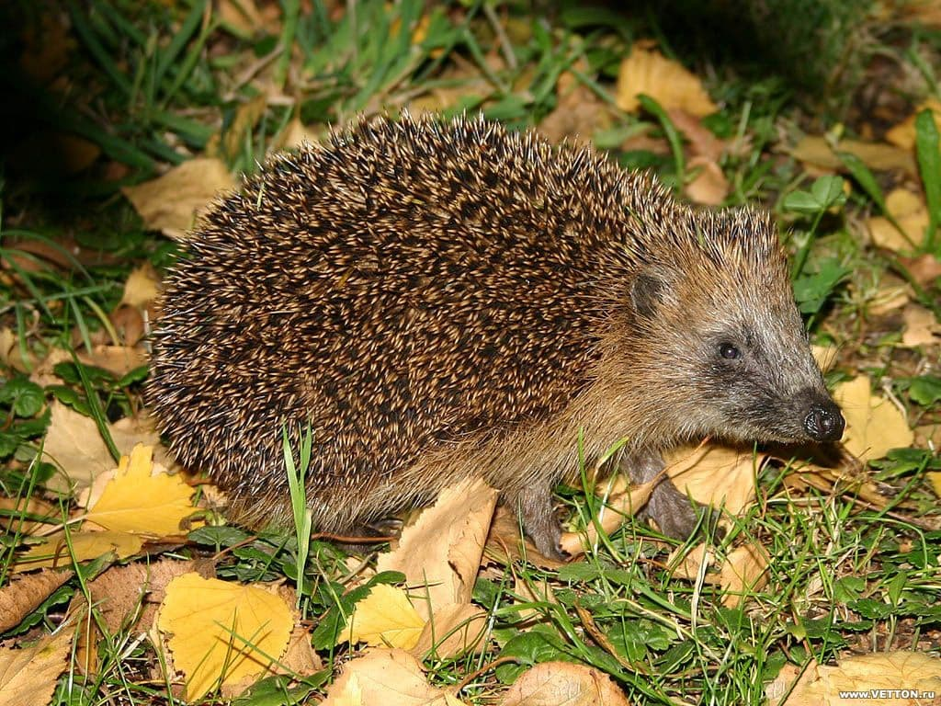
This is a Hedgehog . He has short legs and a back covered with needles. Eats apples and mushrooms, lives in the forest and steppe. Day it can be found rarely, is a nocturnal animal.

Slide 6
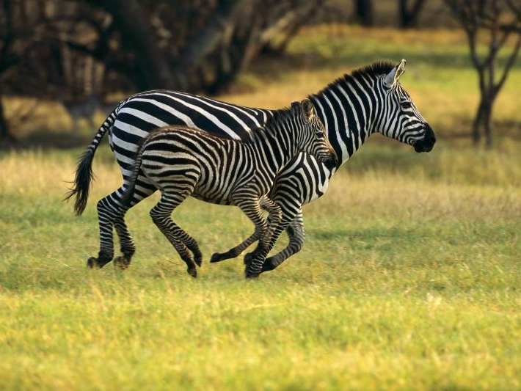
This wild animal is a Zebra. She looks like a horse, only with stripes. Zebras live in Africa eat grass.

Slide 7
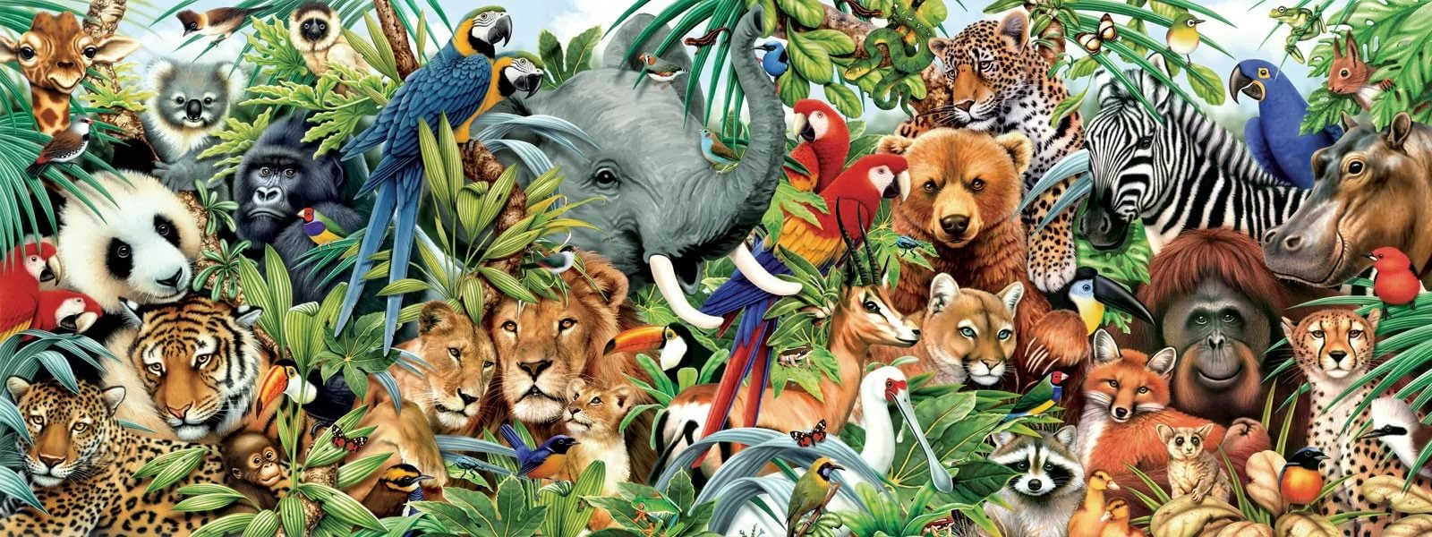
Thank you for your attention!

