Slide 1
My Zoo
Выполнял Курилов артем 4б

Slide 2
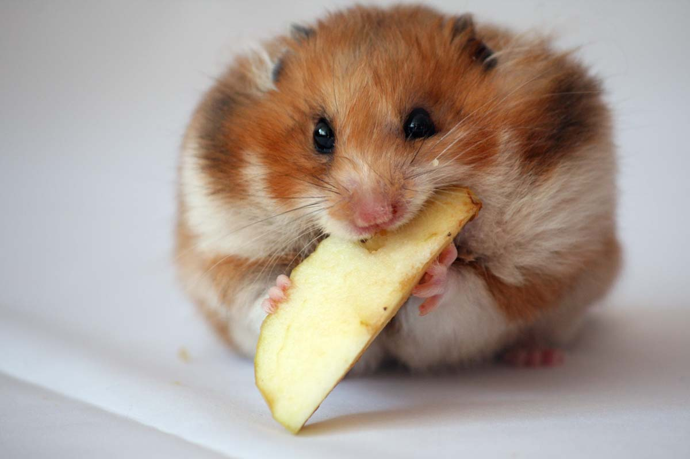
Hamster
Hamster is a little rodent. They live in Asia and Europe. They are great pets and you can play with them. But they need some care. The hamster lives about three years. They like fruit and vegetables. Hamsters are night animals. They have acute hearing and poor eyesight. They recognize objects by smell. Whiskers the hamster – the organ of touch. Hamsters are very clean. They wash and freshen up several times a day. Hamsters love fruits and vegetables

Slide 3
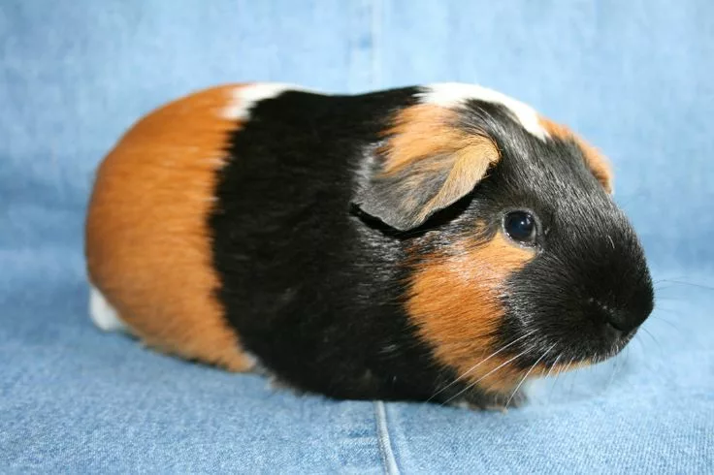
Guinea pigs
Guinea pigs live in Brazil or Peru. They can be different: brown, black, gold, blue. They live about ten years. Guinea pigs like fruit and vegetables, bread and milk. They do not stand to be cold or wet.

Slide 4
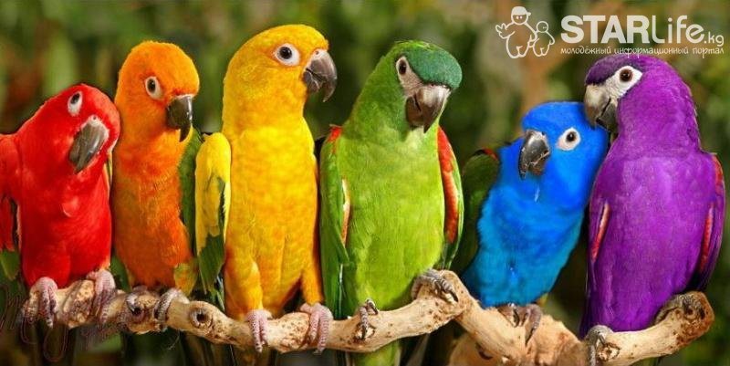
Parrots
Parrots are beautiful tropical birds. They are nice pets. They live about fifteen years. Parrots like seeds. And they need some sand. Some of these birds can talk. Birds at home are an old tradition.

Slide 5
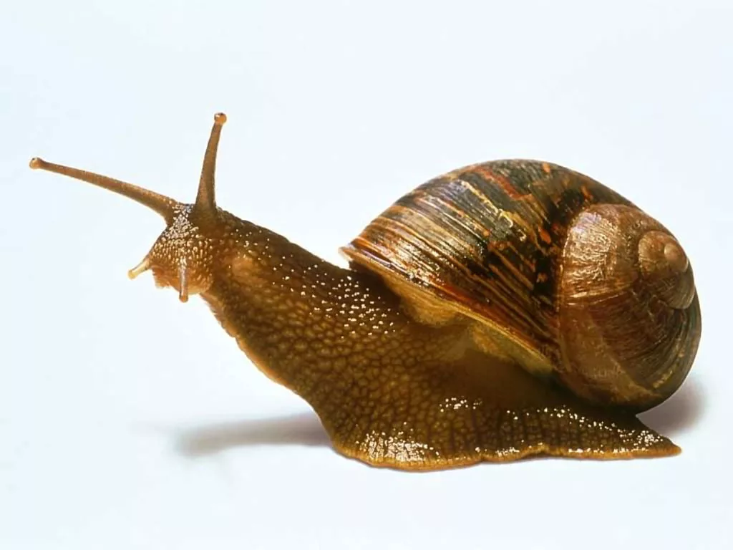
Ahatins
Ahatins are the biggest snails. In Russia they live only at home. Ahatins can live in a small aquarium. They eat fruit, vegetables and meat. They are night animals and they are clever.

Slide 6
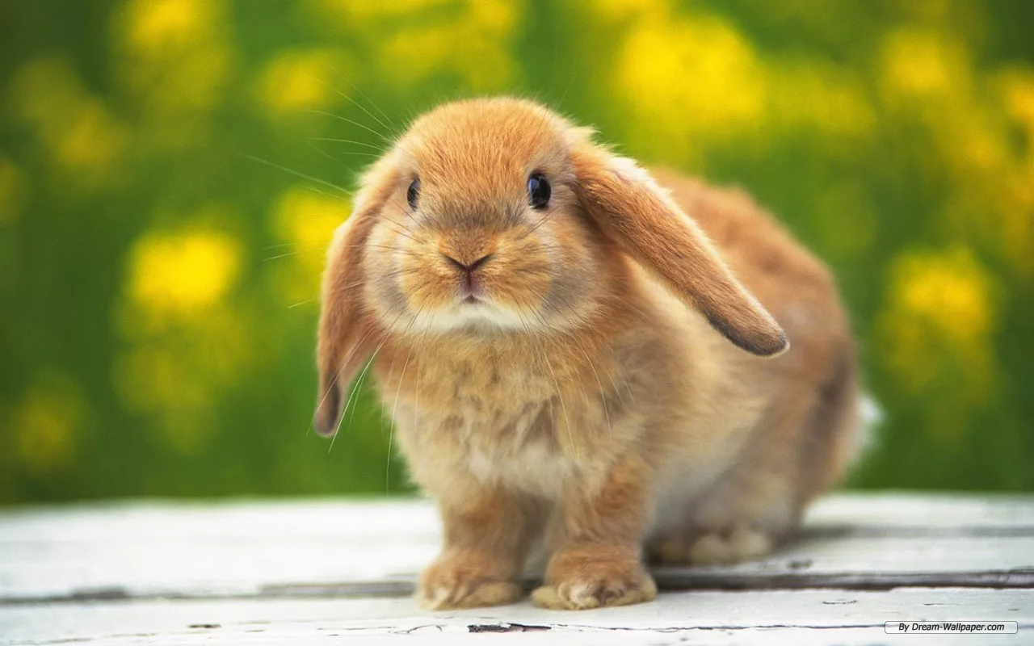
Rabbits
Rabbits are nice animals. They like playing. This is my rabbit. Its name is Mascanya. It likes carrot and cabbage. It gets well with my cat and my parrot. Mascanya likes walking. All the family like it.

Slide 7
Спасибо за внимание!

