Slide 1
My zoo
Completed by Masha KORENYUK

Slide 2
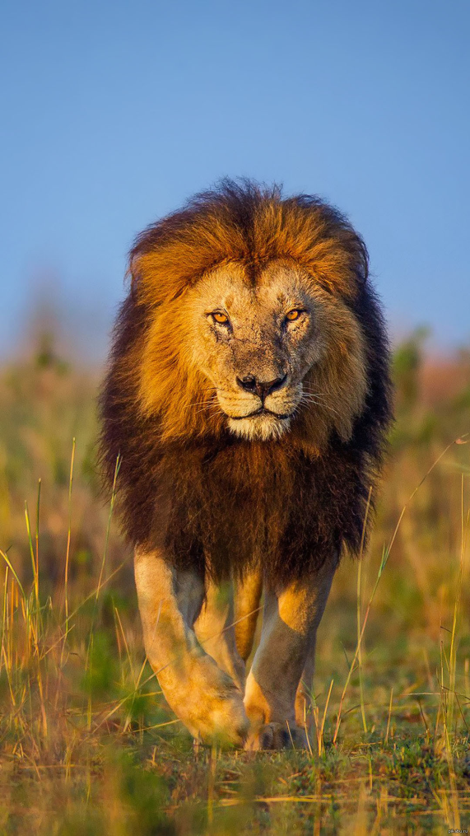
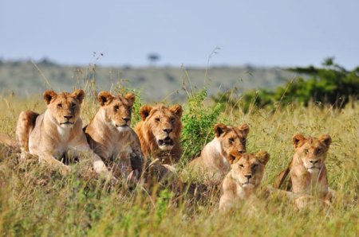
lions
In my zoo will live lions. They are very clever and big.
They live in prides with 1 or 2 lions and by 8 lionesses.

Slide 3
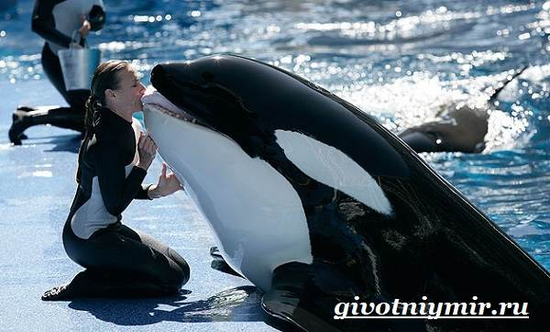
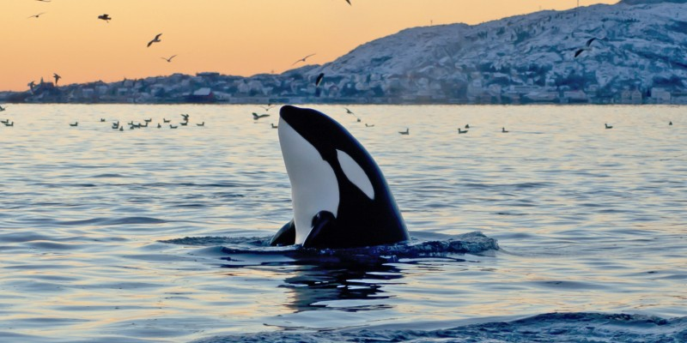
orcas
Also I want to see orcas in my zoo. They are dolphins, but bigger and they have different skins.
Orcas are very friendly…

Slide 4
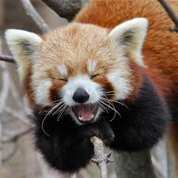
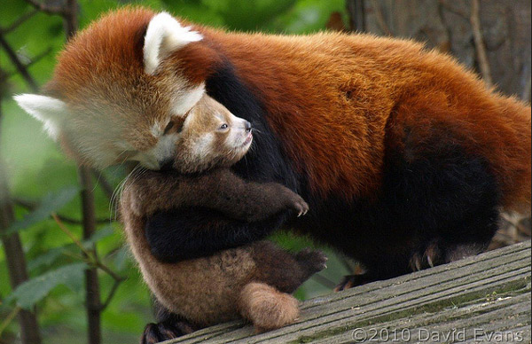
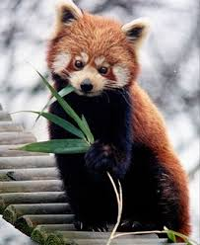
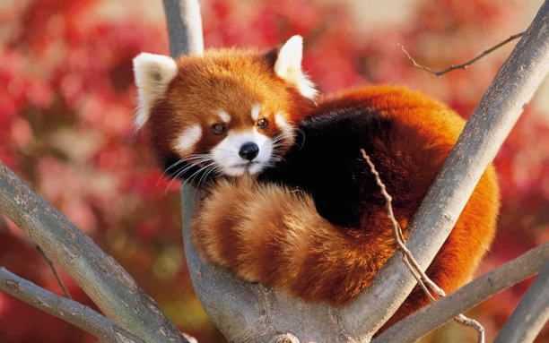
Red pandas
Red pandas are very cute. They live in China and in my zoo.
They are very nimble and fast. Red pandas can climb very good.

Slide 5
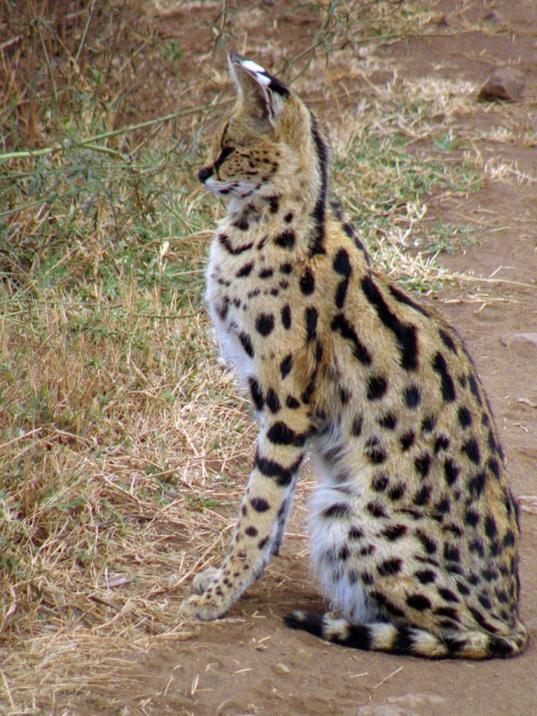
servals
Servals live in savannah and eat mice and other small animals & birds.
They can jump very high. Servals use this ability on hunt.

Slide 6
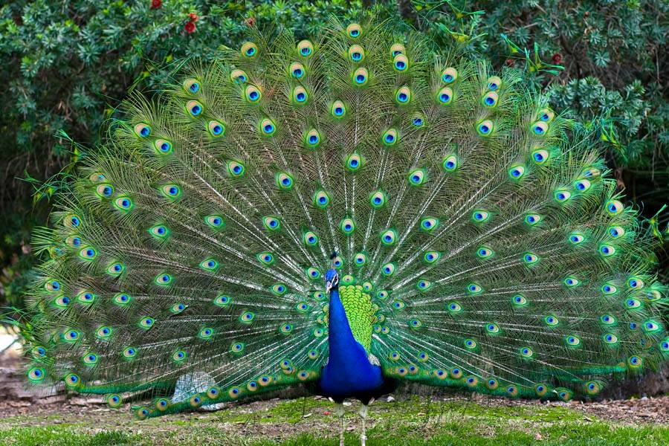
Peacocks
Peacocks are the most beautiful bird on our planet.
They cant fly and sing like other birds, but they are cool…

Slide 7
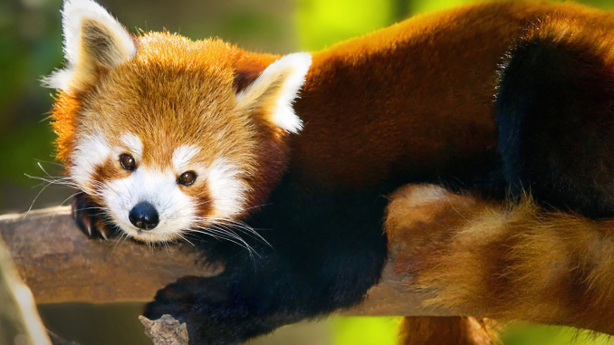
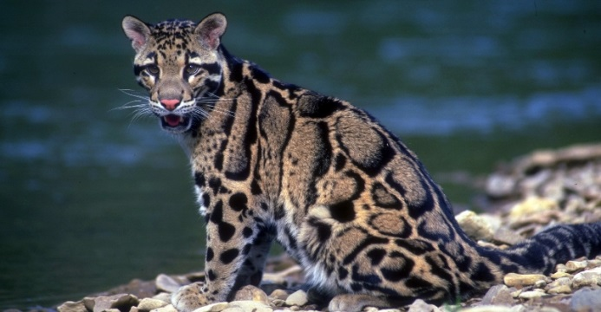
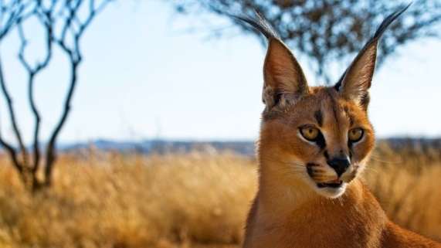
Thank you for watching
And welcome to my zoo☺

