Slide 1
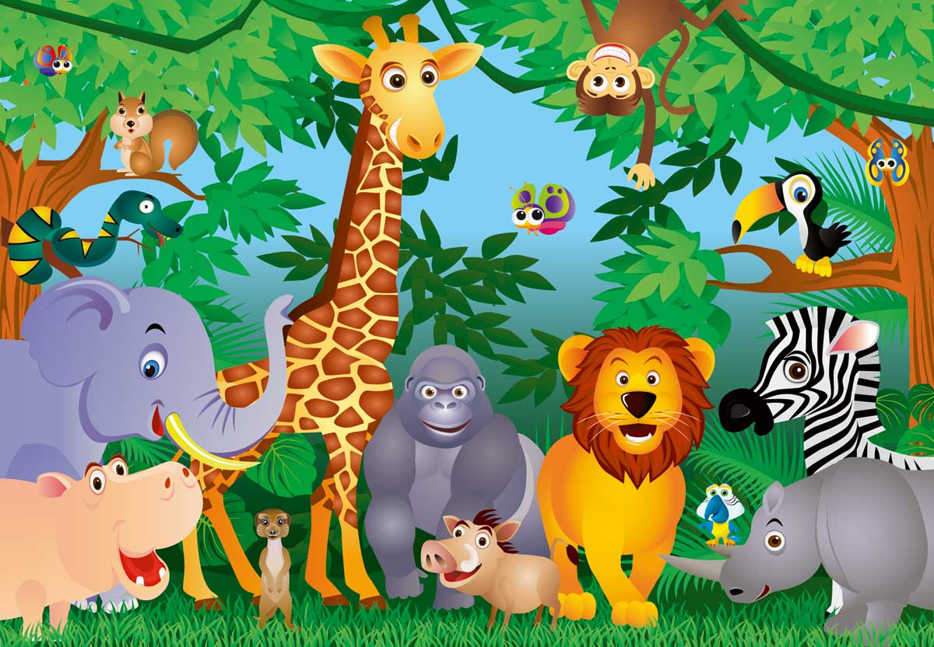
MY ZOO Нигамаев Динар

Slide 2
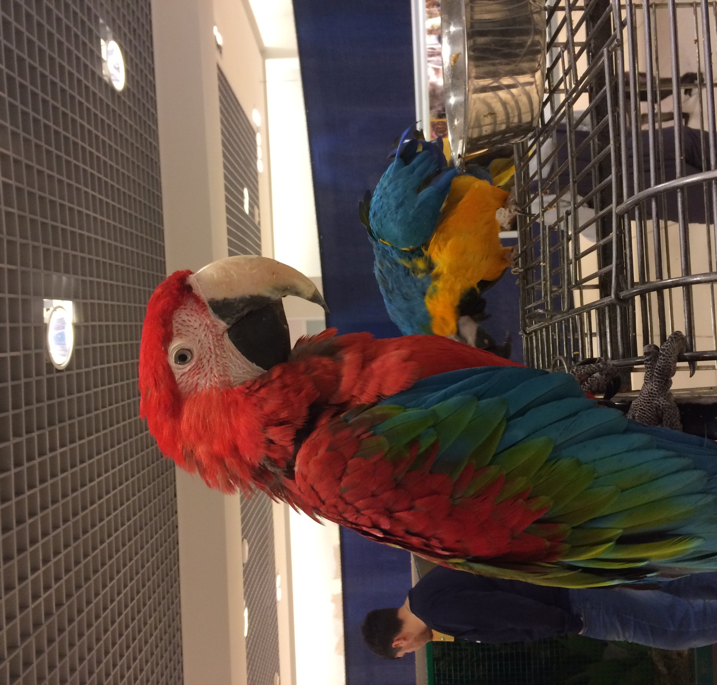
Ara parrot
Large parrots with a very bright and beautiful coloration. They live in the north of South America. They eat a mixture of cereals, various vegetables, fruits.

Slide 3
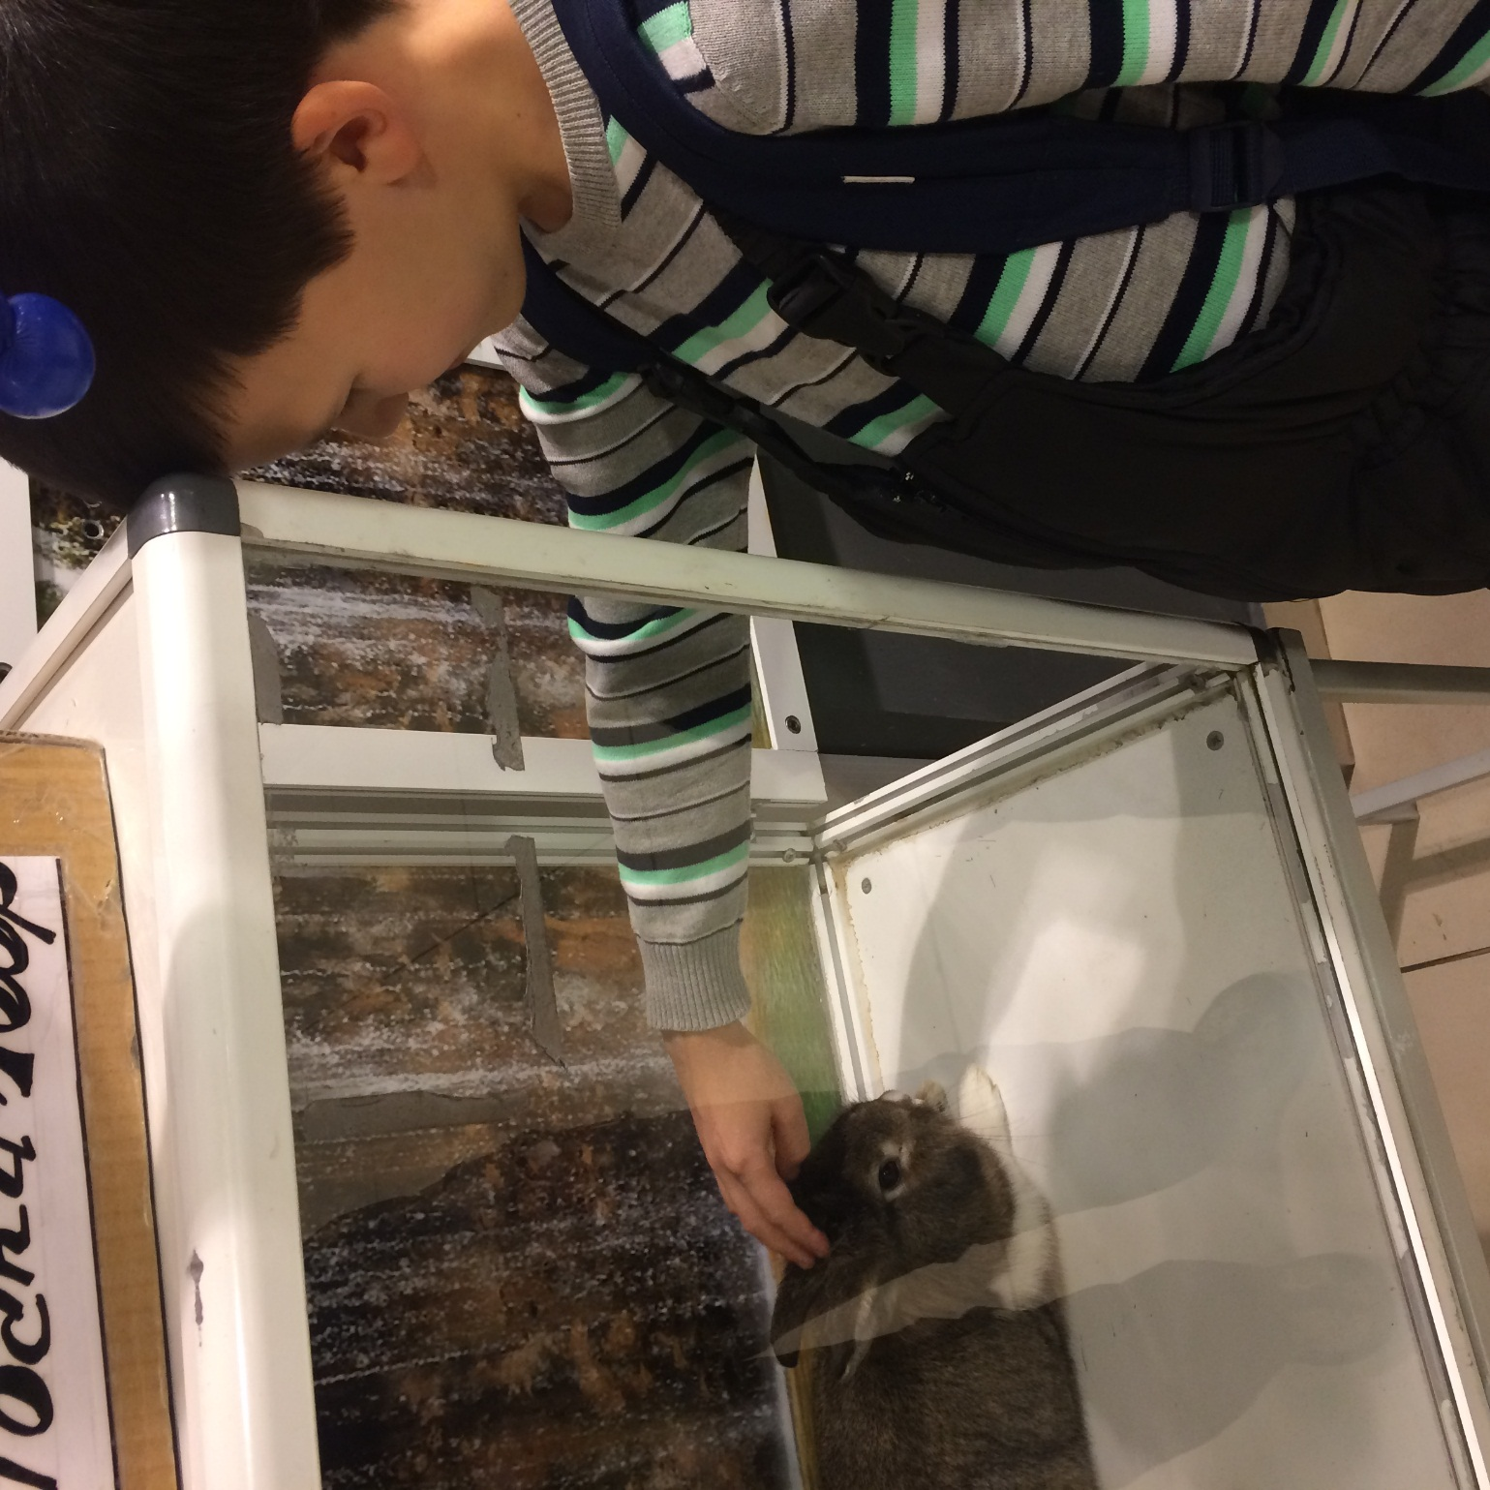
Rabbit
Rabbits have full, oval bodies. Their large ears, which can be more than 10 cm in length. Rabbits have large, powerful hind legs.

Slide 4
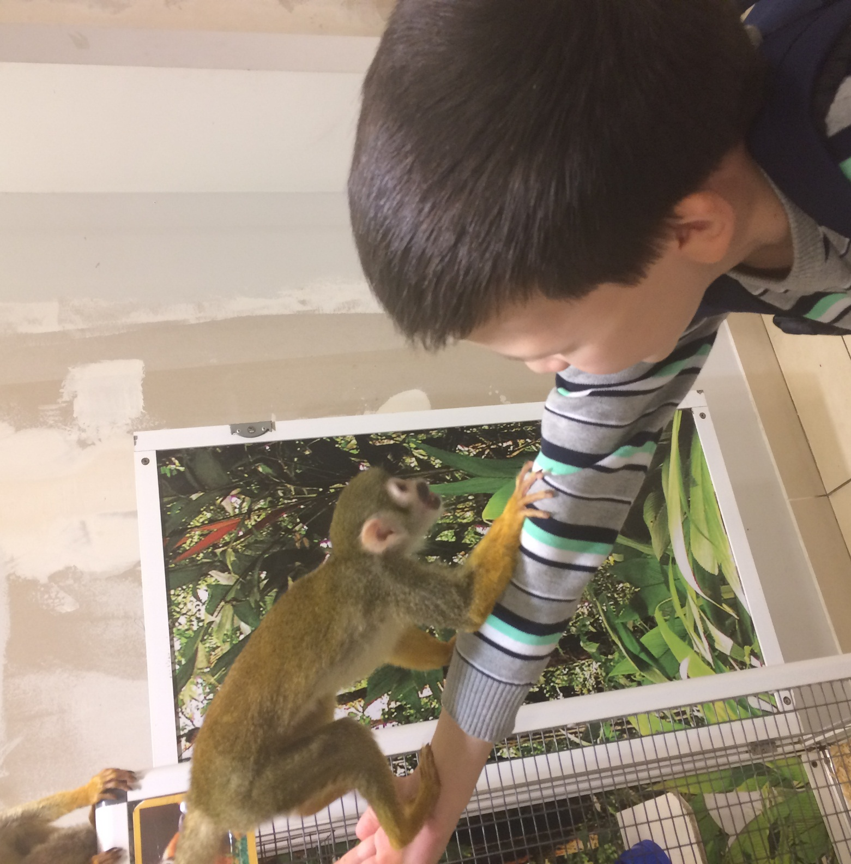
Monkey Simiri
They live in Brazil, Peru. Small monkeys, 25-35 cm long, tail longer than body. They feed on fruits, nuts, berries, insects and small animals.

Slide 5
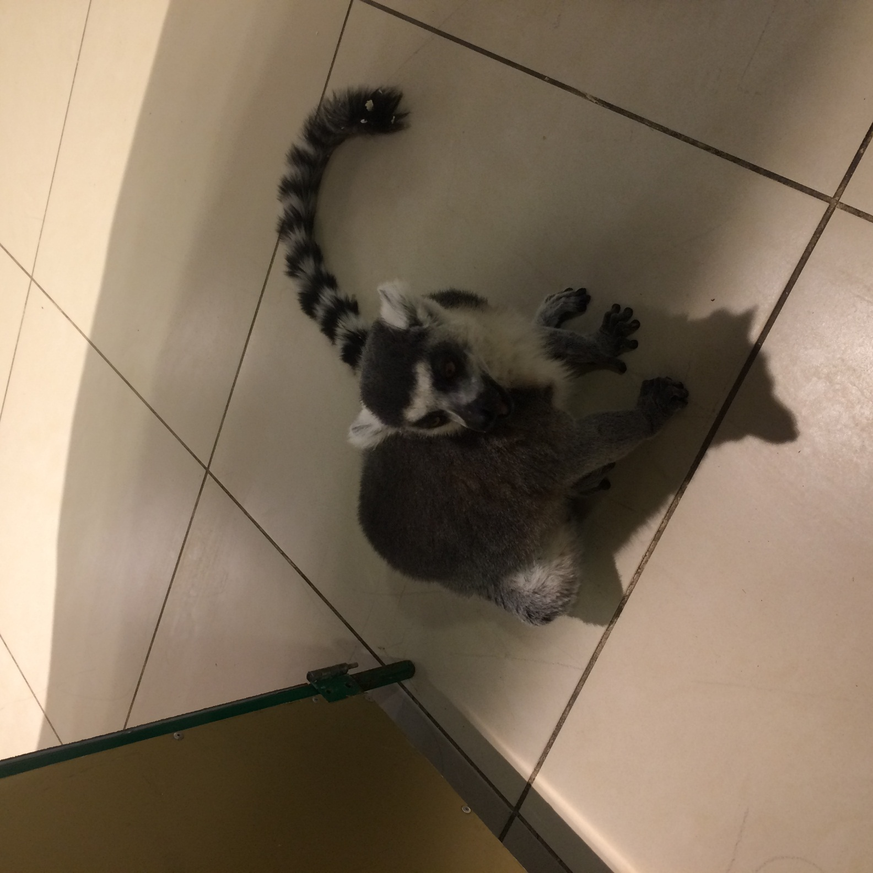
Cat's Lemur
They are slender animals, comparable in size to cats. There are 13 black and white stripes on the tail. Cat lemurs are found in the south and southwest of the island of Madagascar. They feed on leaves, flowers, cacti and insects.

Slide 6
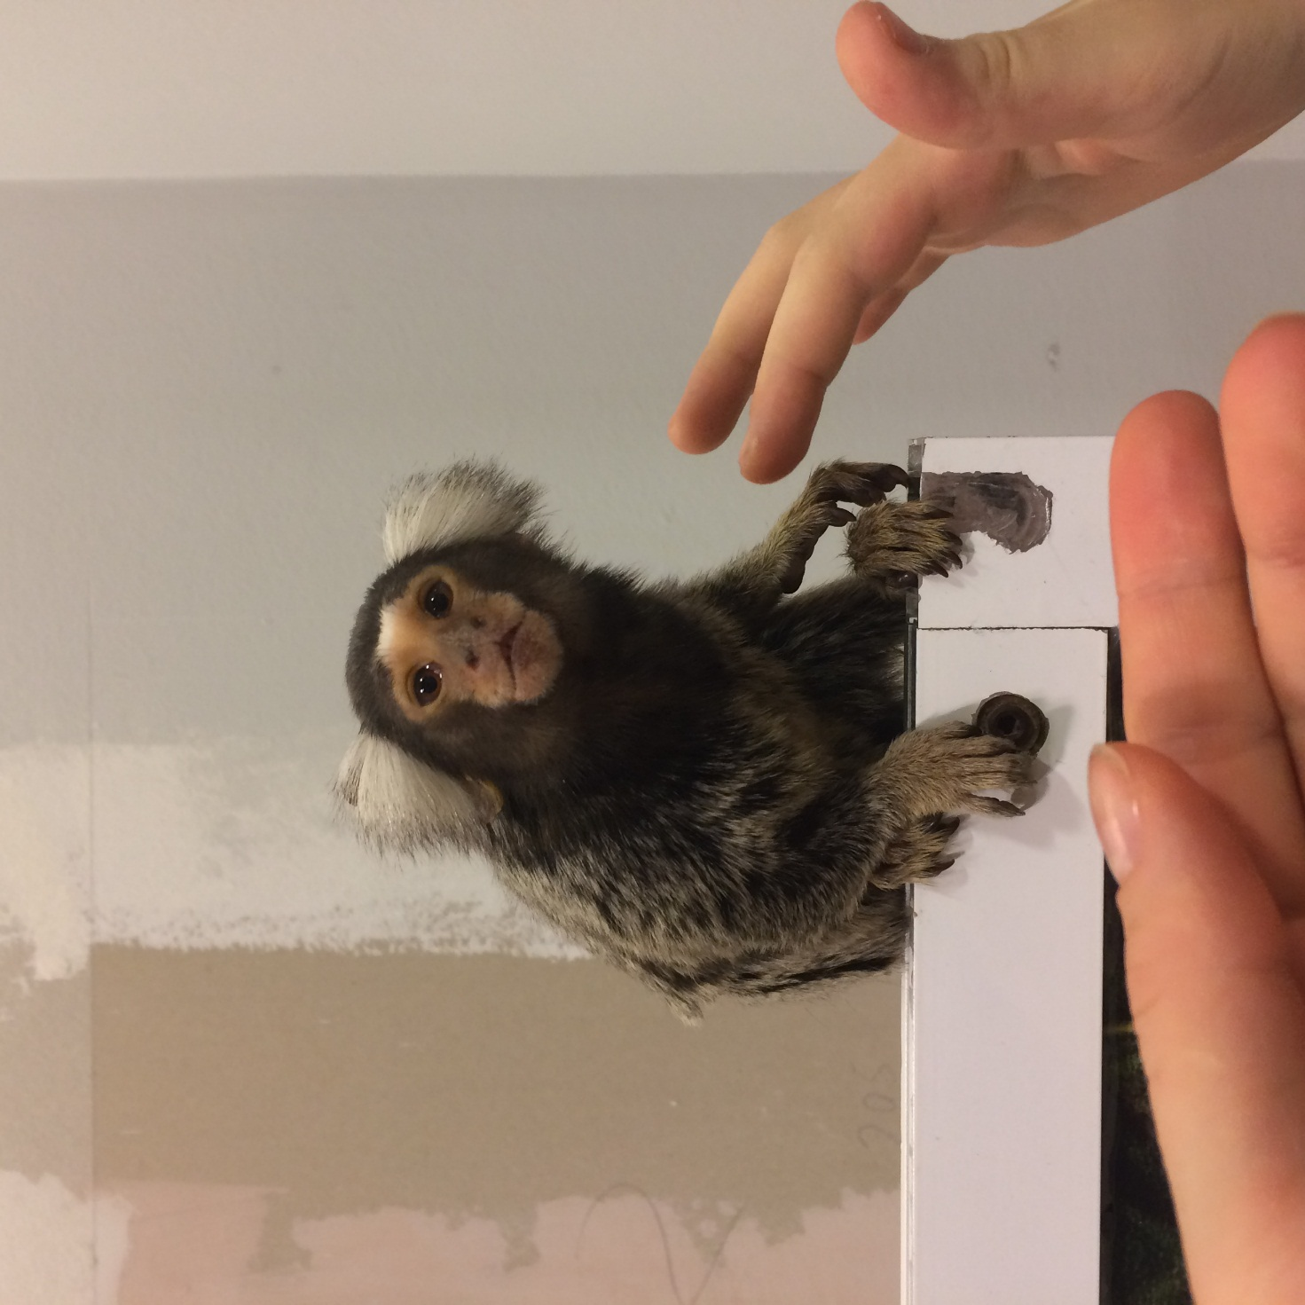
Buffy tufted marmoset
Оne of the smallest primates. They dwell in the forests of the Atlantic coast of Brazil. These are daytime wood animals. They feed on insects only.

Slide 7
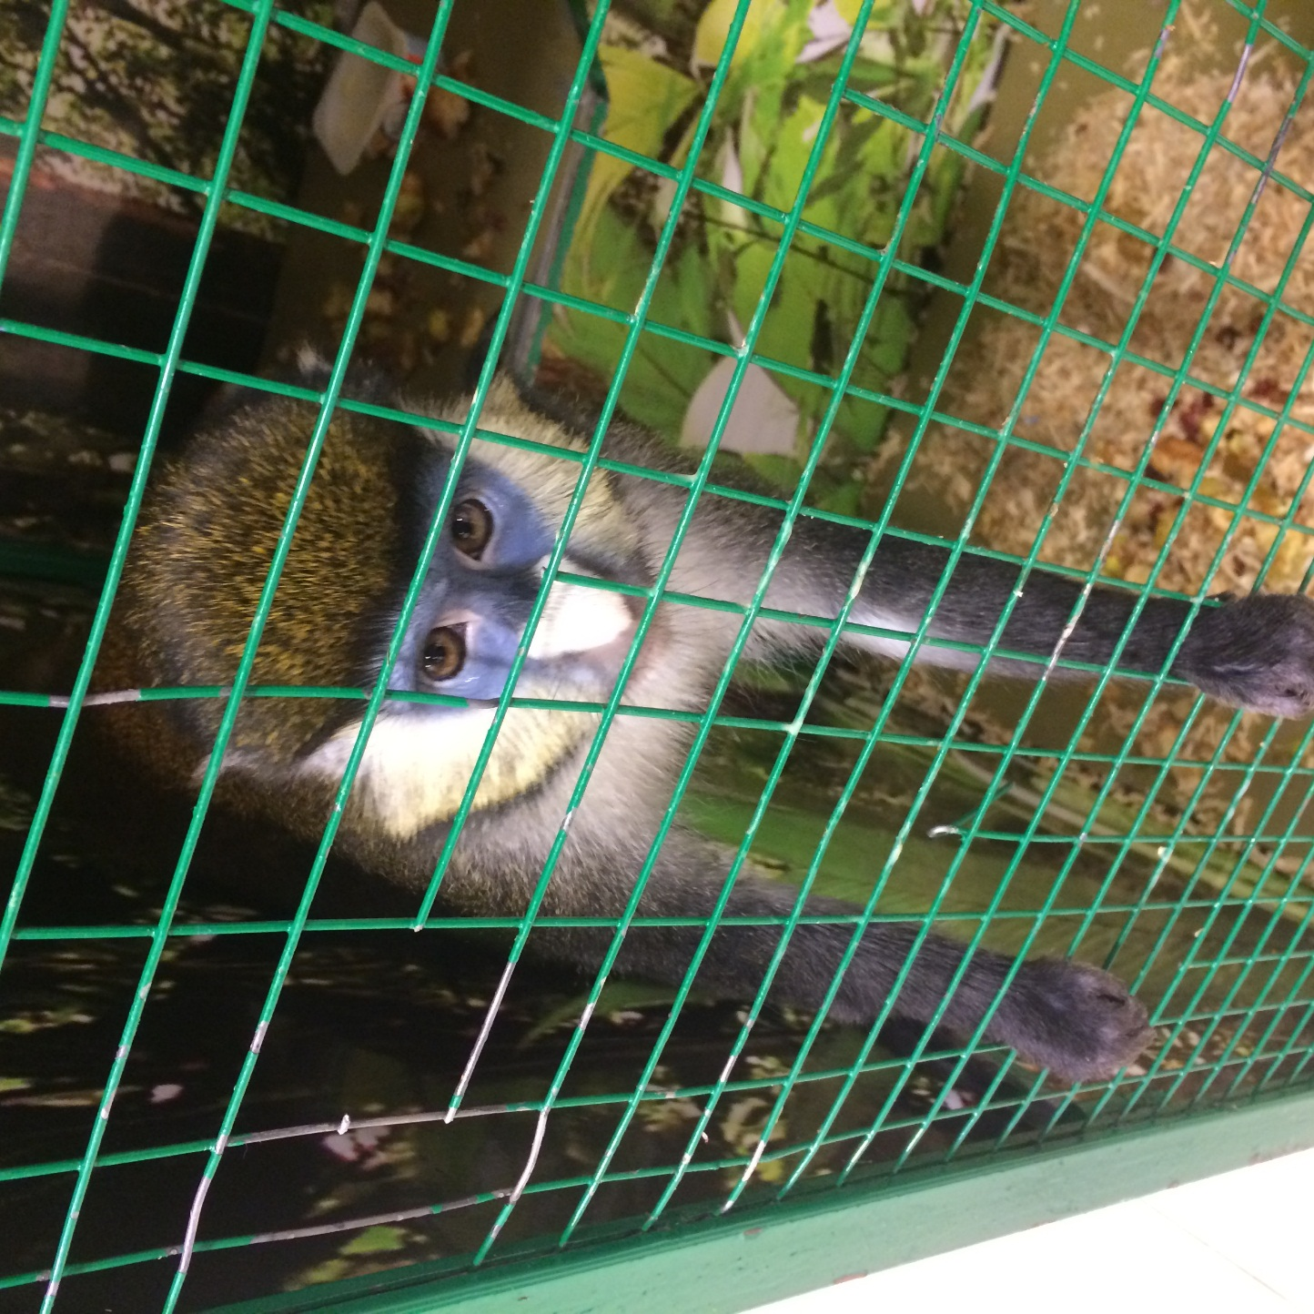
Red-tailed monkey
Dwells in the tropical moist forests of Central Africa. The most numerous are the populations living in Uganda. They feed on fruits, flowers and insects.

