Slide 1
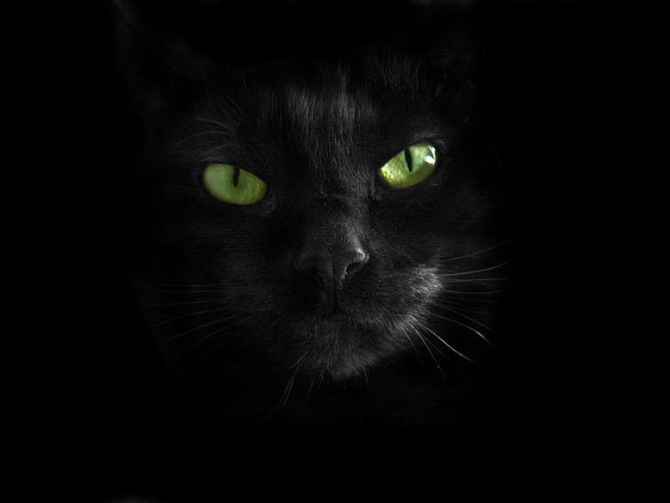
British and Russian superstitions
Pupil of the 6th Form A
School № 10
Shirmanova Karina

Slide 2
The object of research is superstitions.
The subject is the most popular British and Russian superstitions.
The aim of my work is to find out the similarities or differences between British and Russian superstitions.
The tasks are to find, study, analyze and classify information about British and Russian superstitions.

Slide 3
My hypothesis is superstitions in Britain and in Russia are different.
Research methods:
1) search and examination of information
2) analysis
3) classification
4) comparison
5) generalization

Slide 4
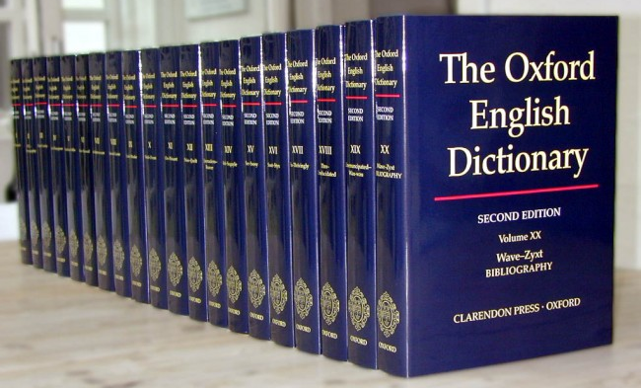
Superstition is a widely held but irrational belief in supernatural influences, especially as leading to good or bad luck.

Slide 5

Russia Great Britain
50% 80%

Slide 6
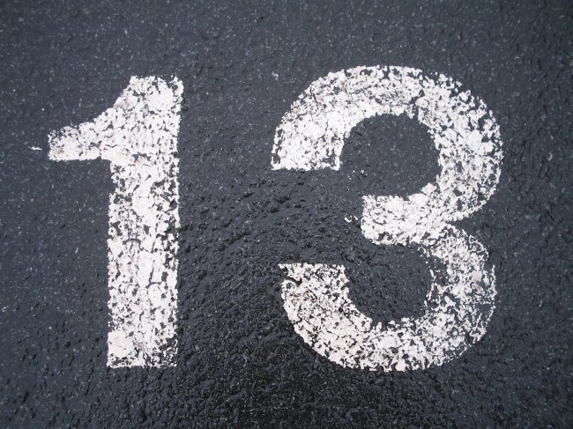

Slide 7
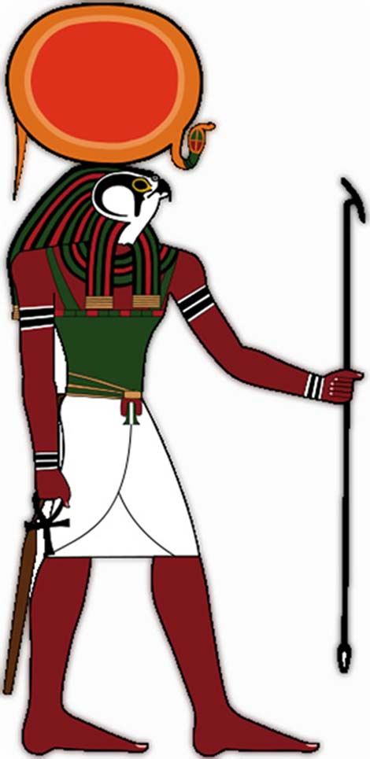

Don’t open an umbrella indoors (bad luck).

Slide 8
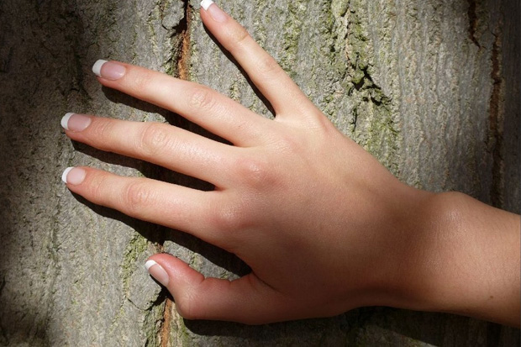
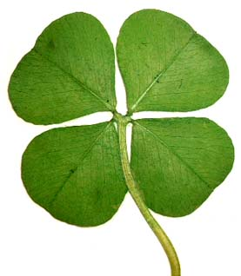
Touch wood
(good luck).
Four-leaf clover
(good luck).

Slide 9
superstitions
animals, birds
things
flowers, trees
wedding
children
clothes
money
travelling
body
food

Slide 10
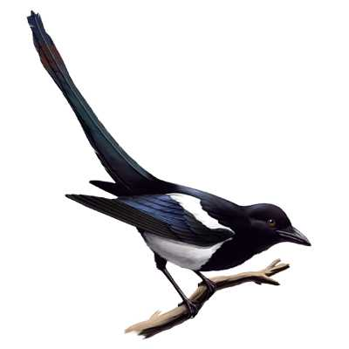
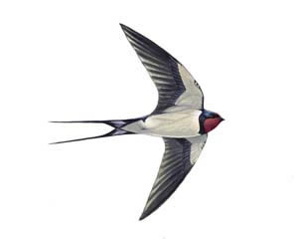
Animals and birds superstitions
British Superstitions | Russian Superstitions
Unlucky to see one magpie, lucky to see two, etc… | If a swallow flies near the ground it will be rain soon.

Slide 11
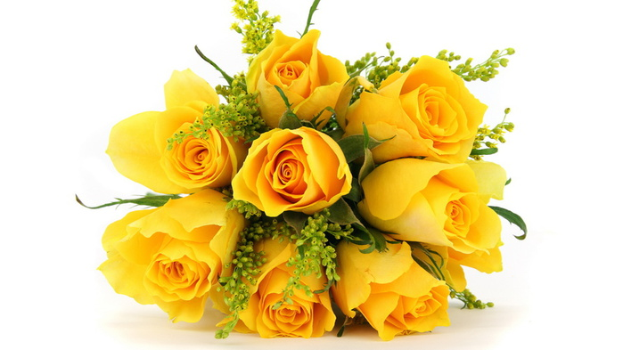
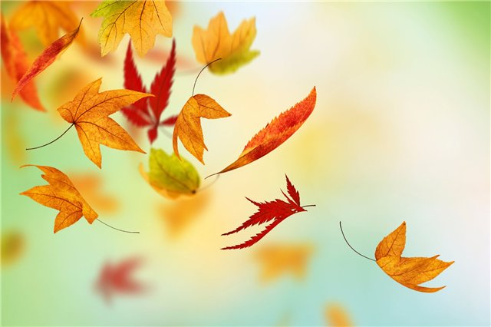
Flowers and trees superstitions.
British Superstitions | Russian Superstitions
Catch falling leaves in Autumn and you will have good luck. Every leaf means a lucky month next year. | Don’t give yellow flower to your girlfriend. It means that your relationship will end.

Slide 12
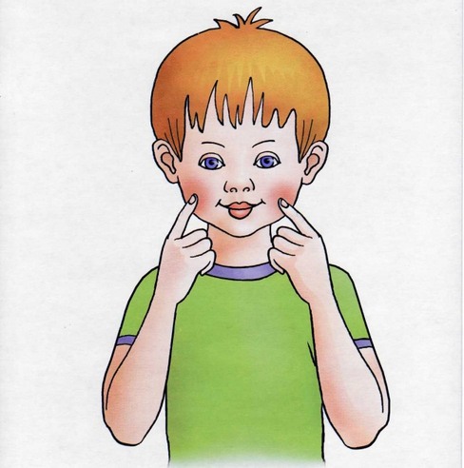

Body superstitions.
British superstition | Russian superstition
Cross your fingers before an important event for good luck. | If your ears or cheeks are hot, someone is thinking or talking about you.

Slide 13
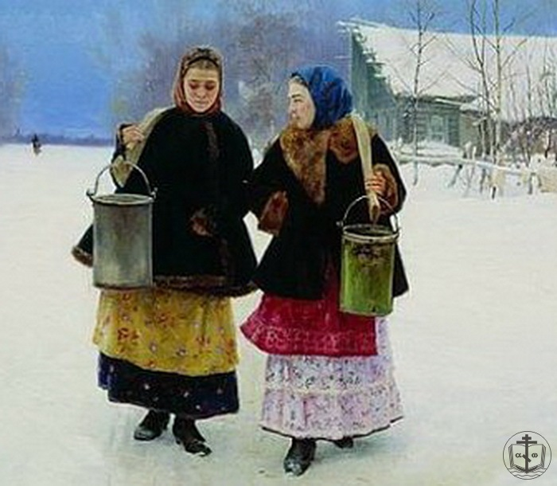
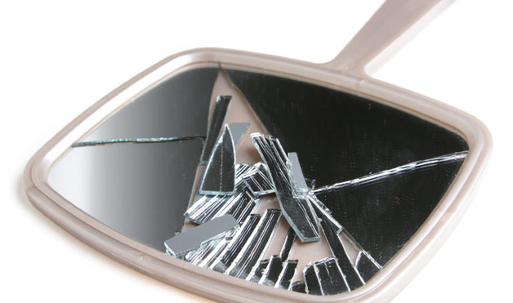
Things superstitions.
British superstition | Russian superstition
Seven years bad luck to break a mirror. | If you meet a woman with empty buck it’s bad luck.

Slide 14
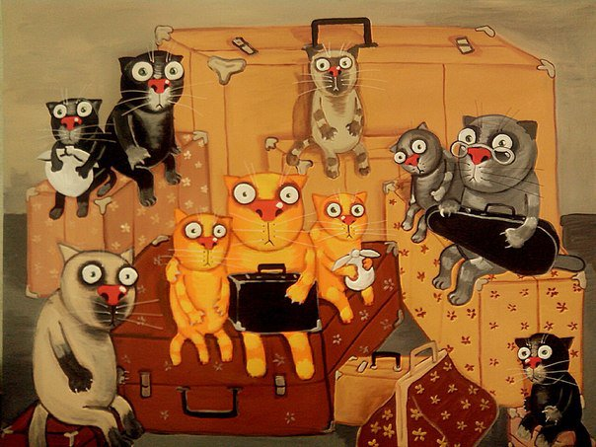
Travelling superstitions.
British superstition | Russian superstition
- | Before a long trip you must sit for a minute and you trip will be good.

Slide 15
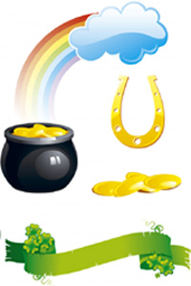
Comparison of British and Russian superstitions.
Identical superstitions.
Superstitions with some differences but with similar meaning.
Superstitions with opposite meaning.
British superstitions without Russian analogues.

Slide 16
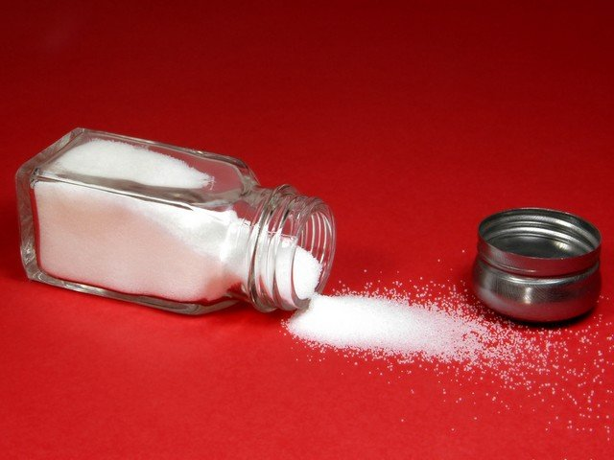
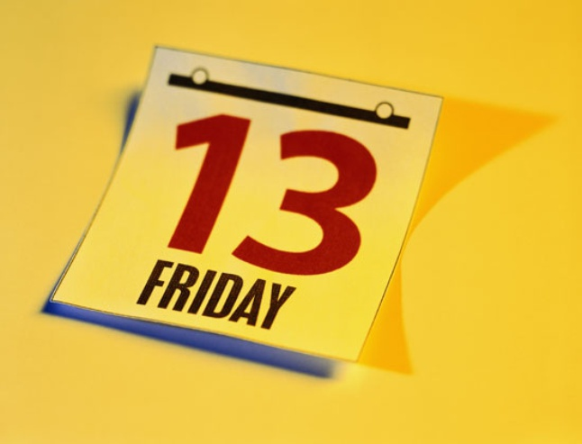
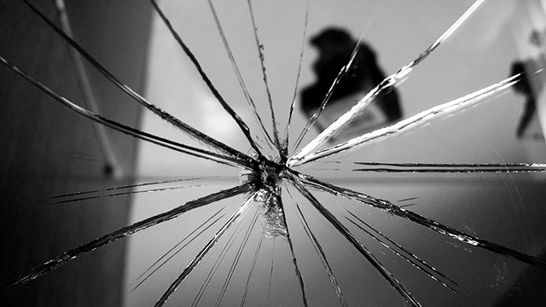
Identical superstitions.

Slide 17

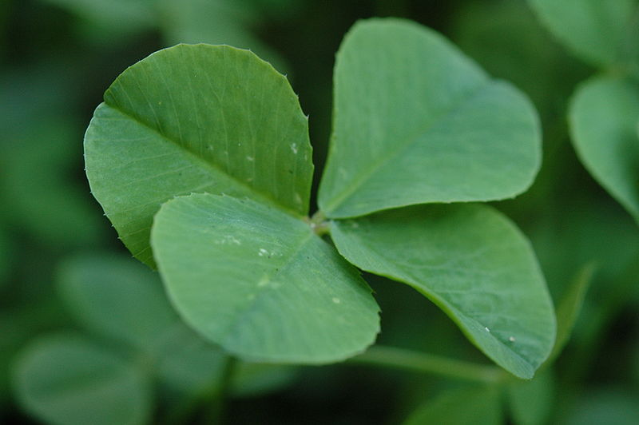
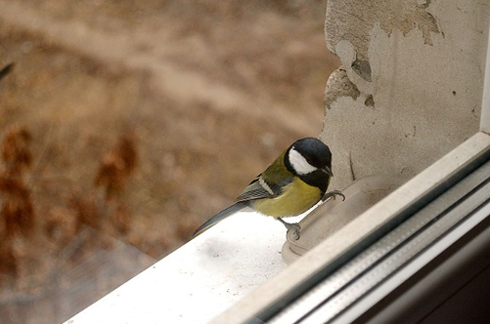
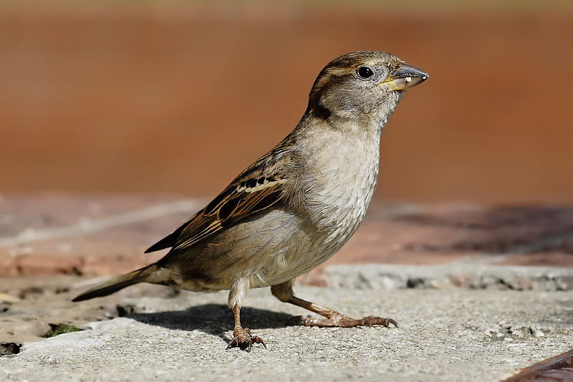
Superstitions with some differences but with similar meaning.
British superstition | Russian superstition

Slide 18
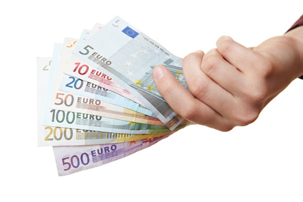
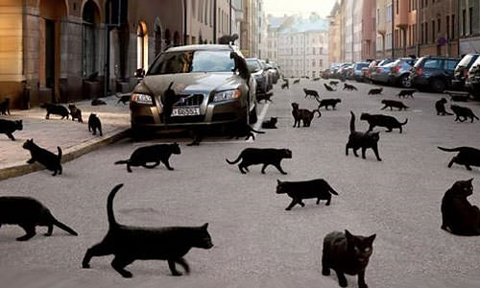
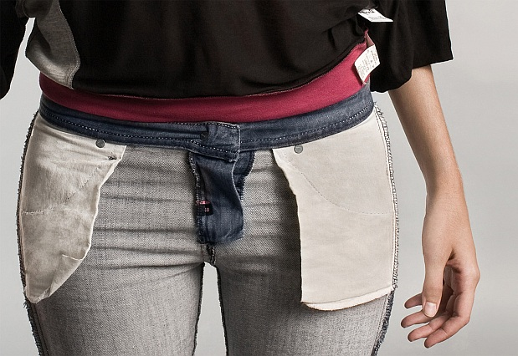
Superstitions with opposite meaning.

Slide 19
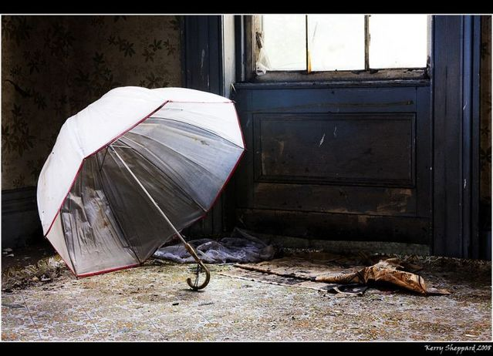
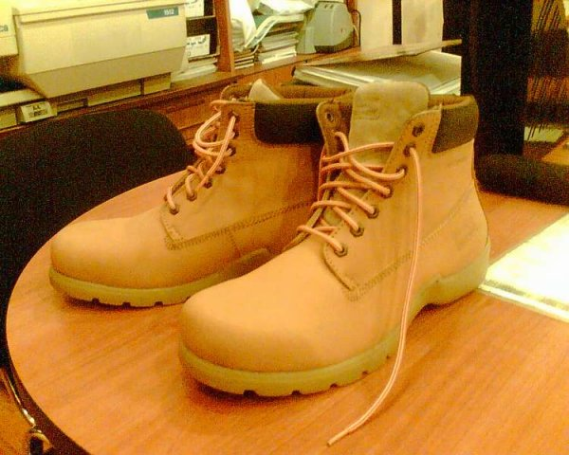
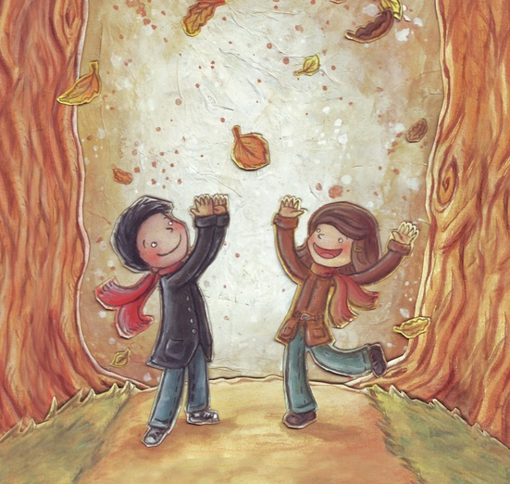
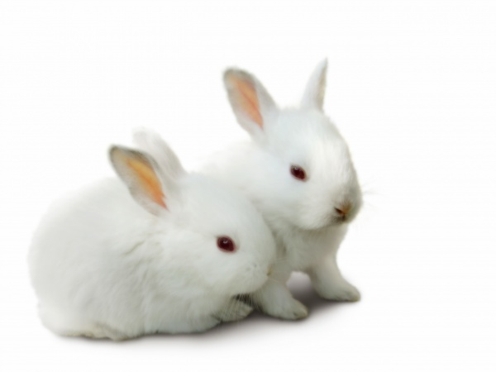
British superstitions without Russian analogues.

Slide 20
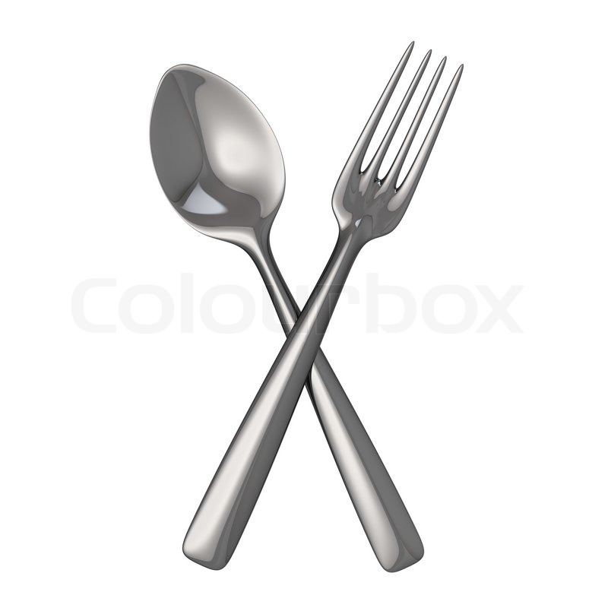
British superstitions without Russian analogues.

Slide 21
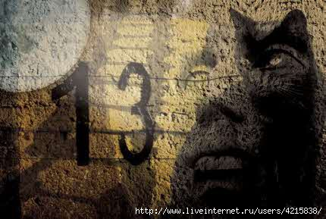
Conclusion.
30 British superstitions
23,3% have similar meaning with Russian superstitions
10% with some differences but with similar meaning
43,3% have no Russian analogues

Slide 22
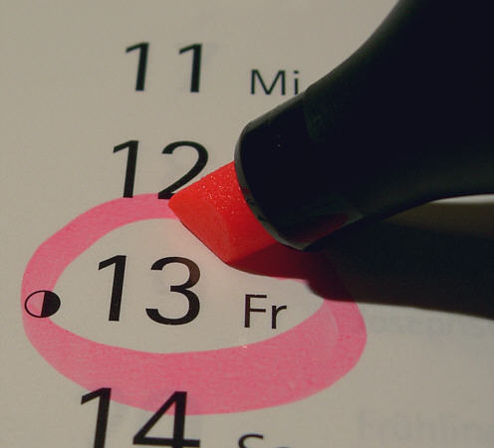
Thank you for your attention.

