Slide 1
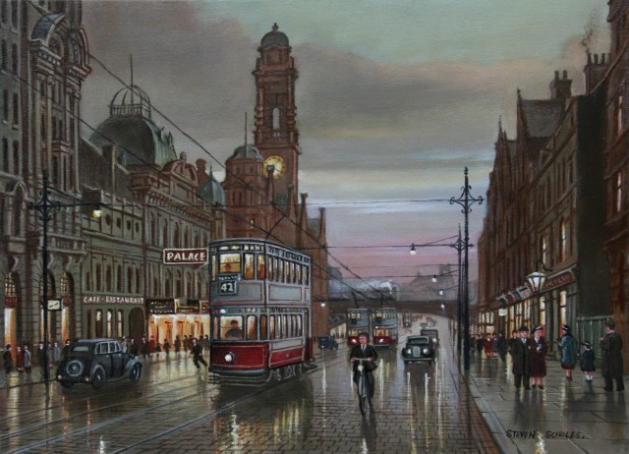
Streets of London and Moscow.
Pupil of 6th form A
School № 10
Zinchenko Ekaterina

Slide 2
My hypothesis is the means of giving the names for the streets in London and in Moscow are the same.
The object is London and Moscow streets.
The subject is their names.
The aim of my work is to find out the similarities or differences between the names of the streets in London and Moscow.

Slide 3
The tasks are to find and study information about London and Moscow streets, classify street names and compare street names of London and Moscow.
To prove my hypothesis I used the following research methods:
1) search and examination of information
2) analysis
3) classification
4) comparison
5) generalization

Slide 4
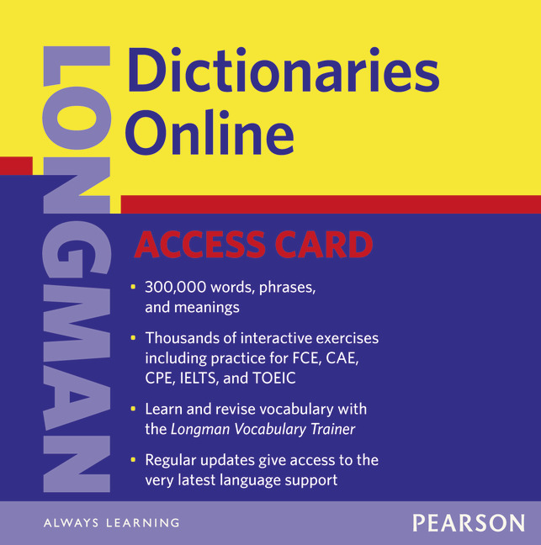
The Longman Dictionary sais that street is a road in a city or town that has houses or other buildings on one or both sides

Slide 5
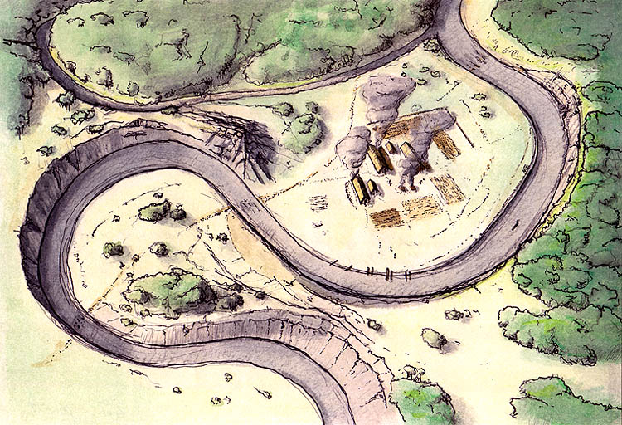
First streets

Slide 6
The types of streets in Britain and in Russia.
№ | In Britain | In Russia
1 | Avenue | +
2 | Road | +
3 | Street | +
4 | - | Range
5 | - | Line
6 | - | Lane
7 | Lane | +
8 | Court | +
9 | Alley | +
10 | Pathway | -

Slide 7
From 20 types of streets
15 – 75% are the same
5 – 25% doesn’t exist in
one of the countries.

Slide 8
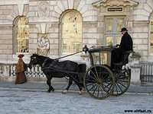
Names of people united by one profession.
Carter Lane – Lane in the City of London where carters (or cabbies) lived traditionally.

Slide 9
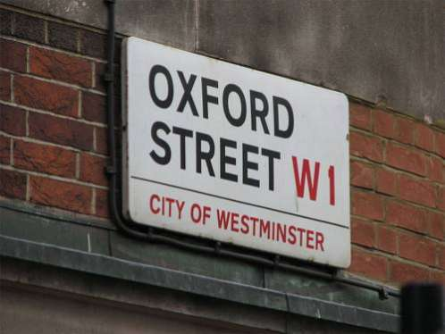
Cities and villages to which they led.
Oxford Street – “Road leading to Oxford” – is one of the oldest streets in London, built by the Romans.

Slide 10
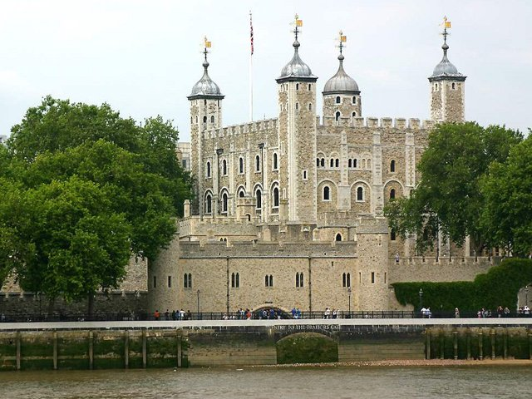
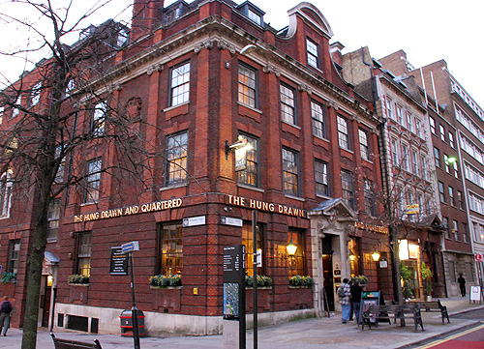
Famous buildings.
Great Tower Street is a street in the City, leading to the Tower.

Slide 11
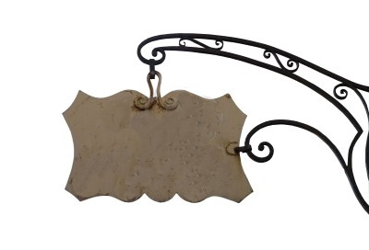
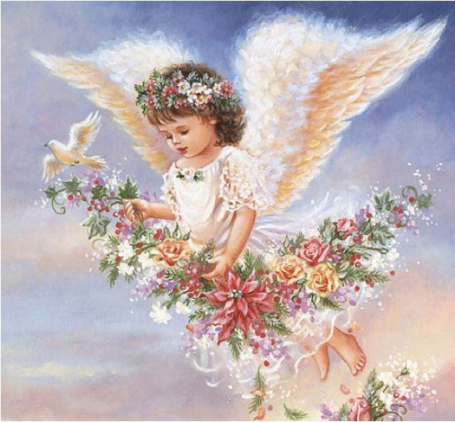
Ancient signboards.
a signboard

Slide 12
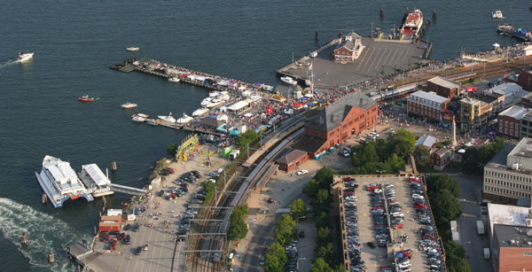
Geographical objects.
Water Street means “Street leading to the water”.

Slide 13
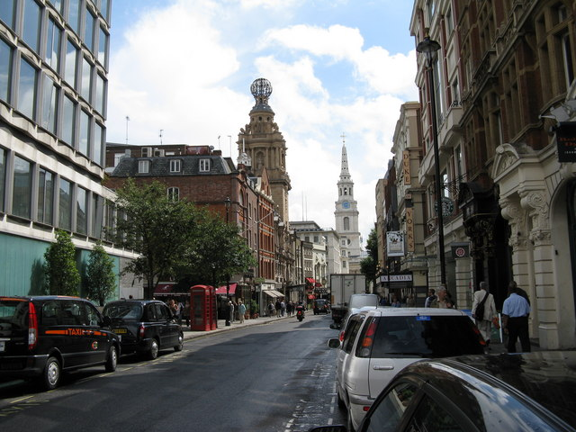
Abbeys, cathedrals, church realities.
St. George Street, St. Martin’s Lane are the streets and alleys, received the name from churches situated there.

Slide 14
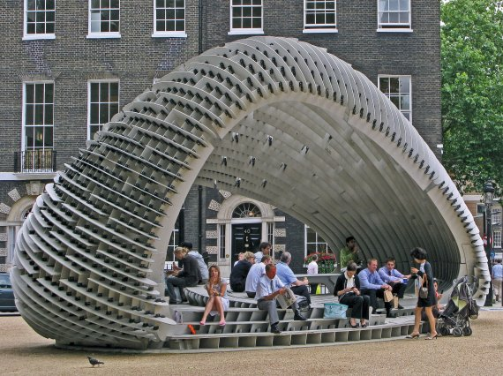
Landowners and homeowners.
Bedford Square, Bedford Avenue, Bedford Place, Bedford Passage, Bedford Street appeared on the lands owned by Duke of Bedford.

Slide 15
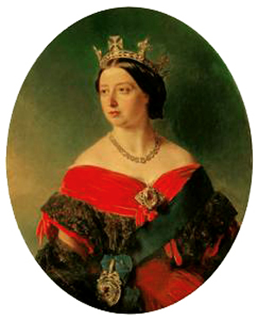
Royal family members, commanders.
Victoria Street, Victoria Road, Victoria Embankment, Prince Albert Road – these streets were named in honor to Queen Victoria

Slide 16
Classification of the street names in Moscow.
Reason | Street name
1.Names of people united by one profession | Monetchikovsky Lane Myasnitskaya Street
2. Cities and villages to which they led. | Tverskaya Street Smolenskaya Street
3.Famous buildings. | Bankovsky Lane Kuznetsky Most
4. Ancient signboards. | -
5. Geographical objects | Polevaya Street Bolotnaya Street
6. Cathedrals, church realities. | Spassky Lane Patriarshy Lane
. Landowners and homeowners. | Volkonsky Lane Yushkovsky Lane
8. Colleges and universities. | -
9. Royal family members, commanders. | Kutuzovsky Avenue Tsarizynskaya Street

Slide 17
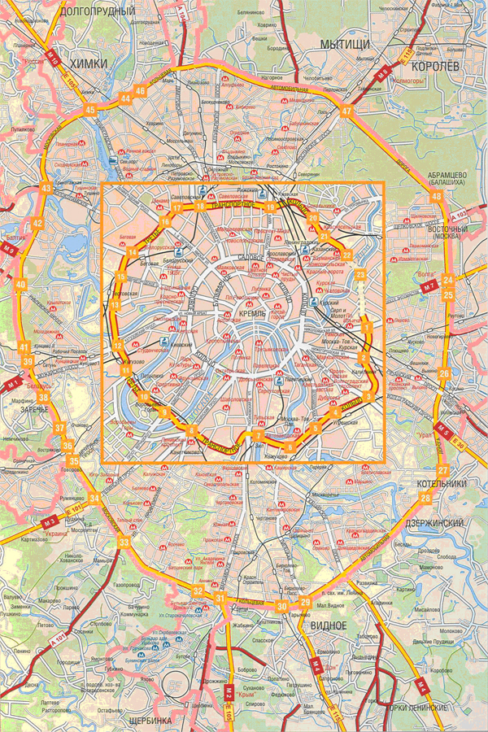
people’s names – Irininskaya Street, Petrovka Street
animals – Medvezhy Lane, Korovy Lane
food – Medovaya Street, Myasnaya Street
writers - Tolstovsky Lane, Griboedovsky Lane
famous people- Gagarin Street, Kosmodemyanskaya Stree
family relations- Babushkin Lane
musical instruments- Barabanny Lane
nationalities- Bolshaya Gruzinskaya Street, Nemetskaya Street

Slide 18

17 reasons
London
Moscow
15
reasons
9
reasons

Slide 19
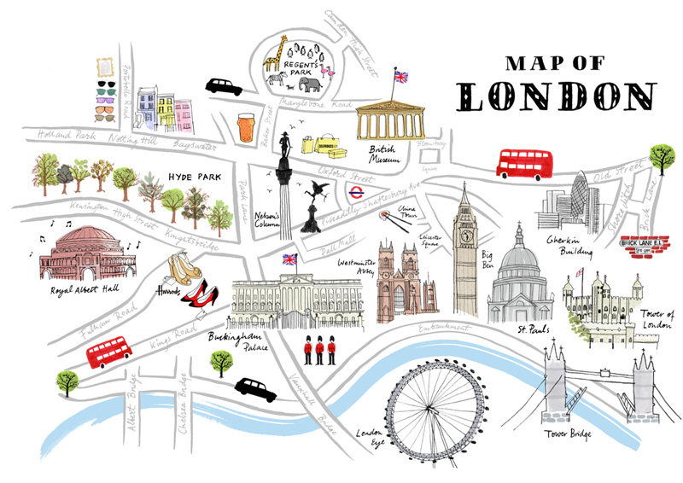
Thank you for your attention.

