Slide 1

The Day I Was Born
Pupil of the 5th form B
School N 10
Soboleva Anastasya

Slide 2
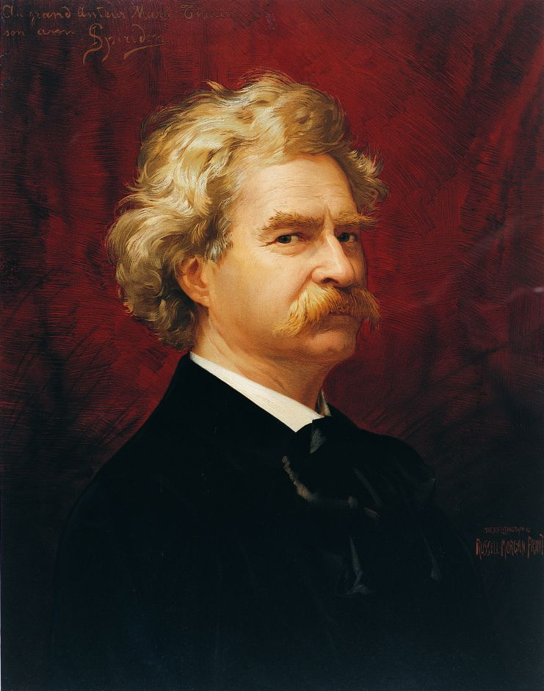
“The two most important days in your life are the day you are born and the day you find out why.” MarkTwain

Slide 3
The aim of my work is to prove that the day I was born is a great day in the world history.
The tasks are to find, study, analyze and classify information event in the past.
The object is historical events.
The subject is the most interesting and important facts about famous people, natural disasters, political, cultural sport events which connected with the date of my birth.

Slide 4

My hypothesis is the day I was born plays the great role in history.

Slide 5
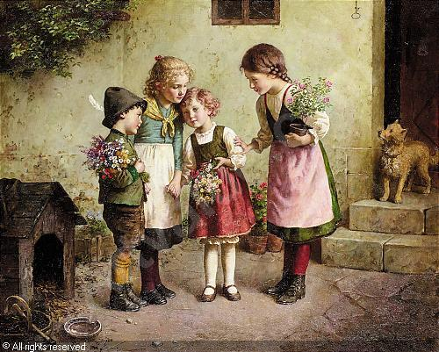
The first country that began to start celebrating children's birthdays was Germany.

Slide 6


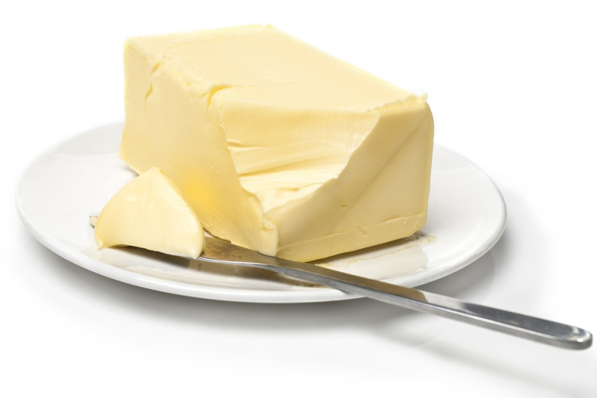
Birthday traditions. Canada
A nose greased with butter or margarine

Slide 7

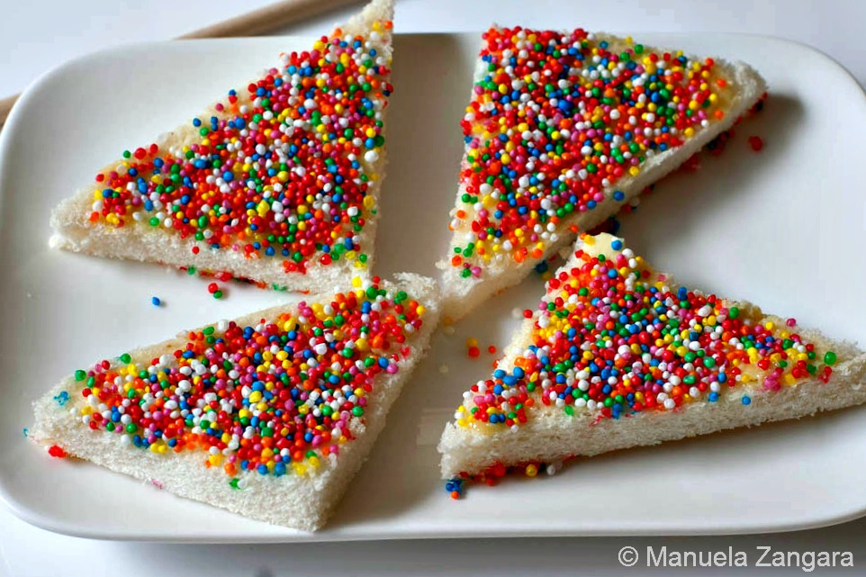
Birthday traditions. Australia.
"Fairy Bread".

Slide 8
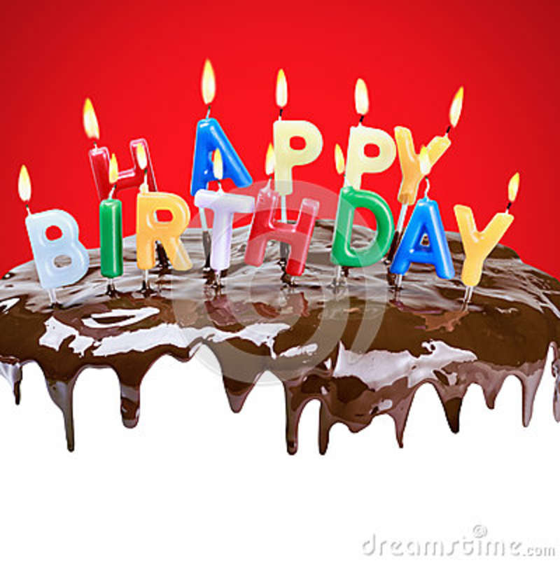
Birthday traditions. USA.
A cake topped with lighted candles.

Slide 9
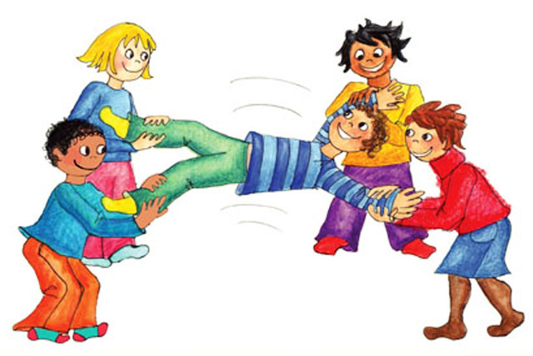
Birthday traditions. England.
Friends and family members pick the child up by the hands and feet and bounce him up and down.

Slide 10

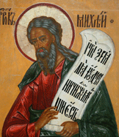
27th of August is the day of Mihey – Tihovey

Slide 11
The full date of my birthday is the 27th of August 2005.
the 27th of August 2005
August 2005
the year 2005
the 27th of August

Slide 12
historical events
politics
science
holidays/
festivals
culture
dates of birth of famouse people
natural disasters
social events

Slide 13
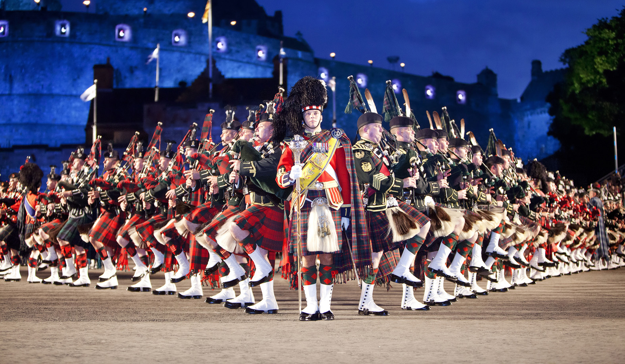
The 27th of August 2005
the close of the Royal Military Orchestras Parade in Edinburg

Slide 14
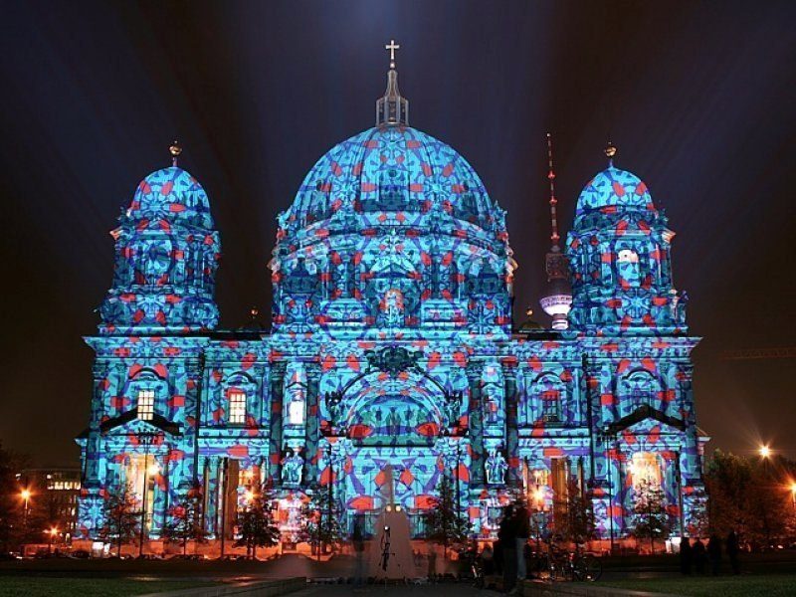
The 27th of August 2005
the International festival “Long Night in Museums”
in Berlin.

Slide 15

National and International holidays:
The Day of Russian cinema

Slide 16

National and International holidays:
The Day of Independence in Moldova.

Slide 17
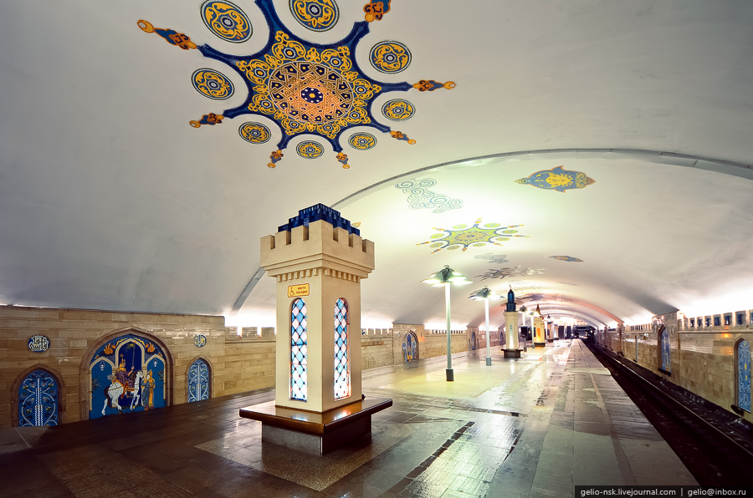
Social life
The Kazan underground was opened.

Slide 18


August 2005 Festivals
“Tomatino” in Spain.

Slide 19
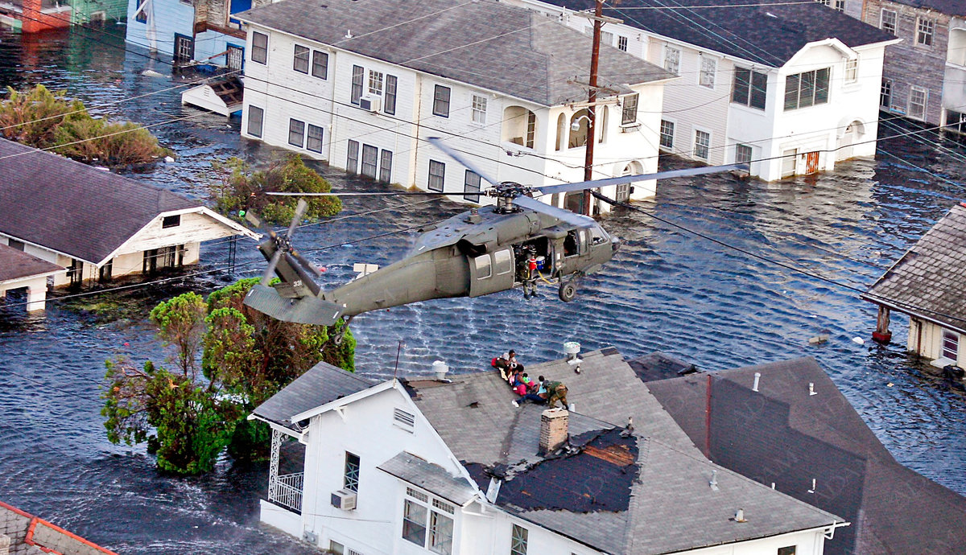
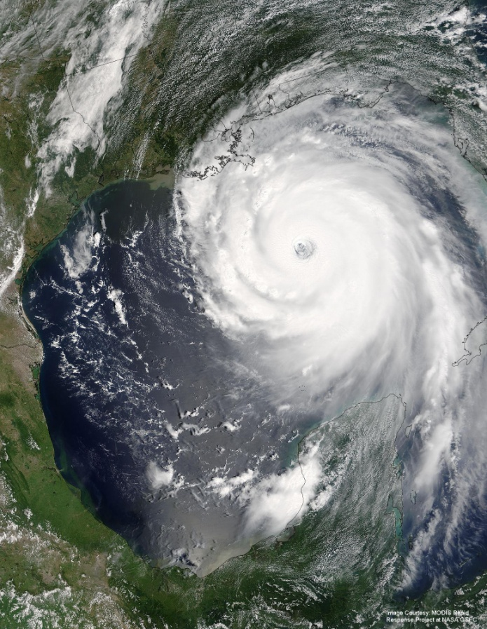
August 2005 Natural disasters
the floods in Europe
Hurricane Katrina

Slide 20




the UK - 7
The USA - 6
Canada - 4
Australia - 4

Slide 21


The year 2005
the International Year of Sport
the International Year of Physics

Slide 22
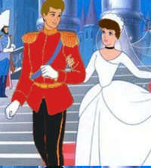
The year 2005 Wedding of prince William and Kate Middleton

Slide 23
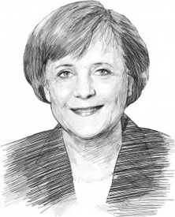

The year 2005

Slide 24
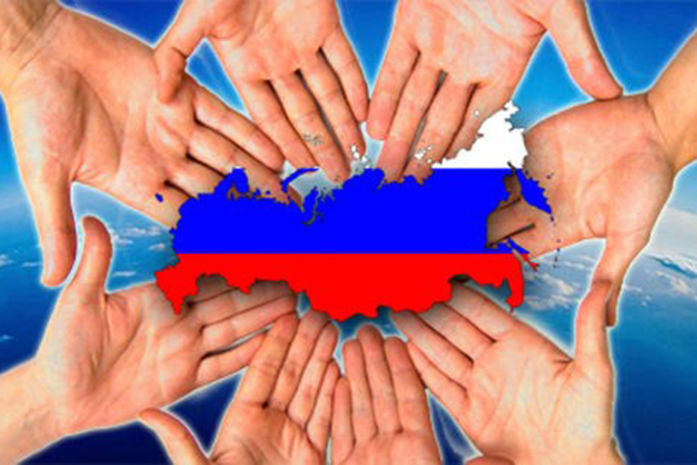
The year 2005
National Unity Day was celebrated in Russia in 2005 for the first time.

Slide 25
27th of August through the history
1940 – Russian engineer Ivan Adomin invented colour television
1955 – the first Guinness Book of Records
1962 – the first medals for Russian schoolchildren
1980 – the summer Olympic Games in Moscow

Slide 26
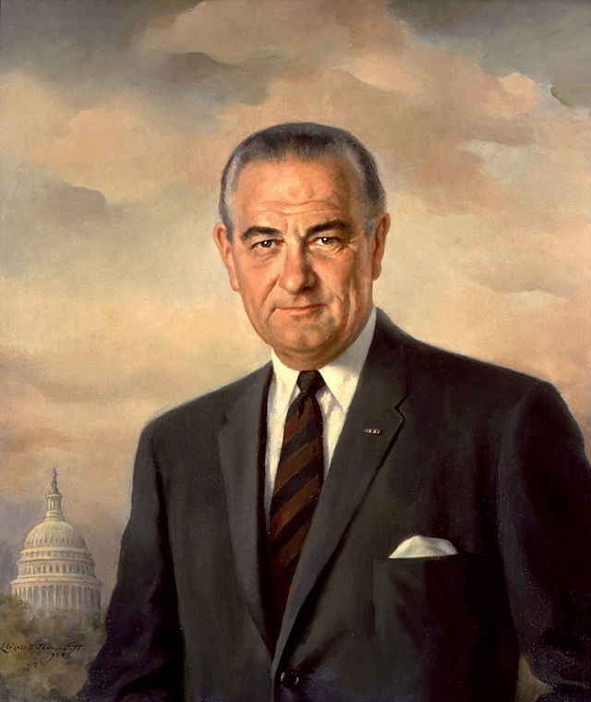
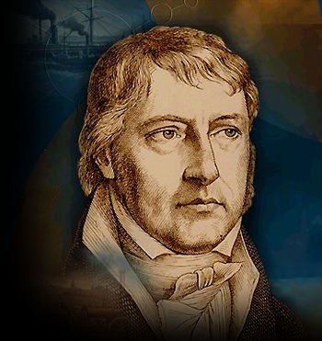
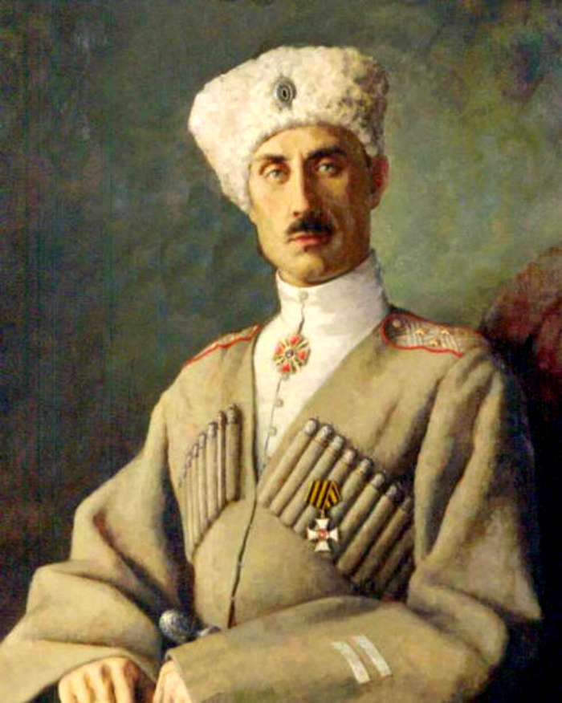
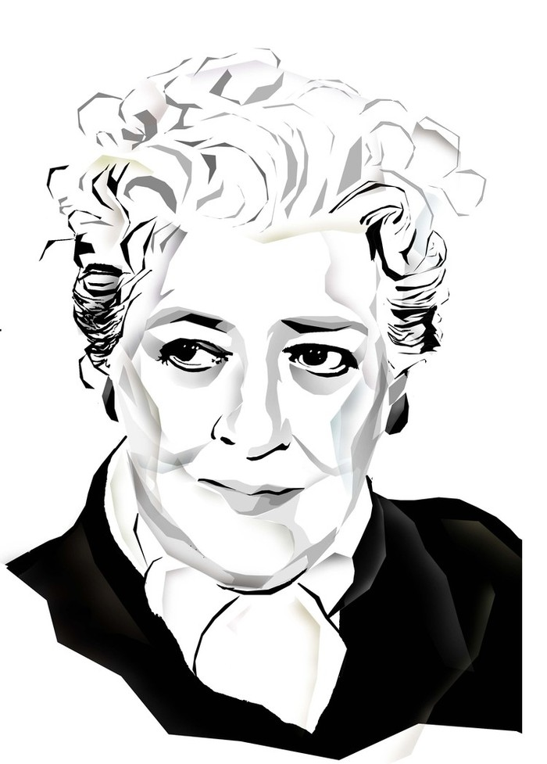
I share my birthday with:
Georg Hegel German philosopher, 1770
Peter Vrangler The Russian general, 1878
Faina Ranevskaya great Russian actress, 1896
Lyndon Johnson American Presidrent,1929

Slide 27

In my work I presented 98 examples of historical events from different branches of social life which connected with the day I was born.

