Slide 1

МОУ «Визимьярская средняя общеобразовательная школа»
Проектная работа
по английскому языку
«Праздники Великобритании: День Святого Патрика»
ученика 6 класса
Краснова Андрея
Руководитель: Захарова Н.Г.
2017 г.

Slide 2


Slide 3
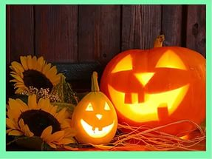
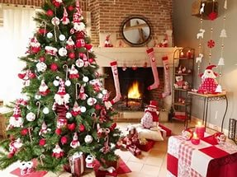
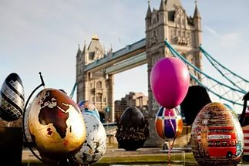
Every year British people celebrate their national, traditional and religious holidays. Many of them are quite old, important and well-known.

Slide 4
They are: New Year’s day, Easter , Pancake day, May Day, Christmas Day , Mother’s Day , St. Valentine’s day and many others.

Slide 5
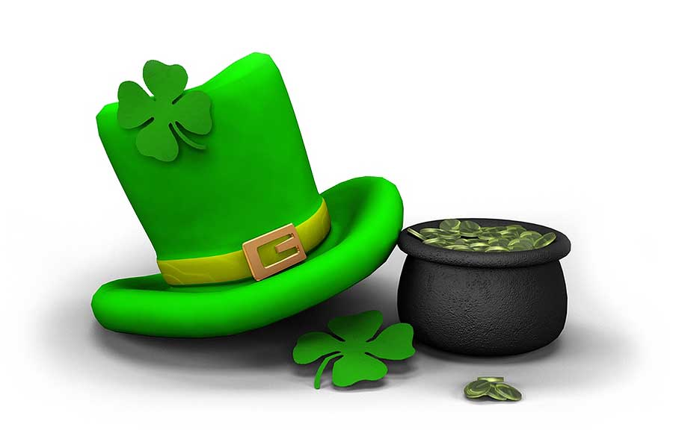
I’d Like to tell you about famous British holiday- « St. Patrick’s Day»
St. Patrick’s Day is celebrated every year on March 17.

Slide 6
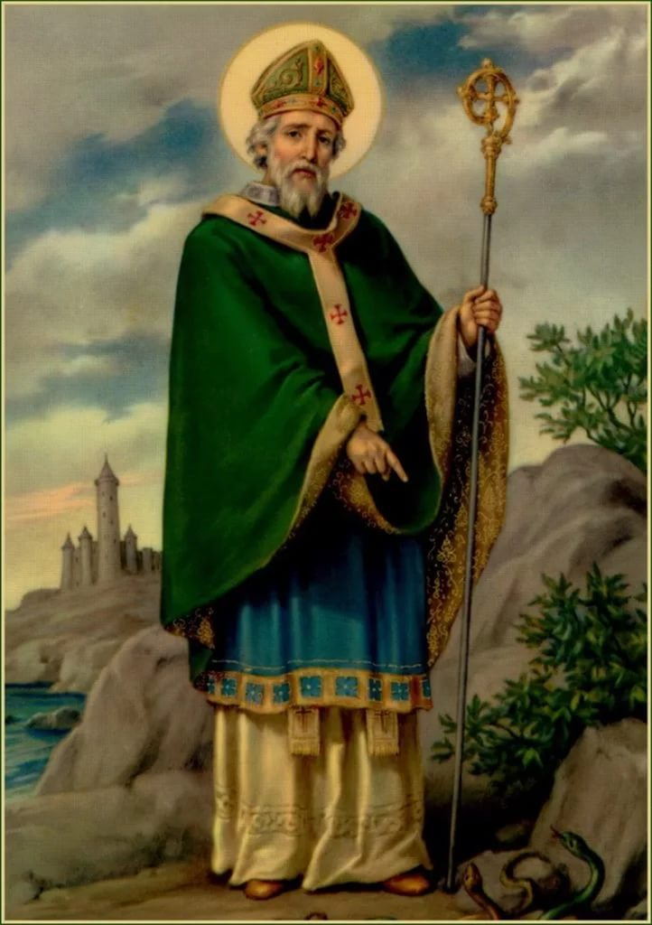
He was the patron of Ireland, and a saint who brought Christianity to the nation.

Slide 7

The national symbol of Ireland is shamrock.
Originally the holiday was celebrated only in Ireland but today a lot of countries in the world celebrated it.

Slide 8
Traditional activities include dressing up in green clothes, holding parades , arranging fireworks, singing and dancing in the streets.

Slide 9
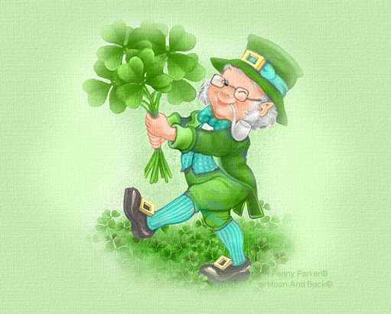
Green is the official colour of St. Patrick’s Day. It is also the national colour of the Irish and the symbol of spring. They also paint green stripes on the city streets.

Slide 10
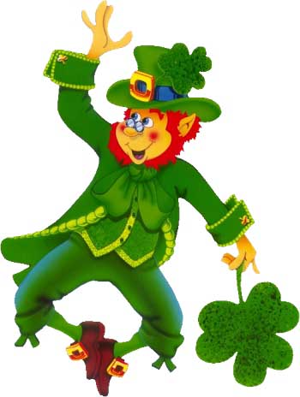
Another symbol of St. Patrick’s Day is Leprechauns. They are little people who wear green clothes and carry the pot of gold.
Another symbol of St. Patrick’s Day is Leprechauns.

Slide 11
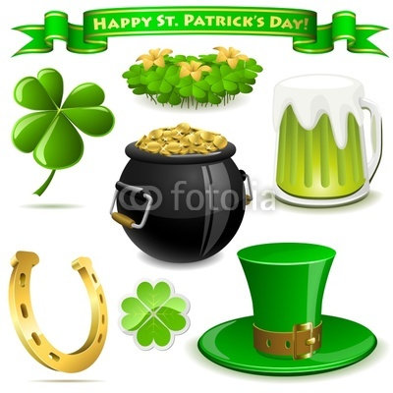

Slide 12
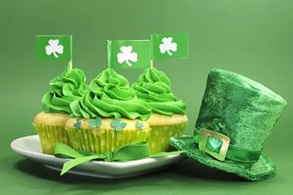
Bacon and cabbage is what most people have on this day. Another popular dish is Irish soda bread and potato pancakes.

Slide 13
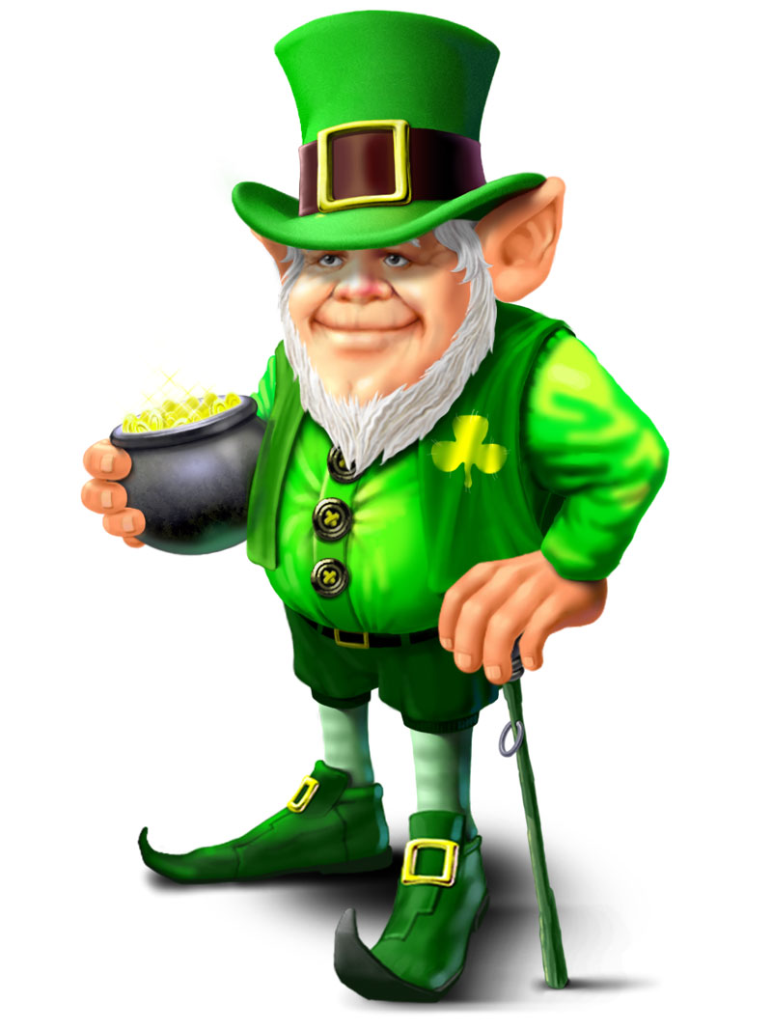
I like this beautiful and funny holiday. I’d like to congratulate you with St’Patrick’s Day!

Slide 14
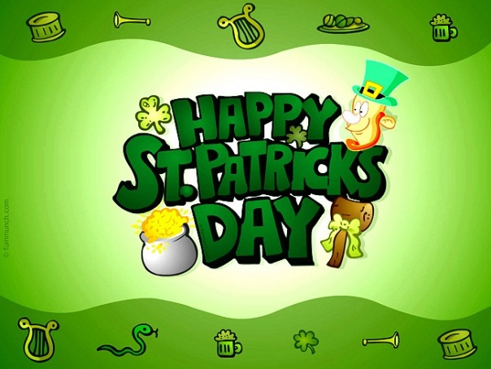

Slide 15
THE END

