Slide 1
The Flora and Fauna of Great Britain
Prepared
By student of form 10th
School of Prostornoe
Kabanova A.A.
Teacher
Ivanova T.S.

Slide 2


Slide 3
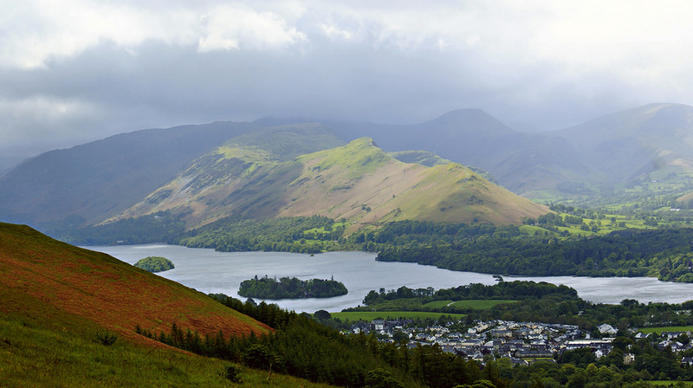
Flora

Slide 4
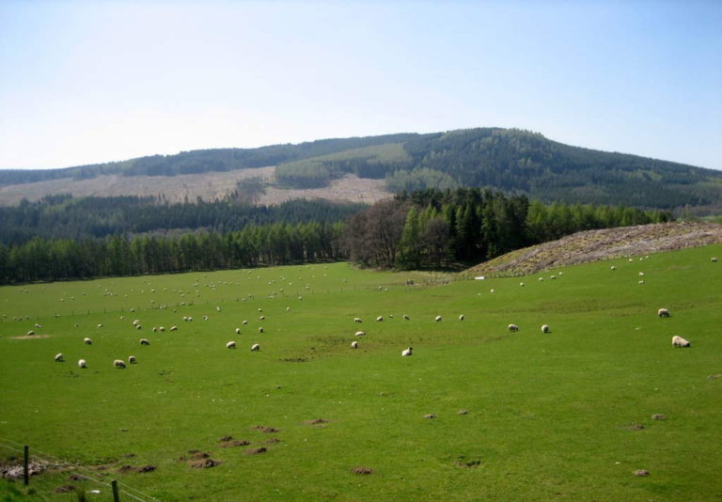
In prehistoric times in most parts of the United Kingdom grew dense forests of oak, birch and other hardwoods, but now, after more than 20 centuries of economic development, the territory is mostly deforested. People uprooted forests, drained the swamps and changed the species composition of flora and fauna, contributed to the soil large amounts of fertilizers.

Slide 5
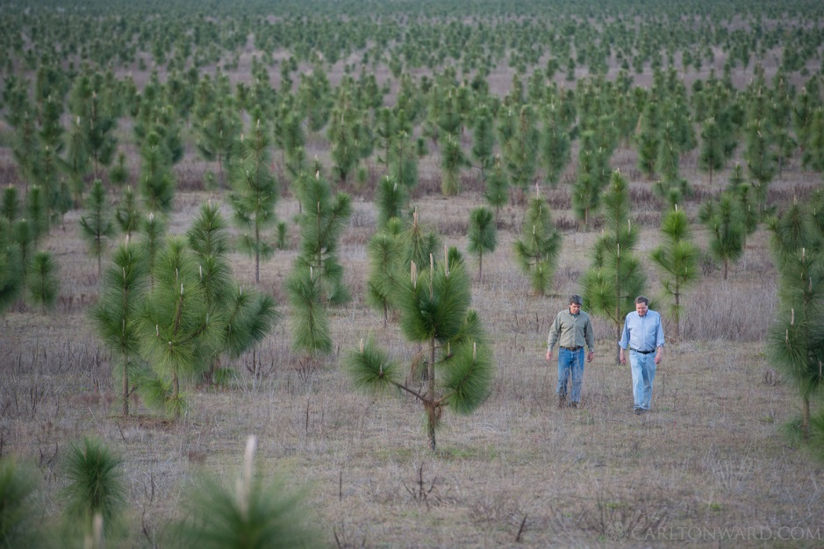
Now held in the country plantations. Was imported from other countries and distributed exotic tree species .
Currently, forests cover only 10% of the UK.

Slide 6
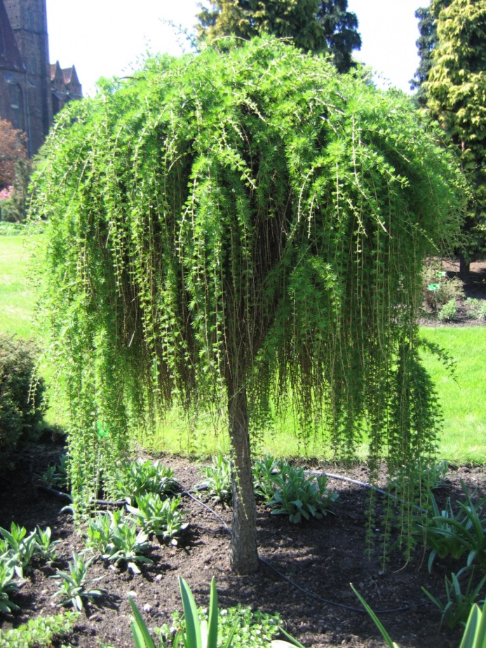
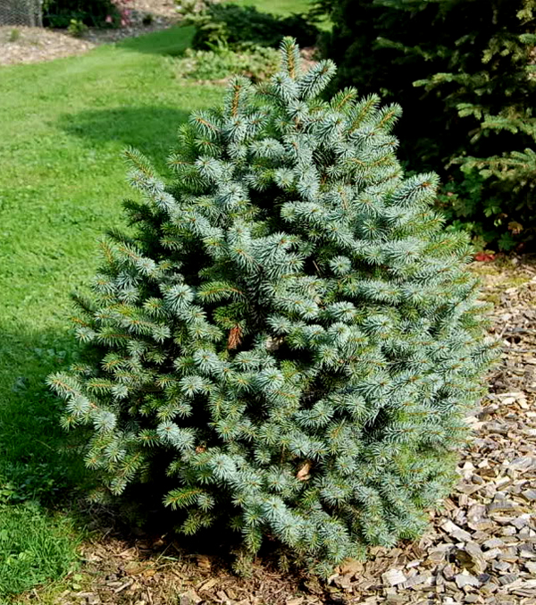
European larch
Sicinska fir

Slide 7
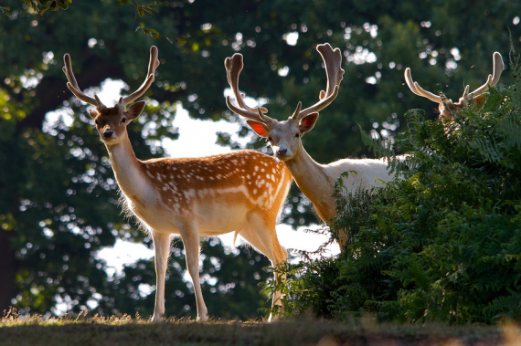
Fauna

Slide 8
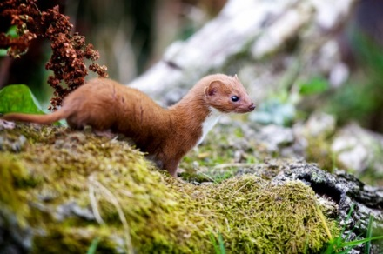
The fauna of the country is not too large variety and typical of Northern Europe. At the moment there are about 70 species of mammals, despite the fact that 13 of them are imported and not indigenous, endemic species there.

Slide 9
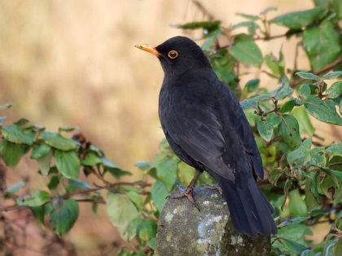
Great variety of different birds (588 species)

Slide 10
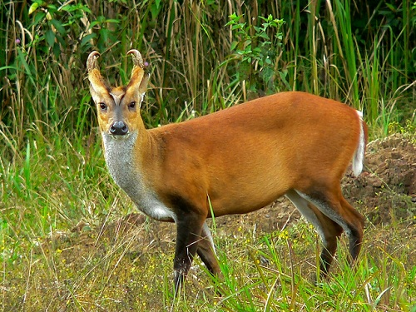
Chinese muntjac
Some animals of great Britain as a result of active hunting throughout the centuries to the present time are rare. Not so much in the forests of the wild ungulates as before

Slide 11
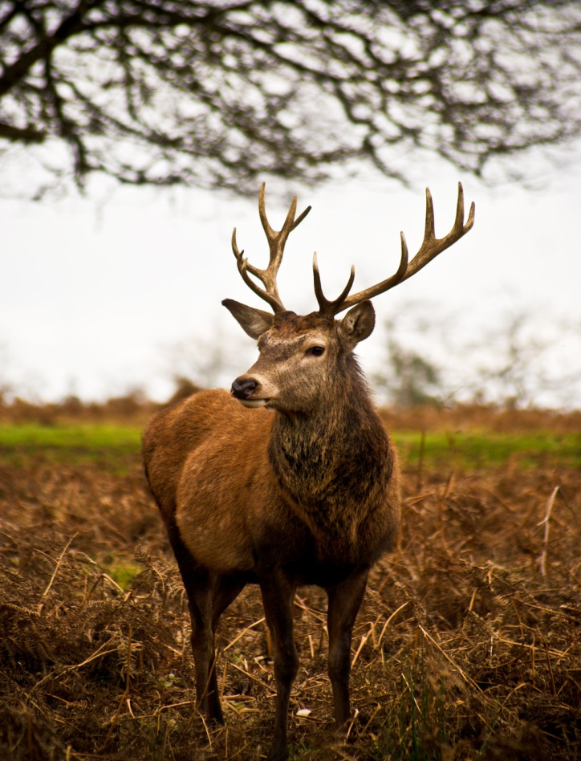
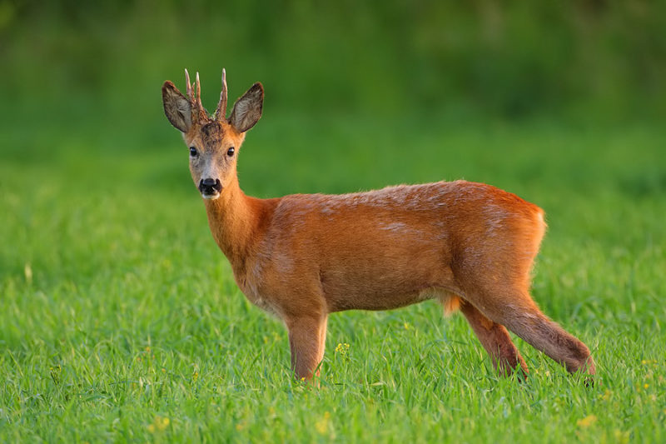
Red deer
European ROE deer

Slide 12
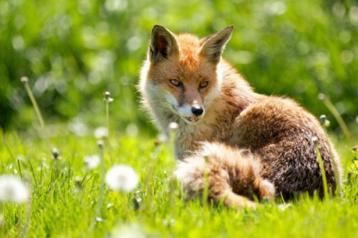
Of large predators are Fox, wolf, wild cat, marten, ermine, weasel, ferret, otter, etc.

Slide 13
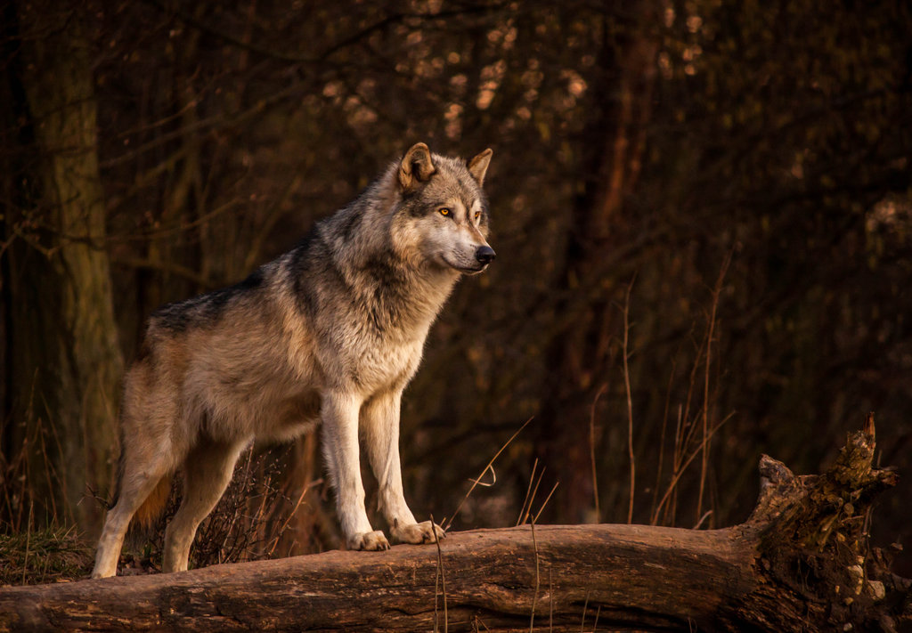
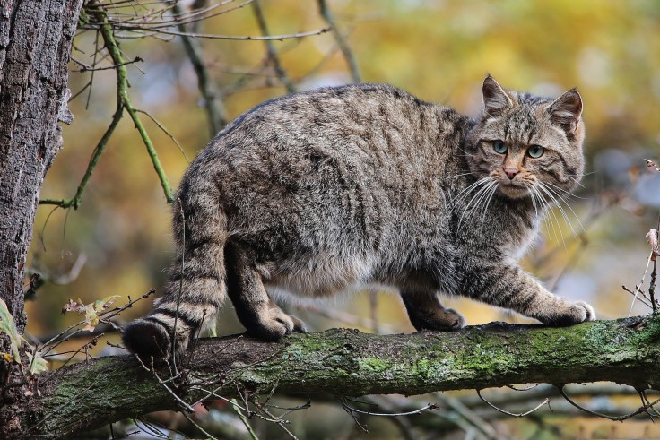
Wolf
Forest cat

Slide 14
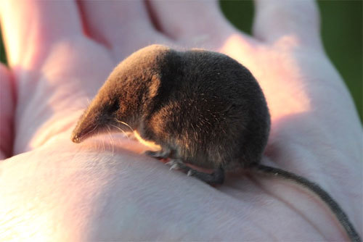
Shrew
Familiar creatures – badgers, boars, shrews

Slide 15
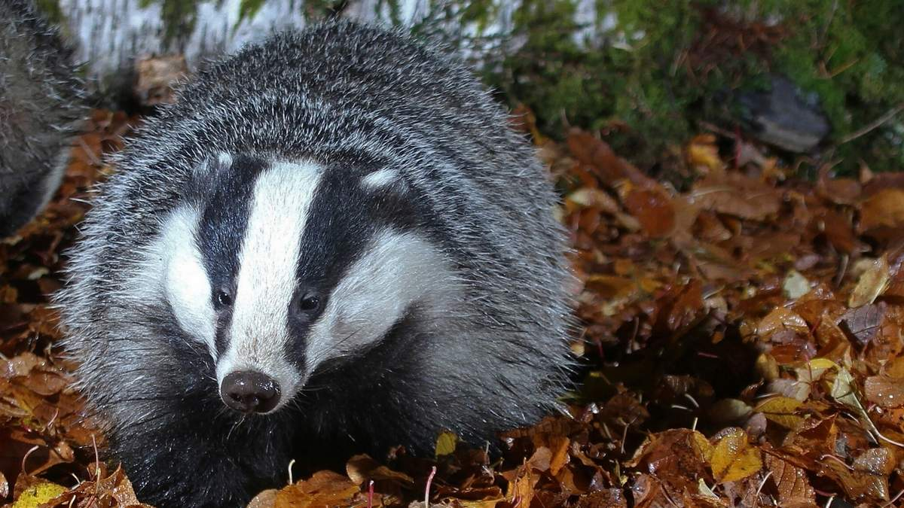
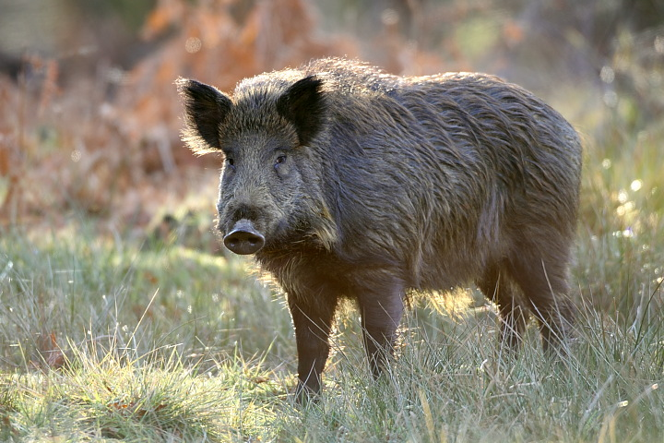
Badger
Boar

Slide 16
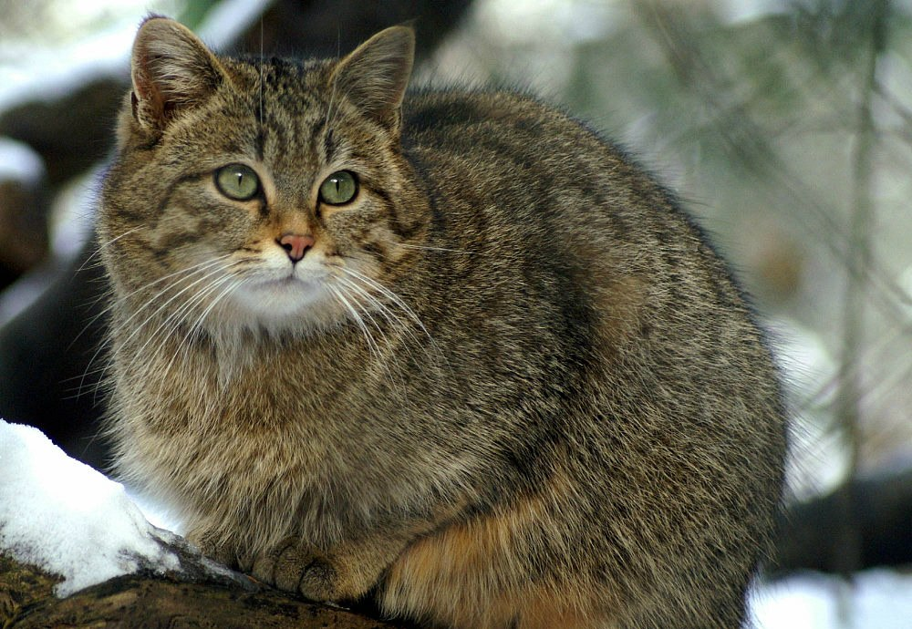
Thank you for your attention!

