Slide 1
PROJECT
“Crimea is our homeland”
Made by pupil of form 7th
^{Elvina Adjiasanova}
^{Teacher: Ivanova T.S.}

Slide 2
Crimean paints
Colorful Crimean beauty.
In the world of the palette there is no richer.
Such colors are found here,
that you do not know the name of color.
But surrounded by tulips and roses,
I did not become covered in oblivion duckweed:
light haze of your hair
Crimea will not paint anything with paint.

Slide 3
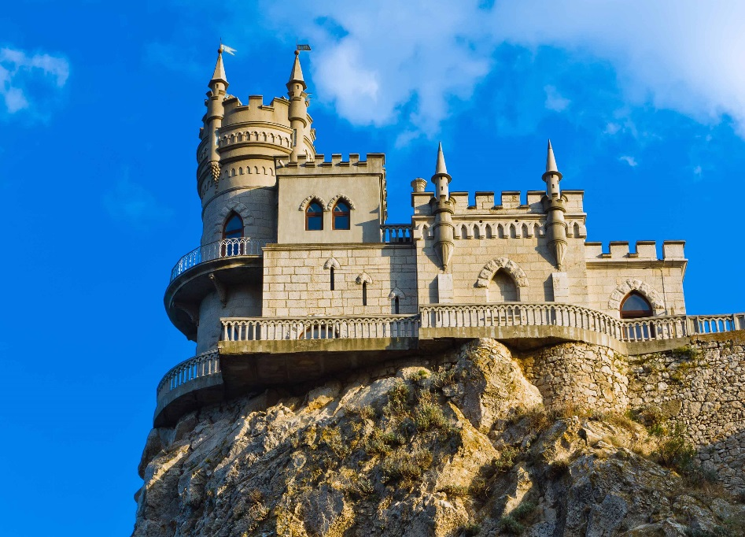
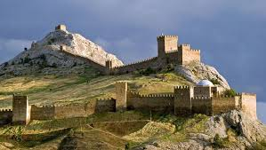
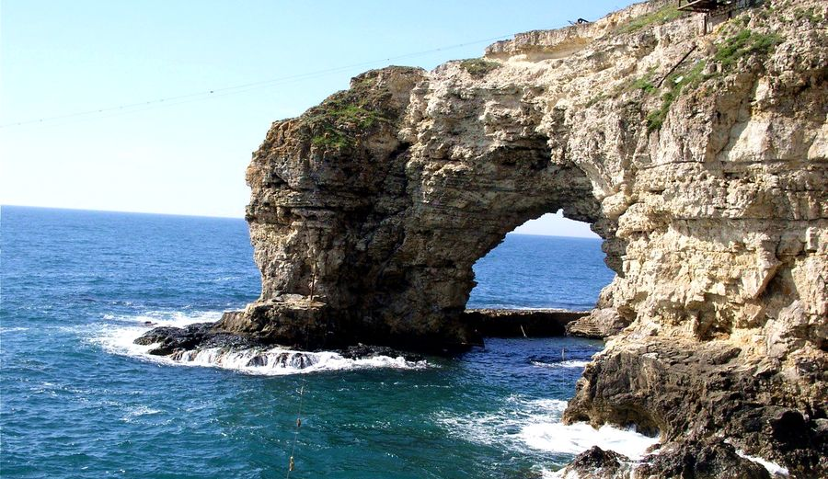
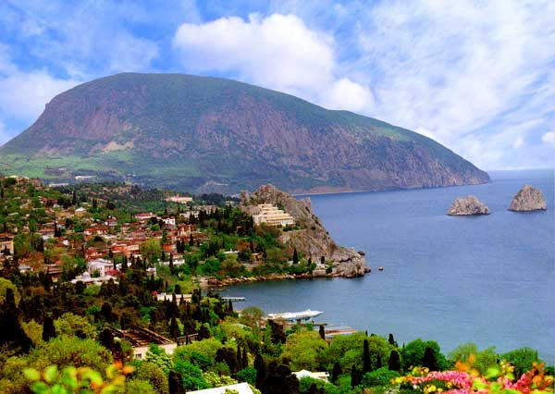
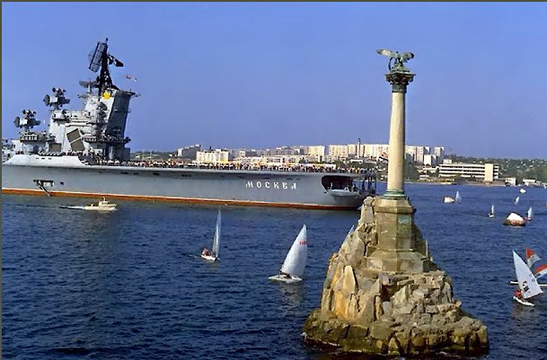
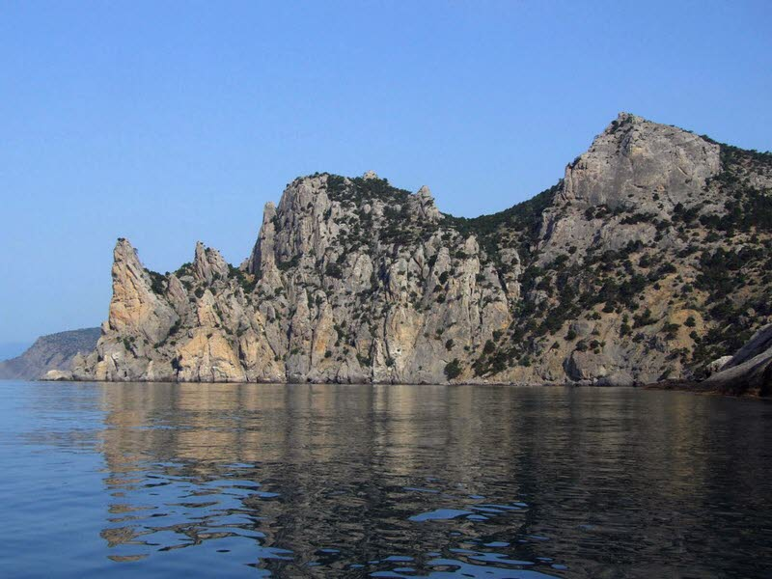
Sights of Crimea

Slide 4
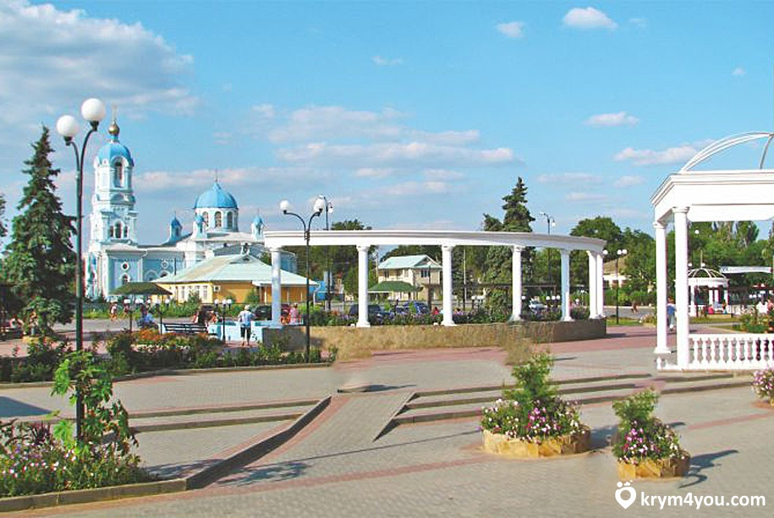
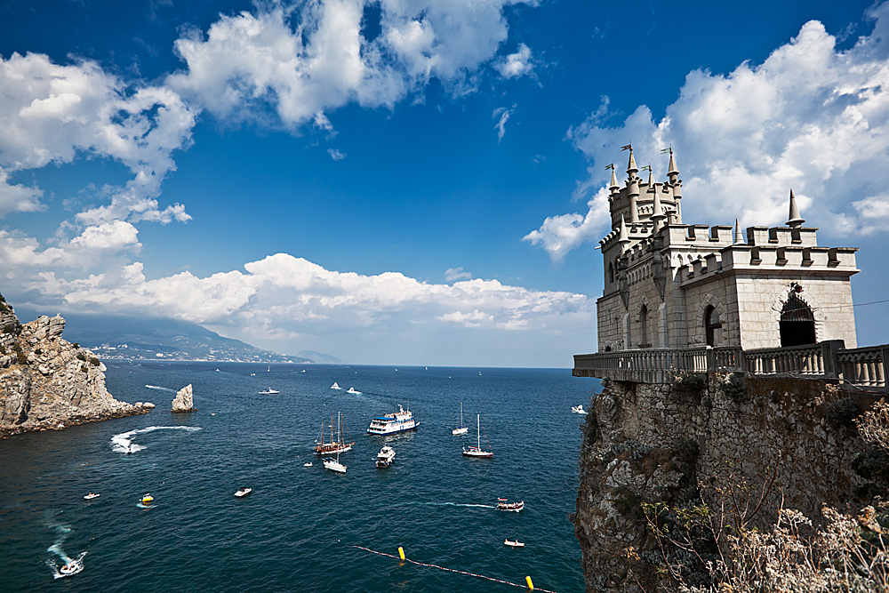
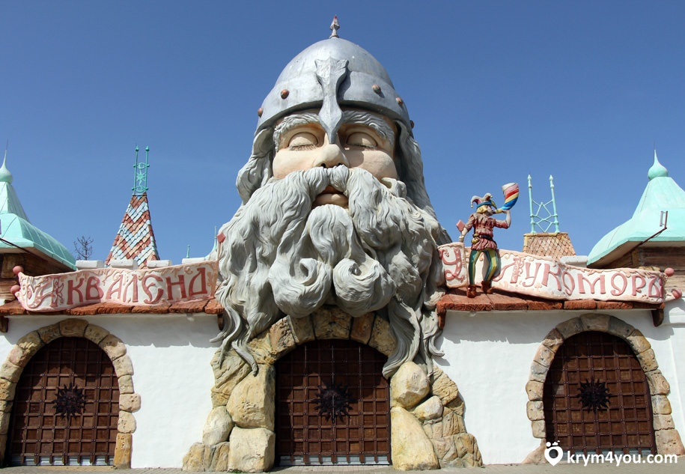
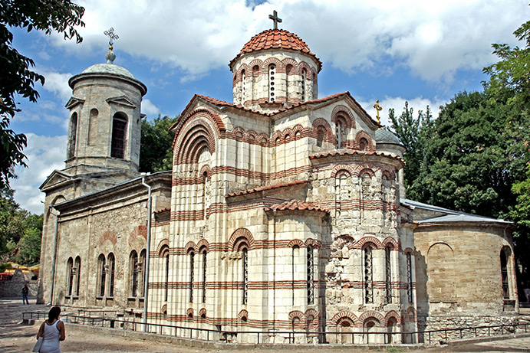
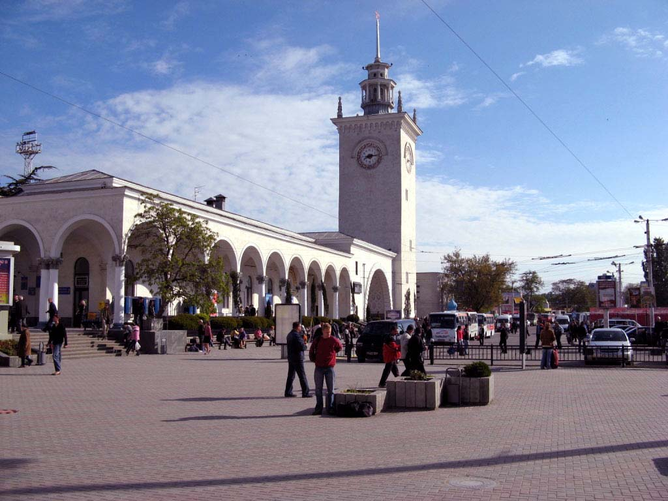
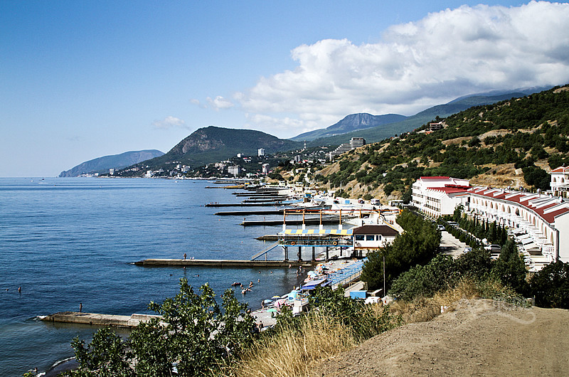
Cities of Crimea
Saki
Yalta
Evpatoria
Kerch
Simferopol
Alushta

Slide 5
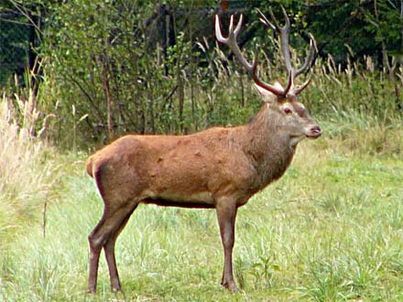
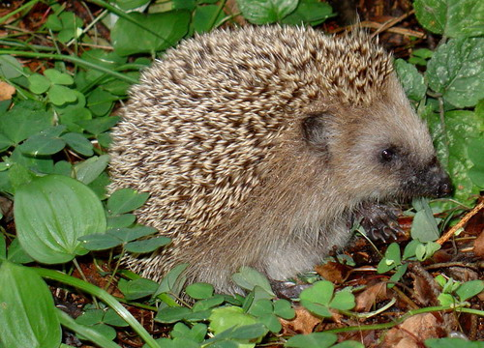
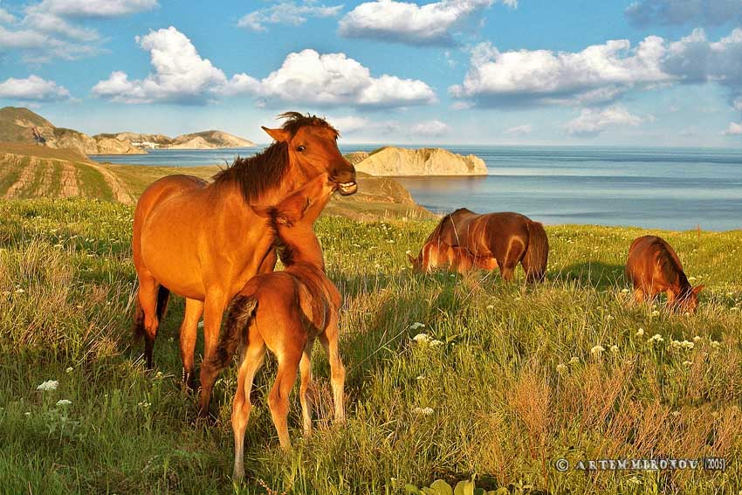
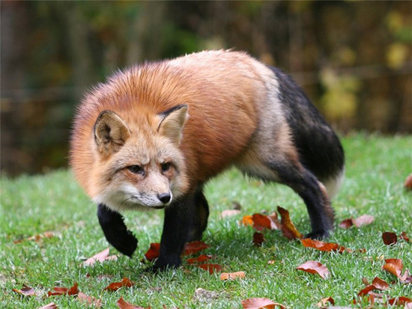
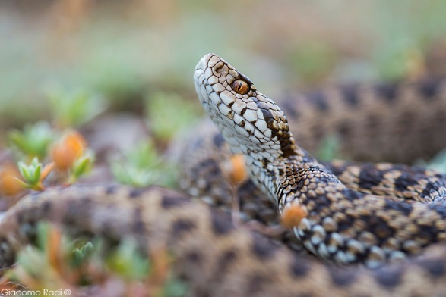
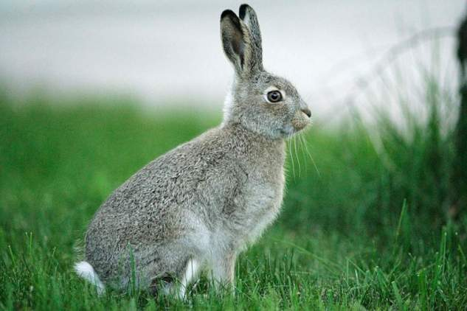
The animal world of the Crimea

Slide 6
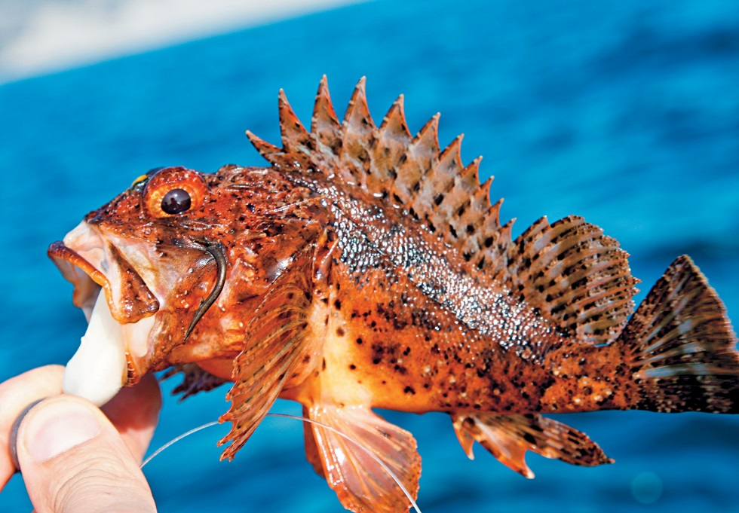
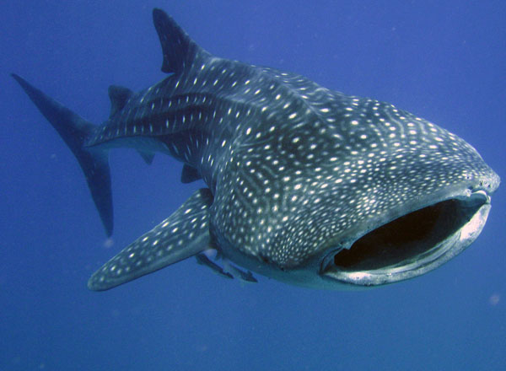
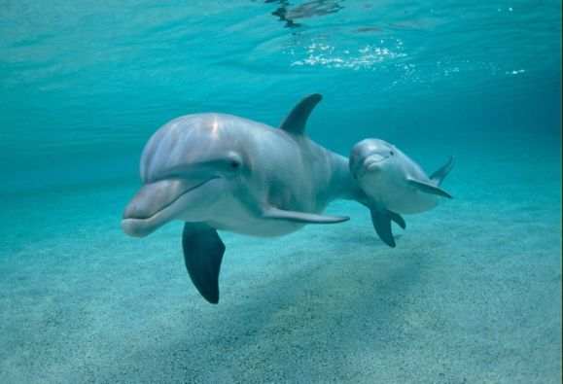
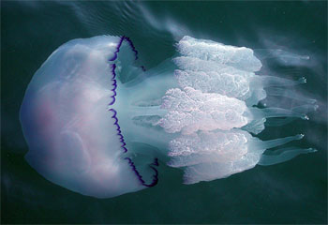
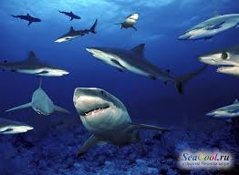
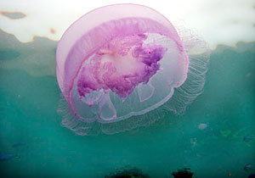
The fauna of the Peninsula is very diverse. We already know that the Crimea is divided into steppe and mountain. And the Peninsula is washed by the Black sea. In the deep sea, this Peninsula is home to various marine species.

Slide 7
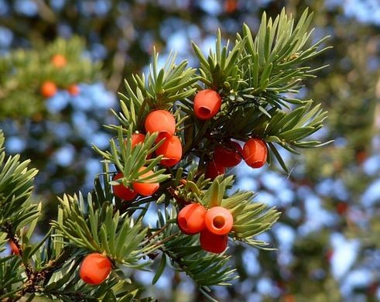
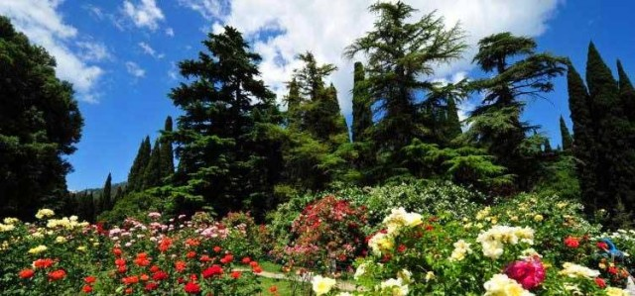
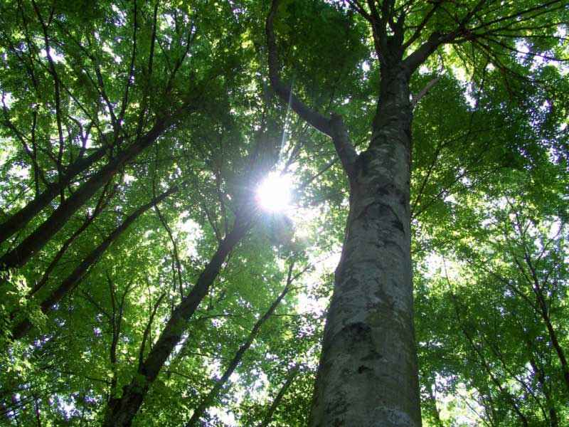
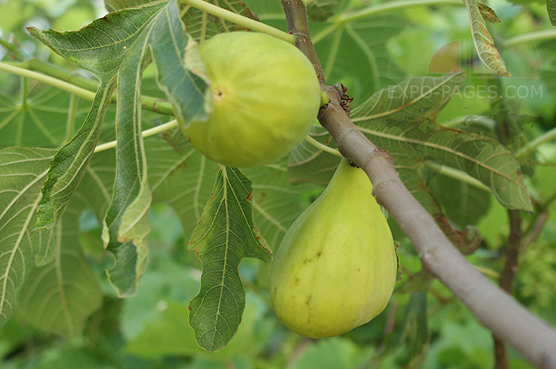
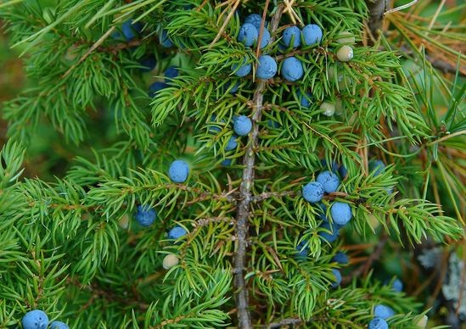
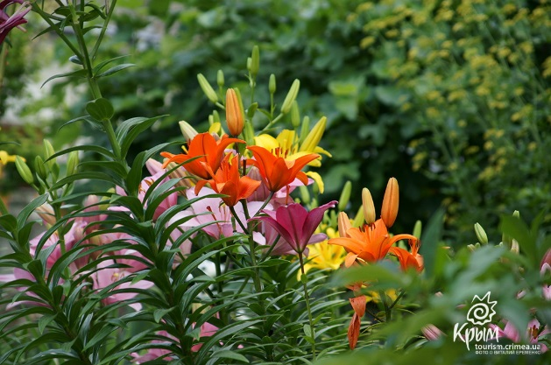
The flora of the Crimea

Slide 8
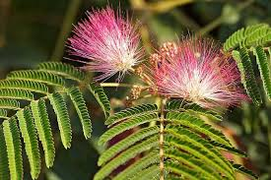
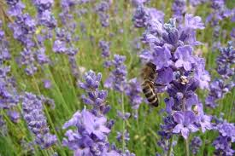
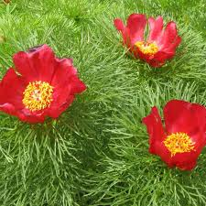
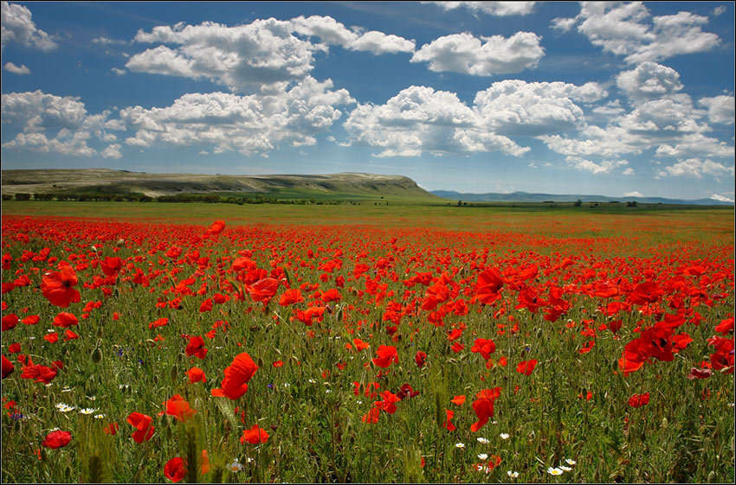
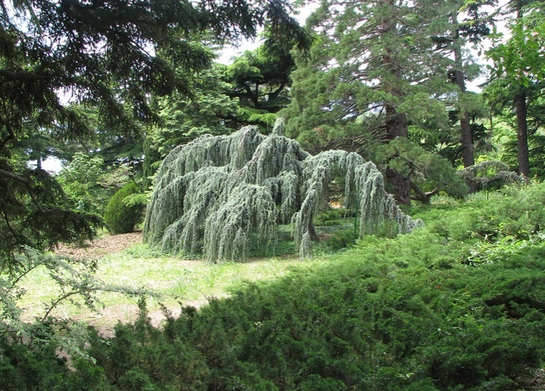
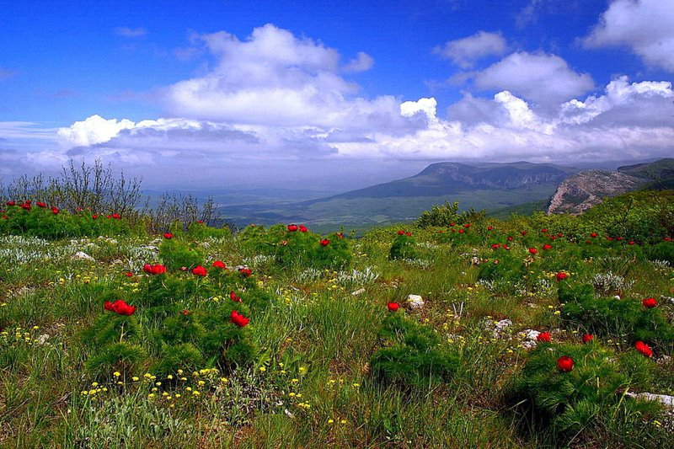
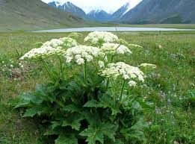
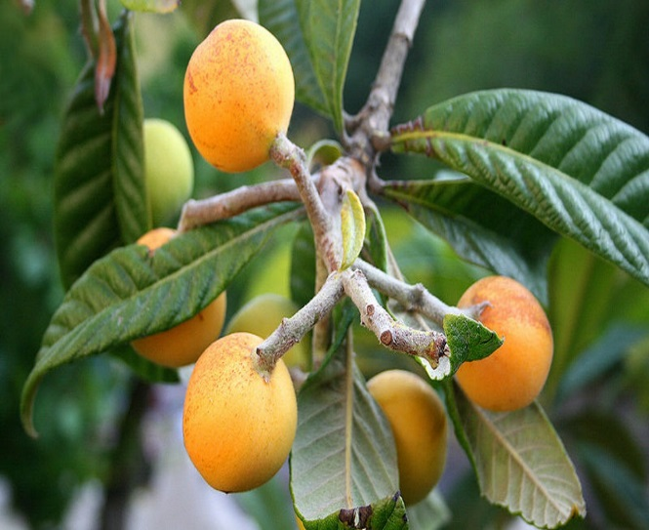
Only in the Crimean flora, there are about 2500 species of wild higher plants. And it is quite a lot. For example, throughout the European part of the former USSR, there are only 1500 species of higher plants. We note the uniqueness of the Crimean flora. It is characterized by significant (about 250), the number of endemic species, i.e. species that are found nowhere in other parts of the world, and only here, in the Crimea.

Slide 9
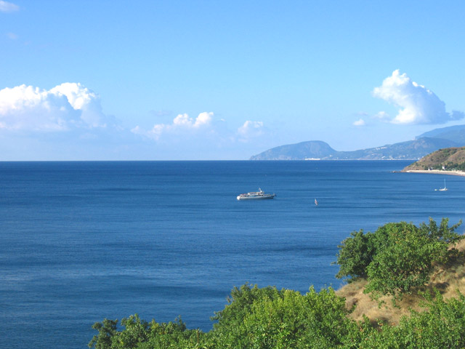
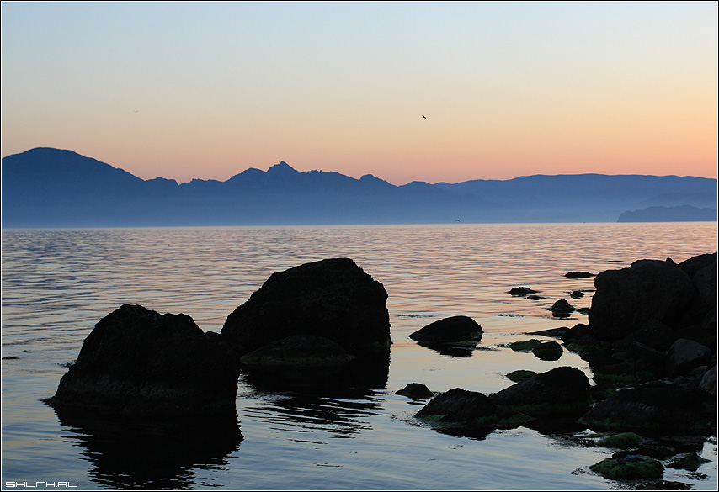
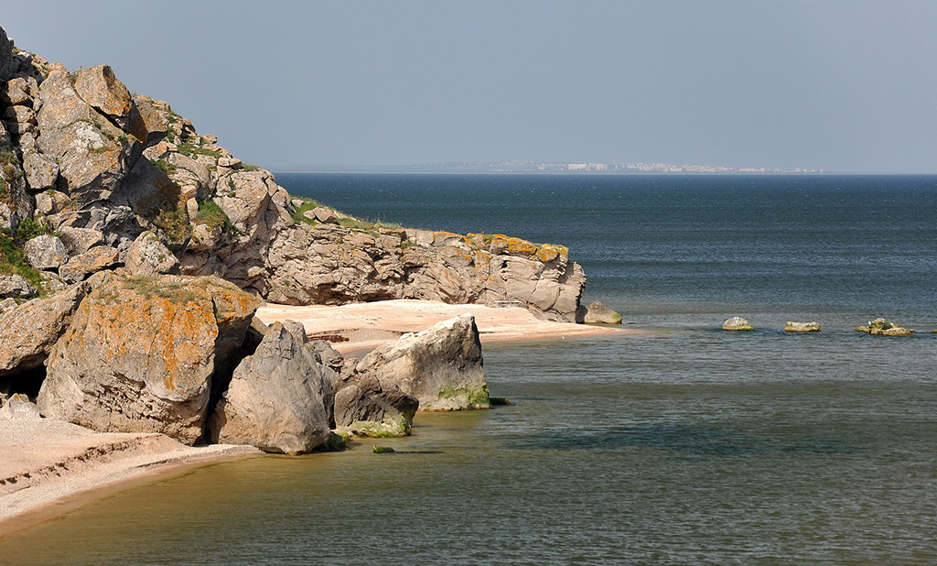
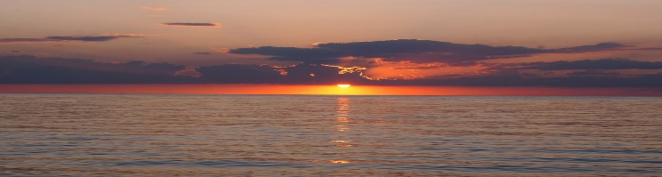
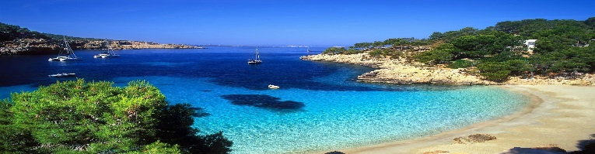
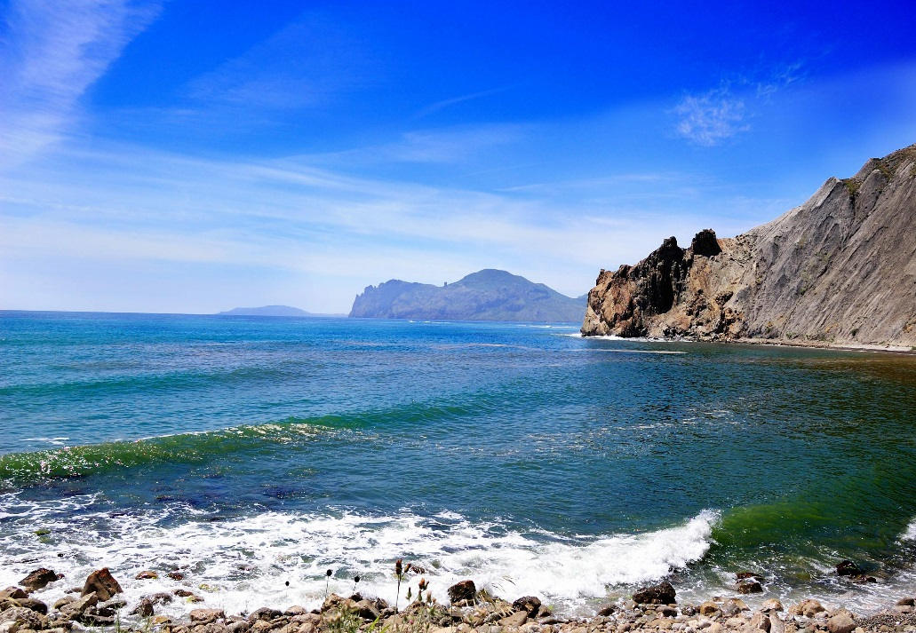
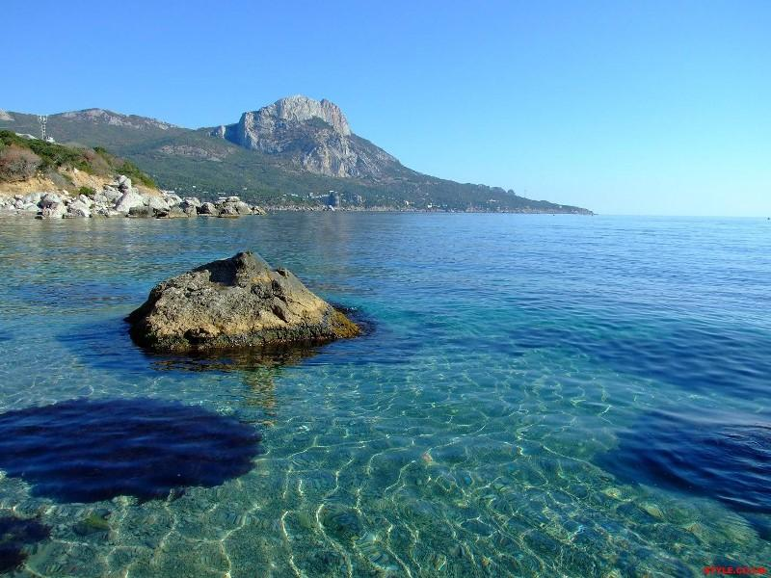
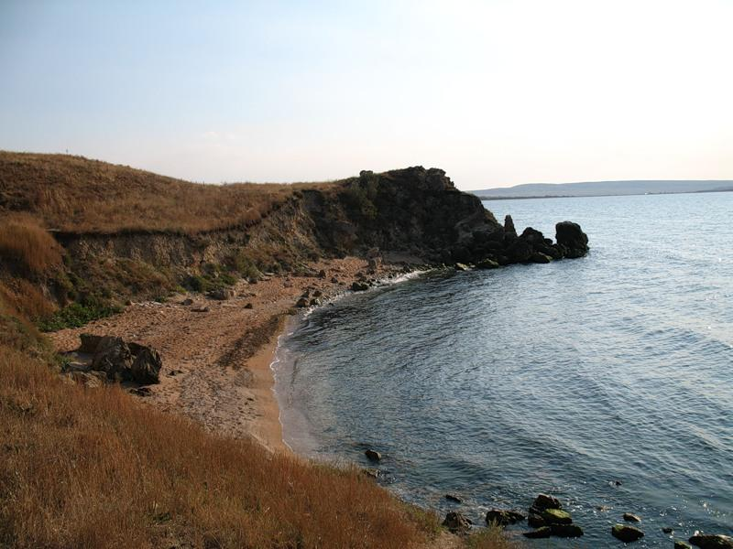
Sea Of The Crimea

Slide 10
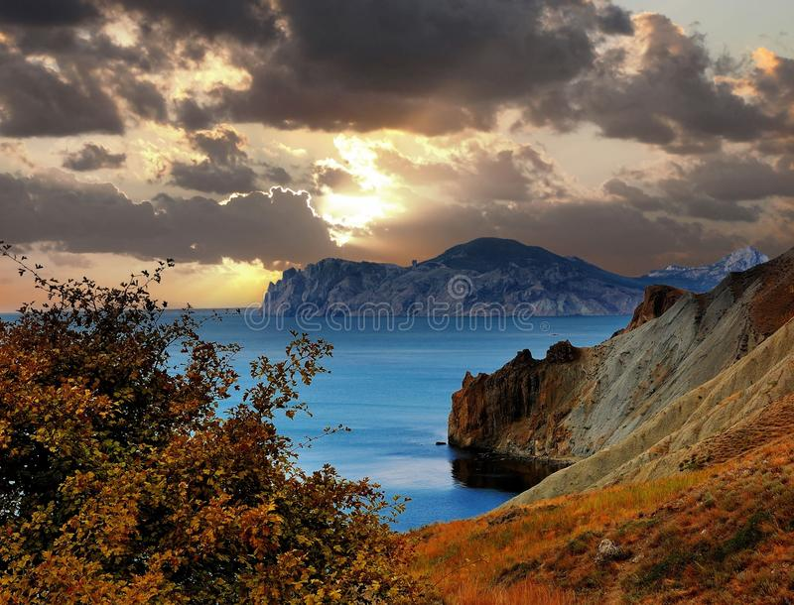
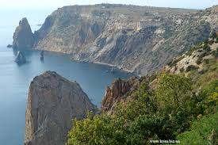
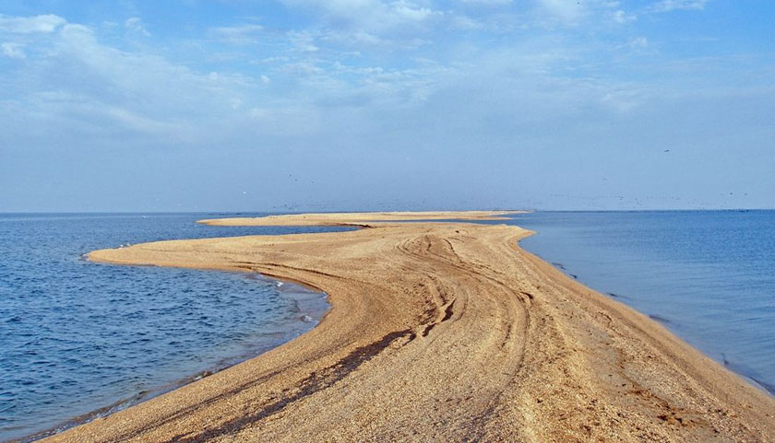
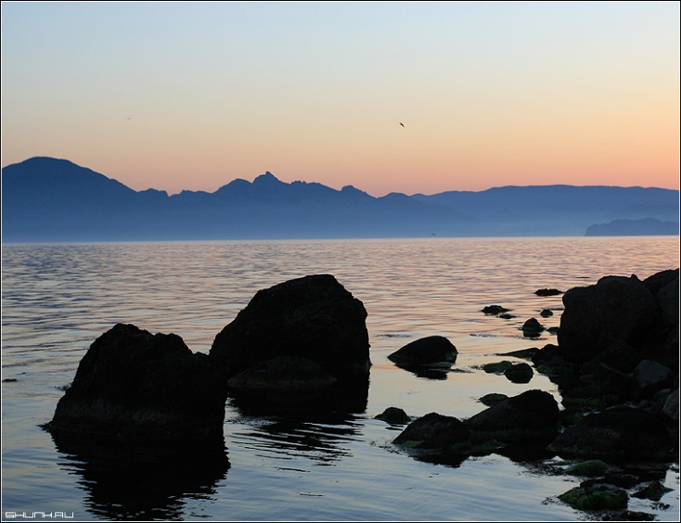





Water resources of the Crimea are of a great variety of resources. It is washed by two seas, and within the main water bodies of the Crimea's rivers, lakes and reservoirs. The reservoirs of the Crimea: the sea Around the Crimea is only two seas — Azov and Black. However, they have so many attractions that beckon tourists from countries of the former USSR. And the black sea coast of Crimea in popularity second only to Sochi.

Slide 11

Water is one of the most important elements on earth. It gives life to all living things. Water is almost the most useful resource person. In the Crimea, which is so well provided with heat, always had a problem with water availability. But this depends on plant life and agricultural productivity.

Slide 12








Slide 13

The Symbols Of The Crimea

Slide 14

Such recognized "panel consisting of three horizontally located color strips: top — blue component of 1/6 of the flag's width, medium, white, part 4/6 of the width of the flag; the bottom one is red, part 1/6 of the flag's width.The basis for the development of flag was based on the traditional . South-East Europe color. Red bottom stripe of the flag symbolizes the heroic and tragic history of the Crimea, the memory of the lessons of the past. Top blue — hope on a prosperous future. The average white stands for equality of all cultures and peoples of the Peninsula, the desire for civil peace.

Slide 15

The coat of arms of the Autonomous Republic of Crimea represents in scarlet the shield is turned to the right of the silver Gryphon, holding in his right paw an open silver shell with a blue pearl. The shield is crowned with the rising sun and surrounded by two white columns, connected blue-white-red ribbon with the motto: "Prosperity in unity". The basis of the symbolism of the Emblem is supposed traditional for Crimea since antiquity, with the image of a Gryphon, which, as a unifying symbol that expresses the idea of interpenetration of cultures and the natural and cultural diversity of Crimea. Griffin, holding in the paw a gem (symbol of the unique area of the planet), to read as guardian of the Republic. Viking shield emblem — a reminder of the trade routes passing through the Crimea, columns are symbols of past civilizations that have left their traces on the Peninsula.

Slide 16
The National Anthem Of Crimea

Slide 17
The national anthem of Crimea (the State anthem of the Republic of Crimea[2]/Anthem of the Autonomous Republic of Crimea[3]) is approved as the resolution of the Supreme Council of Crimea on 18 October 2000 and confirmed by the law of the Republic of Crimea on 5 June 2014

Slide 18
The Crimean Peninsula is a wonderful place where you can relax .This is the place where many miracles .I am very glad that my homeland is Crimea . That Crimea is my home, my destiny. And I can safely say that I am proud of my Motherland .

Slide 19



Crimea is my homeland

Slide 20
The end! Thank you for your attention!

