Slide 1
PROJECT
Нistory of London
Presented by pupil of the 11th form
Samolyuk Elizaveta
Teacher: Ivanova T.S
Dzhankoy, 2018.

Slide 2
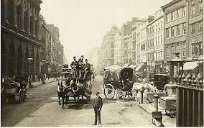
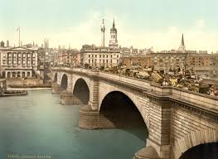
Nearly 2,000 years ago:
The Romans invaded Britain. They founded a Cetlic settlement then known as Londinium and later they had turned it into a large port and important trading centre with a long wall of stone and brick.There has been a «London Bridge» in the same area ever since.

Slide 3
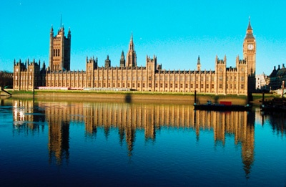
London is the capital of Great Britain, its political, economic and cultural centre. It’s one of the largest cities in the world. Its population is more than 9 million people.

Slide 4
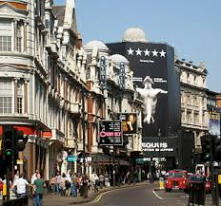
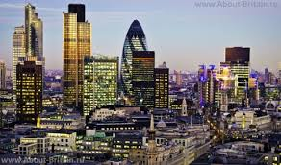
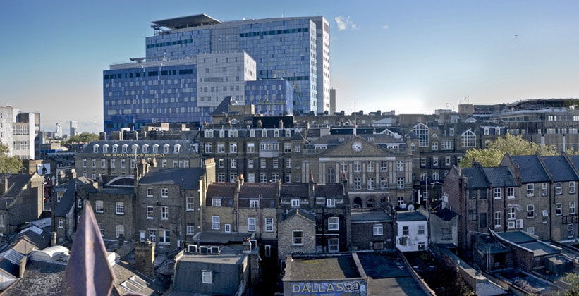
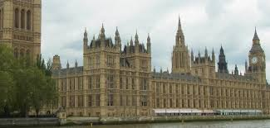
There are four parts in London: West End, East End, the City and Westminster.

Slide 5
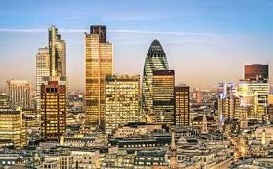
The City is the oldest part of London, its financial and business centre. There are many offices, companies and banks in this part of the capital. The heart of the City is the Stock Exchange. The Tower of London and St Paul’s Cathedral are situated in the City.

Slide 6
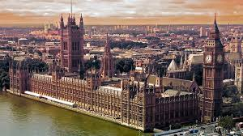
Westminster is also important part of the capital. It’s the administrative centre of London. The Houses of Parliament, the seat of the British Government, are there. Opposite the Houses of Parliament is Westminster Abbey where kings and queens have been crowned and many famous people were buried. The Houses of Parliament are often referred to as the Palace of Westminster.

Slide 7
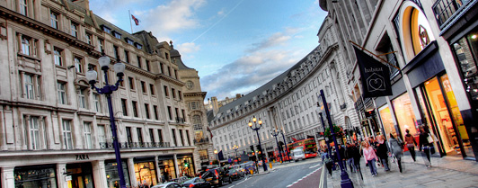
To the west of Westminster is West End, the richest part of London. It is full of luxury hotels, super-markets, cinemas and concert-halls. In the centre of the West End the Trafalgar Square is situated with the famous statue of Lord Nelson.

Slide 8
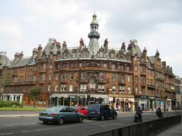
To the east of Westminster is East End, an industrial district of the capital. Most of plants and factories are situated there.

Slide 9
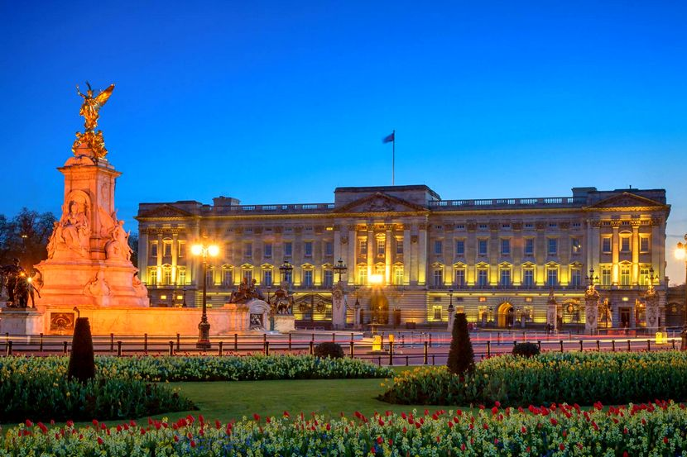
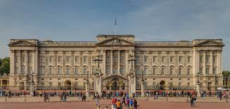
The official London residence of the Queen is Buckingham Palace. The palace was built in 1703 by the Duke Buckingham. The daily ceremony of the Changing of the Guard takes place in its courtyard.

Slide 10
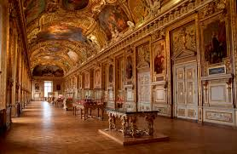
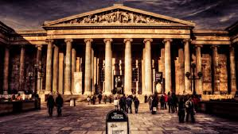
There are many museums in London. For example, the British Museum, the Natural History Museum, the Science Museum. The British Museum is the biggest museum in London. The museum is famous for its library — one of the richest in the world.

Slide 11
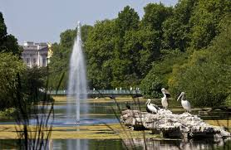
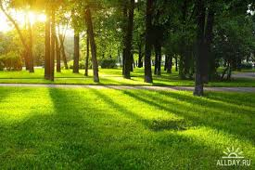
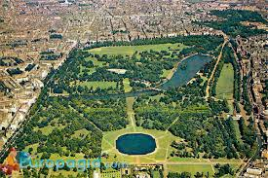
There are many beautiful parks in London. St James’s Park, Green Park, Hyde Park, and Kensington Gardens are linked together and form above 300 hectares of parkland in the heart of London.

Slide 12
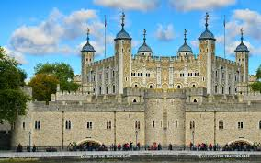
The Tower of London is a very old building in
London. It is nine hundred years old.
The Tower of London stands on
the Thames.In the early days of the history of
England the English kings
lived in the Tower. Then it was a prison
where many people died, black ravens had much
food near the walls of the Tower in
those years.Now the Tower of London is a
museum and many people from other countries
come to see it.

Slide 13
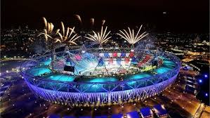
In 2012, London became the first city to host the modern Summer Olympic Games three times.
Interesting facts about London

Slide 14
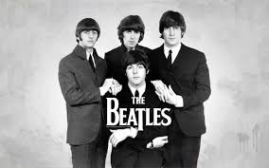
The city is home to the first and original Hard Rock Cafe as well as Abbey Road Studios, where the Beatles recorded many of their songs.

Slide 15
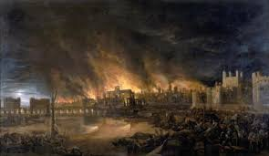
London had suffered from great epidemy of plague and fire in 1666.

Slide 16
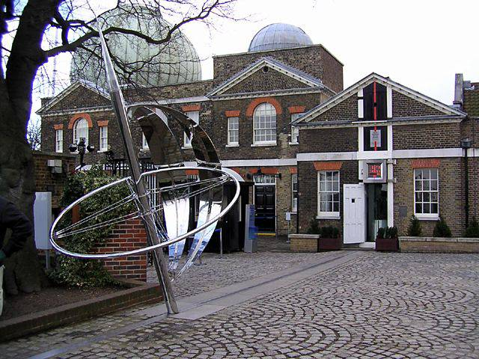
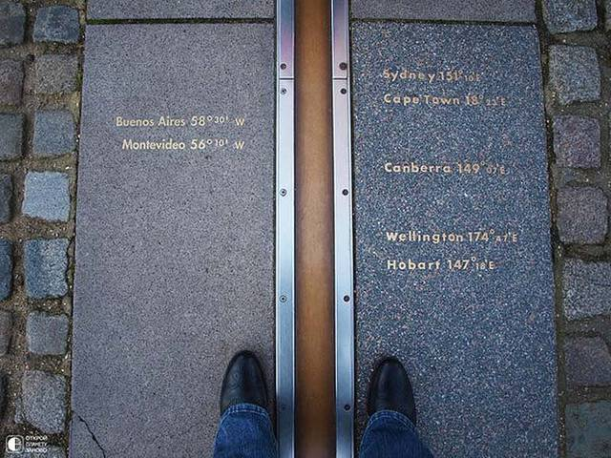
Through the capital of England passes the zero meridian, which allows you to visit both the eastern and western hemisphere of the planet.

Slide 17
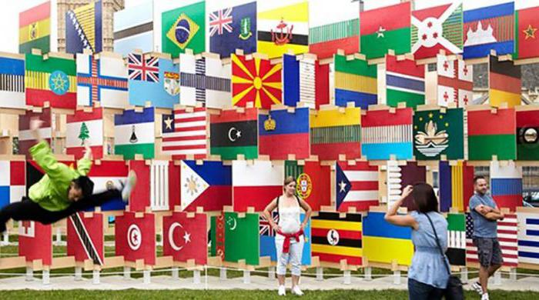
The capital of England is the most multinational and multilingual city in the world.

Slide 18
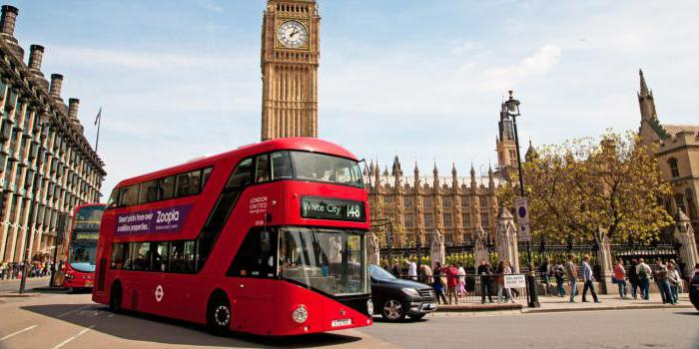
In London, two types of public transport are popular: buses and metro. In 2011, a car rally took place. His distance was 486 million kilometers. This figure is 12 thousand times the circumference of the Earth.

Slide 19
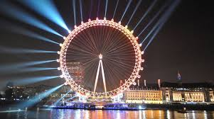
«The London Eye» it is one of the largest wheels in the world. It is located on the south bank of the Thames, in the Lambeth area. The project was implemented in practice for almost six years. Externally, the London Eye resembles a bicycle wheel. At night, it can be seen from afar thanks to LED backlighting. The height of the construction is 135 meters (this is approximately 45 floors). If the wheel is unwound, the length of the rim will be 424 meters.

Slide 20
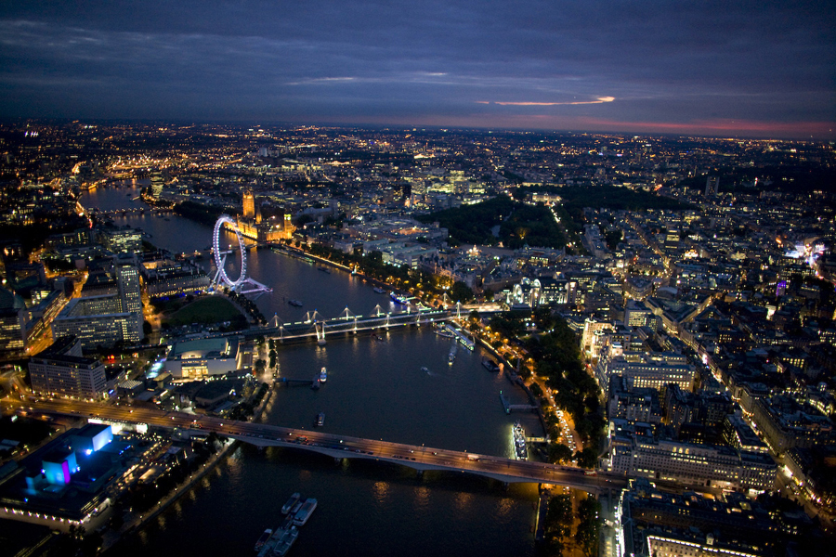
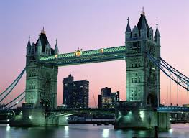
In conclusion, I want to say that London is one of the most beautiful cities in the world and to better know it, you need to visit it

Slide 21
Тhanks for your attention

