Slide 1
PROJECT “Tourist attractions in Russia”
Made by pupil of form 9th
Evgenia Orlova
Teacher: Ivanova T.S.
Dzhankoy, 2018

Slide 2
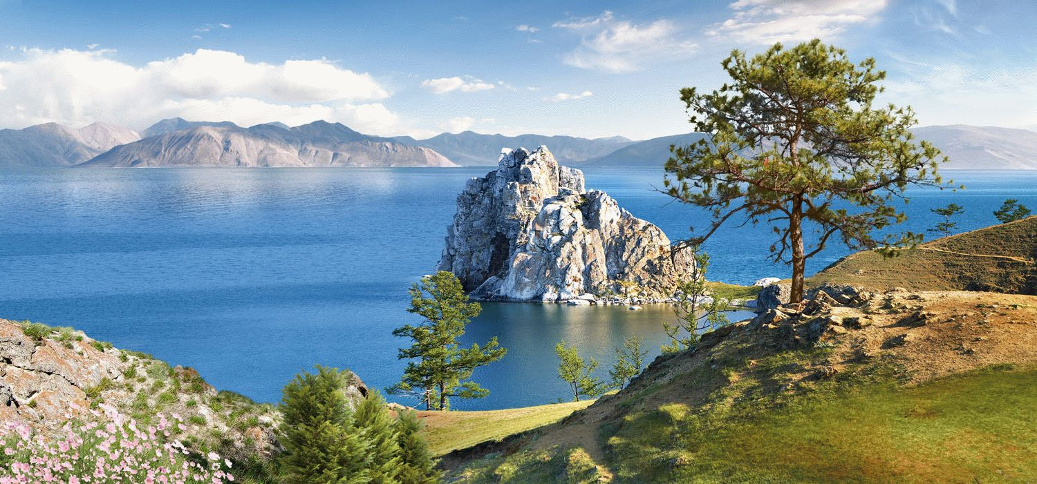
Lake Baikal
Lake Baikal is a lake located in eastern Siberia. This is the deepest lake on our planet and the largest natural reservoir of fresh water. Lake Baikal is also widely known for its endemic fauna. Water in the lake is very clean and clear. There are 27 islands and the biggest one is called Olkhon. Numerous rivers and streams flow into Lake Baikal. The Angara is the only river that flows out from the lake.

Slide 3
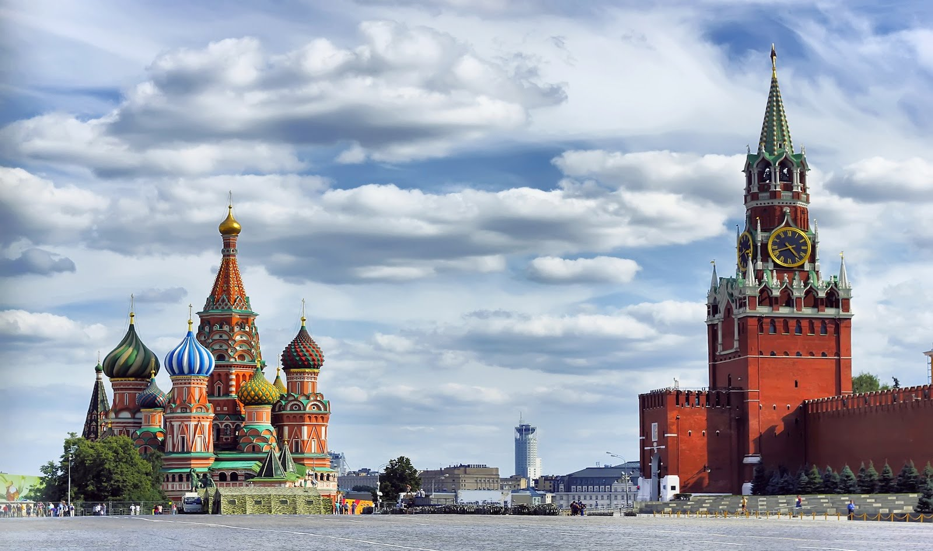
Red Square
Red Square is the main square in Moscow. It is the center of the city, and if you look at Moscow's plan, you will see that it is located in the center of the radial layout of the city. The place for the present Red Square was identified during the reign of Ivan III (the end of XV – beginning of XVI century), when the Kremlin was rebuilt. So, Red Square is allocated along the northeastern wall of the Kremlin. There is the Lobnoye mesto, the monument to Minin and Pozharsky, Lenin’s mausoleum, the Kremlin Wall Necropolis, GUM, the State Historical Museum, St. Basil's Cathedral, Kazan Cathedral in Red Square.

Slide 4
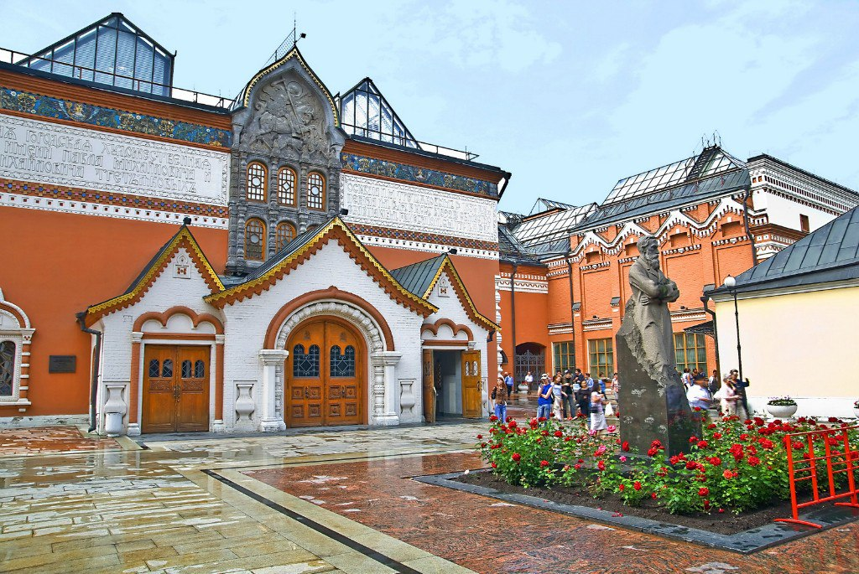
Tretyakov gallery
Tretyakov gallery.The largest Russian Museum has collected a number of masterpieces not only by local artists. What began as a Private collection, today the Tretyakov gallery is known worldwide and is a Museum of Federal significance. To roam the halls of this gallery, you can see many paintings deserve a separate story, so great value that they have for the world culture.

Slide 5
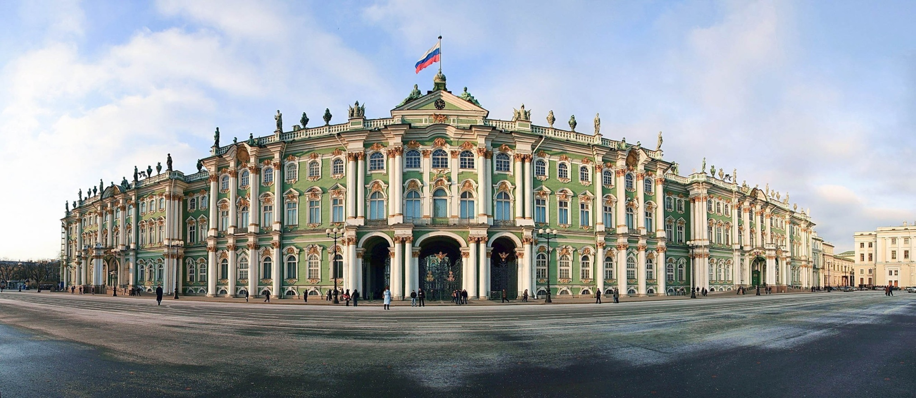
The State Hermitage Museum
The State Hermitage Museum is located in St. Petersburg – the cultural capital of Russia. It is one of the largest museums in the world. The museum was founded in 1764 by Catherine the Great and has been open to the public since 1852. Today, the Hermitage is a complex museum. Its main exhibition is located in five buildings situated in the center of St. Petersburg along the Neva river. The main building of the complex is the Winter Palace

Slide 6
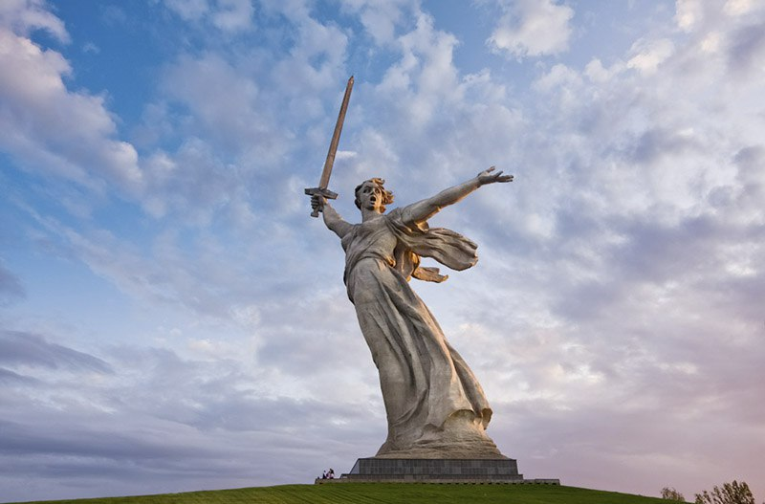
Mamaev Kurgan and the Motherland
The Motherland Calls also called Rodina-mat zovyot, is a statue in Mamayev Kurgan in Volgograd, Russia, commemorating the Battle of Stalingrad. It was designed by sculptor Yevgeny Vuchetich and structural engineer Nikolai Nikitin, and declared the largest statue in the world in 1967. Compared with the later higher statues, The Motherland Calls is significantly more complex from an engineering point of view, due to its characteristic posture with a sword raised high in the right hand and the left hand extended in a calling gesture.

Slide 7
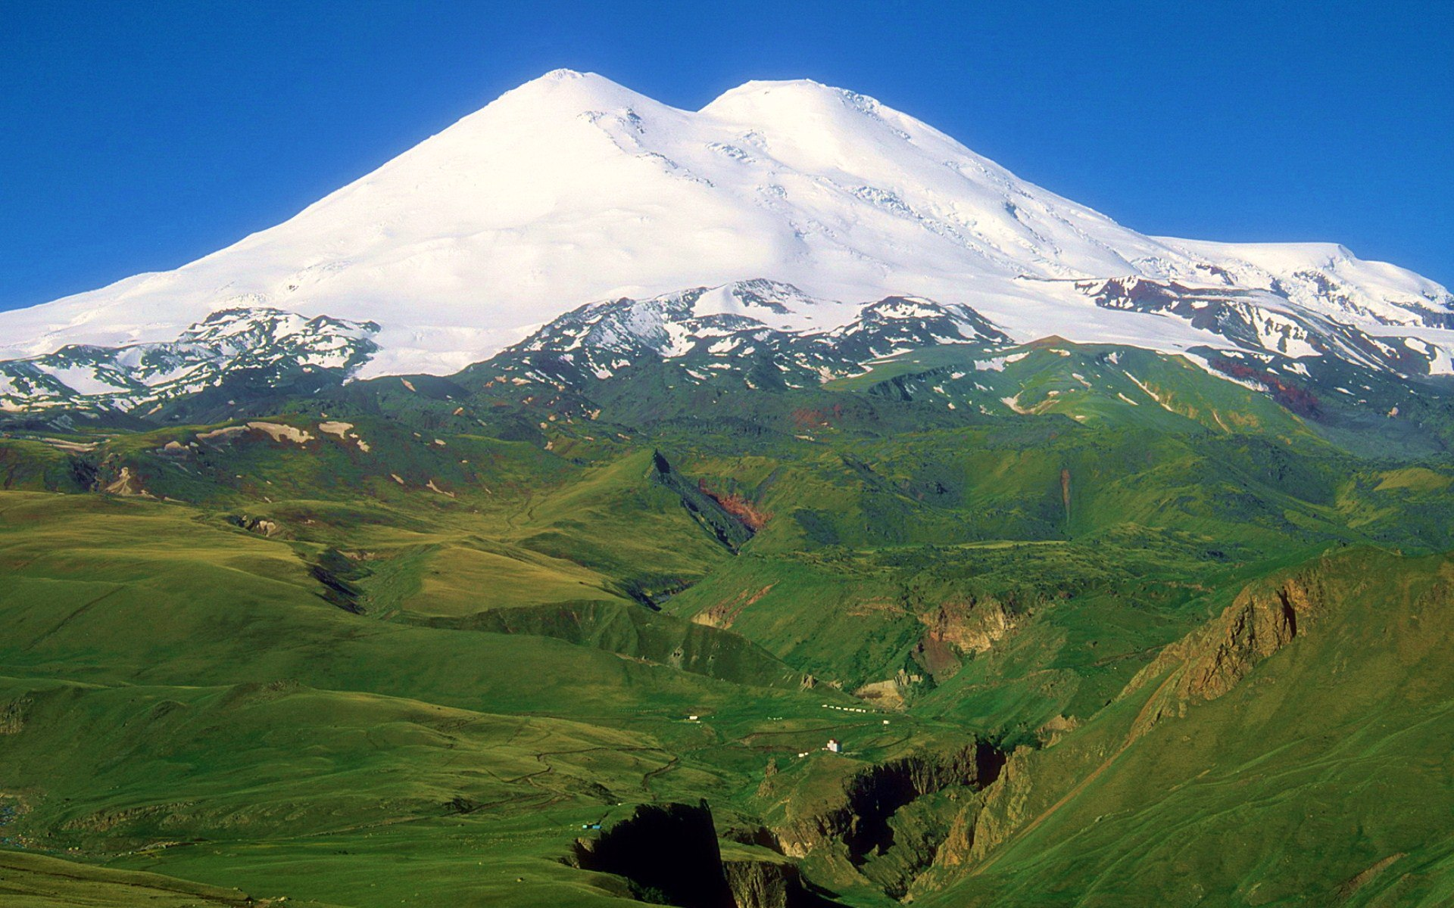
Elbrus
Elbrus The highest mountain in Russia. But if you consider the fact that clear boundaries between Europe and Asia and not, on the whole European territory. Of course, to climb at its 5642 meters will not everyone, but the surroundings of Elbrus still enjoy the glory of one of the most beautiful regions of Russia, with its ancient history and unique atmosphere.

Slide 8
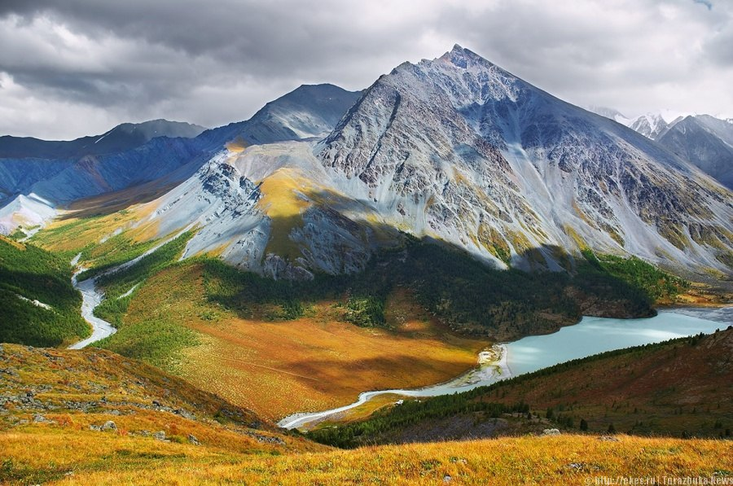
Golden mountains of Altai
Golden mountains of Altai In this area the vast expanses of Russia joined the steppe and tundra, deserts and mountains, pristine lakes and amazing caves, swift rivers, and Alpine meadows. In the Golden mountains of Altai preserved them, here is the highest mountain in Siberia — Belukha, Altai pearl — Teletskoe lake and a lot more interesting.

Slide 9
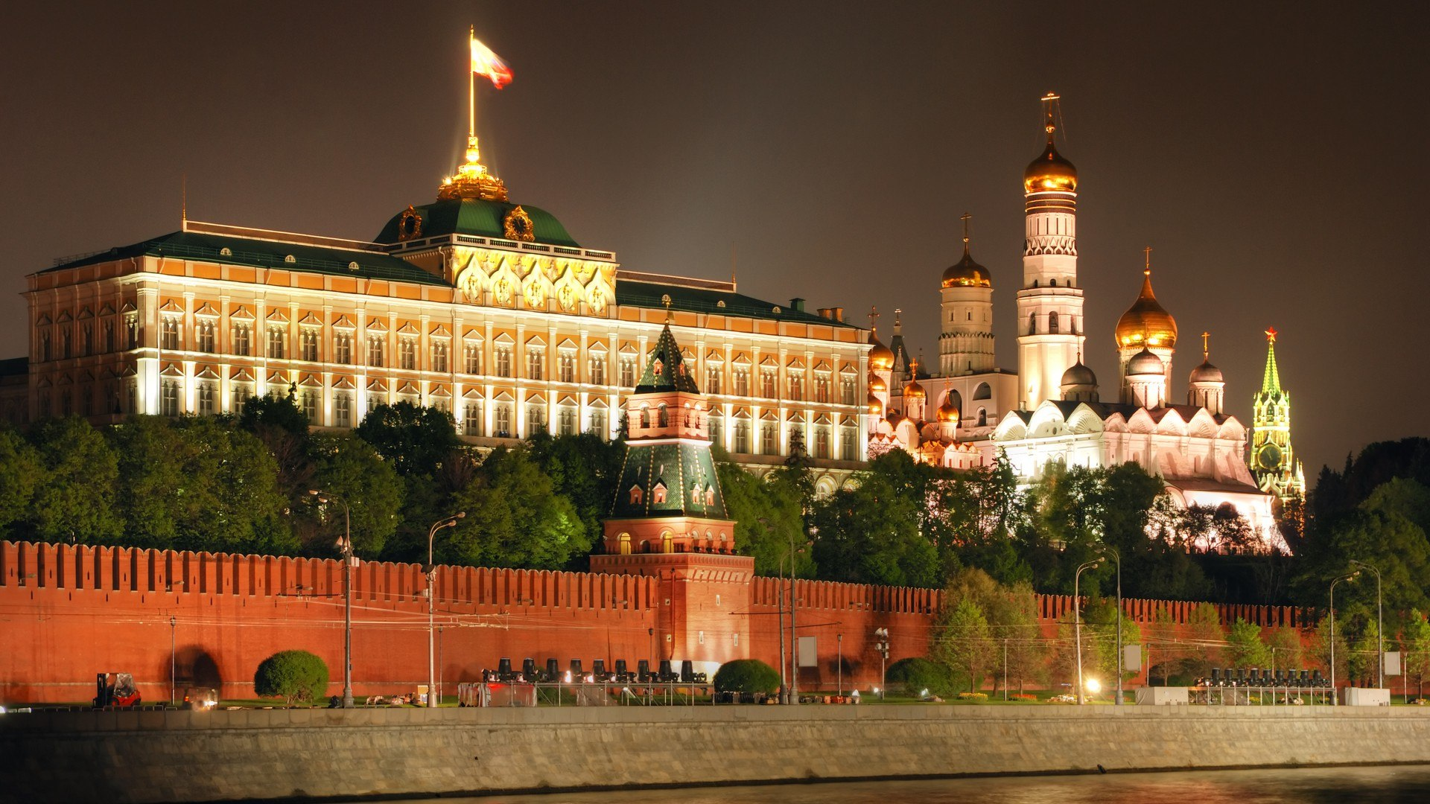
The Moscow Kremlin

Slide 10
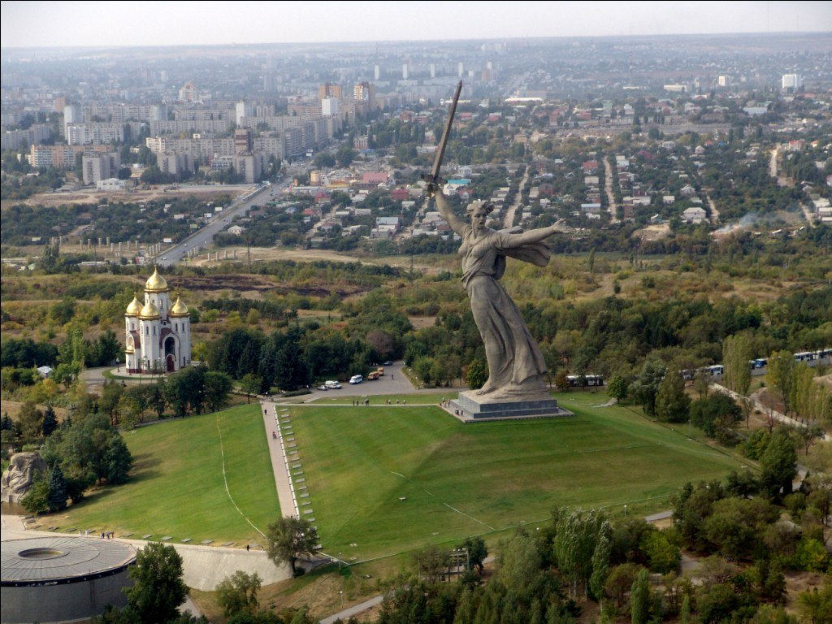
Mamaev Kurgan

Slide 11
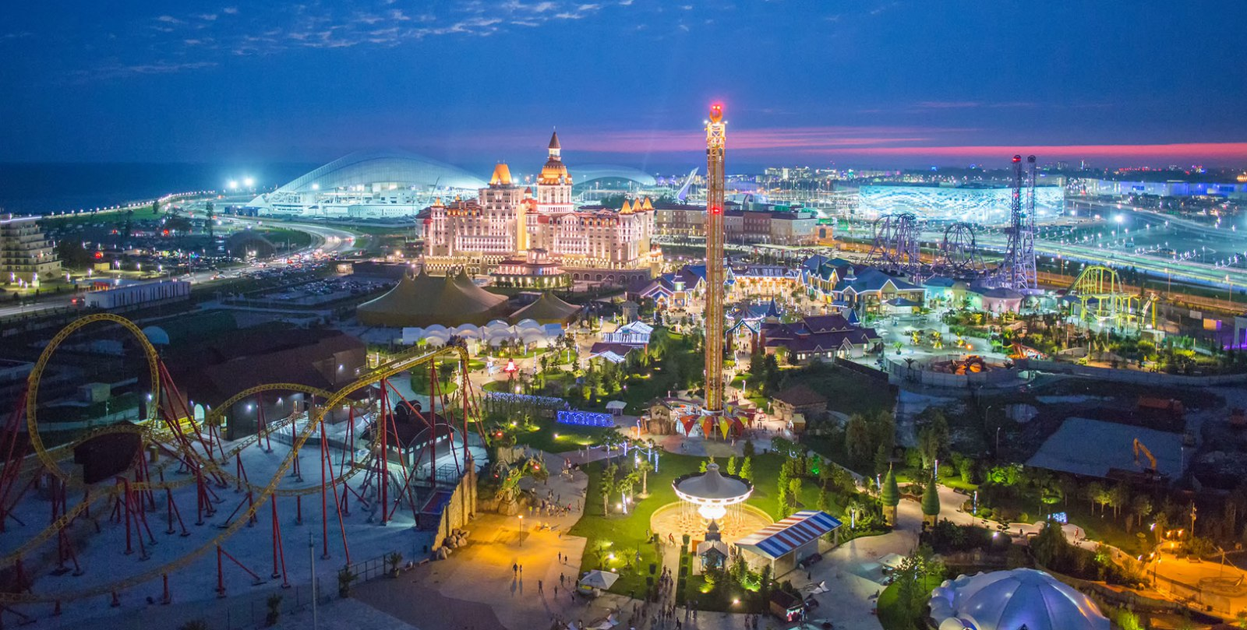
Sochi Park

Slide 12
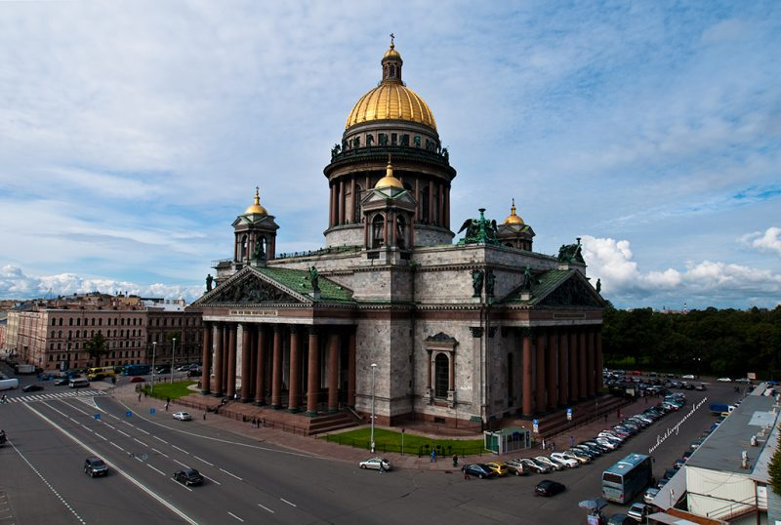
St. Isaac's Cathedral

Slide 13
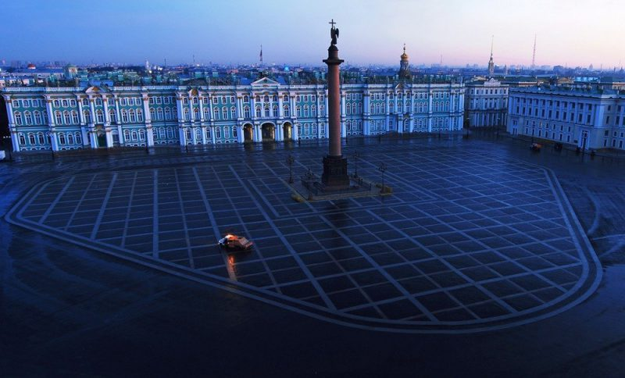
The winter Palace in St. Petersburg

Slide 14
Russia is an amazing country, which will join the collection of the most interesting places seen by any tourist. The beauty of its open spaces, many delightful attractions inspired the works of famous world writers and artists. In Russia there are many parts of nature that shakes to the core with its stunning landscapes. It is also a country of skilled craftsmen who have created masterpieces of architecture, preserving for centuries their grandeur and beauty. To enumerate all the sights of Russia is very difficult, because each region of this great state in the world has many unique places. But still the most popular and visited places can be allocated. Photo with the names and descriptions of the main attractions will allow you to appreciate their beauty and awaken the desire to visit such impressive beautiful places.

Slide 15
Thanks for your attention!

