Slide 1
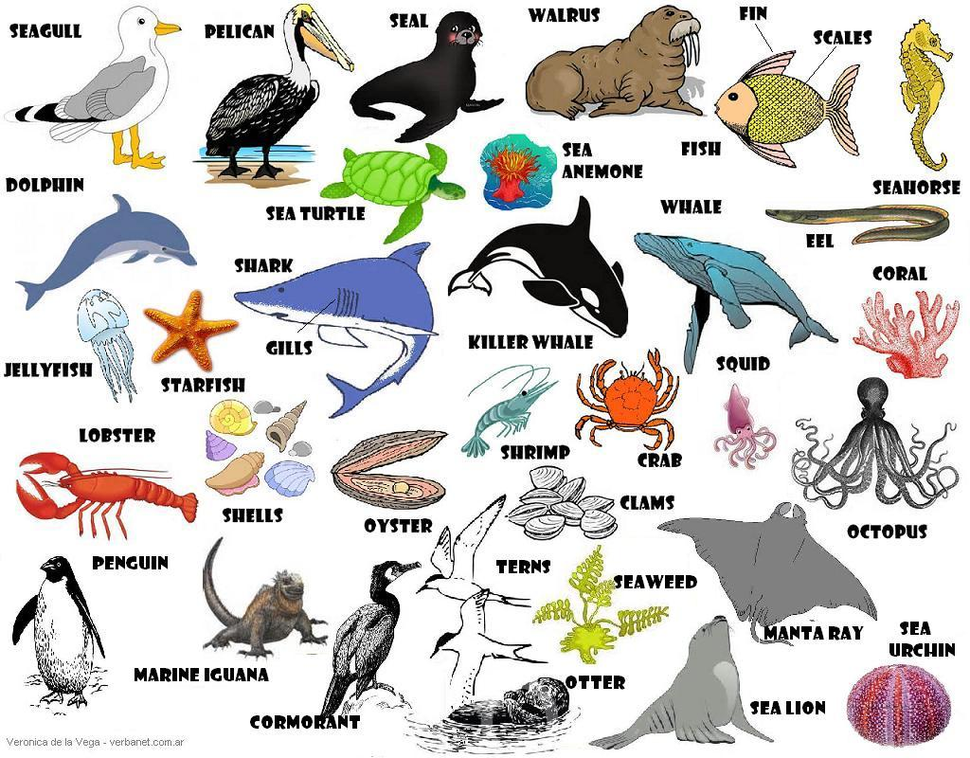
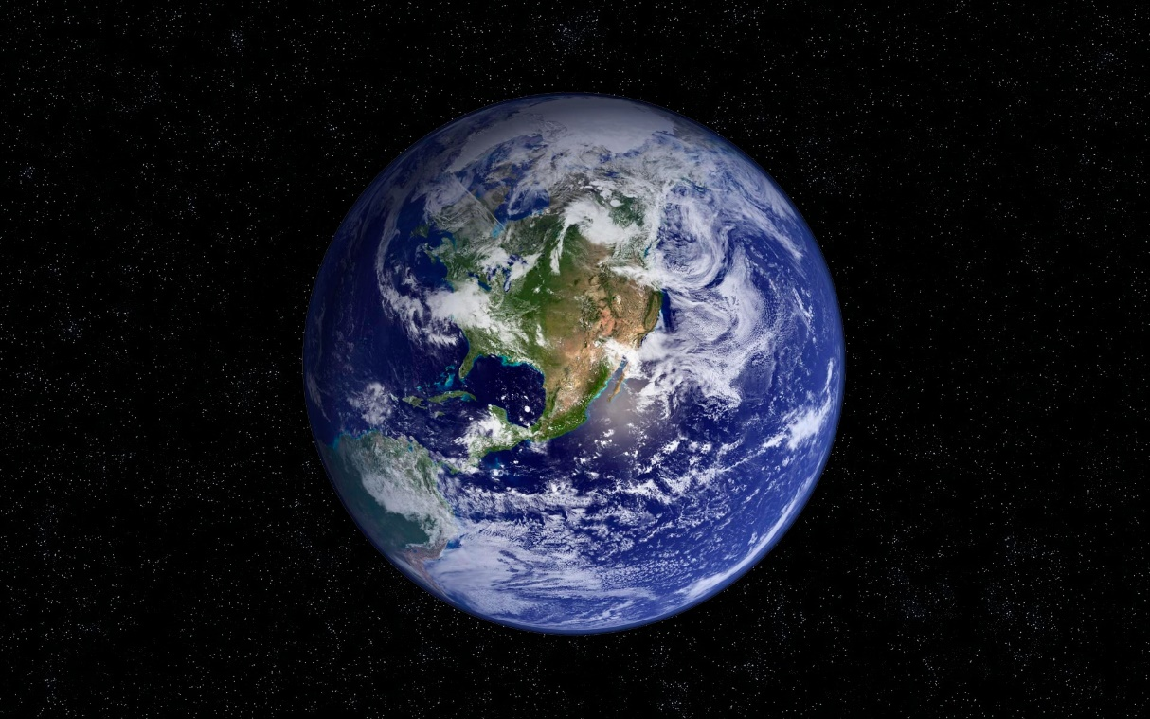
Main types of animals
Шлеина Виктория
5 «Б» класс
ГБОУ Школа № 962

Slide 2
Макет заголовка и объектов с диаграммой
Types of animals:
1) mammals
2) amphibians
3) fish
4) reptiles
5) shellfish
6) echinoderms
7) cyclostomes
8) arthropods
9) birds

Slide 3
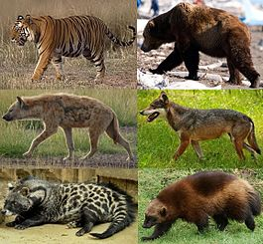
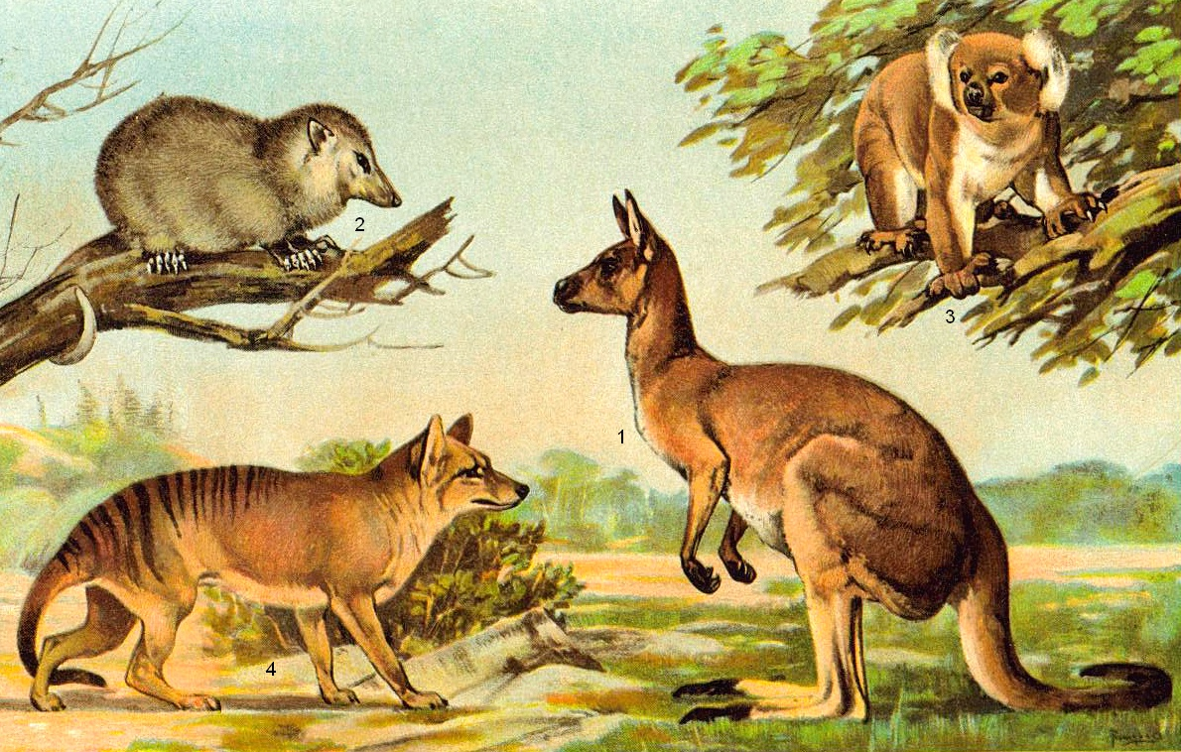
Mammals
Mammals — the class of vertebrates that have mastered land, water and airspace. The main feature of mammals is the way they nurse their young. ALL mammals nurse their young with milk. Most of them give birth to cubs. There are types of mammals that still lay eggs (e.g. platypus, echidna).

Slide 4
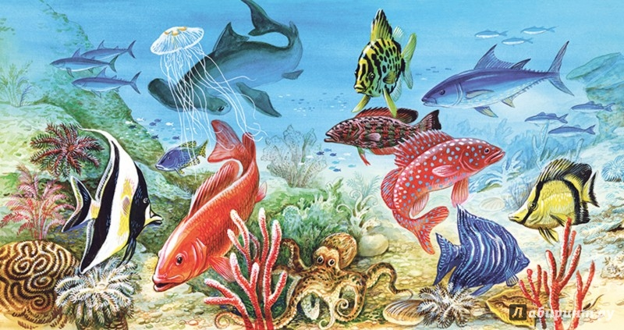
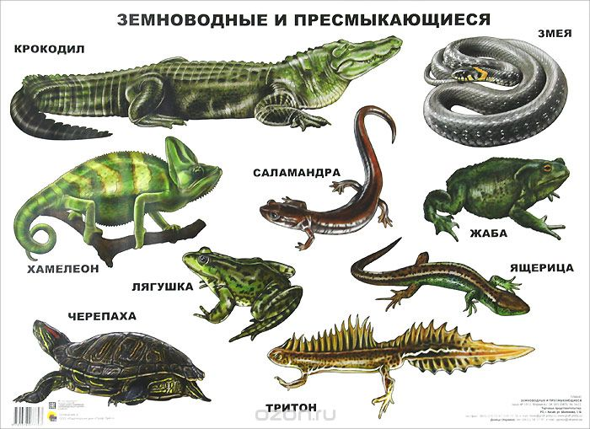
Добавить заголовок слайда - 2
Amphibians
Fish
Amphibians (or amphibia) are a large group of animals. Their name means “who lives in both: - in water and in air.. Amphibians spend most of their life in and around water. Amphibians appeared about 370 million years ago. They live on every continent except Antarctica. But most often they can be found in the tropics.
Fish - a large group of vertebrate animals, spending all of their life in water and breathing through gills. This definition immediately excludes from fish vertebrates, which breathe without gills: whales, seals, dolphins and other water mammals.

Slide 5
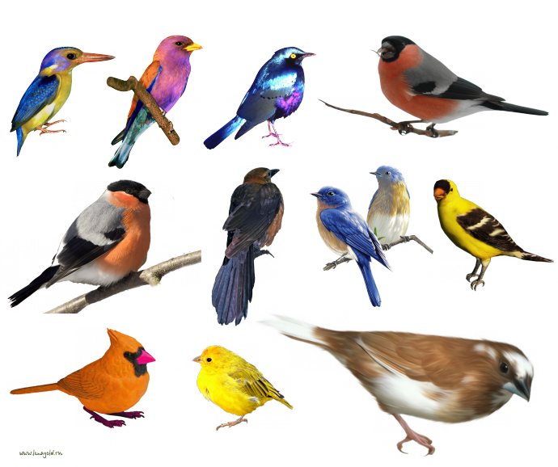
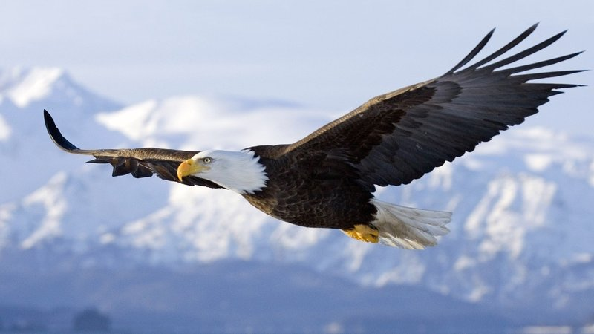
Birds
Birds are the only animals on earth that have feathers, covering their bodies They are vertebrates. Birds live everywhere in the world - from the cold polar regions to the rain forests of Africa. Like mammals, birds are warm-blooded, but they lay eggs and can fly.

Slide 6
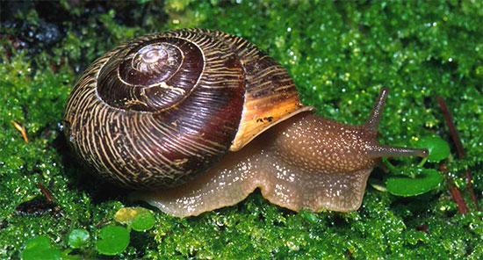
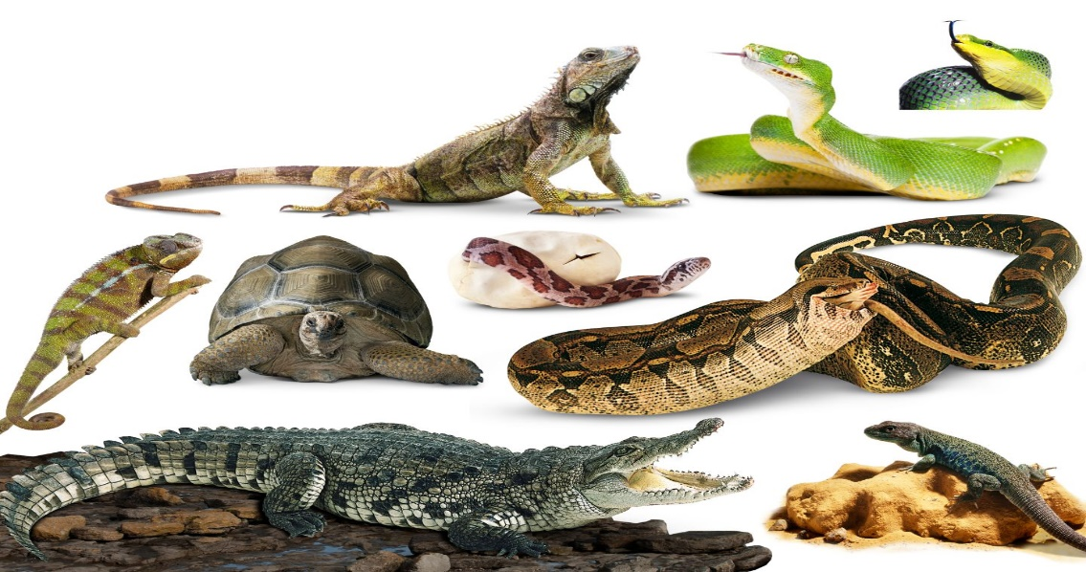
Reptiles
Shellfish
Reptiles are a class of vertebrates Reptiles are cold-blooded, their body temperature depends on environmental conditions. However, they are able to control it, hiding from overheating or avoiding hypothermia. For example, hibernation allows them to survive in winter, and nocturnal activity –to avoid the heat of the day. All reptiles have tough, dry skin covered with scales. Its main function is to protect the body from drying out.
Shellfish - a type of invertebrate animals that includes snails, slugs, oysters, octopus, etc. All mollusks have bilateral symmetrical non-segmented body. Most have a shell in the adult state. The shell consist of three layers to protect the animal’s body. As the animal grows, the shell increases in size.

Slide 7
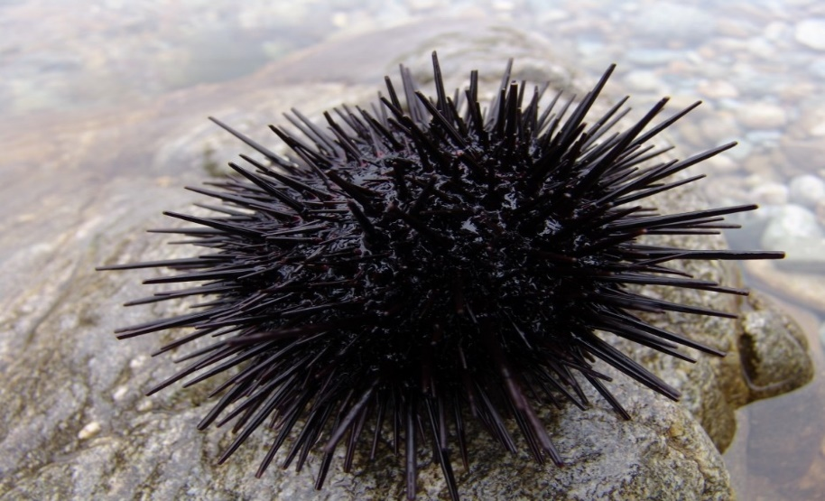
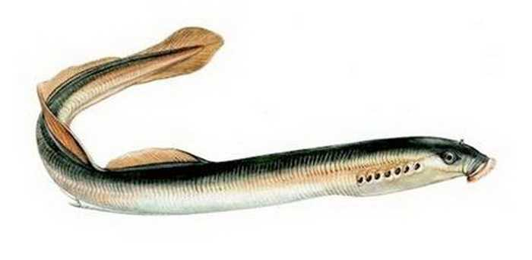
Добавить заголовок слайда - 4
Ciclostomes
Echinoderms
Echinoderms –are a type of exclusively marine benthic animals, mostly free-living, we can find them at all depths of the oceans. There are about 7,000 modern forms. Modern representatives are sea stars, sea urchins, sea cucumbers and sea lilies.
Cyclostomes –are a group of vertebrates Earlier they were also called "lower vertebrates". In evolutionary terms, they are the forerunners of the fish. Cyclostomes include two groups: lampreys and hagfish, (now they are in different classes), and sometimes even subtypes of chordates. Today, there are about 45 species.

Slide 8
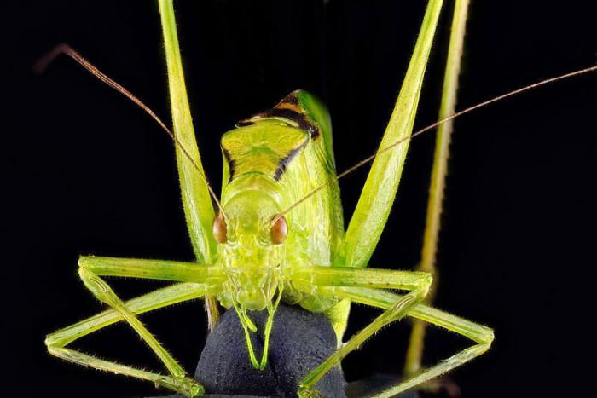
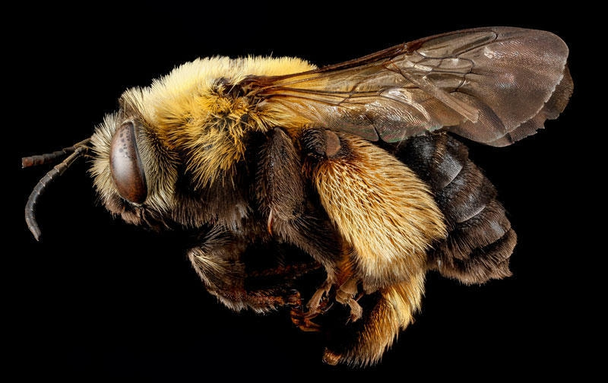
Arthropods
Arthropods – a primary type of animals, including insects, crustaceans, arachnids and centipedes. In number of species may be the most prosperous group of living organisms.
An arthropod is an animal, having an external skeleton (exoskeleton).

Slide 9
Conclusion
Тhe Modern system of the animal world is built on the basis of the identification of kinship between animals and their origin. In the modern system of animal types range from simple (lower) to more complex (higher), which corresponds to the General direction of the historical development of the animal world on Earth.
Each animal is characterized by its structure, nutrition, level of interaction with the outside world.

