Slide 1
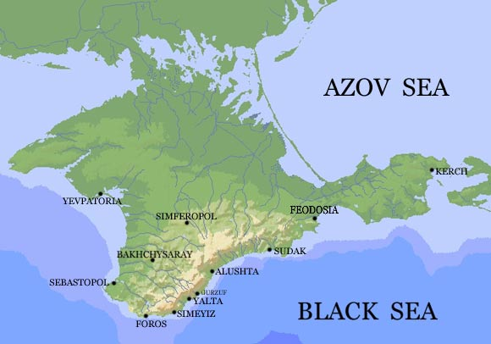
My Crimea
By the pupil of the 5th form
Khavronicheva Olga
The teacher: Ivanova Tatiana Sergeevna

Slide 2
The urgency of the project
The Crimea is a marvellous treasury, a natural storehouse of the secrets of millenniums. Nobody could claim to have become accustomed to this wonderful land full of life and surprises.

Slide 3
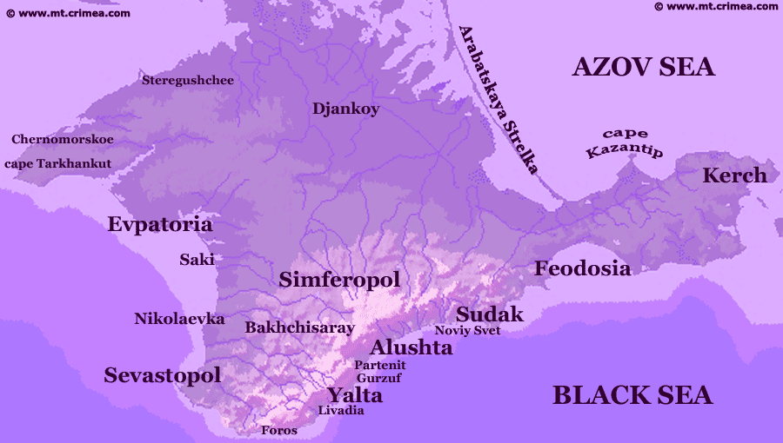
The map of the Crimea

Slide 4
The republic is situated on the Crimea peninsula. It is between the Black Sea in the west and south, and the Sea of Azov – in the east. The total area of the republic is 26100km², population is 2 024 000. It is divided into 15 regions and 15 cities. Symferopol is the capital of the Crimea.
The Crimea consists of two very different parts – treeless steppe of the Crimean Lowland in the northern and central parts, and the Crimean Mountains in the south. The rivers are short and shallow. On the northern slopes of the Crimean Mountains we find the Belbek, the Kacha, the Alma, the Salhyr and other rivers.
It is rich in natural resources, such as iron ore, natural gas, building materials, and salt from the lakes.
The main sea-ports are Kerch, Feodosia, Yalta, Sevastopol and Yevpatoria.

Slide 5

The Flag of the Crimea
The flag has been in use since 1992 and was officially adopted on April 21, 1999. The flag is a triсolour, striped horizontally in blue-white-red.
Designed by A.Malgin and V. Trusov.

Slide 6
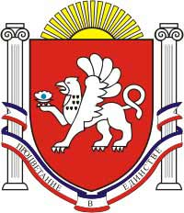
The Emblem of the Crimea
The State Emblem of the Republic of Crimea represents a silver griffin against the background of dark red Varangian shield, facing to the right and holding a disclosed silver shell with a blue pearl in his right paw. The shield is crowned with rising sun, surrounded with 2 white columns and tied with blue-white- red ribbon with motto “Prosperity in unity”, the draft law states.

Slide 7
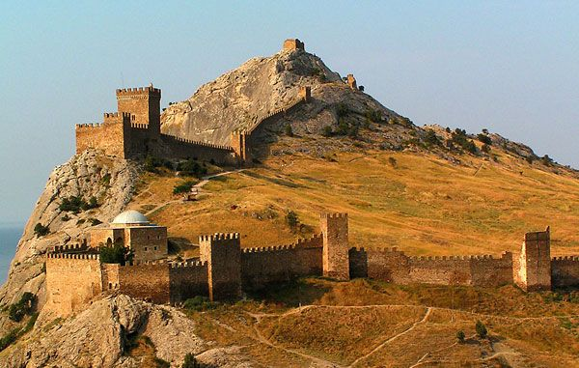
The history of the ancient Crimea
The recorded history of the Crimean Peninsula, historically known as Tauris. The Crimean interior was much less stable, enduring a long series of congests and invasions; by the early medieval period it had been settled by Scythians, Greeks, Romans, Goths, Huns, Bulgars, Kipchaks and Khazars.

Slide 8
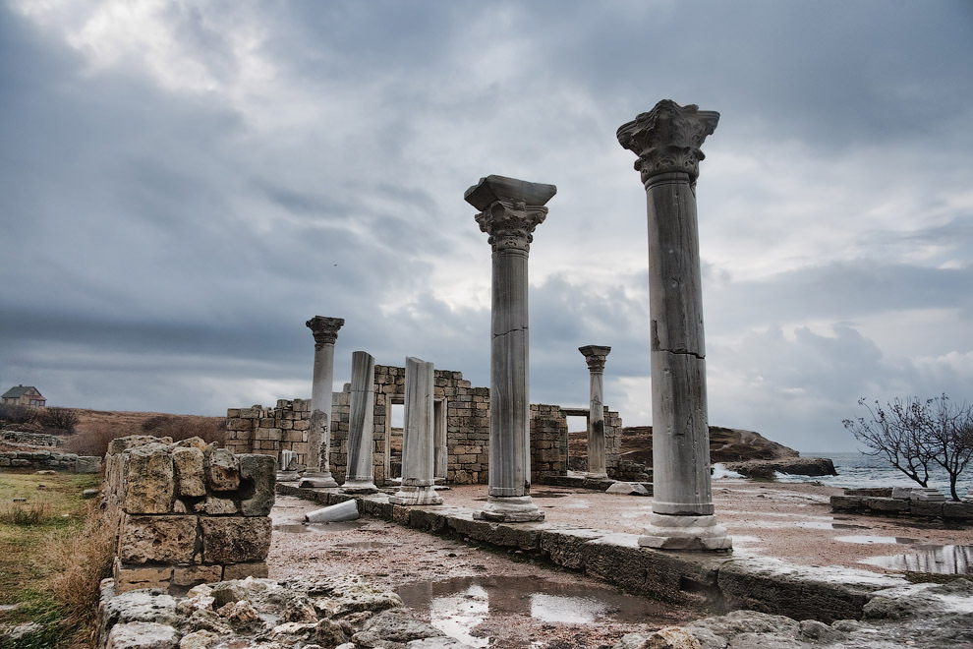
In the medieval period, it was acquired partly by Kievan Rus’, but fell to the Mongol invasions as part of the Golden Horde. They were followed by the Crimean Khanate and the Ottoman Empire, which conquered the coastal areas as well, in the 15th to 18th centuries.

Slide 9
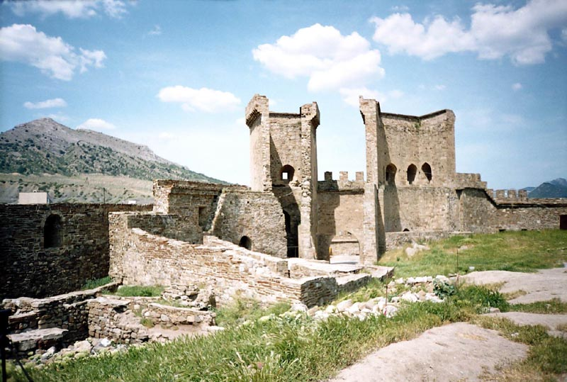
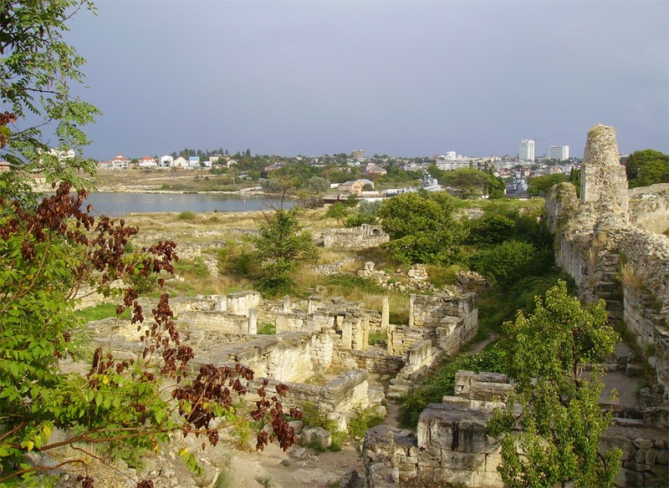
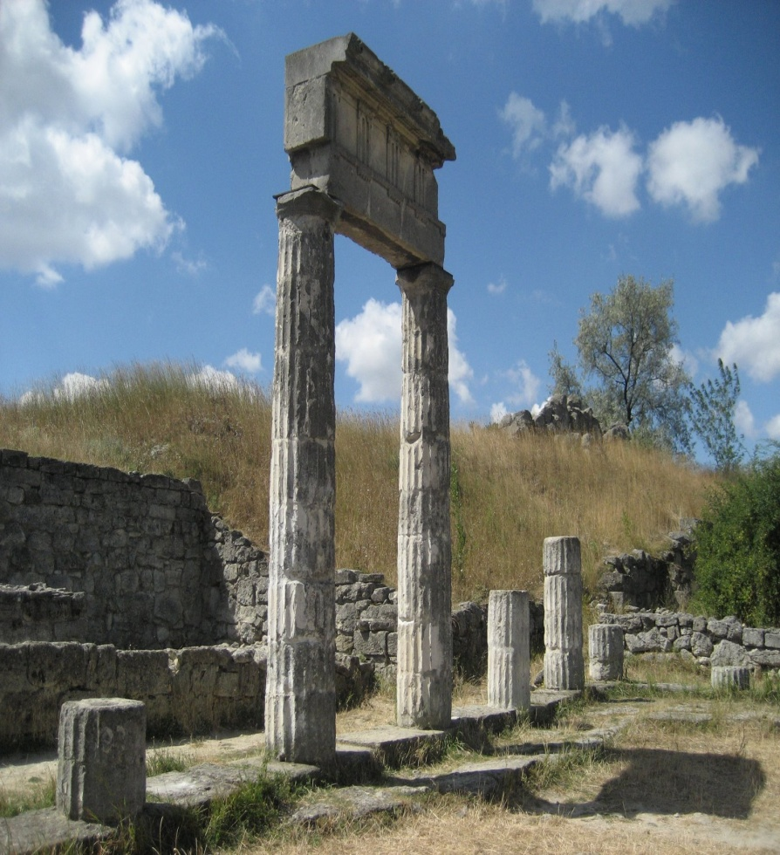
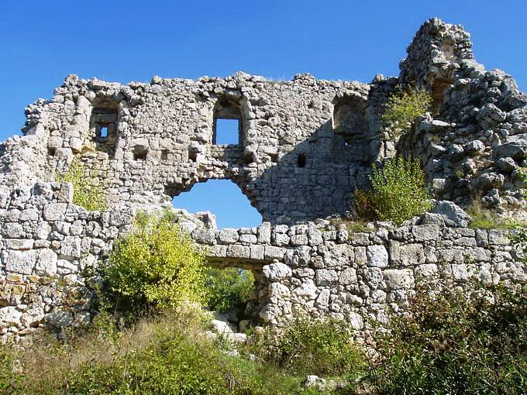

Slide 10
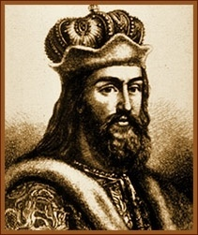
Vladymyr the Great was the grand prince of Kyiv from 980. He became convinced that a monotheistic religion would consolidate his power. In December 987, Vladymyr, his family, and his closest associates were baptized, and he took the Christian name Vasylii. It happened in Khersones (now it is Sevastopol).

Slide 11
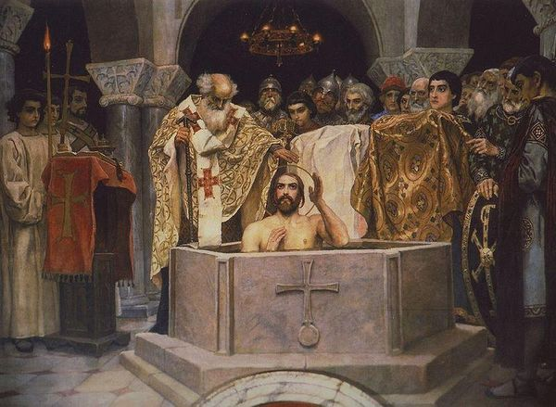
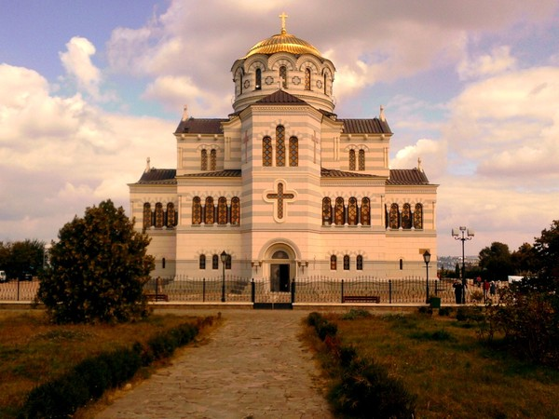
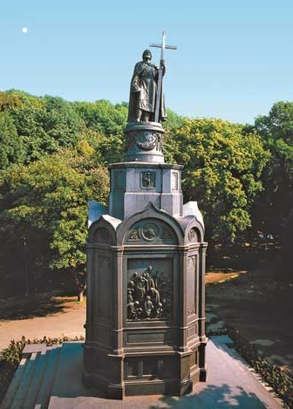

Slide 12
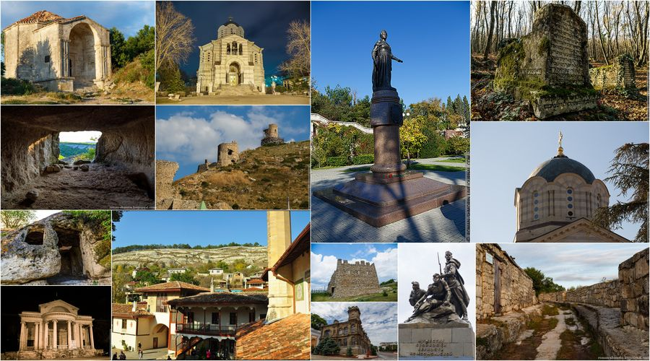

Slide 13
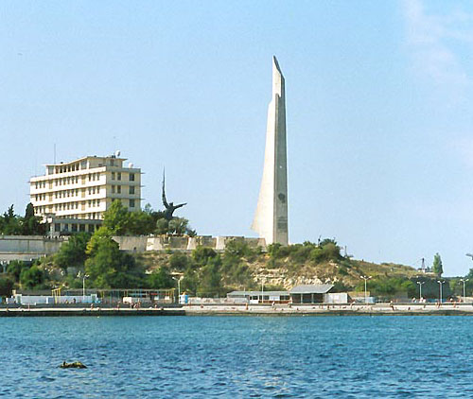
The hero-cities
Sevastopol
The hero-city Sevastopol, situated on the Black Sea coast of the Crimean peninsula. Today, it is a first-rate sea-port and an important industrial, cultural, historical, and tourist center of the Crimea. In Sevastopol are situated the main naval station of the Russian Black Sea Fleet.
The official date of city's birth is considered to be the year of 1783, though the ground that Sevastopol lies on today has been inhabited for many centuries. In classical times, the Greek colony of Chersonesos (or Chersonesus) stood here, and was a part of Roman and Byzantine empires. The territory of ancient city has been turned into the National Preserve of "Tauric Chersonesos.”

Slide 14
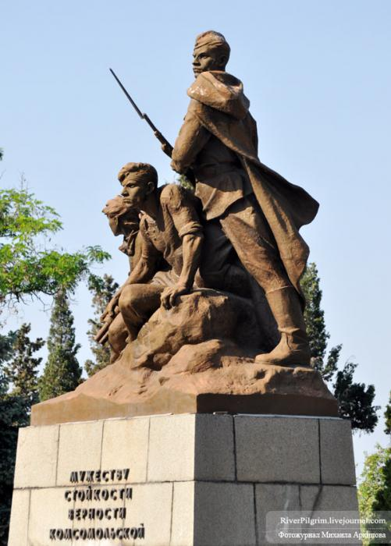
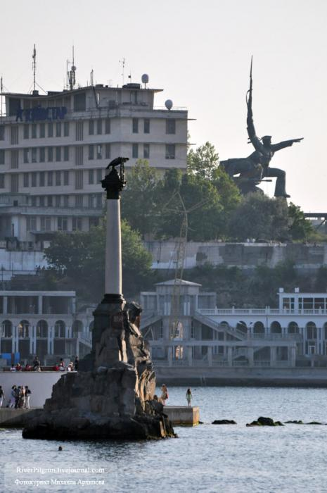

Slide 15
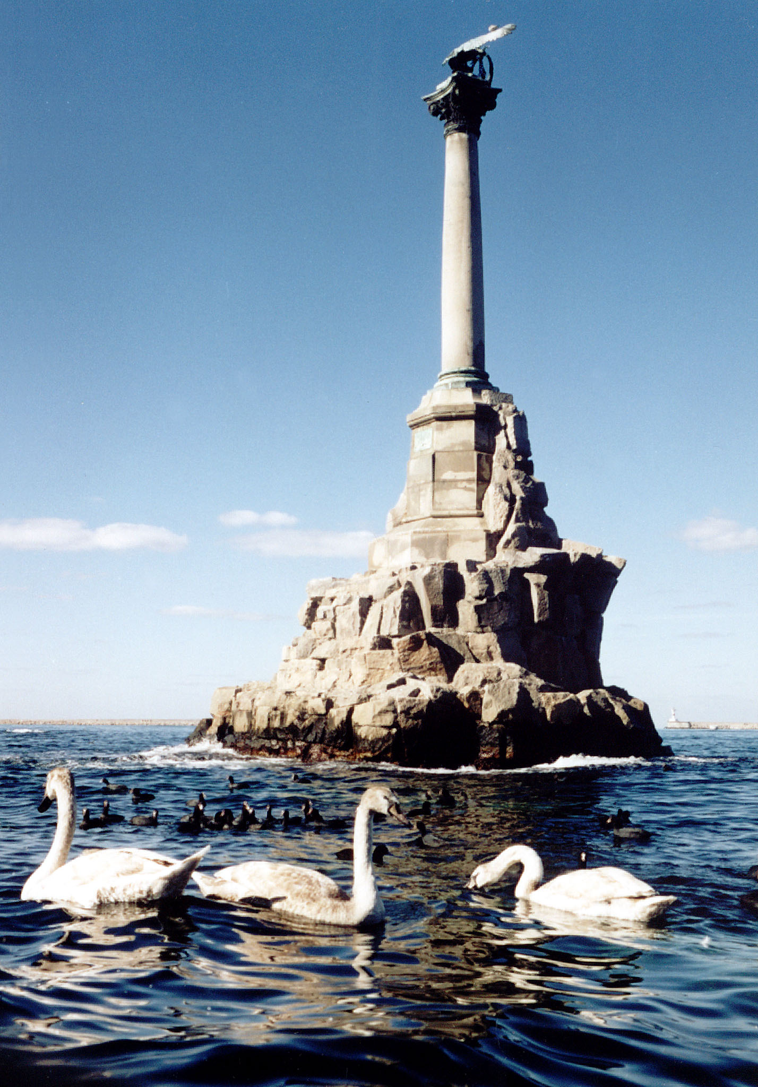

Slide 16
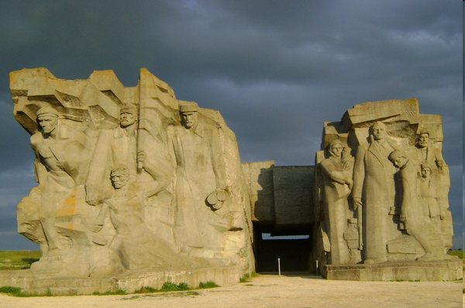
Kerch
Kerch is the third biggest city on the Crimean peninsula. It is located on the coast of the Kerch Strait, which connects the Black and Azov Seas. Unfortunately, Kerch is undeservedly neglected by tourists. Yet it is a most unique city - the oldest in Crimea and one of the oldest in the world; the amount of its cultural and historical wealth is equal to the most popular tourist centers in the region. It is no coincidence that Kerch was included into UNESCO’s "Silk Road.”

Slide 17
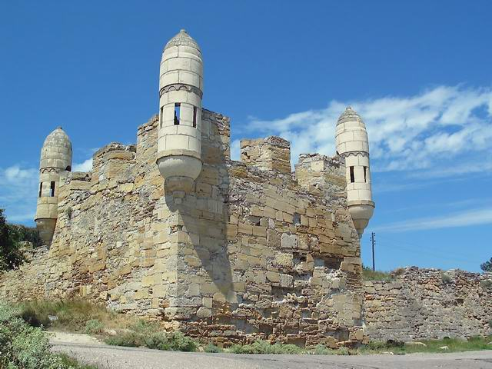
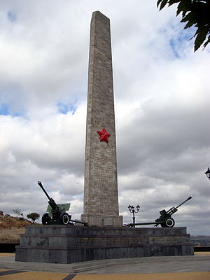

Slide 18
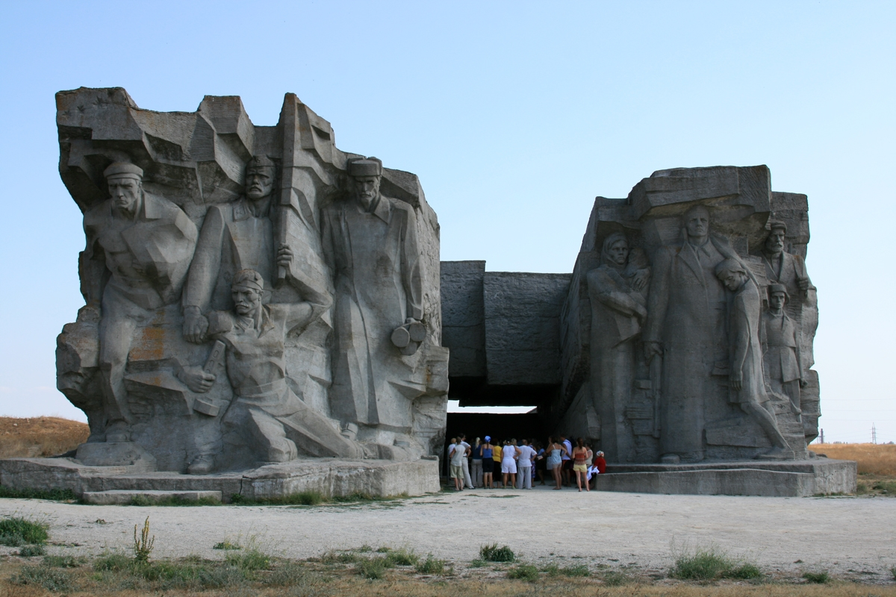

Slide 19
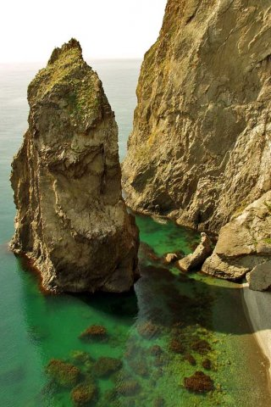
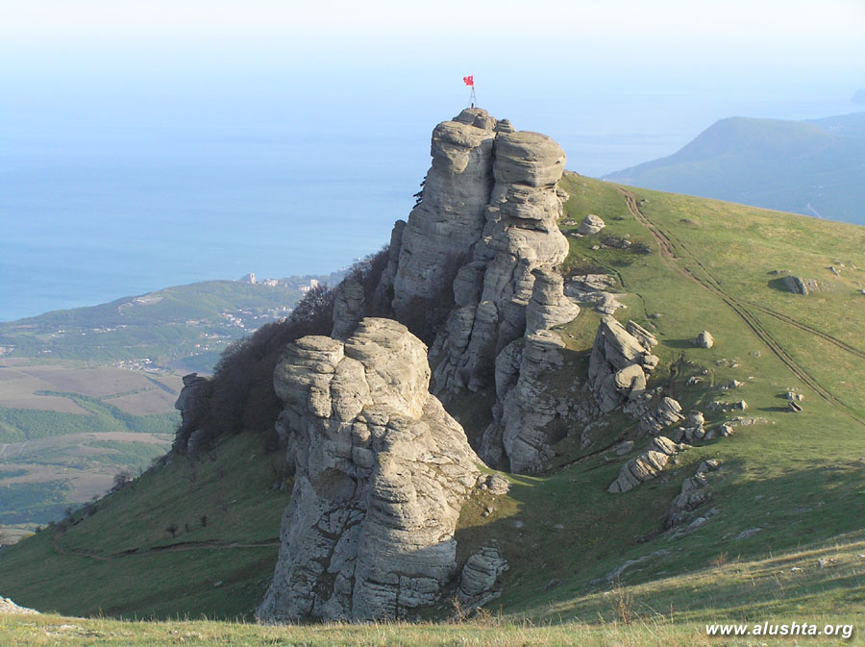
The wonderful Crimea

Slide 20
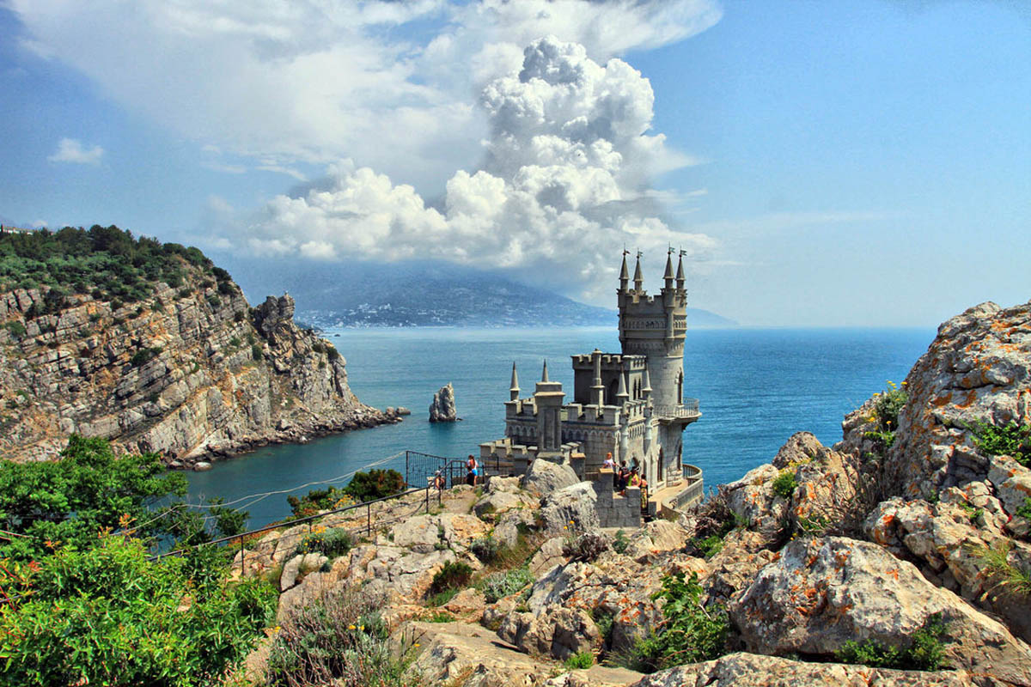
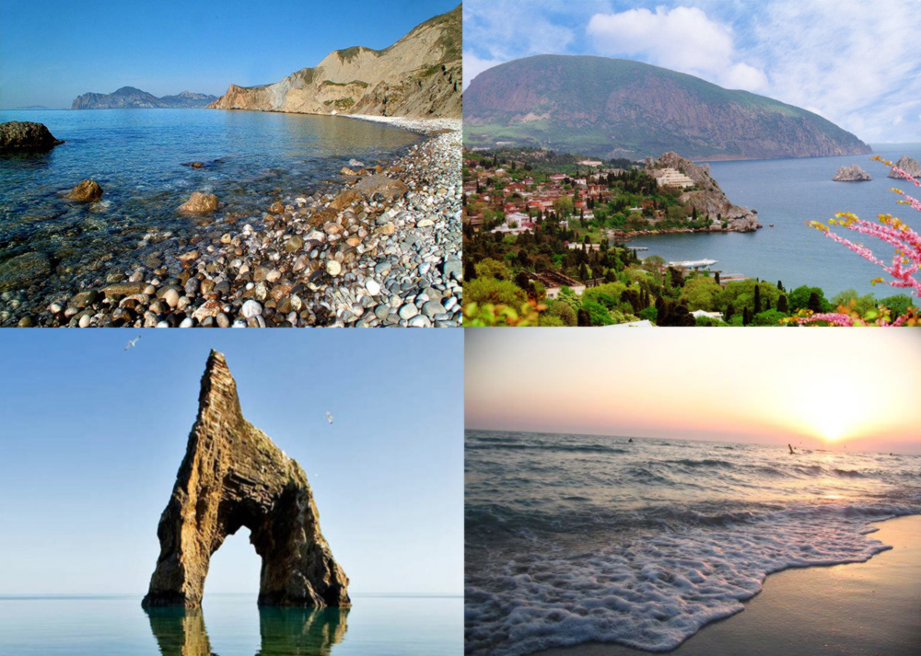

Slide 21
The population of the Crimea
There are 175 nationalities in Crimea.
According to the 2014 census, the ethnic make up of Crimea’s population consists of the following self-reported groups: Russians – 68%
Ukrainians – 15.7%
Crimean Tatars – 10.6%
Others – 4%

Slide 22
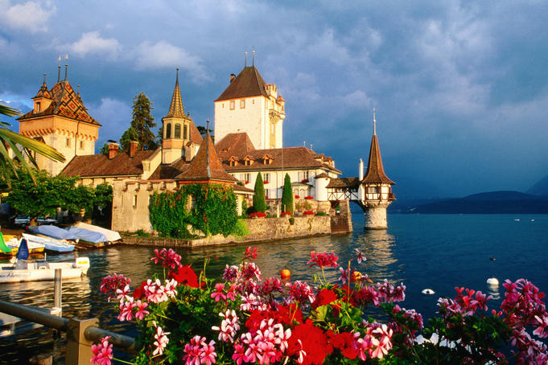
Flora of the Crimea
The Crimea has mostly coniferous and deciduous trees(pine, oak, beech). Plantations of valuable species are increasing. The wealth of the forest includes not only timber, but also, berries, mushrooms and medicinal herbs. In late April crocuses, steppe sedge and other flowers come into the bloom here. In May the meadows are multicolored carpet of flowers, with splashes of bright-red peonies and blue cornflower. Near Yalta are the Nikitsky Botanical Garden containing trees, bushes and grasses from all over the world.

Slide 23
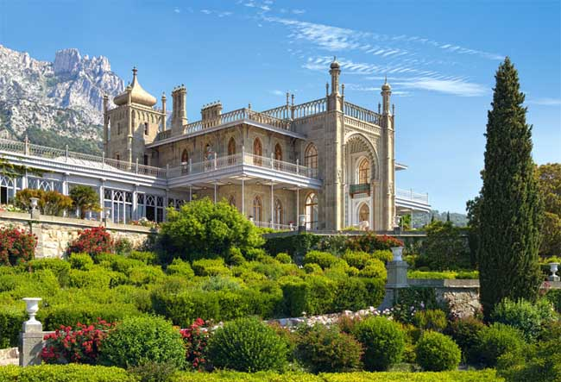
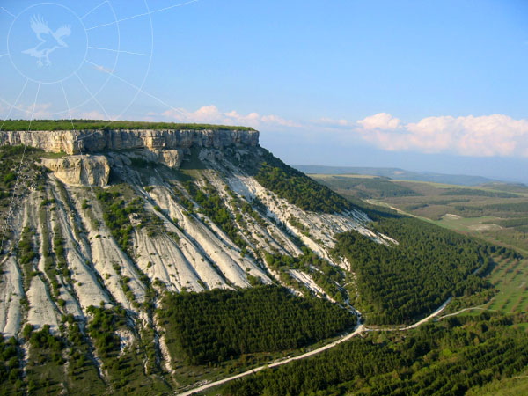
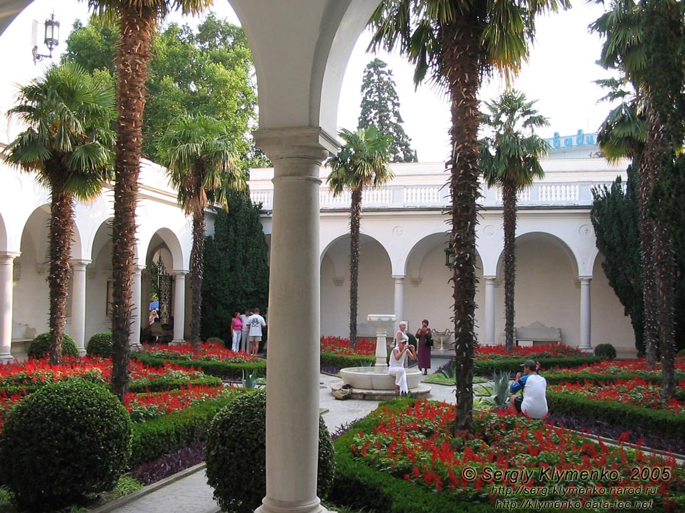
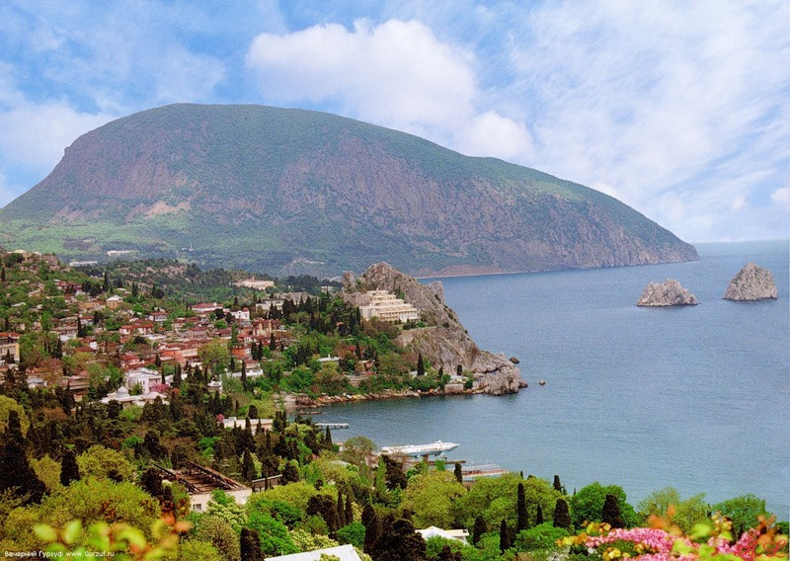

Slide 24
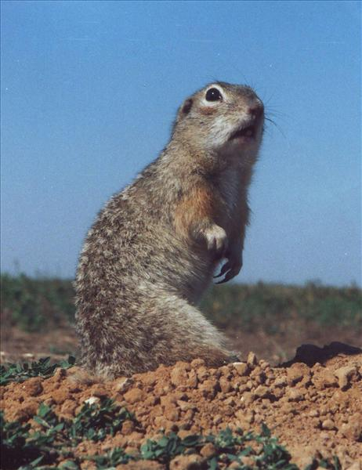
Fauna of the Crimea
The animal world of this region is distinct from the other zones. Birds and animals have survived here which are rare or extinct in other places. Such birds include the carrion eagle, black griffons, owls. We can also find noble deer, small weasel, mountain linnets, etc. The animal life includes many animals from southern countries: badger, fox; there are many lizards and some snakes.

Slide 25
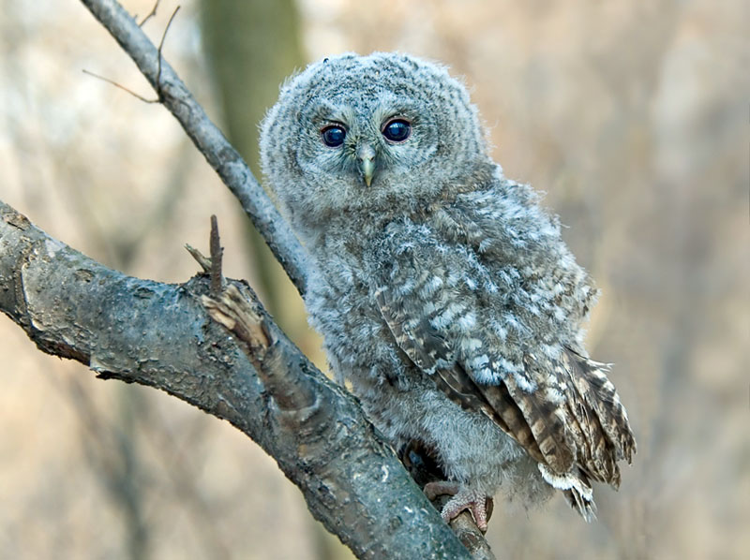
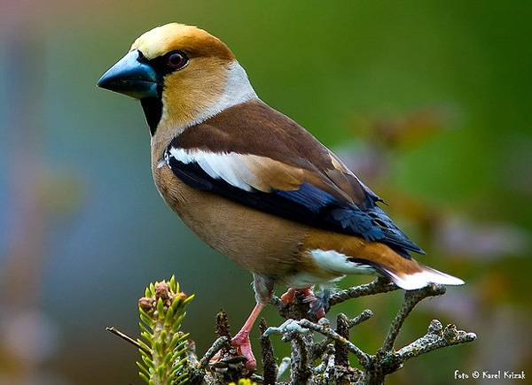

Slide 26
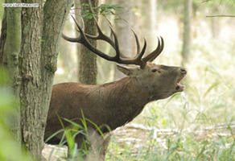
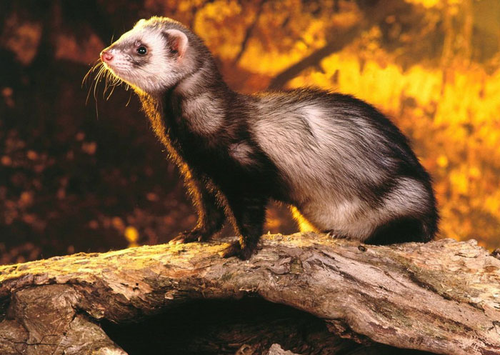
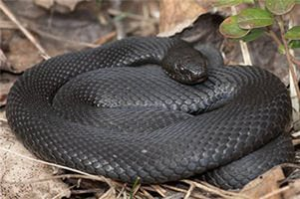
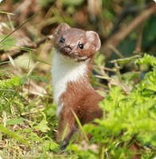

Slide 27
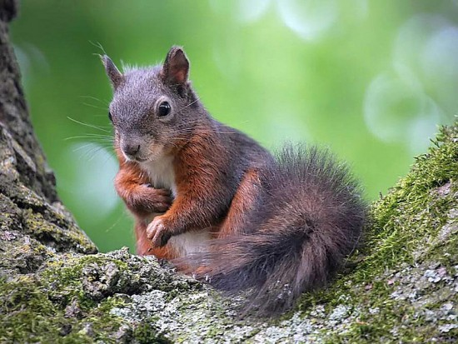
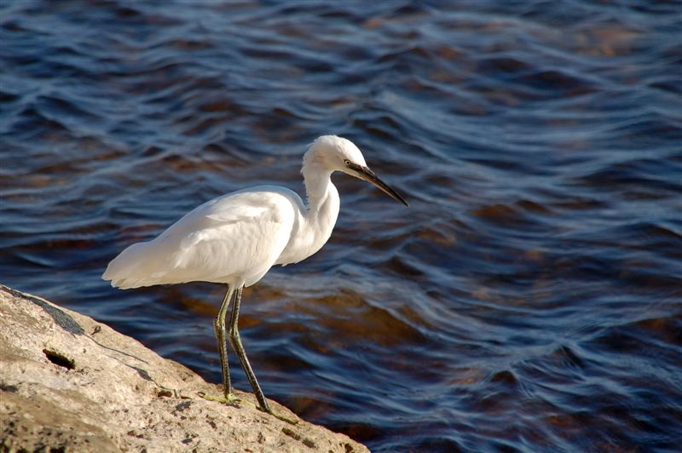
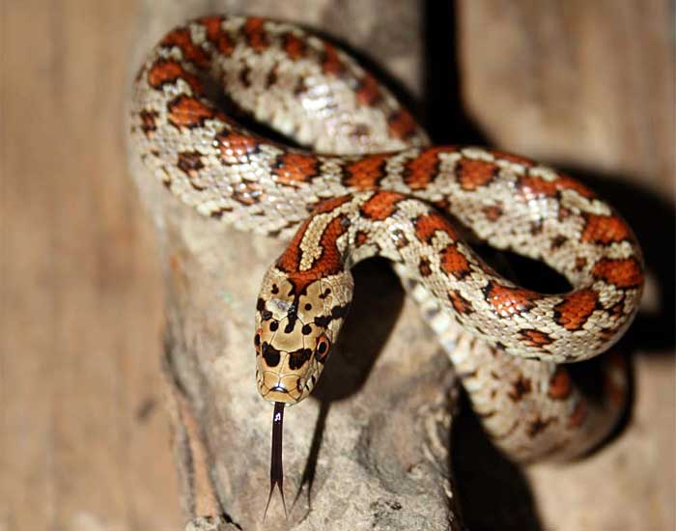
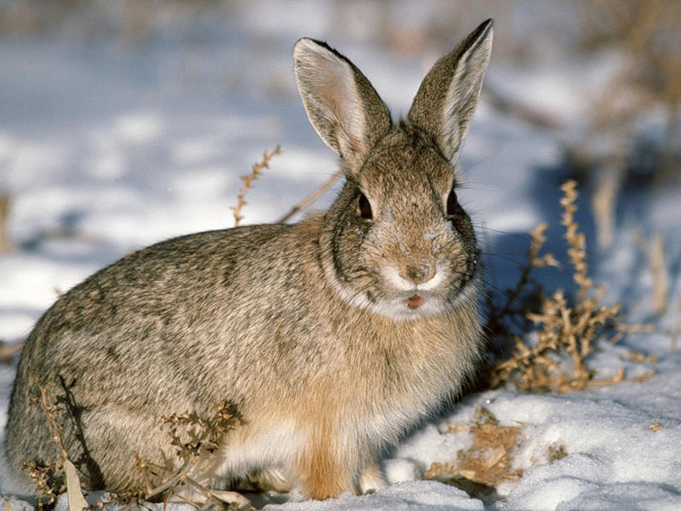

Slide 28
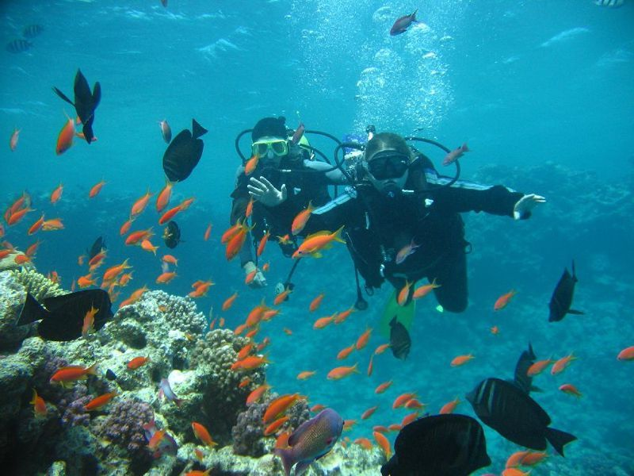
Water Resources
The Black Sea has a surface area of 423 000 sq km. There are only a few islands in it. Its depth is 2000 m. The animal life is limited. Among the best known fish are goby, mullet, plaice, etc.
The Sea of Azov is much less picturesque.

Slide 29
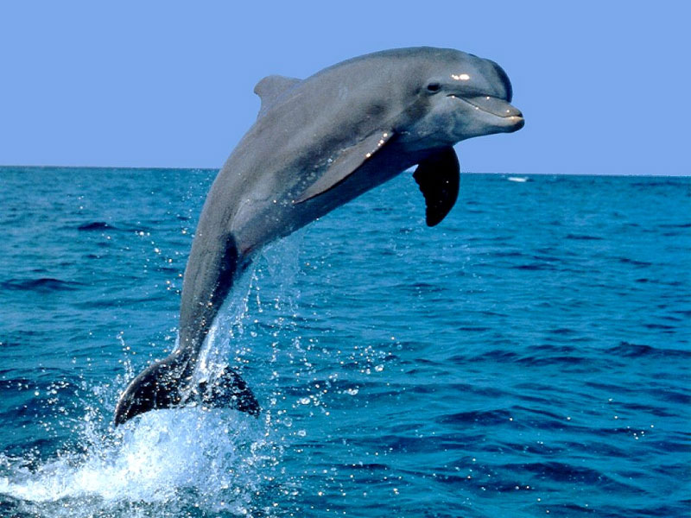
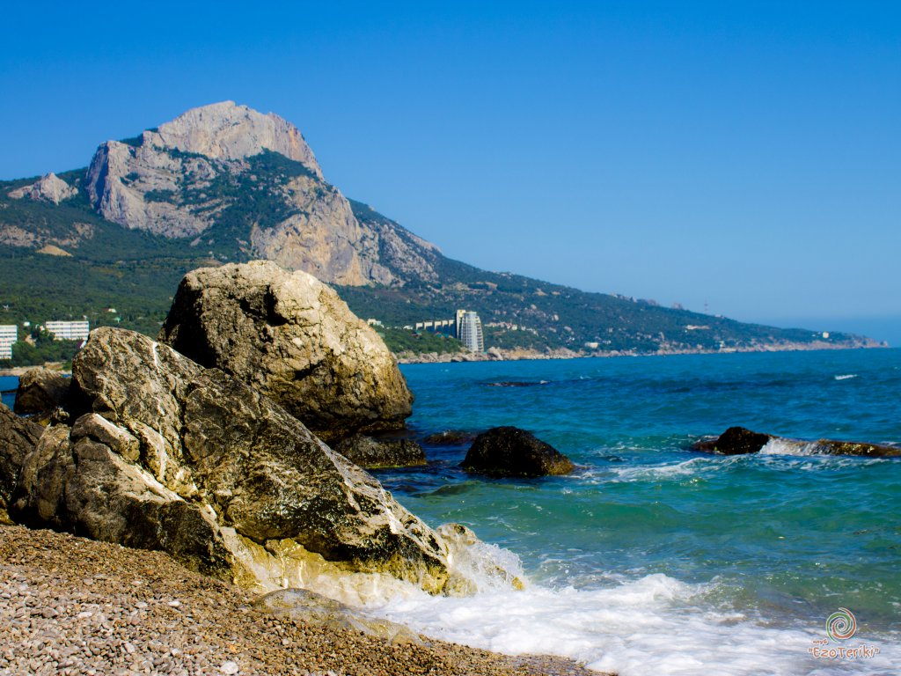
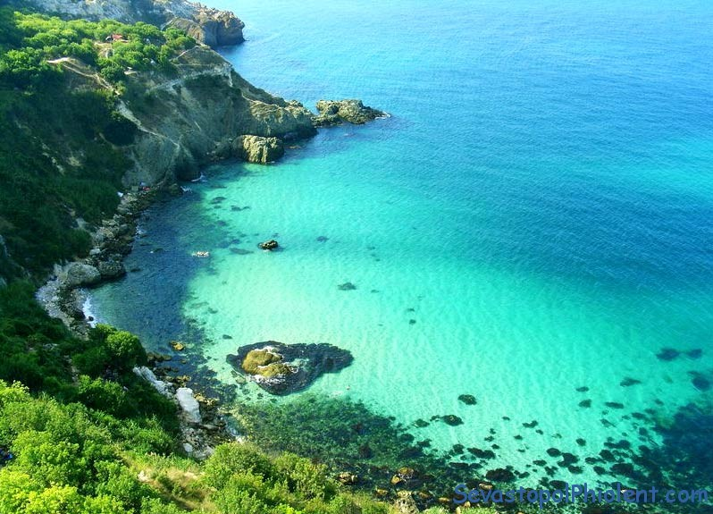
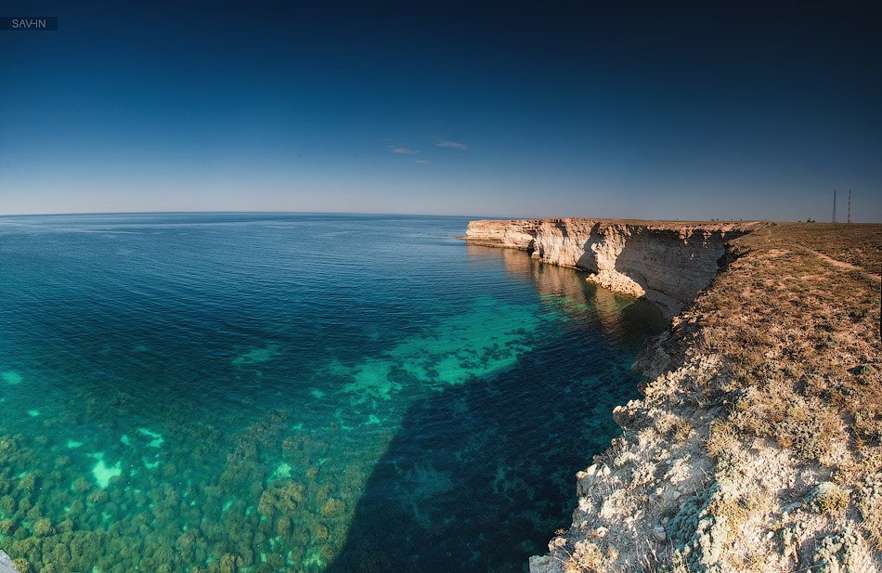

Slide 30
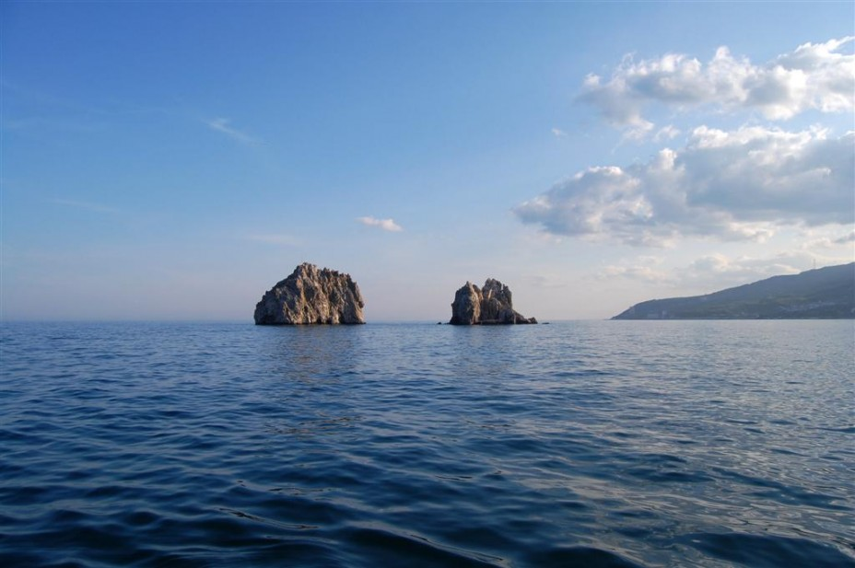
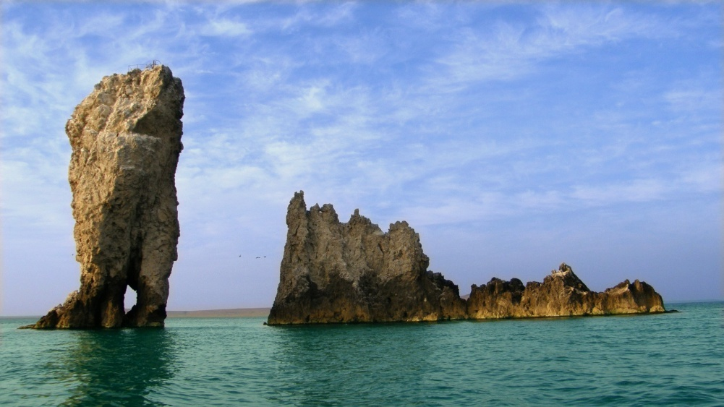
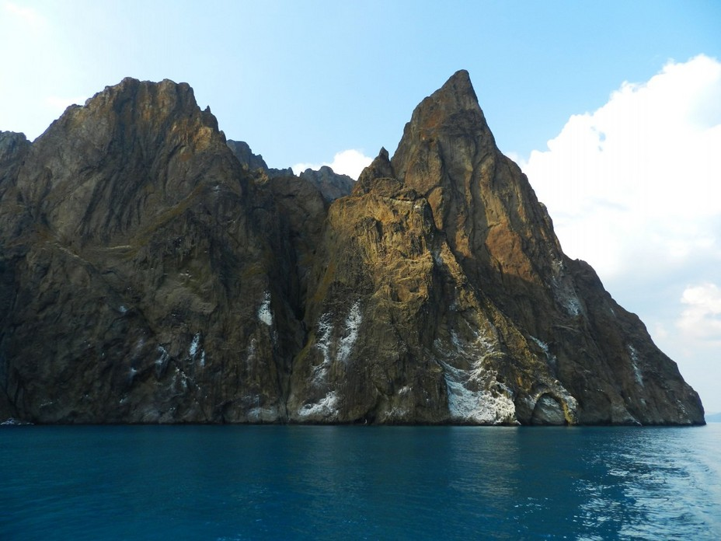


Slide 31

Syvash Bay
Syvash Bay with bitter and very salty waters forms part of the sea. There are wonderful sandy beaches on its northern coast and it is very rich in fish life. It is a small sea, and is the world’s most shallow sea, its average depth being 5-7 m.

Slide 32

The beaches of Taurus are so wonderful.
When we can admire them from the ship…
A.S.Pushkin

Slide 33

The Crimean Referendum
Crimean status referendum, 2014 was a referendum on the status of Crimea held on March 16, 2014, by the legislature of Autonomous Republic of Crimea as well as by the local government of Sevastopol, both subdivisions of Ukraine at the time. The referendum asked the people of Crimea whether they wanted to join Russia as a federal subject, or if they wanted to restore the 1992 Crimean Constitution and Crimea’s status as a part of Ukraine.
Following the referendum, the Supreme Council of Crimea and Sevastopol City Council declared independence of Crimea from Ukraine and requested to join the Russian Federation. On the same day, Russia recognized Crimea as a sovereign state.

Slide 34


Slide 35
My Crimea
I like you infinitely, my native land!
I like your high mounts and yellow sand!
I like your rivers, lakes and seas,
Your fields, your sky and even trees!
I am proud of you, my native Crimea!
Thanks of my destiny I’m living here.
I want you be free the most of all
You are always in my soul!
Ivanova T.S.

Slide 36
THANK YOU FOR ATTENTION!

