Slide 1


Федеральное государственное казенное образовательное учреждение
«Санкт-Петербургский кадетский военный корпус» МО РФ
Международный конкурс просветительно-творческих проектов учащихся
«Жар птица знаний-2018»
Презентация
«Мои питомцы – мои пушистые друзья»
«My pets are my furry friends»
(Spotlight, 5. Module 5c, p.70, ex.5)
Автор: Храмов Владислав 5б, СПБКВК МО РФ
Педагог: Курманалиева Светлана Валерьевна
Saint-Petersburg, 2018

Slide 2

My pets are my furry friends
The animals are the best friends.
They are always faithful.
Spotlight, 5. Module 5c “My pet”
Writing (a description of your pet)
p.70, ex.5
Portfolio: Post your message to the forum. Write about:
Type of pet
Name
Age
Description
Activities
2

Slide 3

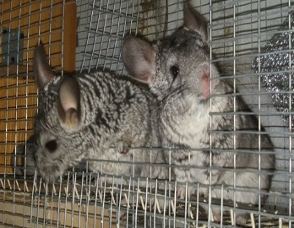
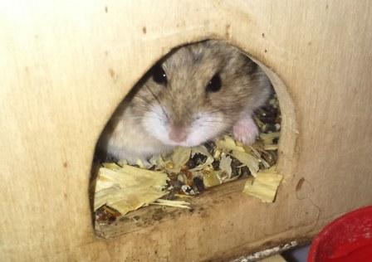
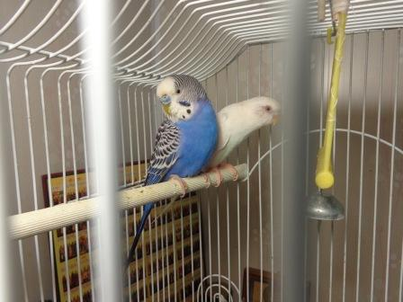
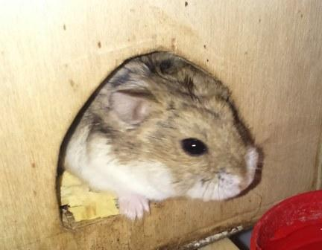
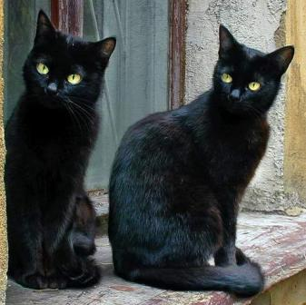
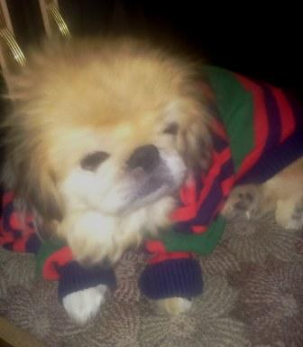
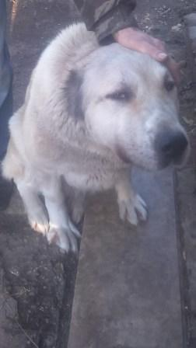
Hello! My name’s Vlad. I study at Saint-Petersburg Cadet Military Corps.
I ‘ve got many pets.
1. 2 chinchillas - p. 4
5. 2 budgies – p.8
2. 2 jungariks – p. 5
4. 2 black cats – p.7
3. 2 dogs – p.6

Slide 4
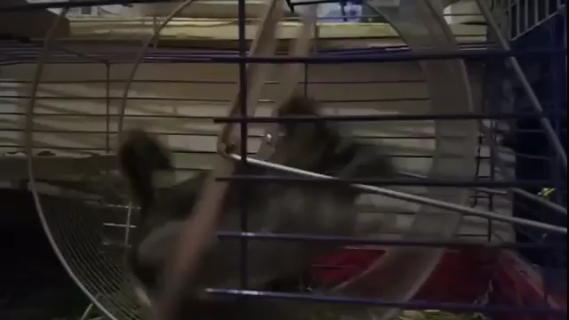
1. Chinchillas
I’ve got 2 chinchillas. Their names are Chuck and Chita. They are 3 years old with big ears and long tails. They have got grey fur. Chinchillas are very cute creatures. Chuck is kind, sweet and very careful. He likes sitting in my arms.
Chita likes running in the wheel. As you see, she is very fast.

Slide 5

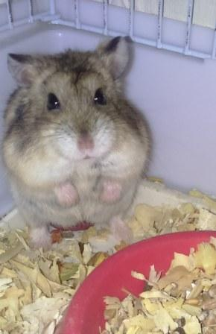
2. Jungariks
Jungariks are small fluffy animals. Their names are Tim and Tom. They are very young. Tim and Tom are 1 years old. They look like hamsters but they are smaller. When I feed them, they play with me.

Slide 6
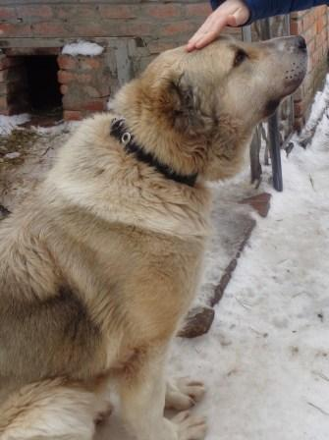
3. Dogs
The names of my dogs are Lorsy and Alma.
Lorsy is very cute, kind and clever. She is 3 years old. Lorsy is small with golden fur and faithful heart. When we leave home, she sees off us. She is very happy when we come back. She barks and wags her tail.
Alma is very tall and serious dog with bright brown eyes. She has good memory and she remembers all members of our family. Alma guards our house. I take her for walks in the part every day. I think dogs are great!

Slide 7

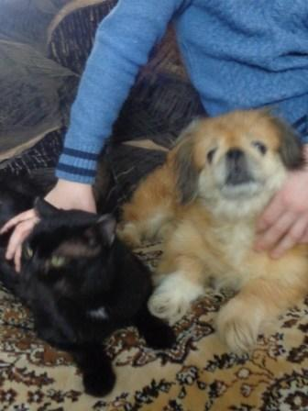
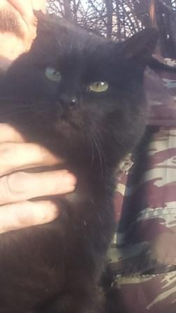
Lorsy & Bucks
4. Black cats
Also I have got 2 cats. Their names are Bucks and Surprise. They are 2 years old. They have got black fur and bright green eyes. Surprise can play in the garden all day. Bucks likes sleeping on my bed. Cats are very friendly. The best friend of Bucks is my dog Lorsy. The cat Surprise loves my grandpa very much.
Surprise & my grandpa

Slide 8


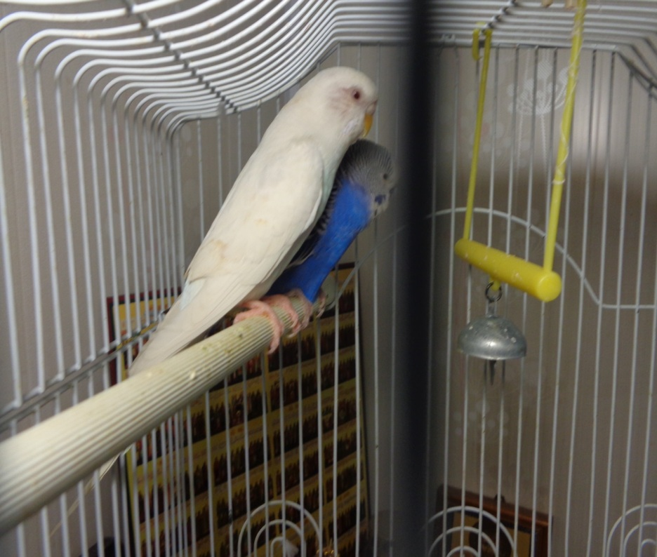
5. Budgies
The budgies’ names are Lada and ….. . They live in a cage. In the morning they chirp and we wake up. Our parrots tell us: “Good morning!”
The budgies’ names are Lada and Grisсha. They have got blue, grey and white feathers and a little yellow beak. My budgies live in their own cage. In the morning they chirp and we wake up. Our budgies tell us: “Good morning!”. They can sing all day long.

Slide 9
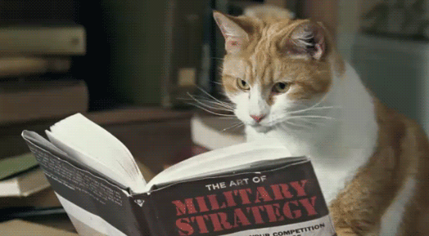
I think my pets are the best! I love them very much. They are my furry friends and “teachers”. They teach me to be neat, careful, faithful and friendly.
9

Slide 10

When we take care of animals and love them,
we learn goodness.
Love animals! They are our friends.
Thank you for attention!

