Slide 1

CLOTHES
Made by
Katkow Vadim,
Sopoev Farhad, Onishchenko ulyana, Dhardimova Evelina
2B class

Slide 2
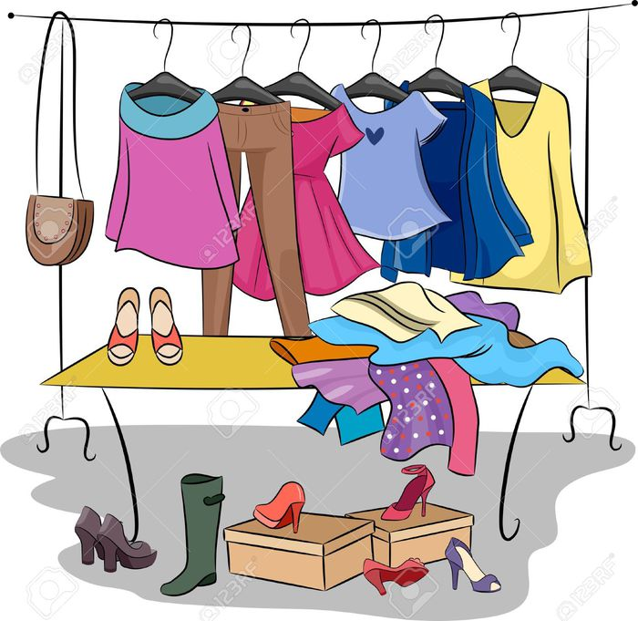
CLOTHES
Made by
Katkow Vadim
2B class

Slide 3
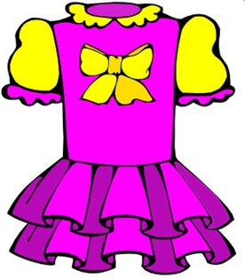

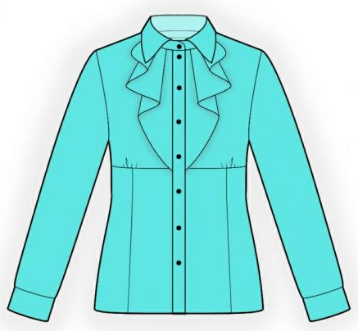
a skirt
a dress
a blouse

Slide 4
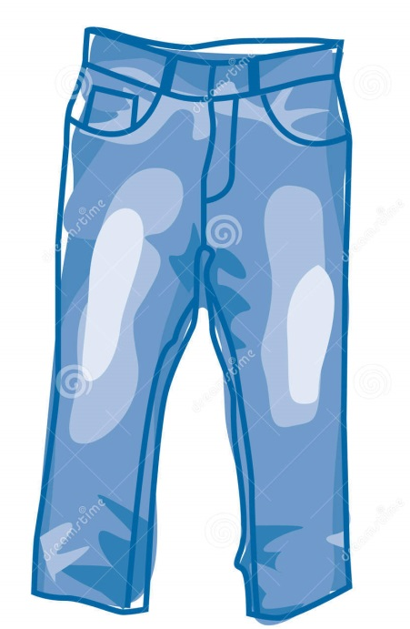
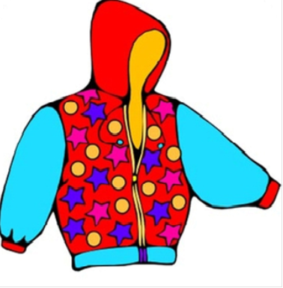
a coat
jeans
a jacket

Slide 5
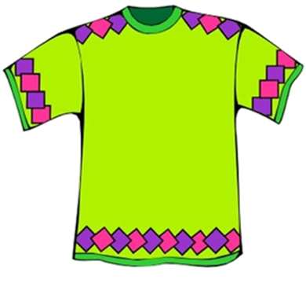
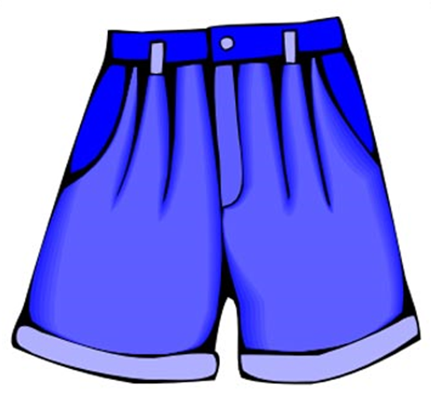
a T-shirt
a shirt
shorts

Slide 6
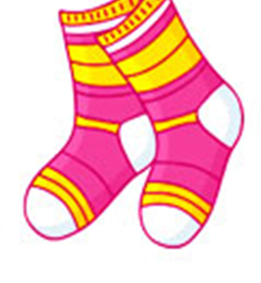
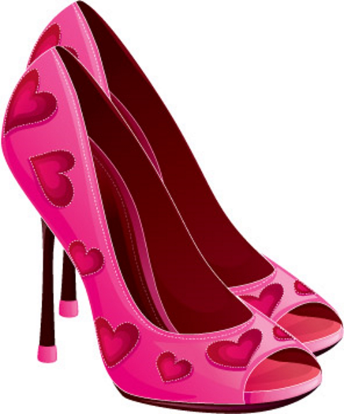
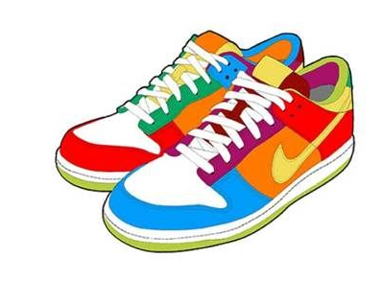
socks
shoes
trainers

Slide 7
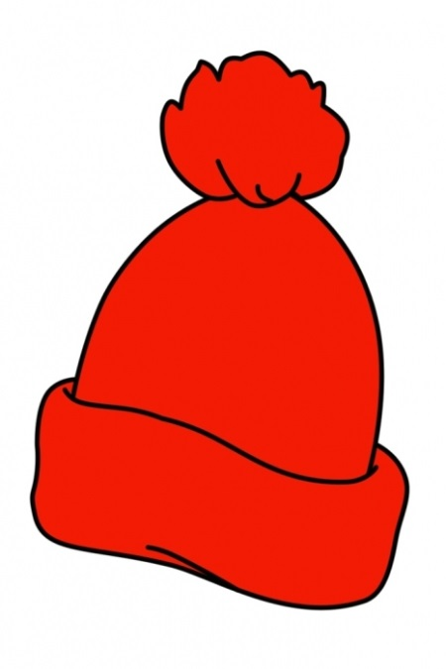
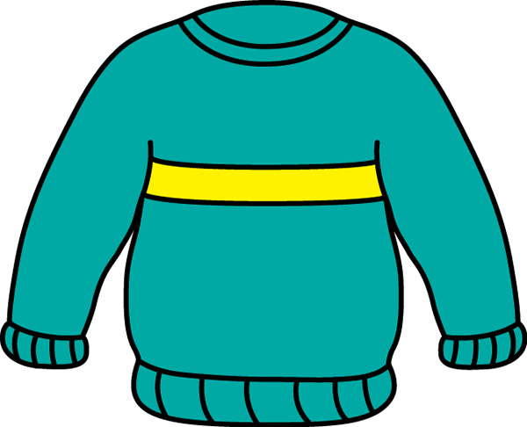

a hat
a sweater
a cap

Slide 8

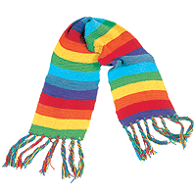
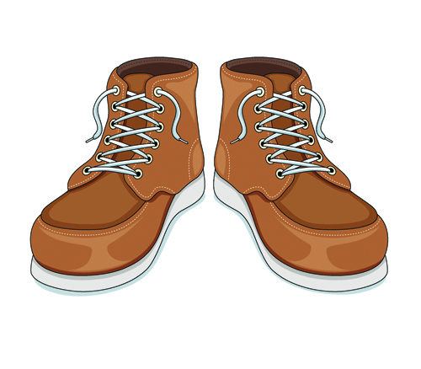
mittens
A scarf
boots

Slide 9
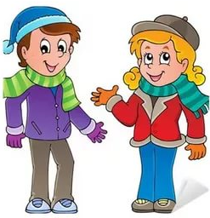
clothes for boys and girls
Made by
Sopoev farhad
2B class
Made by
Sopoev farhad
2B class

Slide 10

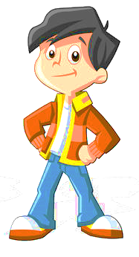
a cap
a jacket
a T-shirt
shorts
jeans
trainers
boots

Slide 11
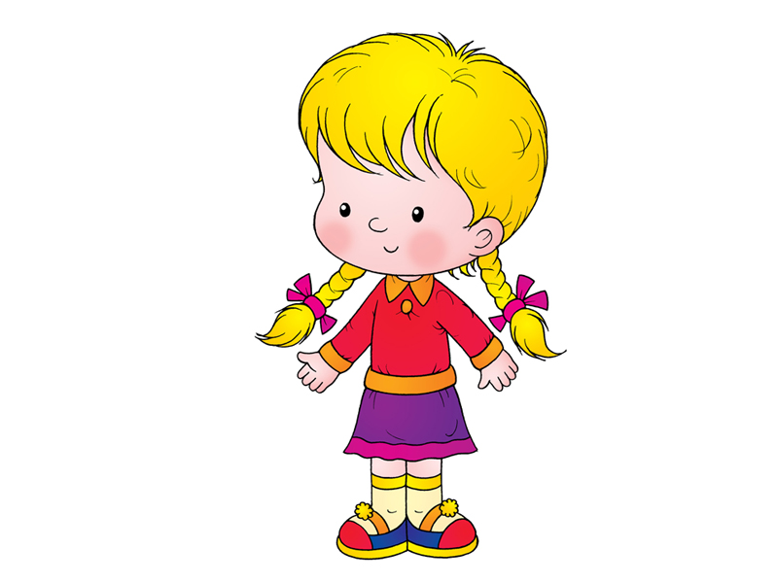
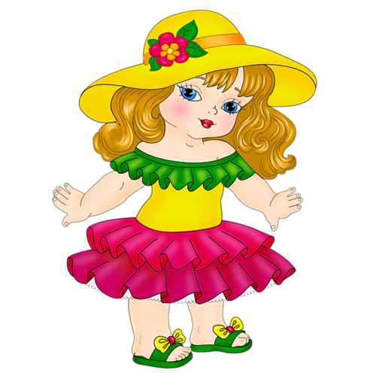
a hat
a blouse
a dress
a skirt
socks
shoes
slippers

Slide 12
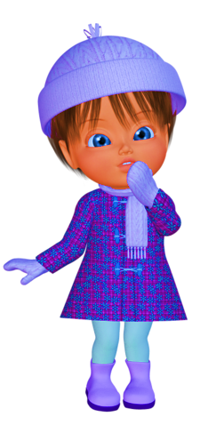
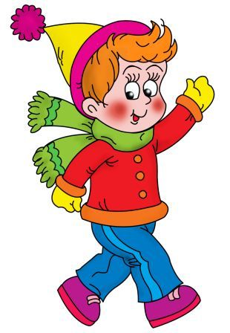
a hat
a scarf
mittens
pants
a coat
boots

Slide 13
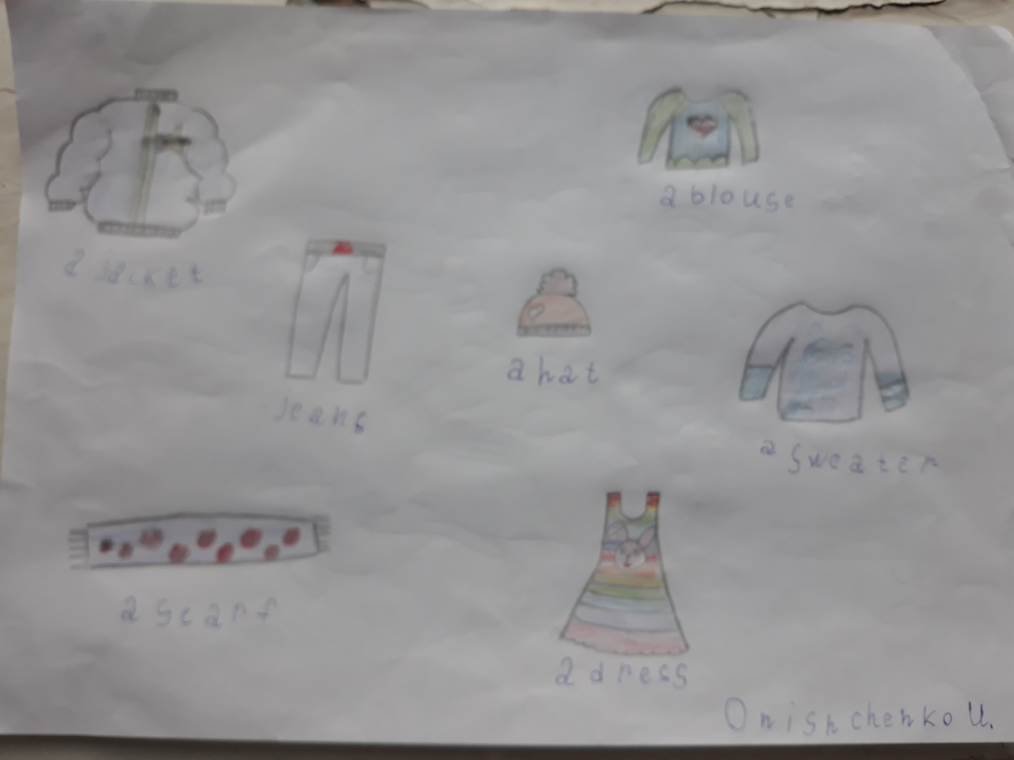
Made by
Onishchenko ulyana
2B class

Slide 14
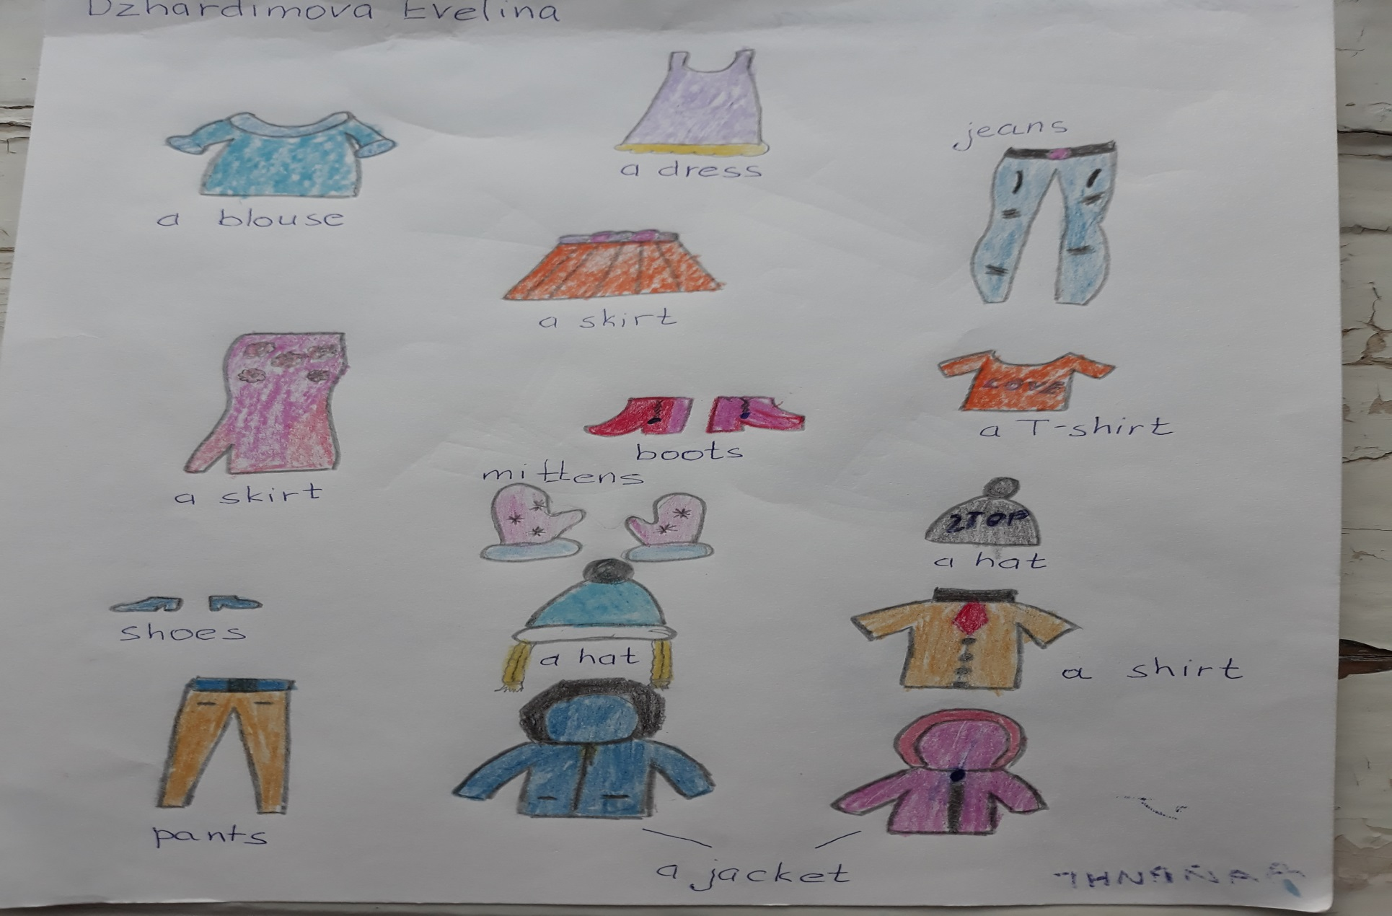
Made by
Dhardimova Evelina
2B class

