Slide 1

Internet.
Social network
Why social network is so popular nowadays?
When did it appear and start developing?
Can we imagine our life without the internet?
The supervisor: Kate Vlasova
The author: Nataly Golyanitskaya

Slide 2
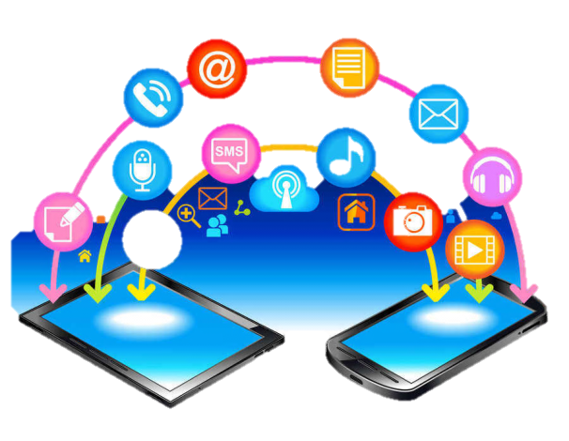

In the 21st century we don’t start our morning with a hot cup of coffee. We are used to start off any day with checking VK, Instagram, Facebook and so on.
Surely, we cannot imagine modern life without the Internet. It’s a place where we can take a photo, communicate with our friends and relatives, find new pals. Moreover, we can get some money. The Internet is a place of our abilities!

Slide 3

1.How become popular in social network?
3.Abilities in the Internet
2.Working in social network
4.Advantages and disadvantages
Click on clouds which you want to know more
5

Slide 4
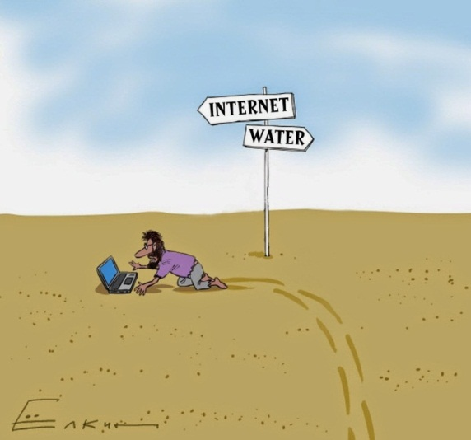
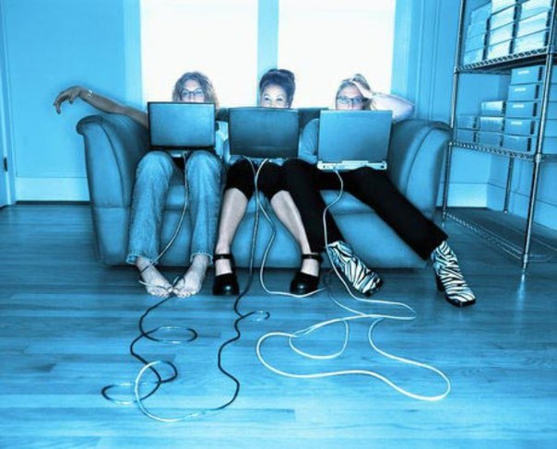
Life without internet. how was it?
Some time ago people didn`t have computers, phones and internet. But it wasn`t boring, everybody had a lot of hobbies and entertainments.
Children spent all their time outside home. Often they left home in the morning and had returned in the evening!
It’s amazing but students liked to study so much! School life was full of bright events and exiting adventures! In spare time you could read a book with pictures and a beautiful cover.
Nowadays most of people use the Internet every day! They read books, watch films, play computer games, chat with friends. It`s convenient, but… Have you ever thought how much time we spend in the Internet? But we could meet our friends more often, read a lot of good beautiful books, go to the cinema with friends and families. The Internet fills our life of real emotions which we can feel during celebratins or walking with friends and family. The Internet has changed lives of people, they will never be able to live without it yet.
6

Slide 5
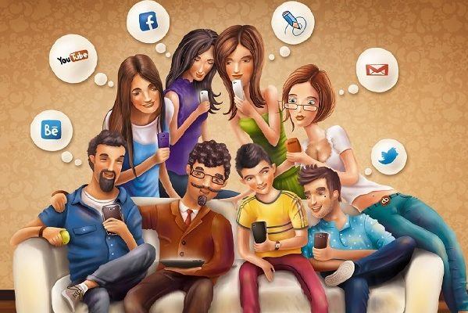
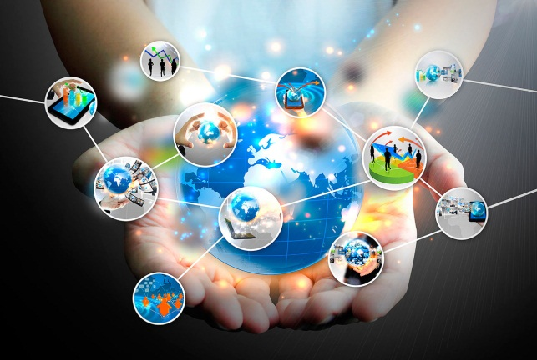
Conclusion
I’m sure, people can`t live without the Internet, because:
They start and finish their day with the Internet, walk in the park with it, have breakfast, lunch and dinner in the cafe or restaurant with the Internet and chat with friends in Social Network!
We can take any information from the Internet in two minutes.
We are used to check our phone in any free time: when we are going by bus or taxi, resting after school or work. We check our social network every day, every hour!
In my opinion Internet has advantages and disadvantages, but it is very useful and convenient. But we mustn`t forget activities which make us happy! We live actual life with wonderful invention is Internet!
THANKS YOU FOR ATTENTION!

Slide 6
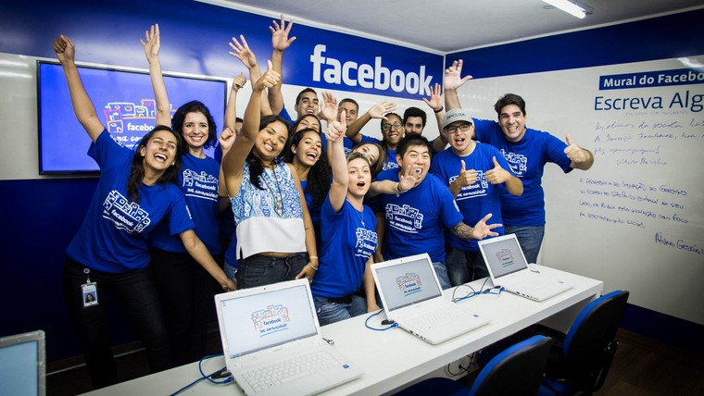
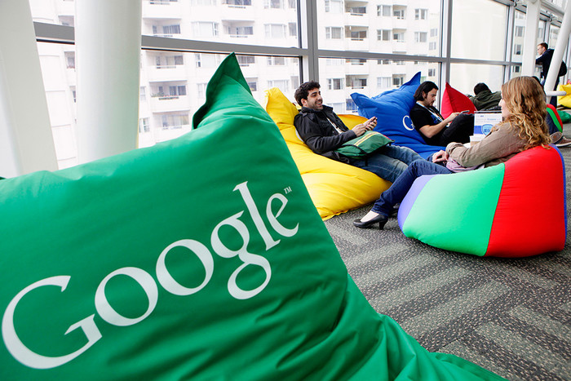

Working in office of society nETwork
Click here
I’ve watched a lot of videos about working in companies of social network. I am sure, it isn`t so boring like wasting time in an usual office! People are fine and happy all of day there! However, they are pretty smart, everybody has a high education. There is a modern, beautiful and cozy interior. Let`s know more about offices!
Click here
Click here

Slide 7
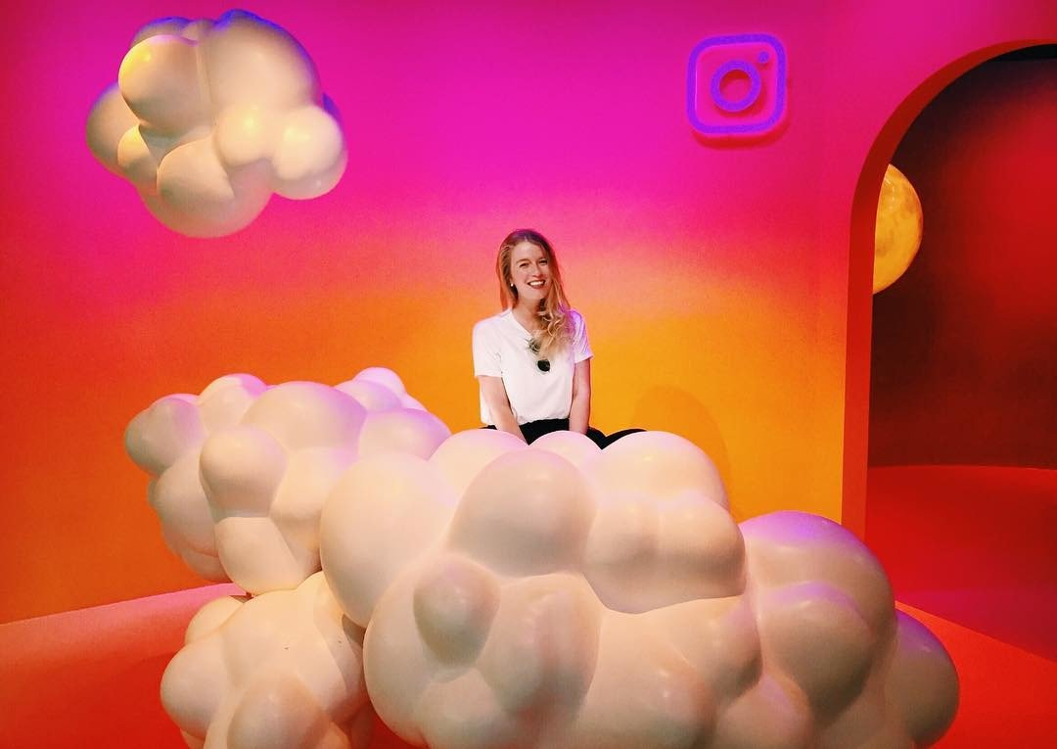
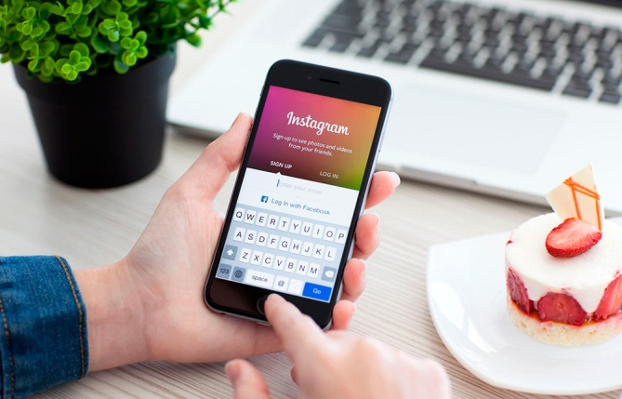
instagram
Instagram is an app created for free exchange of photos and short videos. It appeared in 2010. And it has conquered all over the world! Today, Instagram is popular among stars and politicians, sports and show business and usual people. No wonder it has become a wonderful advertising platform whose skillful approach can bring huge money!
An Instagram worker must have:
strategic vision which helps to understand the needs and interests of the public;
the ability to find locations of potential customers and encourage them to sign up for the public;
the skill of creating the right image of a company or an individual person in Instagram;
the ability to configure all types of advertising, the ability to analyze and predict the customer's budget on promotion.

Slide 8
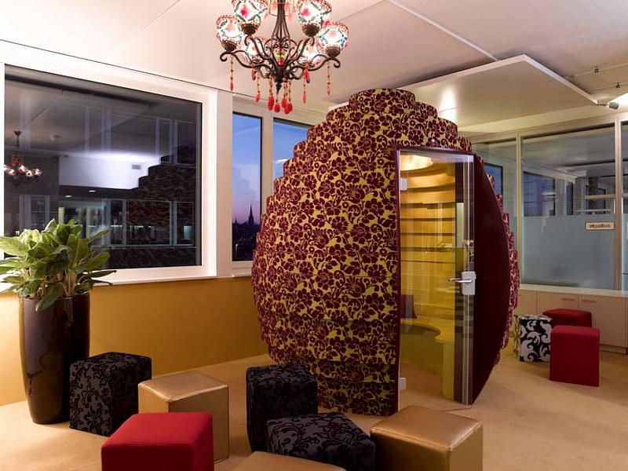
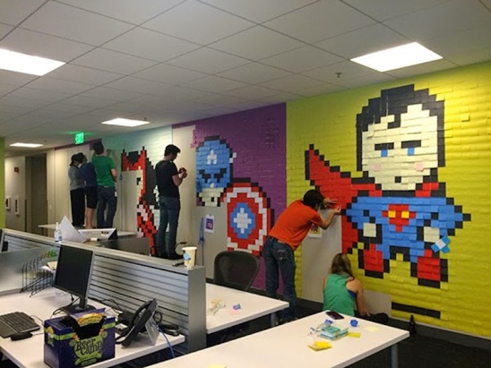
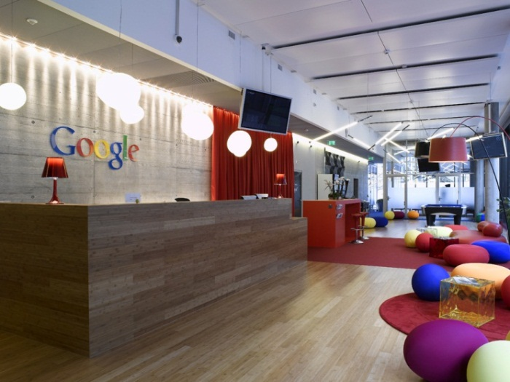
google
The Russian division of Google appeared in December 2005;
The recruitment process in the Corporation is different: a candidate is interviewed not only with the head but also with colleagues. Candidates have to solve non-standard tasks like counting the number of tennis balls that can fit in the plane. There can be no right or wrong answer — the important reaction and way of solving problem;
Usual workers took part in decoration of the office. So, the 4th floor is decorated in the style of Russian fairy tales, the 9th floor is made in the style of the Moscow metro;
All the food in the office is completely free. The 4th floor has a dining room "on the ground", where you can come for breakfast, lunch and dinner. There are different types of cereal and muesli, fresh juice and sandwiches;
You can spend the night in the Google Office : there are a shower and a bed;
In the office you can also play video games and table tennis. The 4th floor has area "Lukomorye". Come here to chat, drink coffee and relax. For this is chess, guitar and a mini library.

Slide 9
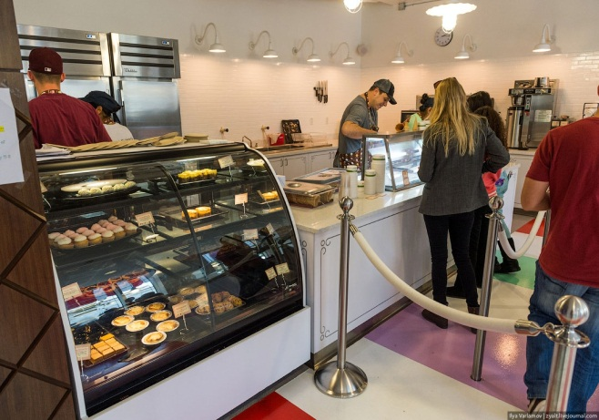
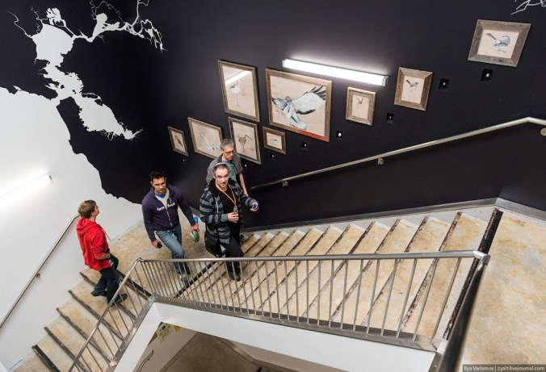
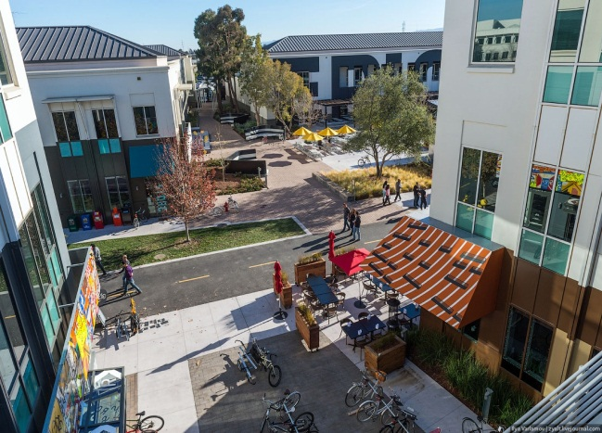
facebook
The company "Facebook" is the most popular social network in the world. It appeared in July 2013, the Facebook audience is 1.2 billion users. The creator of Facebook Mark Zuckerberg is the youngest billionaire in the world.
For workers there is everything needed, e.g. a gym and a game room. There is also a real city with bicycle paths, recreation areas, bridges and even wild foxes inside.
There are lots of different restaurants and cafes. The only difference is that almost all of them are free. You can taste any food you like. There is a Mexican restaurant, burgers, salads and cookies. Do you want a candy? There is a detached cafe with ice cream and cakes.
Workers execute their jobs themselves, so here you can find everything from trainers to huge plush toys.
I was also surprised that the people can leave their phones on the tables. There is an opinion that nothing has stolen there yet. In fact, I didn`t see a security guard. It’s an amazing place!

Slide 10


Advantages and disadvantages
You can have fun from home, well, at least you can watch a film. You don’t need to spend money on tickets in the cinema.
The Internet allows you to buy rare things, which your courier will deliver to your apartment.
The Internet is a huge repository of different types information. It provides an opportunity to learn anything about everything. All virtual libraries and museums around the world open their doors for you.
With social network you can find new friends all over the world and chat with them.
Staying at the computer for a long time is harmful for your health. So, it is important sometimes to look up from the monitor.
The Internet is full of trash. The Internet is full of gossip moving from one blog to another, and information always changes by the principle of "deaf phone“.
Posting in the Internet your photos, videos, buying online with a credit card, you can lose your data . It can be used for criminal purposes.
Virtual reality can replace actual reality. A person spends more and more time in the Internet, it`s detaching him from his real life.

Slide 11
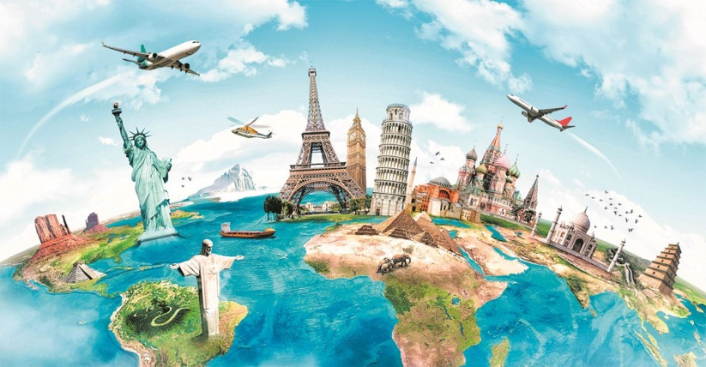
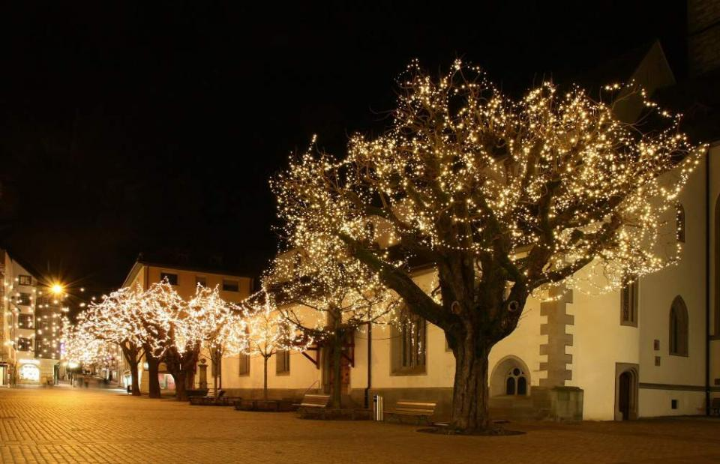
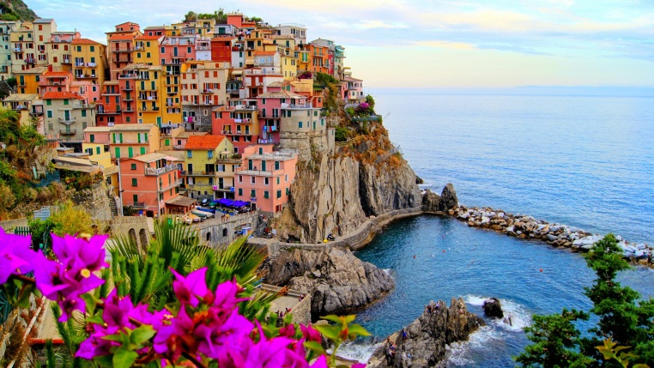
A lot of abilities, nothing impossible!
As for me, I like travelling very much! But I can`t travel around the world because my family don`t get a lot of money! Also, you need enough time for travelling. I mustn`t miss my lessons, I`m afraid I won`t pass my exams!
But in the Internet I can get lot’s of information about different countries! France or Brazil? Italy or Sweden? I will visit all of them just sitting at the computer! I can watch movies about them, read about sights and country`s history! It`s like an excursion in the city. I imagine how I am walking on the paved streets of Paris, there are so cute and interesting people around me! I can see the lights in the trees, listen to the nice music sounding everywhere and just enjoy this lovely evening!
If you have fertile imagination, casual pictures can take you to any place all over the world!

Slide 12
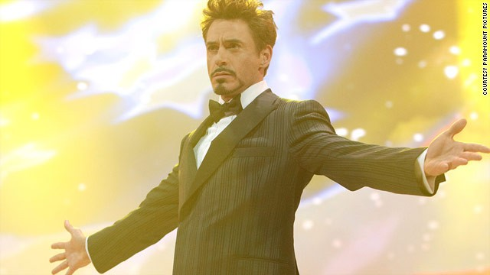
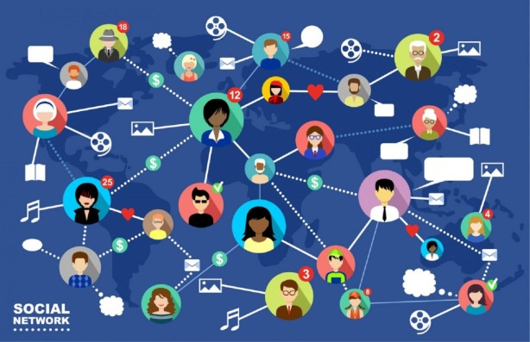

you can be popular in the social network, can’t you?
The first step to fame in a social network is the right choice of audience, namely the social network. The main criterion is your specialty, which will be the basis of developing. Remember that your content should be interesting for users of the selected network.
The second step is nice execution. Do you remember the proverb “Good clothes open all doors"? It also works in social networks. If we are talking about the blog, it must have an attractive design and it must match the theme of your content.
The third step is the content. It doesn’t matter what you are doing – whether you write articles, publish news, take part in discussions, your actions should be directed towards the audience. Remember, the content must be of high quality, because the blog isn`t a place where you can write a blah.
This rules help you to start an own successful blog!

